Slide 1



PORTFOLIO PROJECT · DATA ANALYTICS
Customer Shopping
Behaviour Analysis
Python
Data preparation
PostgreSQL
Business questions
Turning 3,900 customer records into marketing and product decisions
Power BI
Interactive dashboard
Ayush Ummadi
Python · SQL (PostgreSQL) · Power BI
Notes:
Introduce the project: an end-to-end analysis of 3,900 customer records using Python for cleaning, PostgreSQL for analysis and Power BI for the dashboard. The goal is to turn shopping data into clear marketing and product decisions.

Slide 2




THE CHALLENGE
What the business wants to know
“
Who drives revenue?
How spending differs by gender and age group
How can the company leverage consumer shopping data to identify trends, improve customer engagement, and optimize marketing and product strategies?
What sells best?
Top categories, products and customer ratings
What influences spending?
The role of discounts, shipping type and reviews
What builds loyalty?
Business question from the project brief
Repeat buyers, segments and subscriptions
Customer Shopping Behaviour Analysis
2
Notes:
Management has noticed changes in purchasing patterns and wants to know which factors drive purchases and repeat purchases. The analysis is organised around four questions: who drives revenue, what sells best, what influences spending, and what builds loyalty.

Slide 3

DATA AND APPROACH
3,900 customers, analysed end to end
Prepare Python (pandas)
3,900
18
Clean, fix missing values, add features
customers, one row each
columns: demographics, purchase details, loyalty
Analyse SQL (PostgreSQL)
Answer 10 business questions
Visualise Power BI
25
37
Interactive dashboard with slicers
products across 4 categories
missing values (Review Rating only)
Communicate Report and deck
Findings and recommendations
Customer Shopping Behaviour Analysis
3
Notes:
The dataset has one row per customer describing their latest purchase. Data quality was good: only 37 review ratings were missing and there were no duplicates. The workflow moves from Python to PostgreSQL to Power BI, and ends with this deck and a written report.

Slide 4





STEP 1 · PYTHON
Preparing the data for analysis
01
02
03
Fill missing ratings
Standardise names
Add age groups
37 gaps filled with the median rating of the same category
Columns renamed to snake_case for easy SQL
Young Adult, Adult, Middle-aged, Senior (quartiles)
04
05
06
Add purchase frequency
Remove duplicate column
Load to PostgreSQL
Labels like 'Monthly' converted to days (30)
promo_code_used matched discount_applied in every row
Clean table written to the customer table
Result: 3,900 rows · 19 columns · 0 missing values, ready for SQL and Power BI
Customer Shopping Behaviour Analysis
4
Notes:
Six cleaning and feature steps were applied in the notebook. Missing ratings were filled with category medians rather than dropping rows. Two new columns, age_group and purchase_frequency_days, make segment analysis easier. The duplicate promo code column was removed before loading the table into PostgreSQL.

Slide 5

KEY INSIGHT
Revenue follows customer volume, not spend per order
$233,081
Average purchase amount by customer group ($)
total revenue from 3,900 customers
≈ $60
average purchase in every customer group, from $57 to $61
Men generate 68% of revenue simply because they are 68% of customers. The same pattern holds for categories and age groups.
So what: growth has to come from more customers, more frequent orders or bigger baskets, not from any one segment.
Customer Shopping Behaviour Analysis
5
Notes:
This is the most important finding. Average spend per purchase is almost identical everywhere, around 60 dollars, whether we split by gender, age, category or subscription. So revenue differences come from how many customers or orders a group has, not from how much each one spends.

Slide 6
CUSTOMERS · SQL Q1 AND Q10
Who drives revenue?
Revenue by gender
Revenue by age group
$157,890
Male · 2,652 customers · $59.54 per order
$75,191
Female · 1,248 customers · $60.25 per order
So what: men bring in two-thirds of revenue, and Young Adults lead by age, but spend per order is the same for everyone.
Customer Shopping Behaviour Analysis
6
Notes:
Men generate 67.7 percent of revenue because they make up 68 percent of customers; women actually spend slightly more per order. By age, Young Adults contribute the most at 26.7 percent, but the gap between the highest and lowest group is only about 6,400 dollars.

Slide 7
PRODUCTS · DASHBOARD AND SQL Q8
Clothing and Accessories carry the business
Revenue by category
Top products by orders
Clothing
44.7% of revenue
Blouse 171 · Pants 171 · Shirt 169
Accessories
31.8% of revenue
Jewelry 171 · Belt 161 · Sunglasses 161
Footwear
15.5% of revenue
Sandals 160 · Shoes 150 · Sneakers 145
Outerwear
7.9% of revenue
Jacket 163 · Coat 161
So what: 76.5% of revenue comes from Clothing and Accessories; bundle them with Footwear and Outerwear to grow both.
Customer Shopping Behaviour Analysis
7
Notes:
Clothing is the largest category with 104 thousand dollars in revenue, followed by Accessories. Together they generate 76.5 percent of revenue. Within each category, order counts are close, so no single product dominates. Outerwear only has two products.

Slide 8
LOYALTY · SQL Q7
Most customers are already loyal
80%
of customers are Loyal
25
previous purchases on average
2%
are New customers (83 people)
So what: the customer base is mature, so keeping loyal customers and raising their value matters more than acquisition alone.
Customer Shopping Behaviour Analysis
8
Notes:
Customers were segmented by previous purchases: New has exactly one, Returning has two to ten, and Loyal has more than ten. Four out of five customers are Loyal, and the average customer has 25 previous purchases. Only 83 customers are new.

Slide 9
SUBSCRIPTIONS · SQL Q5 AND Q9
The subscription is not lifting spend
Customers by subscription
$59.49 vs $59.87
26.9% of revenue
average spend per order: subscribers spend slightly less
comes from subscribers, matching their 27% share of customers
27.6% vs 22.4%
2,518 repeat buyers
of repeat buyers subscribe, compared with other customers
have not subscribed yet, the biggest opportunity
■ Subscribed 1,053 ■ Not 2,847
So what: rework subscription benefits to encourage bigger or more frequent orders, and target unsubscribed repeat buyers.
Customer Shopping Behaviour Analysis
9
Notes:
27 percent of customers subscribe and they bring in 26.9 percent of revenue, but they spend slightly less per order than non-subscribers. Repeat buyers are a bit more likely to subscribe, 27.6 versus 22.4 percent, yet 2,518 repeat buyers still have not subscribed.

Slide 10
DISCOUNTS · SQL Q2 AND Q6
Discounts are common, but not only for low spenders
43%
of all purchases used a discount (1,677 customers)
Most discount-dependent products (% of purchases discounted)
839
discount users still spent above the $59.76 average
50%
of discount users are above-average spenders
So what: review margins on the most discounted products and offer premium deals to high-spending discount users.
Customer Shopping Behaviour Analysis
10
Notes:
43 percent of purchases use a discount. Half of those customers, 839 people, still spend above the average, so discounts are not just attracting bargain hunters. Hat, Sneakers, Coat, Sweater and Pants have the highest share of discounted purchases, about half of their sales.

Slide 11


EXPERIENCE · SQL Q3 AND Q4
Ratings are average; faster shipping means slightly higher spend
Top 5 products by average rating (out of 5)
Average purchase by shipping type
$60.48
+3.5%
Express
$58.46
more per order with Express
Standard
Every product averages between 3.62 (Shirt) and 3.86. Lowest rated: Shirt 3.62, Jeans 3.65, Blouse 3.68.
All six shipping types average between $58.46 and $60.73, so the difference is small.
So what: no product clearly delights customers. Use reviews to improve low-rated items, and test free express shipping as a perk.
Customer Shopping Behaviour Analysis
11
Notes:
Ratings are tightly grouped around the overall average of 3.75. Gloves, Sandals and Boots are the best rated, while Shirt, Jeans and Blouse are the lowest. Express customers spend about two dollars, or 3.5 percent, more per order than Standard customers, but this is a relationship, not proof of cause.

Slide 12
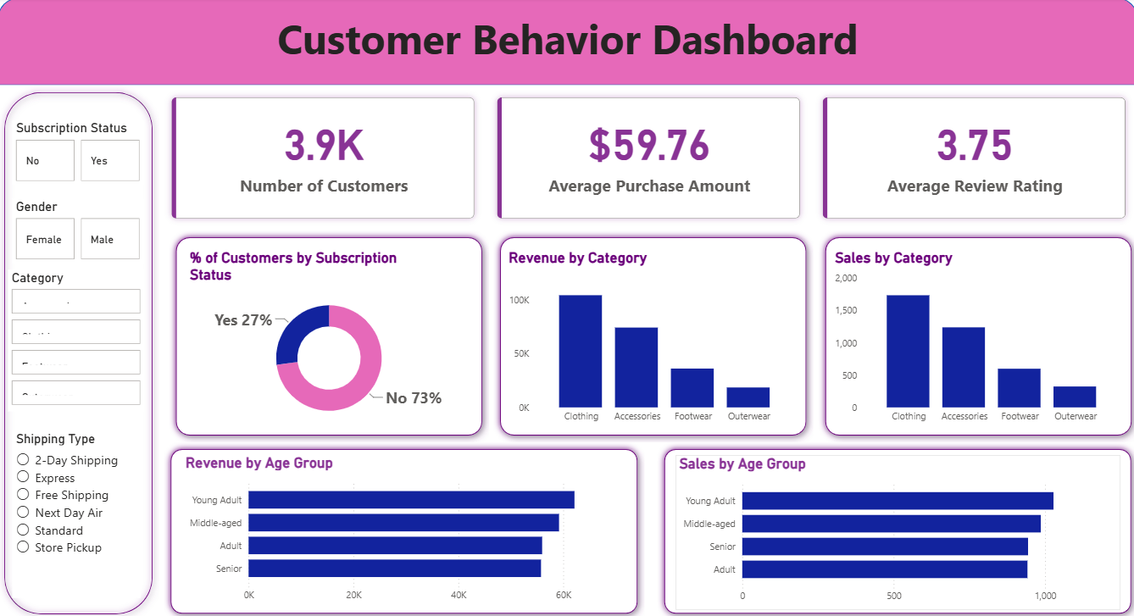




STEP 3 · POWER BI
An interactive dashboard for day-to-day decisions
3 KPI cards
Customers (3.9K), average purchase ($59.76) and average rating (3.75)
5 charts
Subscription split, plus revenue and orders by category and by age group
4 slicers
Filter by subscription status, gender, category and shipping type
3 DAX measures
COUNT and AVERAGE measures behind the KPI cards
Connected live to the PostgreSQL customer table
Customer Shopping Behaviour Analysis
12
Notes:
The Power BI dashboard connects directly to the PostgreSQL table. Stakeholders can filter by subscription status, gender, category and shipping type to explore the patterns covered in this presentation.

Slide 13




WHAT TO DO NEXT
Seven recommendations
Rework subscription benefits
Strengthen core categories
Add perks that drive bigger or more frequent orders; target the 2,518 unsubscribed repeat buyers
Keep Clothing and Accessories prominent; bundle Footwear and Outerwear with them
Reward loyal customers
Improve product satisfaction
Tiered loyalty programme for the 3,116 Loyal customers
Act on feedback for Shirt, Jeans, Blouse; feature Gloves, Sandals, Boots
Review the discount strategy
Target campaigns by age
Check margins on Hat, Sneakers, Coat, Sweater, Pants; premium offers for 839 high spenders
Tailor campaigns for Young Adults while keeping messaging broad
Grow average order value
Start with the first three: they target the largest groups of customers and revenue.
Bundles, cross-selling and free-shipping thresholds to increase basket size
Customer Shopping Behaviour Analysis
13
Notes:
Seven recommendations follow from the findings. The first three have the biggest reach: improving subscription benefits, rewarding the large loyal base, and making discounts more selective. The rest focus on basket size, core categories, product quality and age-based targeting.

Slide 14


KEEP IN MIND
Limitations and next steps
Limitations
Next steps
Snapshot data
Add purchase dates
One latest purchase per customer and no dates, so no trends over time
Track trends and measure real repeat-purchase timing
Dataset quirk
A/B test discounts
No female customer subscribed or used a discount, likely a sample artefact
Find the best balance between sales and margin
Even distributions
Predict subscriptions
Season, payment method and size are spread almost evenly
Model which repeat buyers are most likely to subscribe
Correlation only
RFM segmentation
Differences such as higher spend with Express do not prove cause
Use recency, frequency and monetary value once history exists
Customer Shopping Behaviour Analysis
14
Notes:
The data is a single snapshot per customer without dates, and several columns are almost evenly distributed, which suggests a synthetic dataset. The next steps would be to add transaction dates, run A/B tests on discounts, and build a model to predict subscription likelihood.

Slide 15

THE BOTTOM LINE
Grow revenue with more loyal customers and bigger baskets, not deeper discounts.
80%
≈ $60
76.5%
customers already loyal
spend per order everywhere
revenue from 2 categories
Thank you
github.com/AyushUmmadi
Notes:
To sum up: the business already has a loyal customer base and consistent spend per order. The biggest opportunities are to make subscriptions more rewarding, grow basket size, and use discounts more selectively. Thank you.

