Slide 1

[Samsung PRISM] Preliminary Discussion
Detecting ghost artefacts in the given Multi Frame HDR processed image
Team
College Professor(s): XX / Email ID
Students:
XX / Email ID
XX / Email ID
XX / Email ID
XX / Email ID
Department:
Date: 20th August 2023

Slide 2
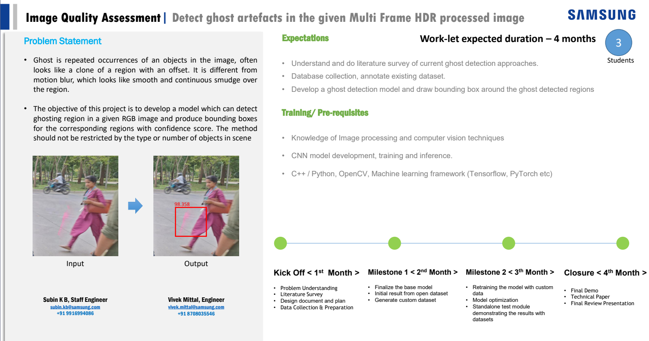

Slide 3
Literature survey and study
Major Observations / Conclusions:
(provide details about your findings, experimental opinion – Use separate slide if necessary)
Some of the techniques used for ghost artefacts detection-:
SSIM (Structural Similarity Index)-:Measures image similarity by comparing a reference image with a target image. It divides images into patches, assesses patch similarities, identifies potential ghost artifacts, reassembles images into HDR format, and effectively prevents ghost artifacts in the final HDR image.
CNN Approach-:(Same method as above but using patches and CNN)A patch having a ghost artifact when matched with a patch that does not have the ghost artifact can be effectively detected using the method of convolutional neural network.
Variance based method-: This method uses the concept of local variance to identify regions in an image where objects are likely to be blurred. It involves a series of computations based on radiance values and variance measures to make this determination. The threshold of 0.18 and the VI calculations are specific parameters used in this method to quantify blurriness.

Slide 4
•Entropy based method-:In this method, the process involves calculating the entropy for each pixel in the low dynamic range (LDR) images, representing the degree of variation in the pixel's surroundings. An Uncertainty Image (UI) is then generated by comparing pixel entropies across different LDR images. A weighting function is applied to give higher importance to brighter pixels. The UI is utilized to detect "ghost" regions, where pixel information significantly varies between images, using a threshold of 0.7 to identify such regions.
•Prediction based-:In this prediction-based approach, we start by predicting the brightness of pixels in one image (Ll) based on another image (Lk) using a camera response function and exposure time information. Then, we compare these predictions to the actual brightness values in Ll. If the predicted and actual values significantly differ, we identify those pixels as "ghost pixels." This process is applied to all pixels, generating a "ghost map" for Ll, highlighting pixels that behave unexpectedly compared to our predictions.
•Ghost Artifact Removal in DTI Images-:A multi-stage post-processing pipeline focusing on texture analysis effectively removes ghost artifacts from Diffusion Tensor Imaging (DTI) images. The approach involves segmentation, feature extraction, and classification, using mathematical morphological processing for segmentation, selecting texture features for maximal class dependence, and employing the Adaptive Neuro-Fuzzy Interface System (ANFIS) for differentiation. This method shows promise in advancing neuroimaging image processing.

Slide 5
•Simplified CNN for Artifact Detection-:A simplified CNN architecture, similar to AlexNet, utilizing 2D convolutional layers with ReLU activation functions, max-pooling layers, and SoftMax outputs, detects artifacts in images. It successfully identifies 97% of previously flagged images and outperforms by detecting ten times more images with artifacts while maintaining a precision of approximately 78%.

Slide 6
Queries
Challenges :
(Discuss in the form of bullets, what are the next action steps, any road blocks / bottlenecks)
Few of the challenges
Finding dataset of processed HDR images having ghost artefacts for training purpose
Very limited resources/research for detecting ghost artefacts in already pre processed HDR image
Ideas which can be implemented
Image resizing
Developing(Training) a CNN model to identify ghost artefacts by breaking the HDR image into small patches and comparing it with its surrounding patches. Further more increasing the accuracy by training the model to identify characteristics of ghost regions such as Inconsistent Positioning,Variability,Color and Luminance Differences,Bluriness etc

Slide 7
Thank you

