Slide 1
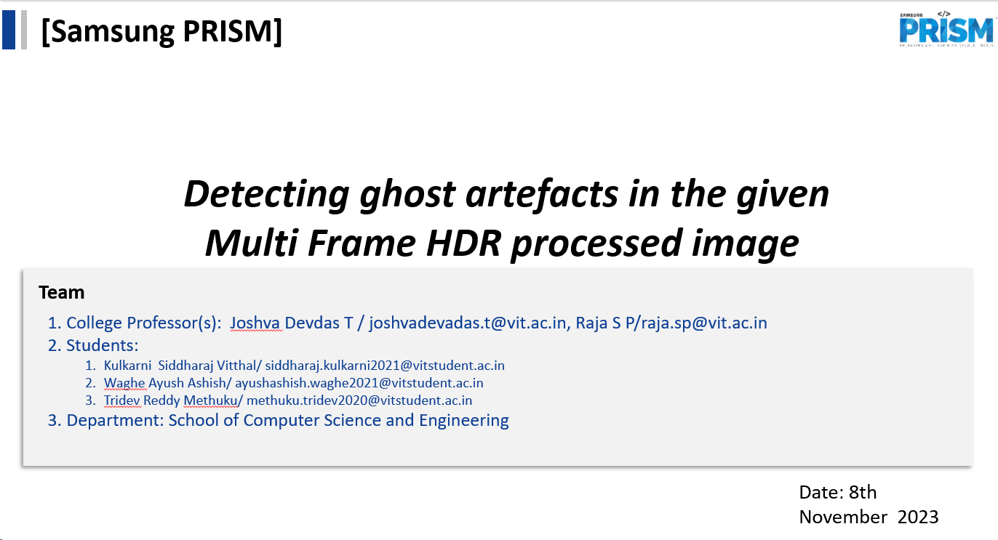

Slide 2
Progress till now
Literature review-:
SSIM (Structural Similarity Index),CNN Approach,Variance based method,Entropy based method,Prediction based,Ghost Artifact Removal in DTI Images,Simplified CNN for Artifact Detection
Collection and labelling of dataset
Training the models (Yolo,ssd-mobilenet-v2,ssd-mobilenet-v2-fpnlite-320)

Slide 3
KPIs achieved till now
1)Collection and generation of custom dataset-:
We have created the dataset of ghost artifacts and annotated them in the xml/json/text(for yolo) format
2)Labelling of dataset-:
Labeled the dataset using labelImg,Labelme,Labelbox as per requirements
3)Training of YOLO model
4)Training of Tensorflow models
ssd-mobilenet-v2
ssd-mobilenet-v2-fpnlite-320

Slide 4
Technical challenges faced and solving them
1)No direct dataset of ghost artifacts available-:
-Used the set if LDR images and combined them to generate ghost artefacts using softwares like easyHDR and adobe photoshop
2)Compatibility issues of annotations softwares-:
-For solving these issues we tried changing the source codes to some extent of softwares like labelImg using online resources like Blogs/youtube
-Used alternatives like labelImg,Labelbox
3)Having less dataset
Though combining the dataset generated only around 100 images. Hence used online tool “makesense” thus having around 300 images.
4)Training the YOLO model

Slide 5
Tensorflow model
1)Compatibility issues
2)XML to CSV file conversion errors due to different format

Slide 6
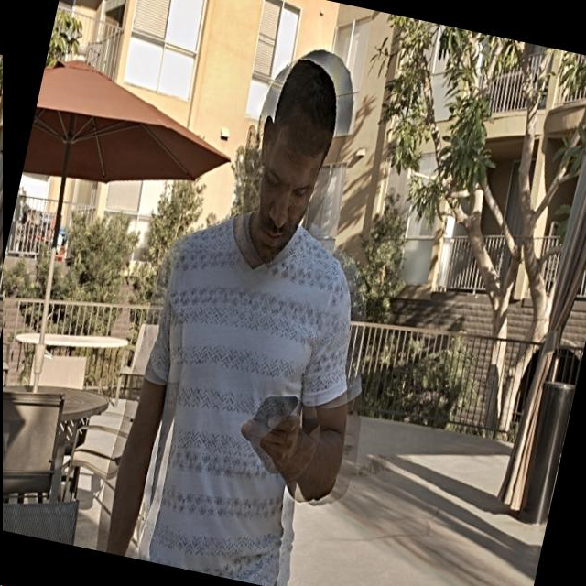
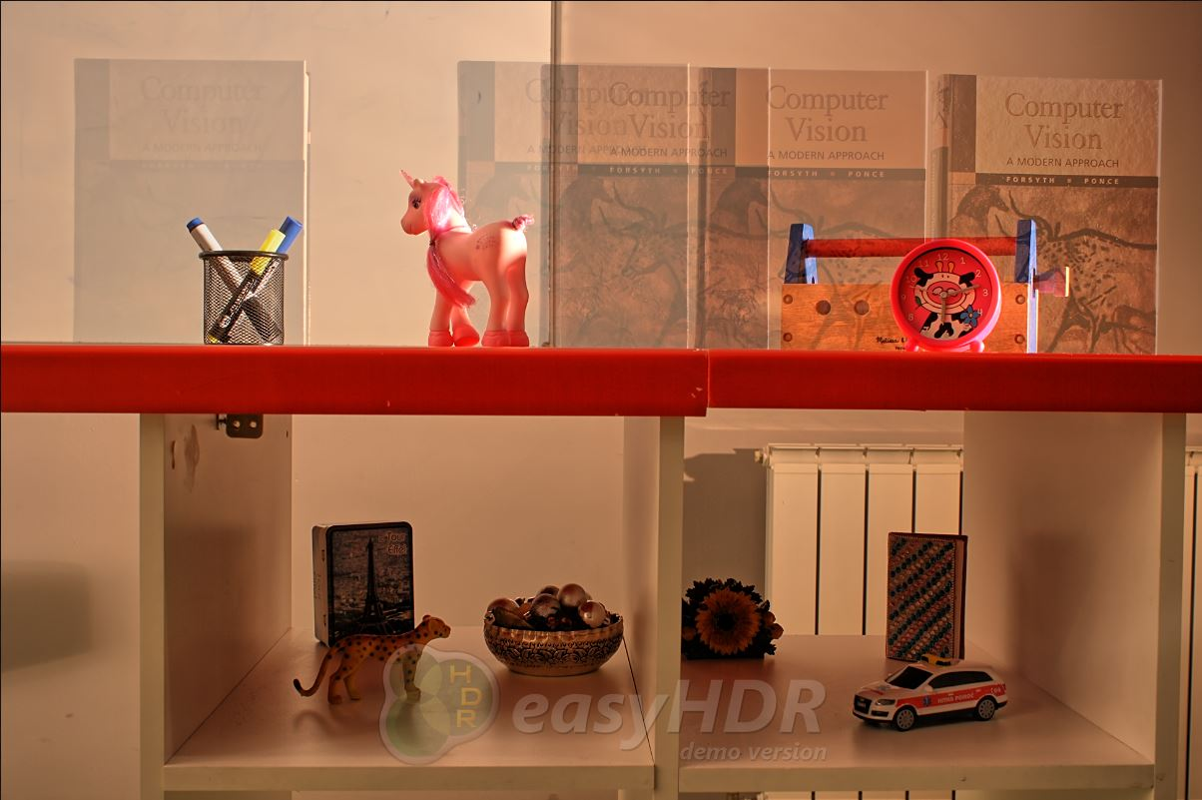
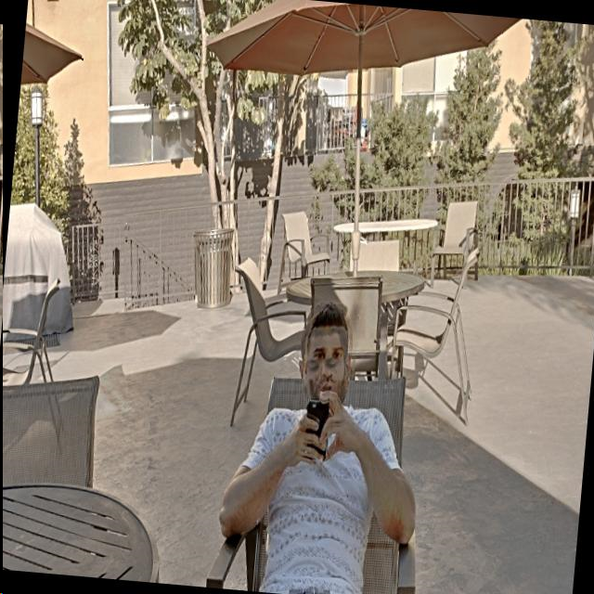
Dataset examples output-:

Slide 7
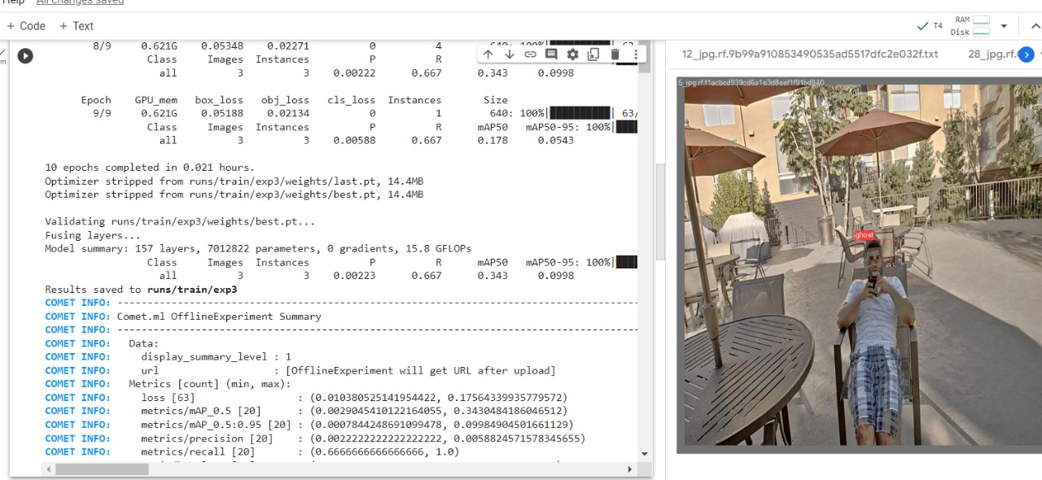
Results till now
Yolo-:

Slide 8
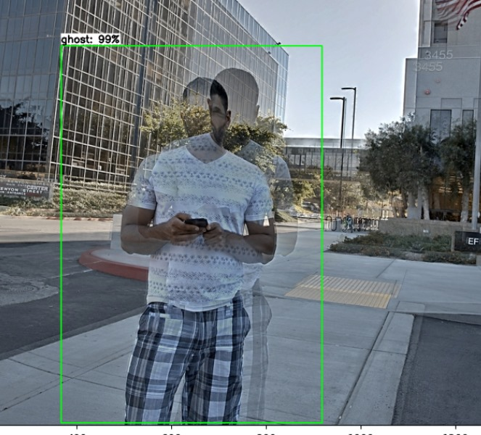
Tensorflow-ssd-mobilenet-v2-fpnlite-320

Slide 9
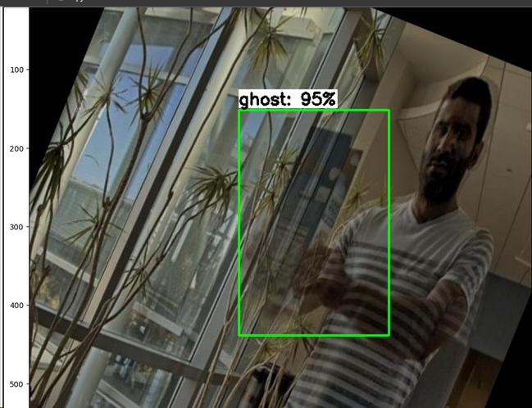
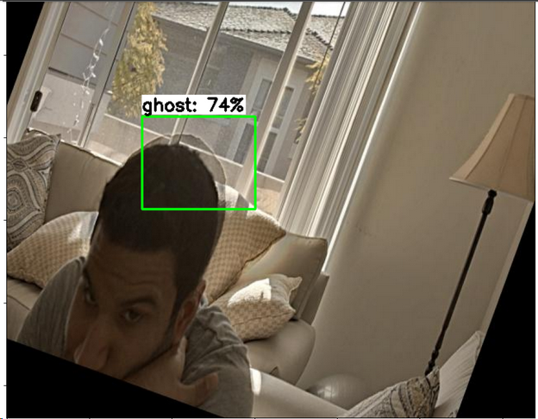
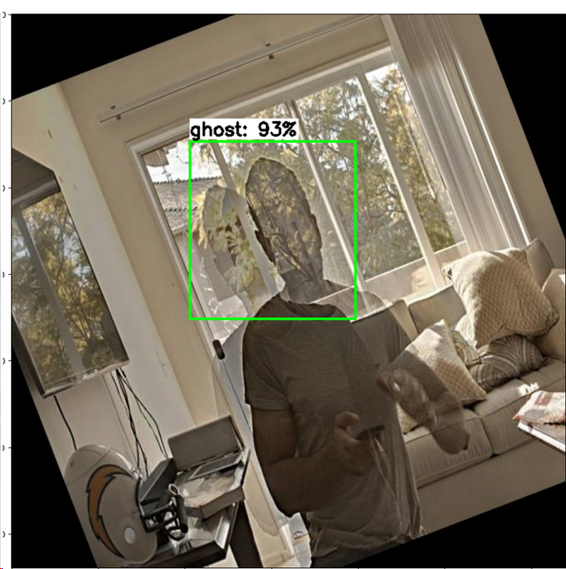
Tensorflow-ssd-mobilenet-v2 Number of steps-:25000 Batch size-:8 MAP score-:55.64 Trained on-:90 images

Slide 10
Upcoming Month’s plan
-Our next step will be to work further on the model of CNN
-We will also be trying Unet for localisation of object and respective ghost
-Working on different tensorflow models
-Increasing the accuracy of annotations (as currently used only rectangles) by using polygons to detect more accurately and detecting multiple instances of ghost artefacts
-Increasing accuracy with multiple instances of ghosts while annotation
-Adding another output node for detection of ghost to say if a ghost exists in an image
-Working on models like mask based residual networks

