Slide 1
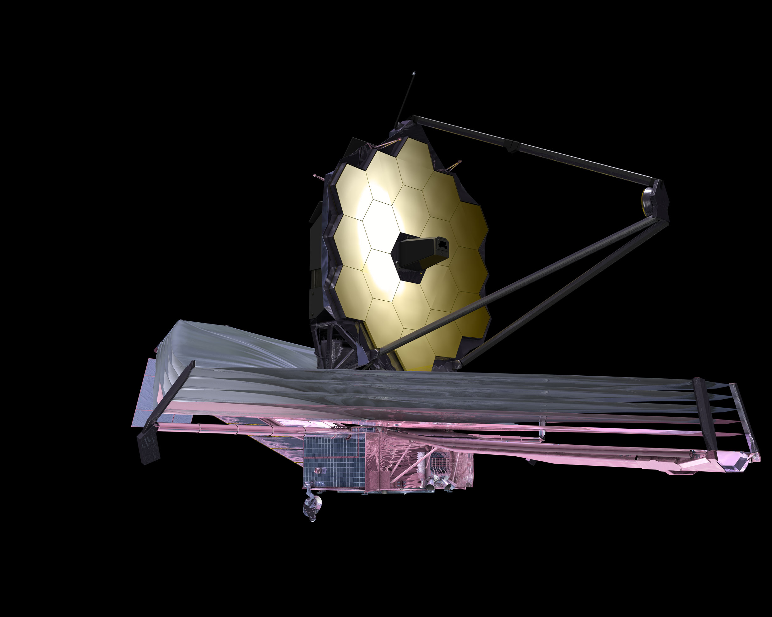
Entering JWST Live Viewer

