Slide 1


Intelligent Farmers E-Marketplace with Prediction of Crop Risk Factors
Sr.No. | Roll no. | Student full name
1 | 36 | Bhola Ayusha Sandeep
2 | 37 | Chendake Shrutika Sunil
3 | 38 | Karjol Megha Shivanand
4 | 39 | Machal Akshata Shriniwas
Under the guidance of
Guide Name:Mr.P.S.R.Patnaik
Email Id:
psrpatnaik@gmail.com
Walchand Institute of Technology, Solapur
(www.witsolapur.org)

Slide 2
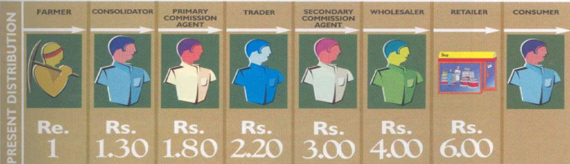

Idea of project in detail
India is a huge Agricultural Hub and more than 50% of the Indian workforce is involved in agriculture. Thus, considering this a proposed system named “Kisaan Sahayak” : Intelligent Farmers e-Marketplace with prediction of crop risk factors.
It is a smart approach which implements the following features.
It provides an E-Marketing platform which will reduce the role of middlemen who are hindering the trading sector in agriculture. This E-Marketing platform is free of cost and can be accessed from anywhere and made available in understandable language to farmers using php.
Walchand Institute of Technology, Solapur
2

Slide 3
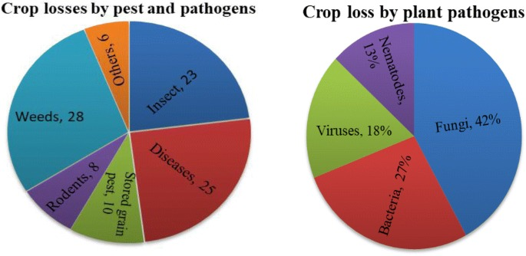
It also provides a Leaf Disease Detection system which detects the disease of crop and give solution for it.

Slide 4
Background of project
A Intelligent Farmers E-Marketplace with prediction of crop risk System is responsive web application . The application is divided into two parts, one is for E-Market portal and second is leaf disease detection.
On E-Market portal the farmers can add their products by simply using the dropdown menus to sell their products and buyers can buy the products from this portal and they can easily pay to farmers using third party payment gateway which is friendly to use This reduces the involvement of retailer.
Leaf disease detection is the most useful feature for farmers as they worried about their crop diseases, by simply taking the image of crop, we provide the information of disease and solution for it. Accordingly farmer can cure the disease of crop.
Walchand Institute of Technology, Solapur
3

Slide 5
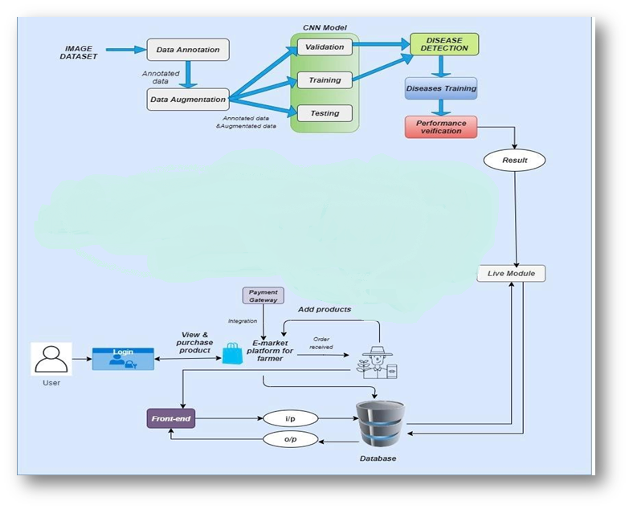
System architecture
Walchand Institute of Technology, Solapur
4

Slide 6
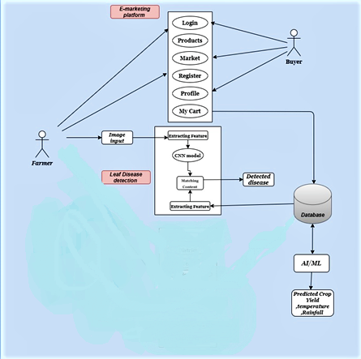
Methodology (working)
.First of all the user have to register or login to the portal. After login/registeration they can free to use the features like E-market, disease detection, yield prediction.
Walchand Institute of Technology, Solapur
5

Slide 7





Technology stack
Technologies Required:
Front End- HTML5, CSS, JS, Bootstrap
Web Framework- Flask
Backend- Python 3.7
ML Libraries/ APIs/ Framework- Pandas, Tensorflow, Keras, Matplotlib, Numpy, Pickle
Database-MySQL(5.6)
Operating System- Windows/ Linux/ IOS
PHP: It is called Hypertext Preprocessor.
CNN:Most commonly applied to analyze visual imagery.which can take in an input image,and be able to differentiate one from the other.
Firebase:Is a Backend-as-a-Service
Walchand Institute of Technology, Solapur
6

Slide 8
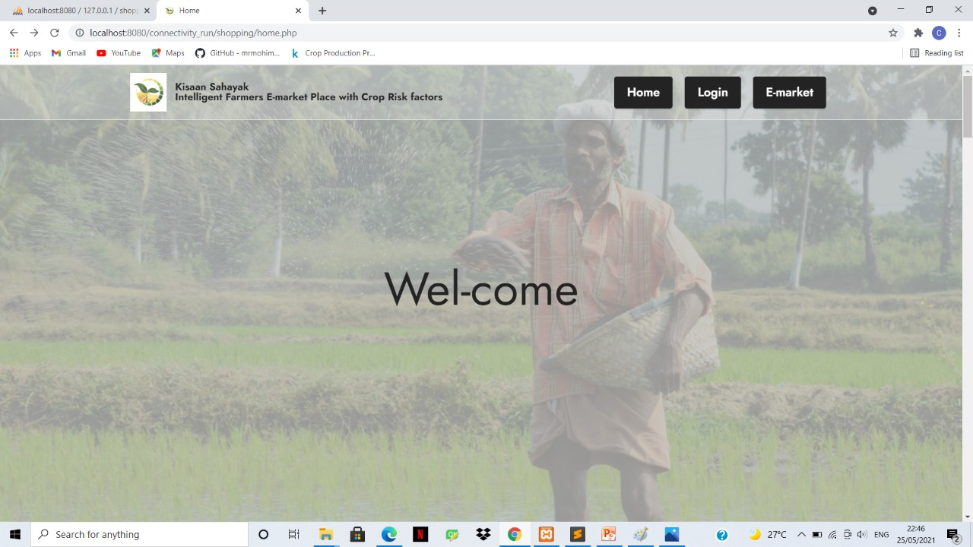
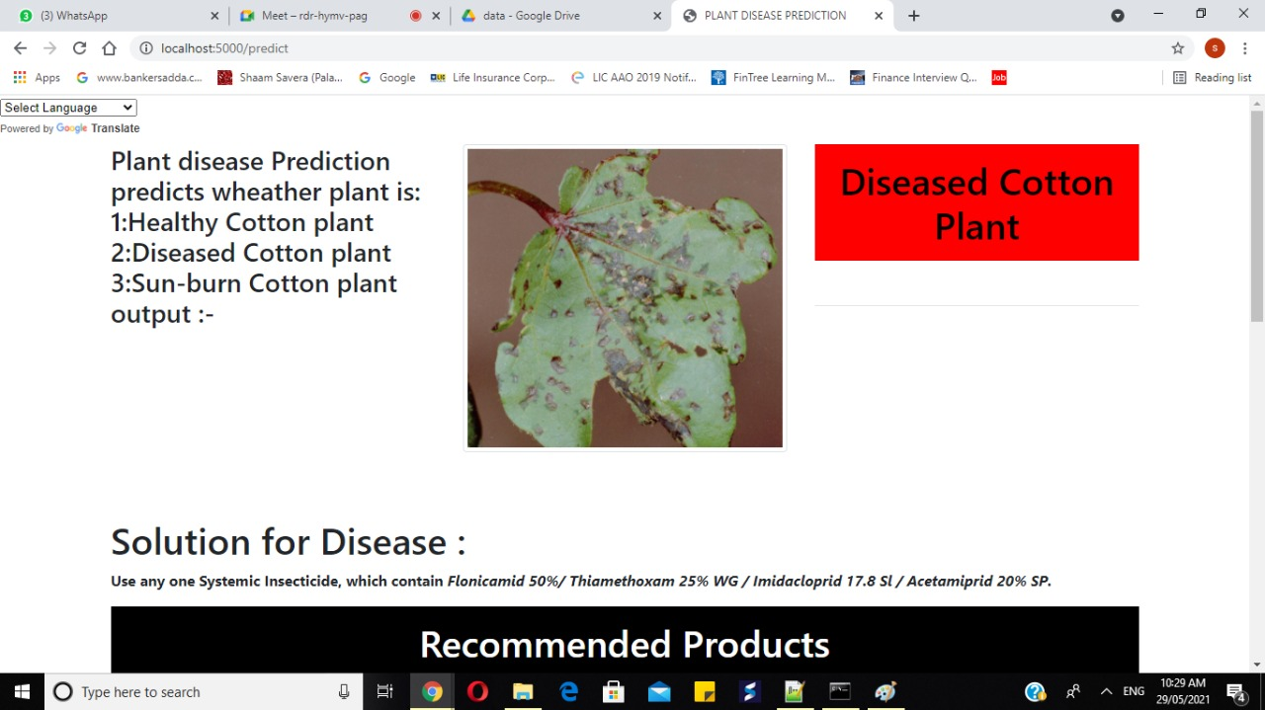
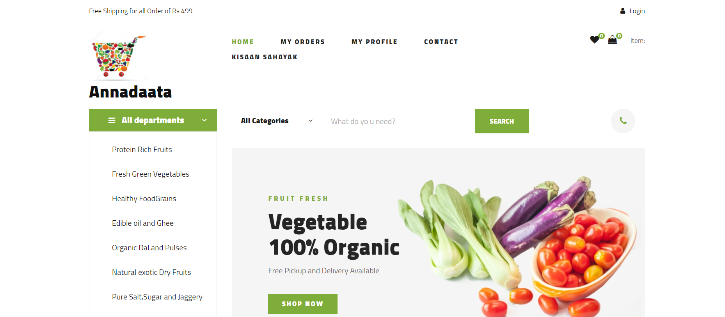
Results
Walchand Institute of Technology, Solapur
7

Slide 9
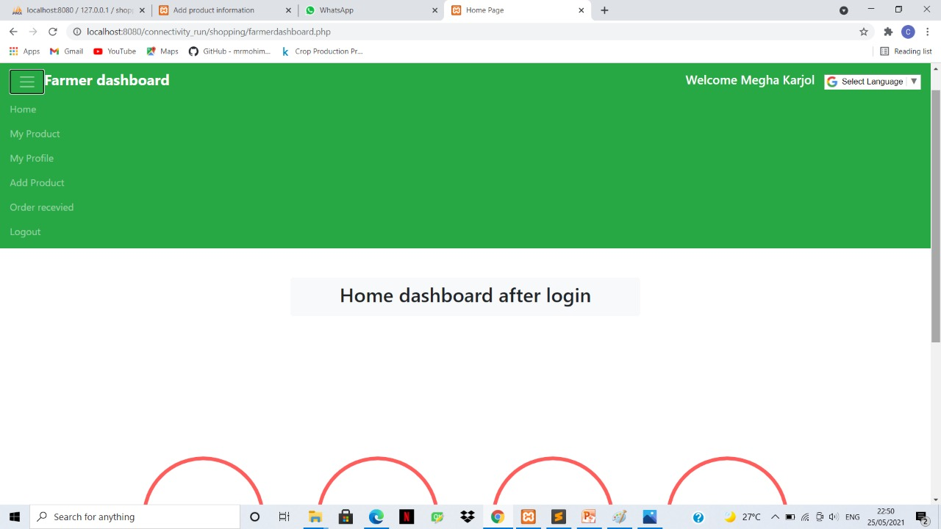
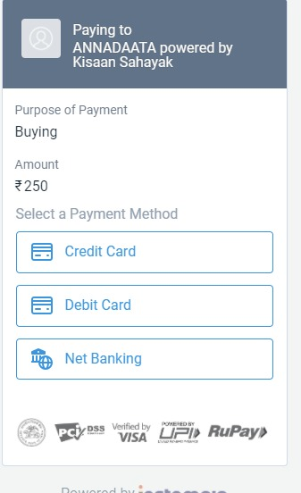

Slide 10
Conclusion
. “Intelligent Farmers E-Marketplace with Prediction of Crop Risk Factors”is a responsive web application. It is multilingual with more than 100 available languages. The web application has firebase phone number based OTP authentication for the convenience of farmers.
. This model is divided into two parts, one is E-marketing platform, second is Leaf disease detection system which is the biggest advantage over existing systems in the market.
The detection can be improved if more attributes are considered but lack of data reduces the parameters of the ML model. This can be further improved by improving the data set with more number of attributes in the detection model.
. In conclusion, we have given well optimized solution for the problems which will definitely help the farmers with proper and optimized suggestions and detection in building the economical status of agricultural production dependent countries.
Walchand Institute of Technology, Solapur
8

Slide 11
Future scope
.Adding IVR system to help the farmer for getting detailed and understadable information about their farm as well as crop.
.The data set of various plant diseases can help to get more improved knowledge about plant diseases.
. Feature like providing crop yield prediction with improvement feature like showing profit or loss of yield production.
. Future work is aimed at an improved data set and adding more features to the system.
9
Walchand Institute of Technology, Solapur

Slide 12
References
This information can be provided by reference to an appendix or to another document.
https://data.gov.in/
https://www.kaggle.com/emmarex/plantdisease
Subhadra Mishra, Debahuti Mishra, Gour Hari Santra. Applications of Machine Learning Techniques in Agriculture Crop Production: A Review Paper, Oct 2016.
P.Priya, U.Muthaiah, M.Balamurugan. Predicting yield of the crop using Machine Learning Algorithms.
M. Hunter, R. Smith, M. Schipanski, L. Atwood and D. Mortensen, "Agriculture in 2050: Recalibrating Targets for Sustainable Intensification", BioScience, vol. 67, no. 4, pp. 386-391, 2017. Available: 10.1093/biosci/bix010. Fig. 10. Confusion matrix – validation dataset Fig. 11. Top losses plotted – validation dataset Fig. 12. Confusion matrix – test dataset
"PlantVillage", Plantvillage.psu.edu, 2020. [Online]. Available: https://plantvillage.psu.edu/. [Accessed: 31- Jan- 2020].
D. Klauser, "Challenges in monitoring and managing plant diseases in developing countries", Journal of Plant Diseases and Protection, vol. 125, no. 3, pp. 235-237, 2018. Available: 10.1007/s41348-018-0145-9.
Walchand Institute of Technology, Solapur
10

Slide 13
Thank You !!!
Walchand Institute of Technology, Solapur
11

