Slide 1
2321101122 –
Software Engineering

Slide 2
Unit-1 Fundamentals of Software Engineering

Slide 3
Why Software Engineering?
Build Reliable Systems: Learn how to create software that works well, is scalable, and easy to maintain.
Develop Problem-Solving Skills: Gain the ability to break down and solve complex problems.
Real-World Applications: Understand how software impacts our daily lives and how to build solutions that address real problems.
Full Development Life Cycle: Learn the stages of software development—from planning to maintenance.
High Job Demand: Software engineers are in high demand across various industries.
Ethics and Security: Ensure your software is secure and ethical, protecting user privacy.
Adapt to New Technologies: Software engineering helps you stay updated with rapidly changing tools and technologies.

Slide 4
History
The term "software engineering" was first introduced at a (North Atlantic Treaty Organization - NATO) NATO conference in 1968 in Garmisch, Germany to address the inconsistency and unreliability in software development and to emphasize the need for better quality assurance and reliability.
It was during this conference that the term “Software Engineering” was first used to suggest that software development should be treated as an engineering discipline, like mechanical or civil engineering.

Slide 5
What is Software Engineering?
The term software engineering is the product of two words,
Software + Engineering = Software Engineering

Slide 6
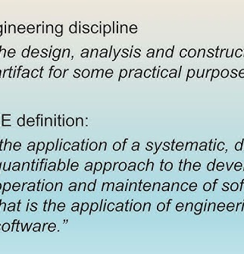
What is Software Engineering?
IEEE stands for Institute of Electrical and Electronics Engineers. It is a professional organization dedicated to advancing technology for the benefit of humanity, with a focus on electrical engineering, electronics, computer science, and related fields.

Slide 7
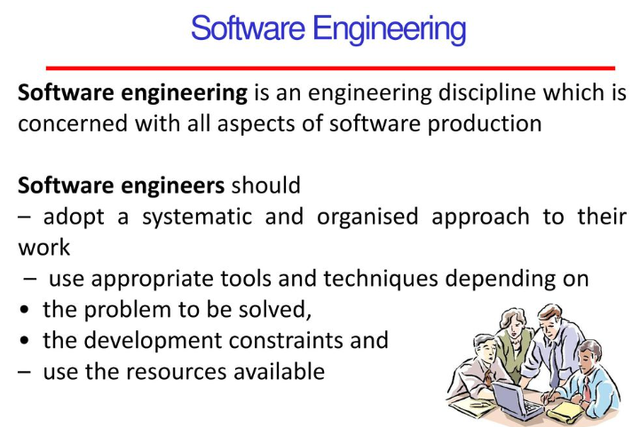

Slide 8
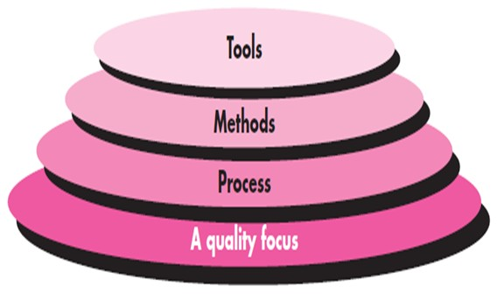
Layers of software engineering

Slide 9
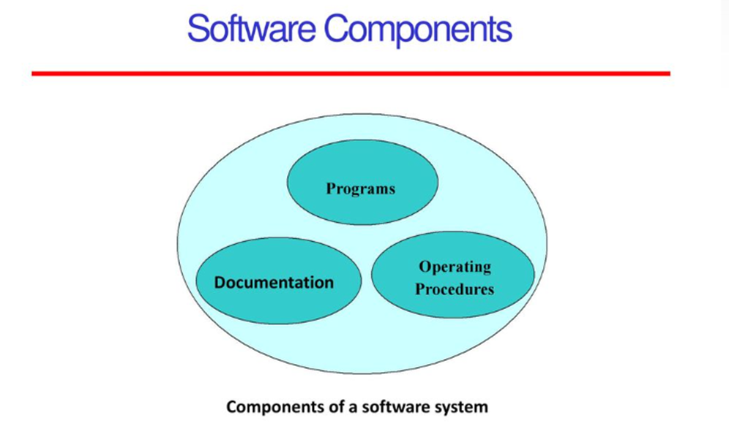

Slide 10
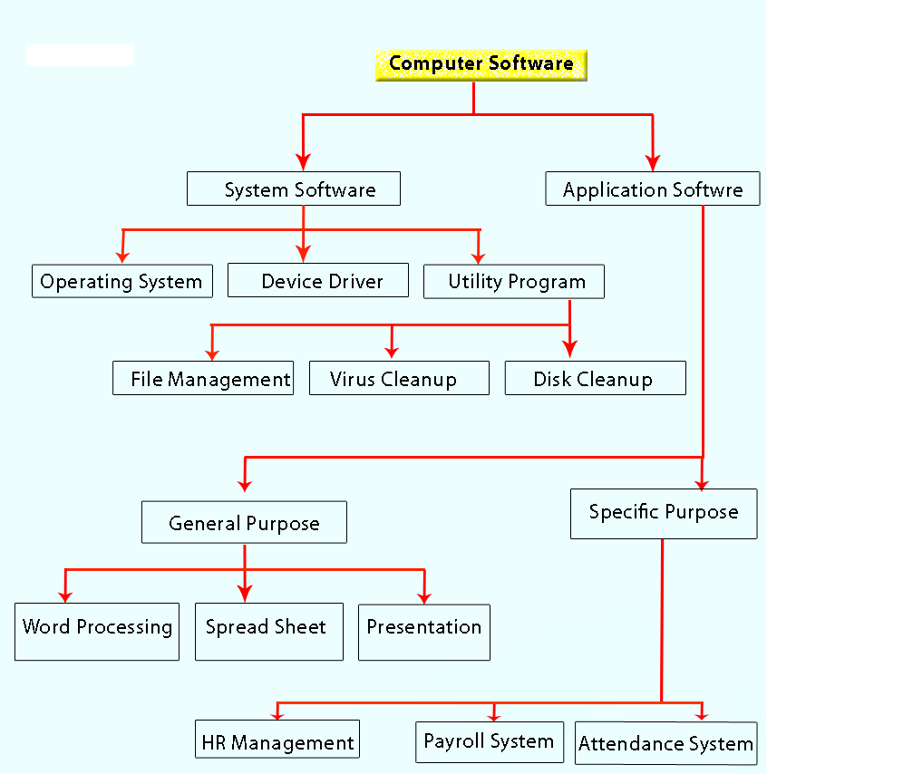
Types of Computer Software

Slide 11
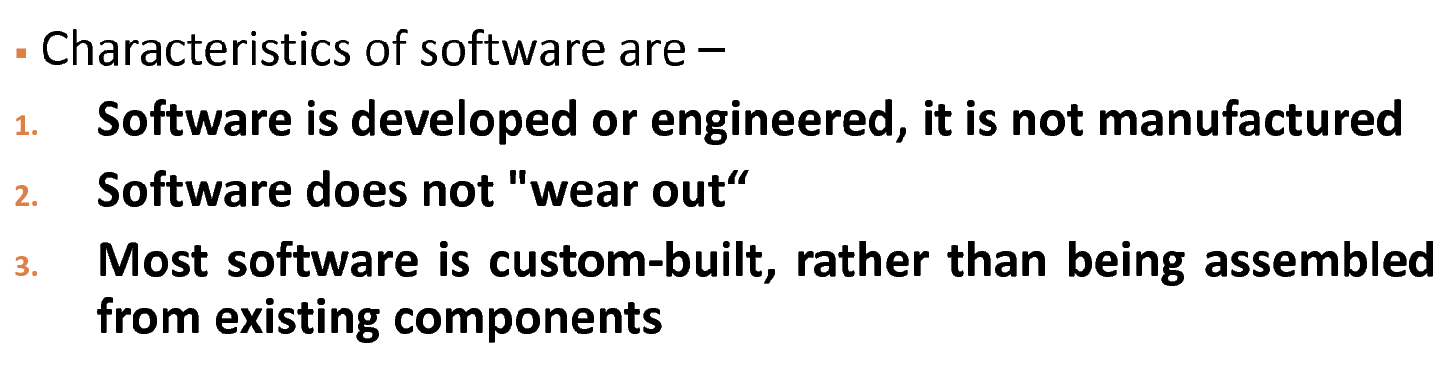

Slide 12
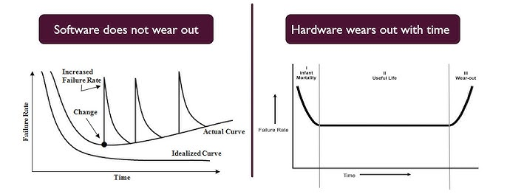

Slide 13
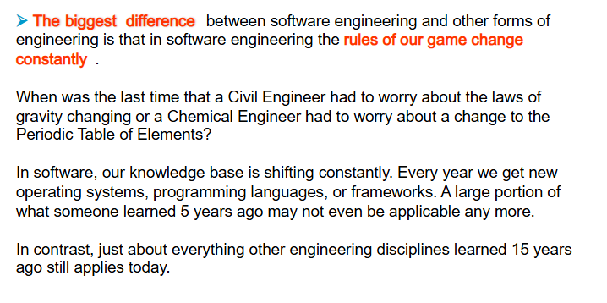
Difference between software engineering and traditional engineering

Slide 14
Software Development Life Cycle (SDLC)
The term "Software Development Life Cycle" refers to the SDLC process.
It is also known as software development process.
The SDLC (software development life cycle) is a concept that specifies the actions that must be completed at each step of the software development cycle.
ISO/IEC 12207 is a global software life-cycle management standard. It aspires to be the ideal Model for all software development and maintenance aspects.
International Organization for Standardization (ISO)
International Electrotechnical Commission (IEC)

Slide 15
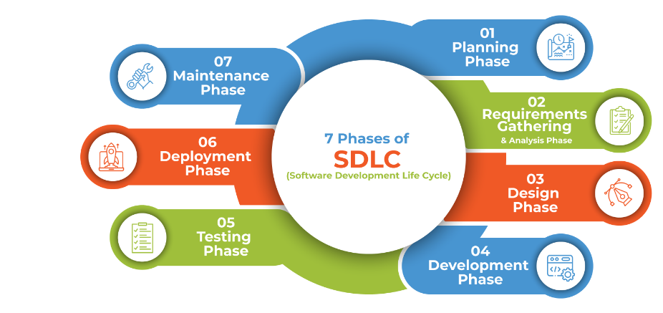
Stages/Phases of the Software Development Process

Slide 16
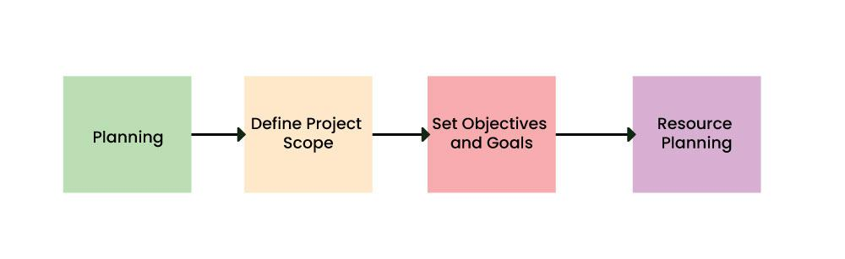
Planning
Define project scope & feasibility → Project Proposal

Slide 17
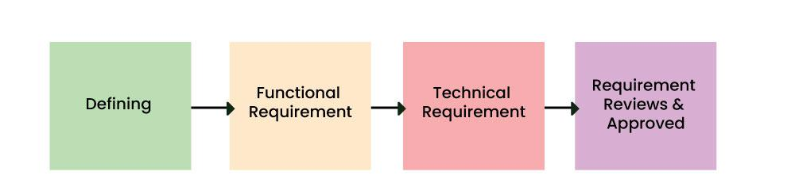
Requirement Analysis
Gather & finalize requirements → SRS Document

Slide 18
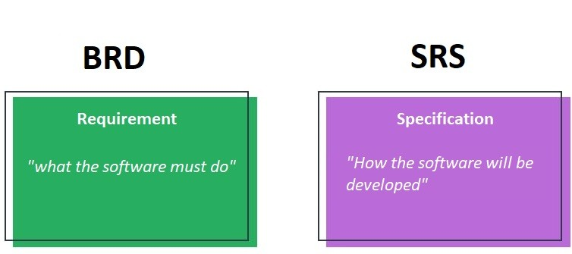
BRD – Business Requirement Document
SRS – Software Requirement Specification

Slide 19
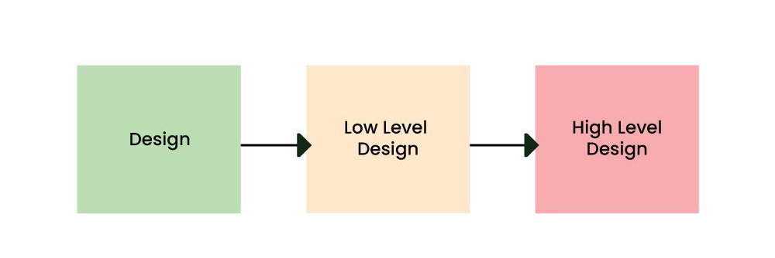
Design
Create system architecture & UI → System Design Document (SDD)

Slide 20
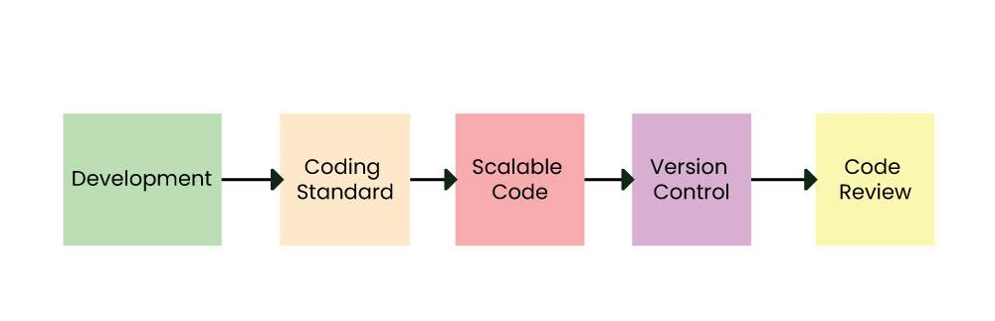
Coding/Implementation
Develop & integrate modules → Source Code Repository

Slide 21
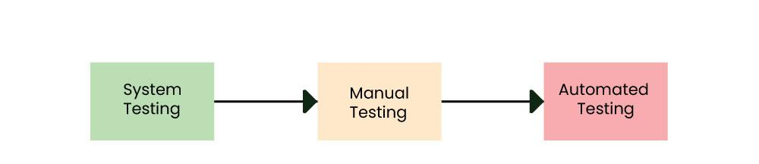
Testing
Identify bugs & validate software → Test Report

Slide 22
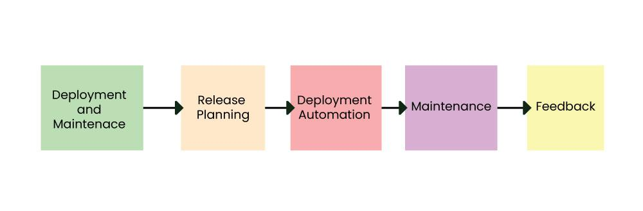
Launch application → Deployed Software
Deployment & Maintenance
Fix bugs & improve features → Maintenance Log

Slide 23
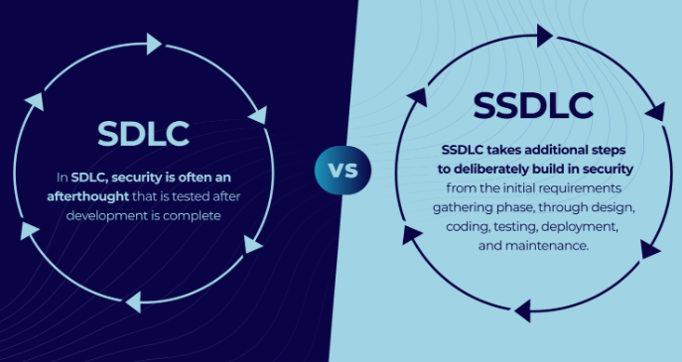
Software Development Lifecycle (SDLC) v/s Secure Software Development Lifecycle (SSDLC)

Slide 24
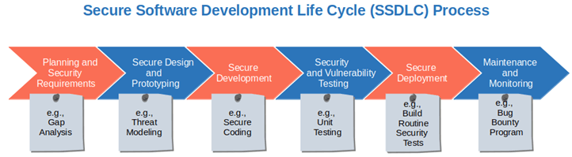

Slide 25
Software Development Life Cycle Models
To this day, we have more than 50 recognized SDLC models in use.
Each brings its favorable aspects and disadvantages for a specific software development project or a team.

Slide 26

Software Process Model
A Software Process Model is a structured framework that defines the stages and activities involved in developing software.
It serves as a roadmap for planning, designing, developing, testing, and maintaining software applications.

Slide 27
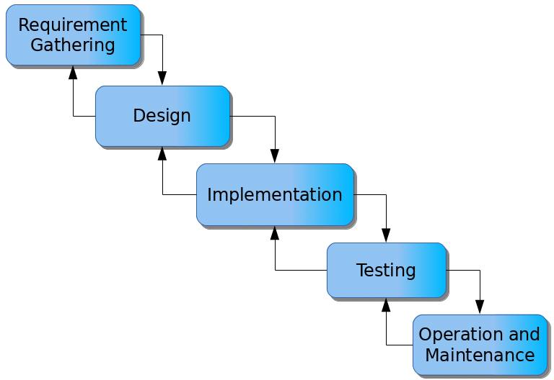
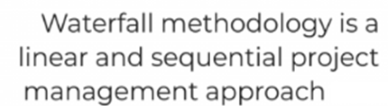
Waterfall Model

Slide 28
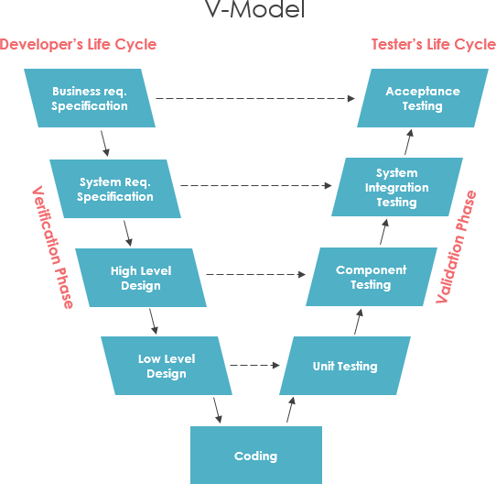
V-Model
Verification and Validation (also abbreviated as V&V)
Verification means Are we building the product right?
Validation means Are we building the right product?

Slide 29
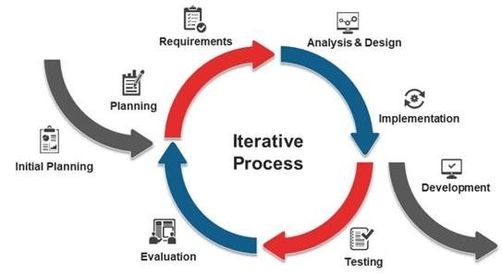
Iterative Model

Slide 30
Types of Evolutionary Models
Incremental Model
Spiral Model
Prototyping Model

Slide 31
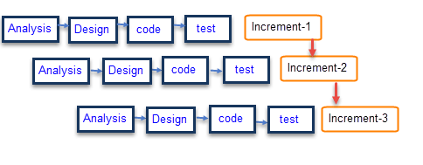
Incremental Model

Slide 32
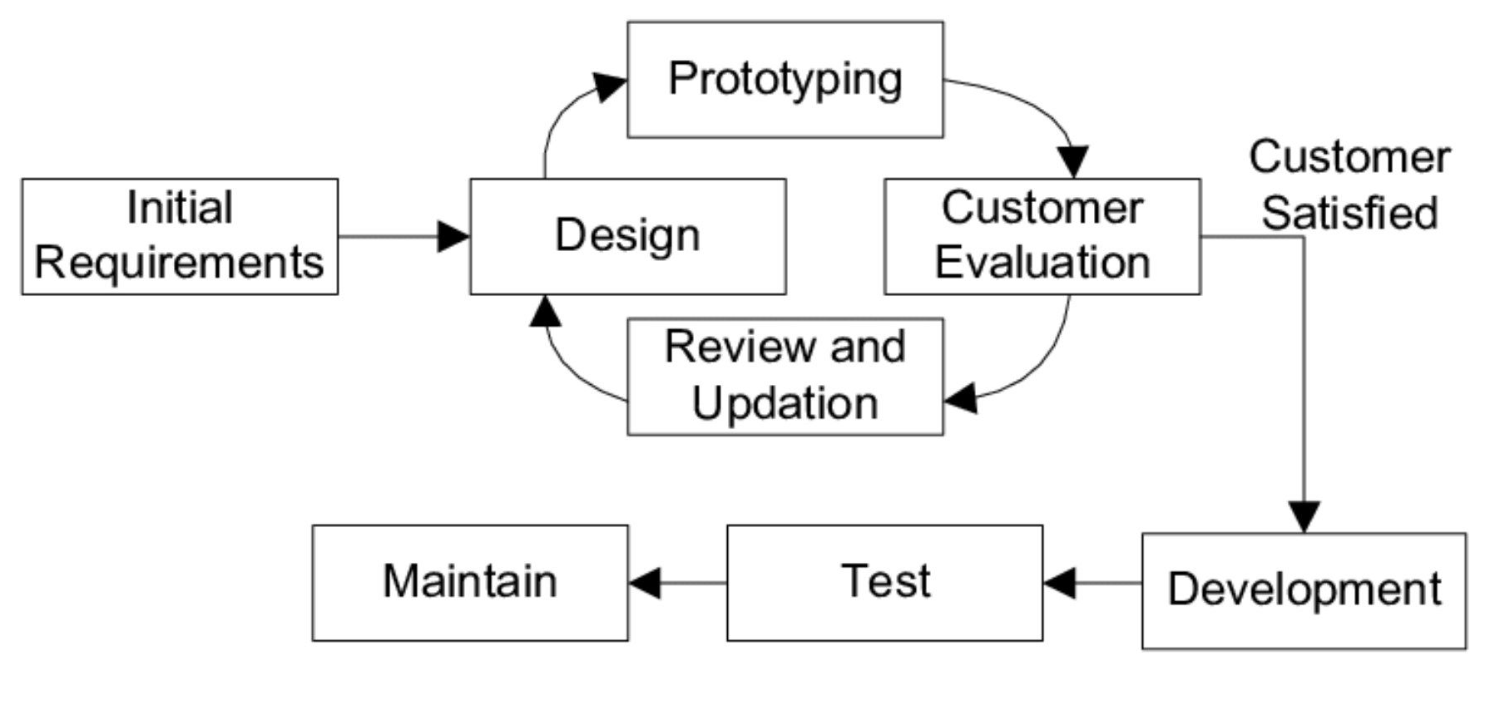
Prototype Model

Slide 33
Spiral Model
Spiral model is a risk driven software development process model.
It is known a meta model.
Repeated cycles (spirals) of planning, risk assessment, and prototyping

Slide 34
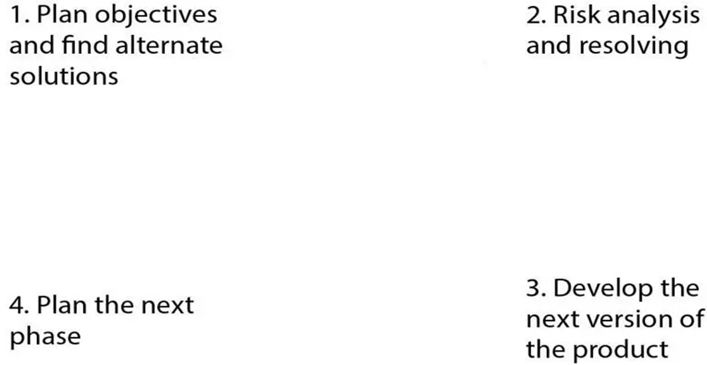
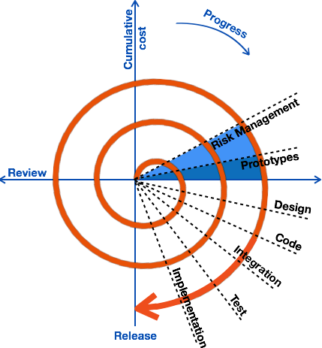

Slide 35
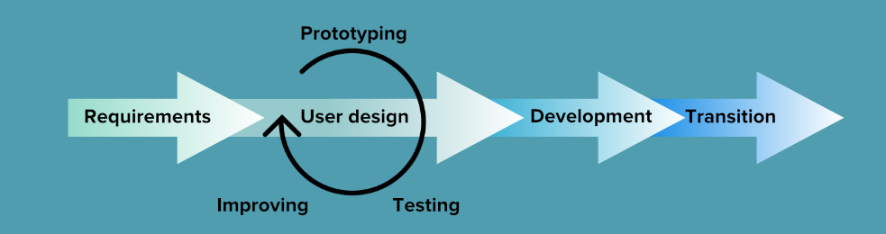
Rapid Application Development (RAD)

Slide 36
Agile Methodology
The term "Agile" means "able to move quickly and easily.“
Agile is a methodology, not a model.
Agile is more of a methodology or framework rather than a single process model. It is a set of principles and values that guide how projects should be managed. Within Agile, there are specific process models such as:
  Scrum
  Kanban
  Extreme Programming (XP)
Agile refers to a flexible and iterative approach to software development and project management.
It is based on the Agile Manifesto (2001), which emphasizes collaborative approach, adaptability to change, customer feedback, and continuous improvement.

Slide 37
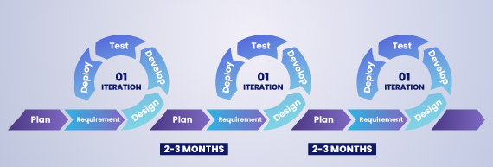
Agile Methodology

Slide 38
Difference between Waterfall Model and Agile Methodology

Slide 39
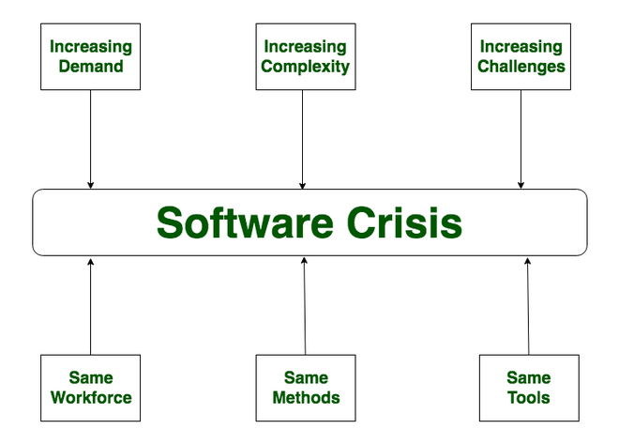
Software Crisis
The term “software crisis” refers to the numerous challenges and difficulties faced by the software industry.

Slide 40
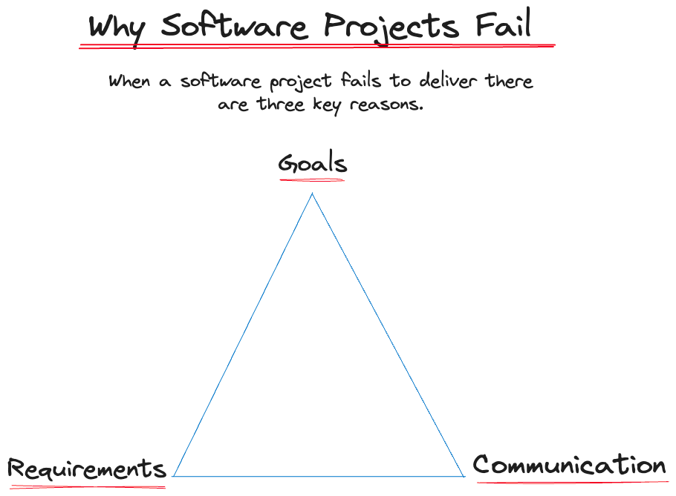
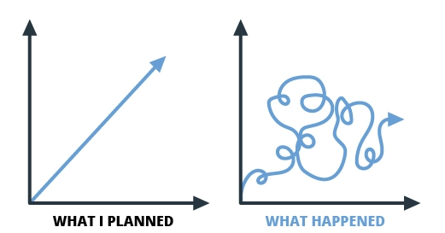

Slide 41
Why do projects fail even after implementing best practices?
Categorizing projects as either “successful” or “unsuccessful”, they can be categorized as:
Ideal projects: The project is completed on-time, on-budget, on-value, and with all features and functions as initially specified.
Imperfect projects: The project is completed and operational but over-time, over-budget, below predicted value, and/or lacking features.
Failed projects: The project is cancelled at some point during the development cycle.

Slide 42
Case Study: The 2021 Facebook, Instagram & WhatsApp Outage
What Happened?
On October 4, 2021, Facebook, Instagram, and WhatsApp went offline for 6+ hours worldwide, affecting billions of users.
What Went Wrong?
A misconfiguration in the Border Gateway Protocol (BGP) disconnected Facebook’s servers from the internet.
This led to a cascading failure where even Facebook employees couldn't access internal systems to fix it.

Slide 43
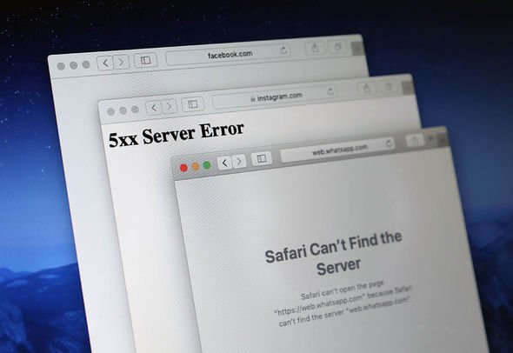


Slide 44
Why Was This a Software Crisis?
Single Point of Failure – Facebook’s entire network was affected due to one error.
No Backup Plan – The failure blocked access to key recovery tools, slowing the fix.
Global Impact – Businesses and users who rely on WhatsApp and Facebook for communication and advertising faced huge disruptions.

Slide 45
Key Takeaways for Software Engineers
✔ Proper Testing – Changes to critical network configurations must be tested carefully.
✔ Redundancy is Essential – Backup systems should be in place to prevent a total shutdown.
✔ Fast Incident Response – Engineers need alternative access methods for quick recovery.

Slide 46
Case Study: Toyota Car Accidents – A Software Crisis in Automotive Safety
What Happened?
Toyota faced a major crisis when drivers reported that their cars were accelerating unintentionally, even when they were not pressing the gas pedal. This led to multiple accidents and fatalities, forcing an investigation into the cause.
What Went Wrong?
Software Malfunctions – Toyota’s Electronic Throttle Control System (ETCS) had critical bugs.
Memory Corruption – Software errors led to unexpected acceleration without driver input.
Safety System Failures – The software disabled fail-safe mechanisms, making it impossible to stop unintended acceleration.
Single Points of Failure – The system design lacked redundancy, meaning a single malfunction could compromise the entire vehicle.

Slide 47
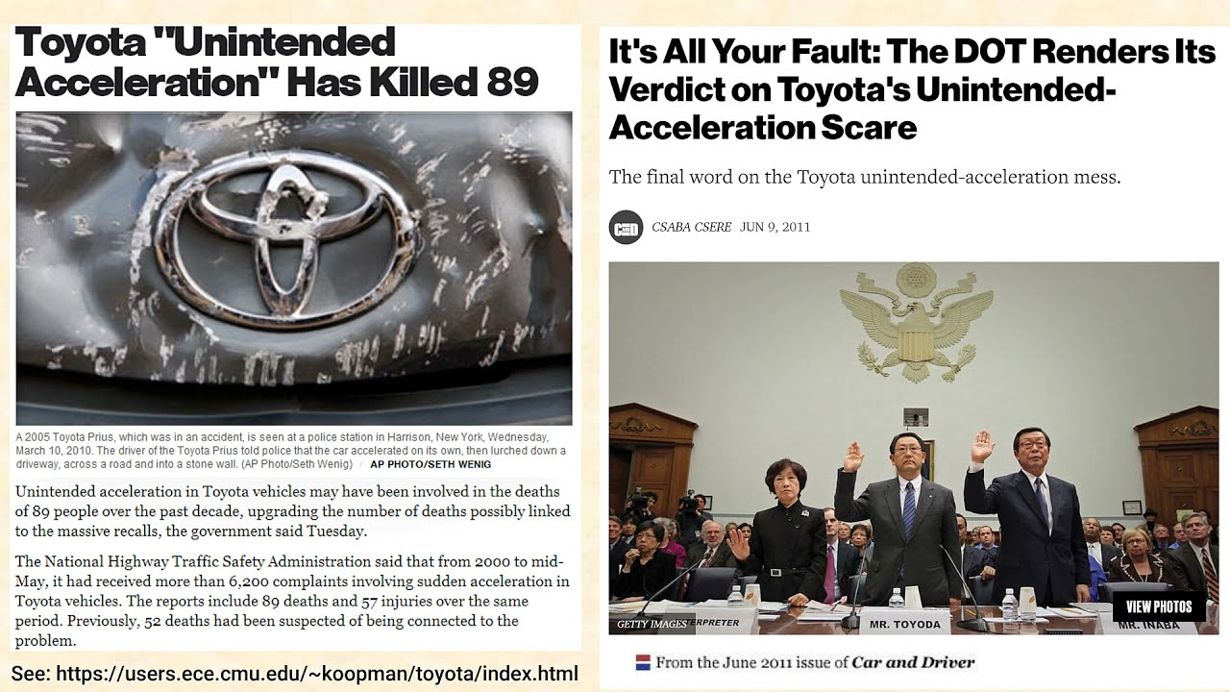
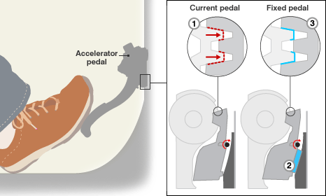

Slide 48
Why Was This a Software Crisis?
Life-Threatening Consequences – The failure directly contributed to car crashes and fatalities.
Poor Software Design – The system had memory handling errors that were not properly addressed.
Massive Recall & Reputation Damage – Toyota recalled millions of vehicles, and its stock price dropped 20% in weeks.

Slide 49
Key Takeaways for Software Engineers
✔ Software in Critical Systems Must Be Error-Free – Automotive and safety-related software must undergo rigorous testing.
✔ Fail-Safe Mechanisms Are Essential – Safety systems should never be disabled due to software failures.
✔ Redundancy Prevents Single Points of Failure – Critical software should have backup systems to prevent catastrophic failure.

Slide 50
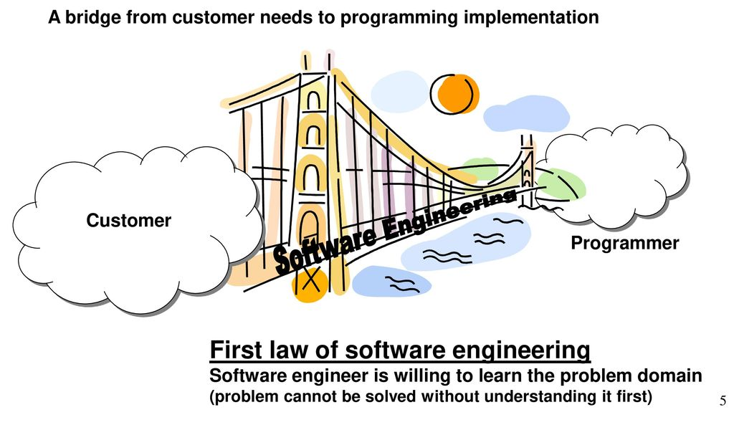
First law of software engineering

Slide 51
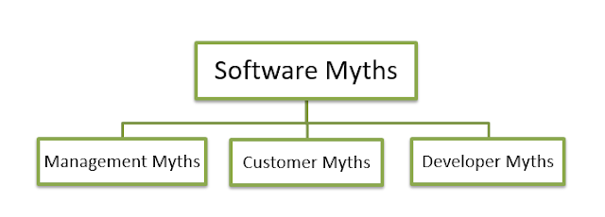
Software Myths

Slide 52
Management Myths
❌ Myth: "We have books and manuals with all the software standards, so developers can just follow them."
✔ Reality: Software development evolves constantly, and manuals may be outdated. Developers need hands-on experience with modern tools.
❌ Myth: "If a project is late, hiring more programmers will speed it up."
✔ Reality: New team members take time to learn, so adding more people late in the project can slow things down.
❌ Myth: "We can outsource the project and relax."
✔ Reality: If a company can't manage projects well internally, outsourcing won't fix the problem. Poor communication can lead to project failure.

Slide 53
Customer Myths
❌ Myth: "We just need to tell the developers a basic idea, and they can figure out the rest."
✔ Reality: Without detailed requirements, software may not meet expectations.
❌ Myth: "Software is flexible; changes can be made anytime."
✔ Reality: The later the change, the more expensive and time-consuming it is.

Slide 54
Developer/Practitioner Myths
❌ Myth: "Once we deliver the software, our job is done."
✔ Reality: Most work happens after delivery, including bug fixes, updates, and support.
❌ Myth: "Testing can wait until the software is fully developed."
✔ Reality: Testing should happen at every stage to catch errors early.
❌ Myth: "Too much documentation slows down development."
✔ Reality: Good documentation helps teams understand and maintain the software easily.

Slide 55
Example Case Study:
A startup wants to build a food delivery app like Zomato. The manager believes they can just give developers a rough idea and let them figure out the details. After months of development, the app is missing key features like order tracking and payment integration.
Question: What myth is this?
Example Case Study:
A gaming company released a new battle royale game. Players complain about lag, crashes, and features. The company realizes that developers focused only on writing the program without proper testing.
Question: What myth is this?

