Slide 1
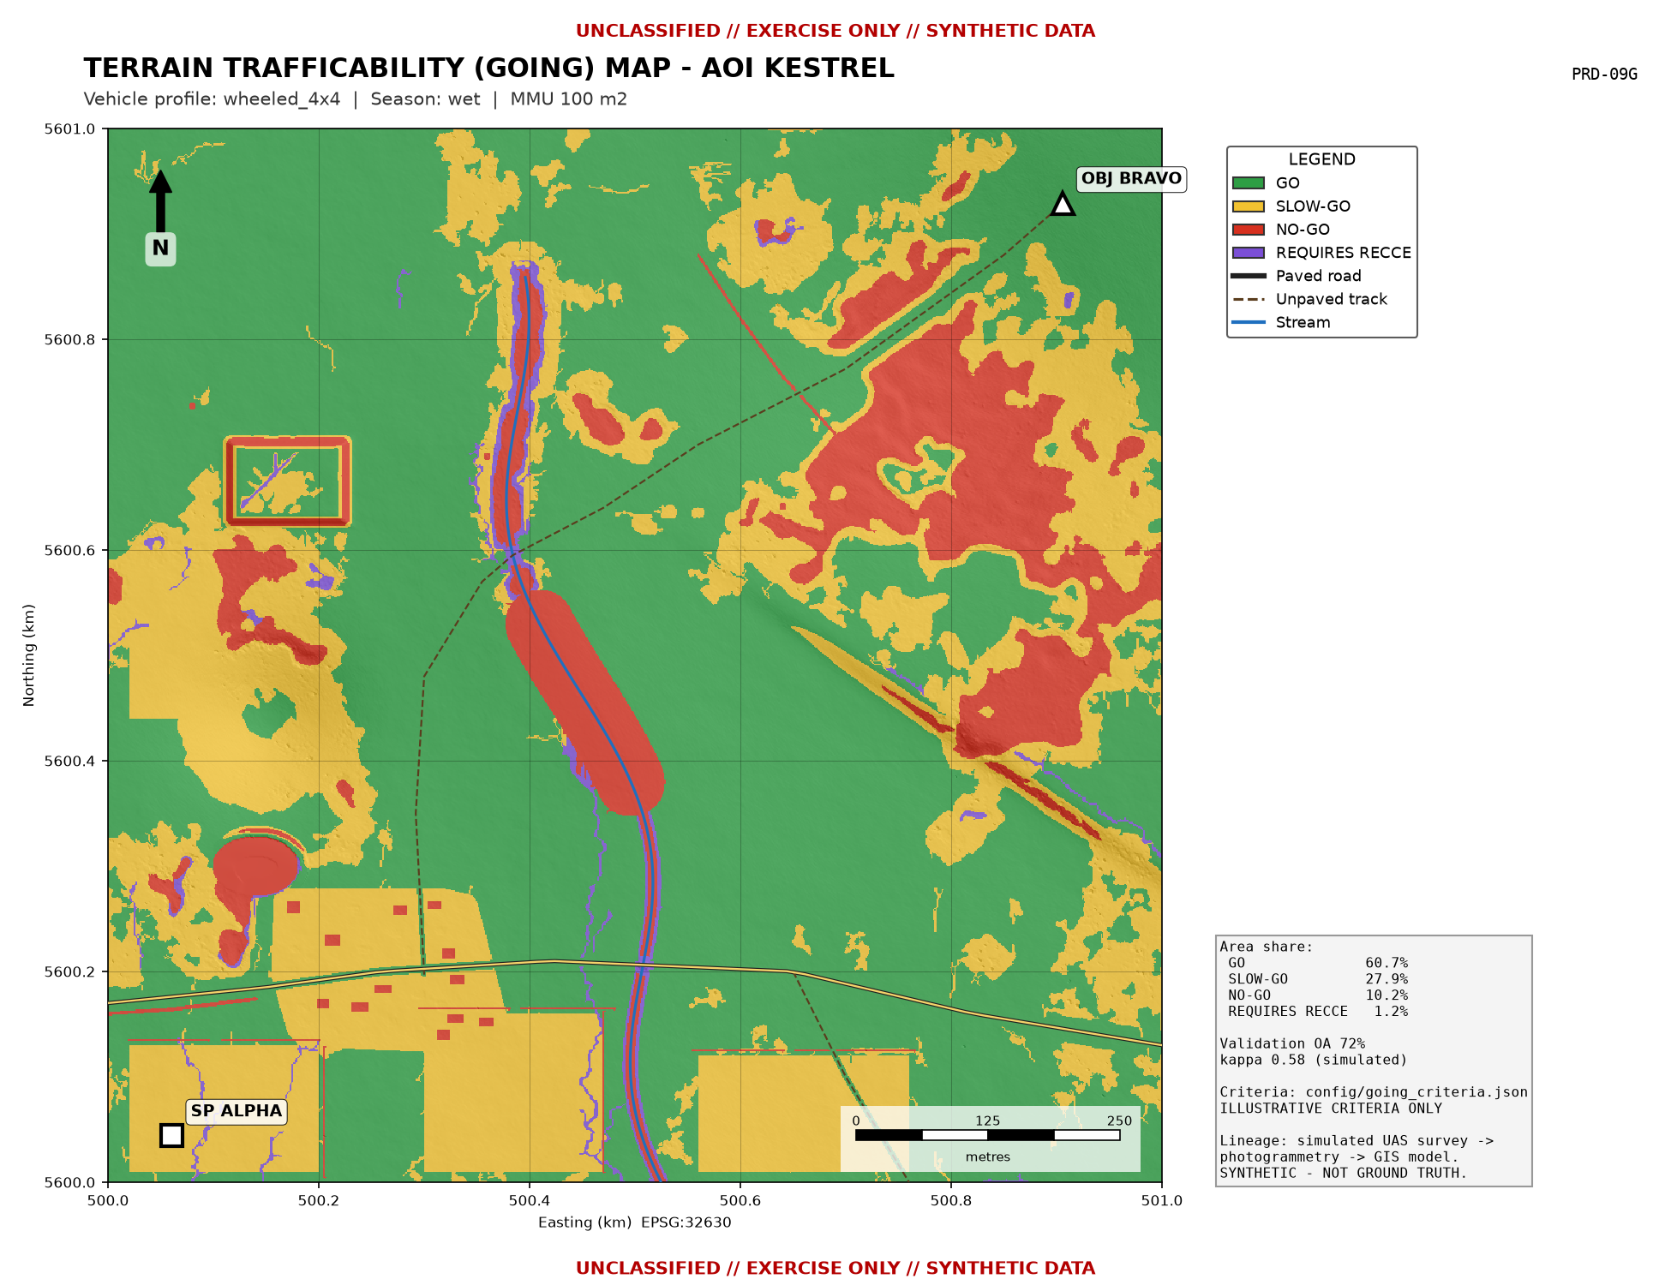
UNCLASSIFIED // EXERCISE ONLY // SYNTHETIC DATA
EXERCISE TERRA SWIFT
Rapid Terrain Mapping & Terrain Trafficability (GOING) Analysis using UAS and GIS
Operator briefing - AOI KESTREL (notional, 1 km2)
Geospatial Cell, Course Syndicate GEO-1
Software-only demonstration: simulated UAS survey -> photogrammetry products -> QGIS terrain database -> GOING classification -> route assessment -> validation
All data synthetic. Criteria illustrative, not doctrine.
1
UNCLASSIFIED // EXERCISE ONLY // SYNTHETIC DATA
Notes:
Introduce the syndicate and the purpose: to show that a small team with commonly available software can turn UAS imagery into a validated mobility product quickly and repeatably. Stress the marking: everything shown is synthetic.

Slide 2
UNCLASSIFIED // EXERCISE ONLY // SYNTHETIC DATA
BOTTOM LINE UP FRONT
Capability demonstrated:
  - 1 km2 terrain package (ortho, DSM/DTM, 19 rasters, 23-layer GeoPackage, 15 map products) generated end-to-end in about 17 s
  - Automated GOING classification (GO / SLOW-GO / NO-GO / REQUIRES RECCE) by vehicle profile and season
  - Independent QGIS model reproduces the result (97% cell agreement)
Key results (SIMULATED):
  - Classification overall accuracy 72% (95% CI 0.64-0.79), kappa 0.58
  - DTM accuracy: 0.05 m RMSEz in the open, 0.65 m under canopy
  - Recommended route under the illustrative weights: C-ASSURED (1.9 km, about 6 min, no unverified crossings)
Main limitation: the UAS sees the top of the canopy and the surface of the ground, not soil strength, so REQUIRES RECCE areas must be checked on the ground.
2
UNCLASSIFIED // EXERCISE ONLY // SYNTHETIC DATA
Notes:
Give the commander the answer first. Make the distinction between the capability demonstrated (real, repeatable workflow) and the numbers (simulated, illustrating the method).

Slide 3
UNCLASSIFIED // EXERCISE ONLY // SYNTHETIC DATA
WHAT IS DEMONSTRATED vs SIMULATED
Component | Status | Simulated element
Survey design (GSD, overlap, lines, GCPs) | Demonstrated - real calculations, QGC .plan files | Not flown
Photogrammetry (SfM) | Procedure documented for WebODM/ODM | Products simulated with realistic error
GIS terrain database & derivatives | Demonstrated on the products | Input data synthetic
GOING classification | Demonstrated: Python + QGIS model | Criteria illustrative
Route comparison & line of sight | Demonstrated (least-cost, viewshed) | Speeds illustrative
Validation | Method demonstrated (stratified, CM, kappa) | Ground observations simulated
Automation & map production | Demonstrated: one-command rebuild, A3 PDFs | -
3
UNCLASSIFIED // EXERCISE ONLY // SYNTHETIC DATA
Notes:
This slide protects the integrity of the project. Every result elsewhere in the brief should be read against this table.

Slide 4
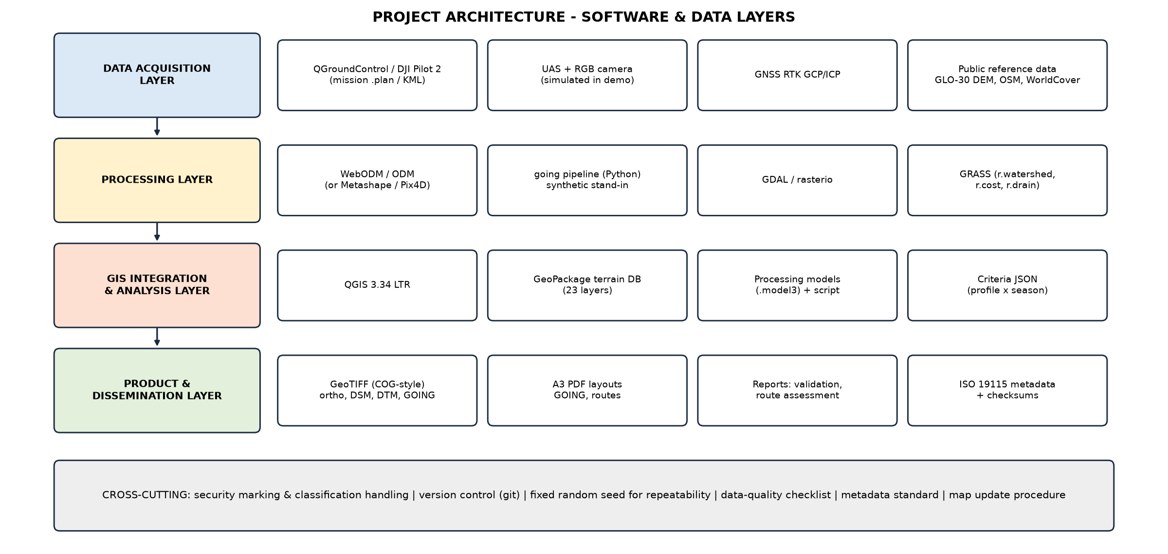
UNCLASSIFIED // EXERCISE ONLY // SYNTHETIC DATA
PROJECT ARCHITECTURE & SOFTWARE
4
UNCLASSIFIED // EXERCISE ONLY // SYNTHETIC DATA
Notes:
All software is free and open source and runs on a standard laptop: QGIS 3.34 LTR with GRASS, WebODM/ODM, QGroundControl and Python 3 with GDAL. Commercial alternatives (Metashape, Pix4D, ArcGIS Pro) can replace any component without changing the method.

Slide 5
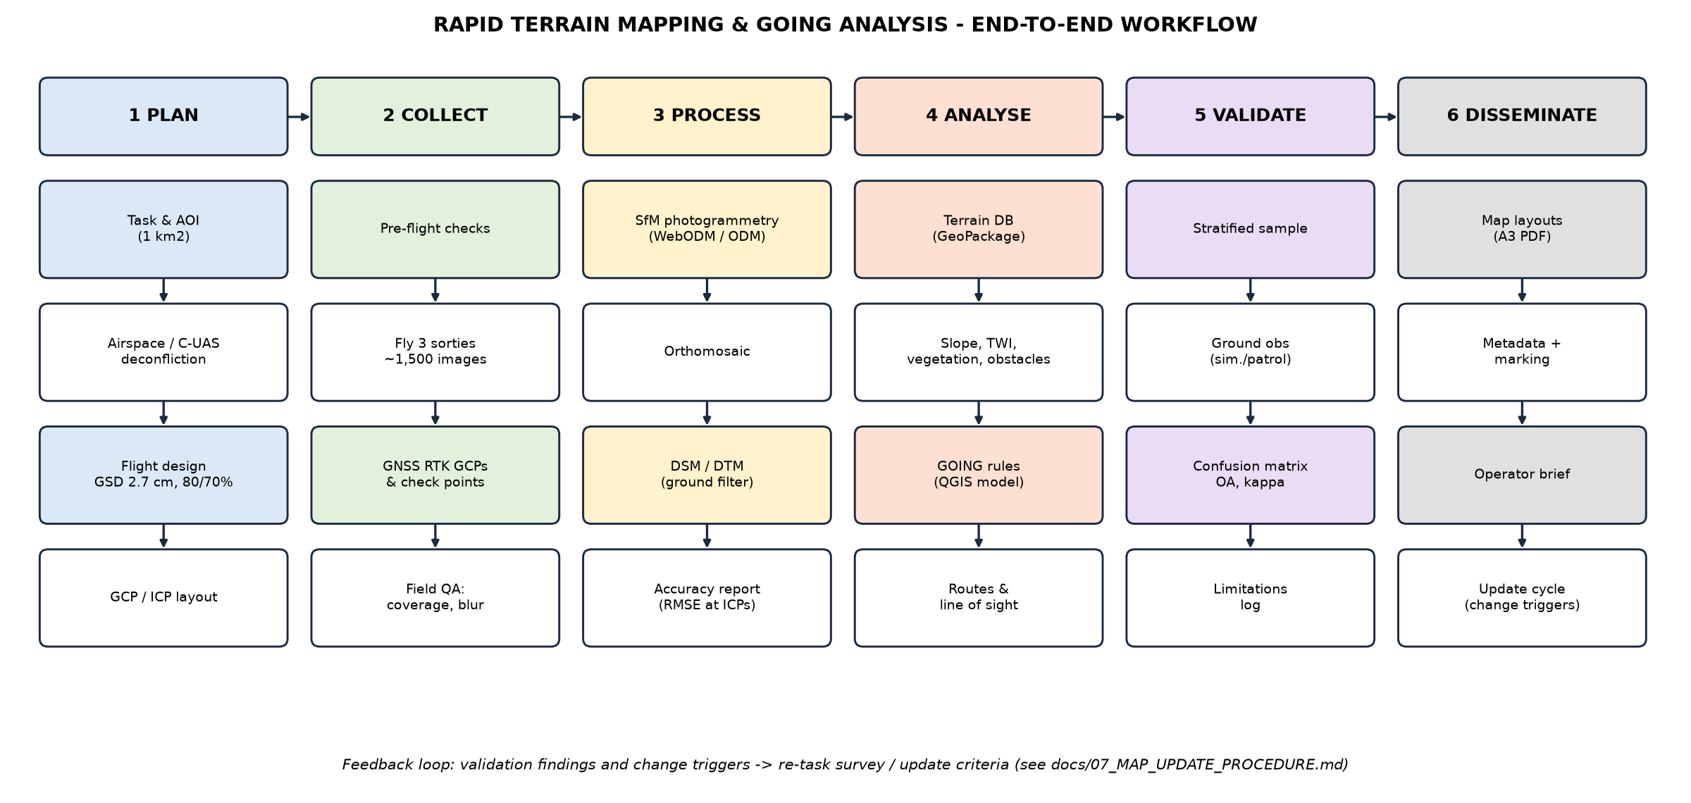
UNCLASSIFIED // EXERCISE ONLY // SYNTHETIC DATA
END-TO-END WORKFLOW
5
UNCLASSIFIED // EXERCISE ONLY // SYNTHETIC DATA
Notes:
Six phases. Planning-to-dissemination time for a real 1 km2 task depends mainly on processing hardware and ground-truthing; analysis and map generation are automated.

Slide 6
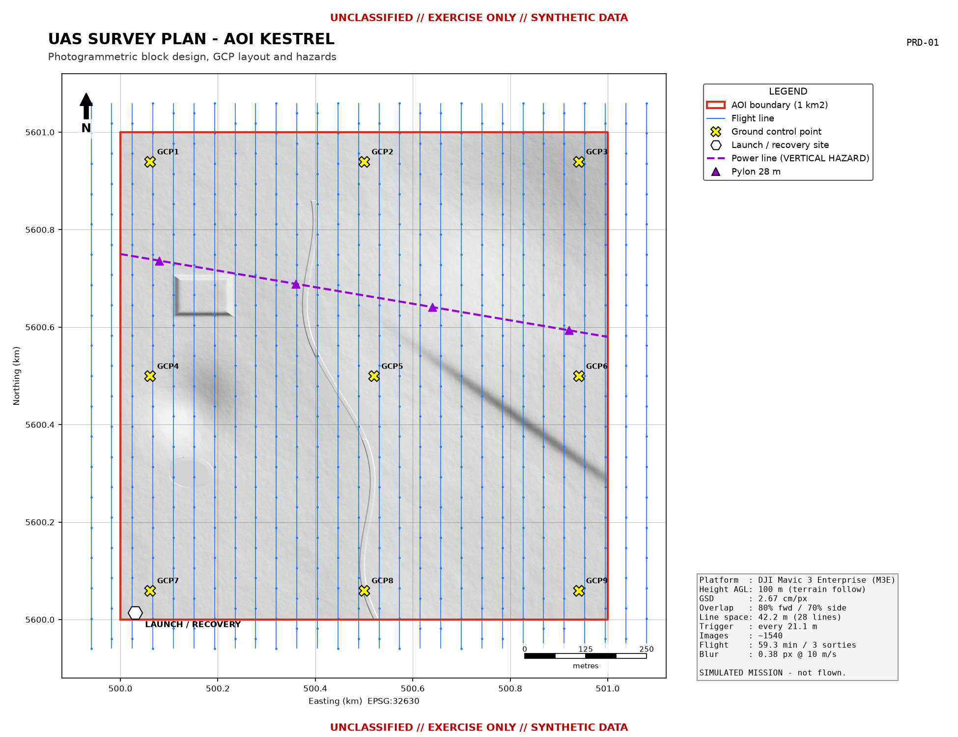
UNCLASSIFIED // EXERCISE ONLY // SYNTHETIC DATA
PHASE 1 - UAS SURVEY PLAN
Simulated mission - parameters computed by going.survey
GSD 2.67 cm/px at 100 m AGL (terrain-follow)
Overlap 80% forward / 70% side
28 lines, 42.2 m apart
Trigger every 21.1 m
~1540 images, 59.3 min in 3 sorties
9 GCPs + 25 independent check points
Hazard: 33 kV power line, 28 m pylons
Output: QGroundControl .plan per sortie
6
UNCLASSIFIED // EXERCISE ONLY // SYNTHETIC DATA
Notes:
Explain overlap choice (80/70 for mixed vegetation), terrain-following to keep GSD constant, and the vertical hazard. Mention airspace authorisation and friendly C-UAS deconfliction (SOP).

Slide 7
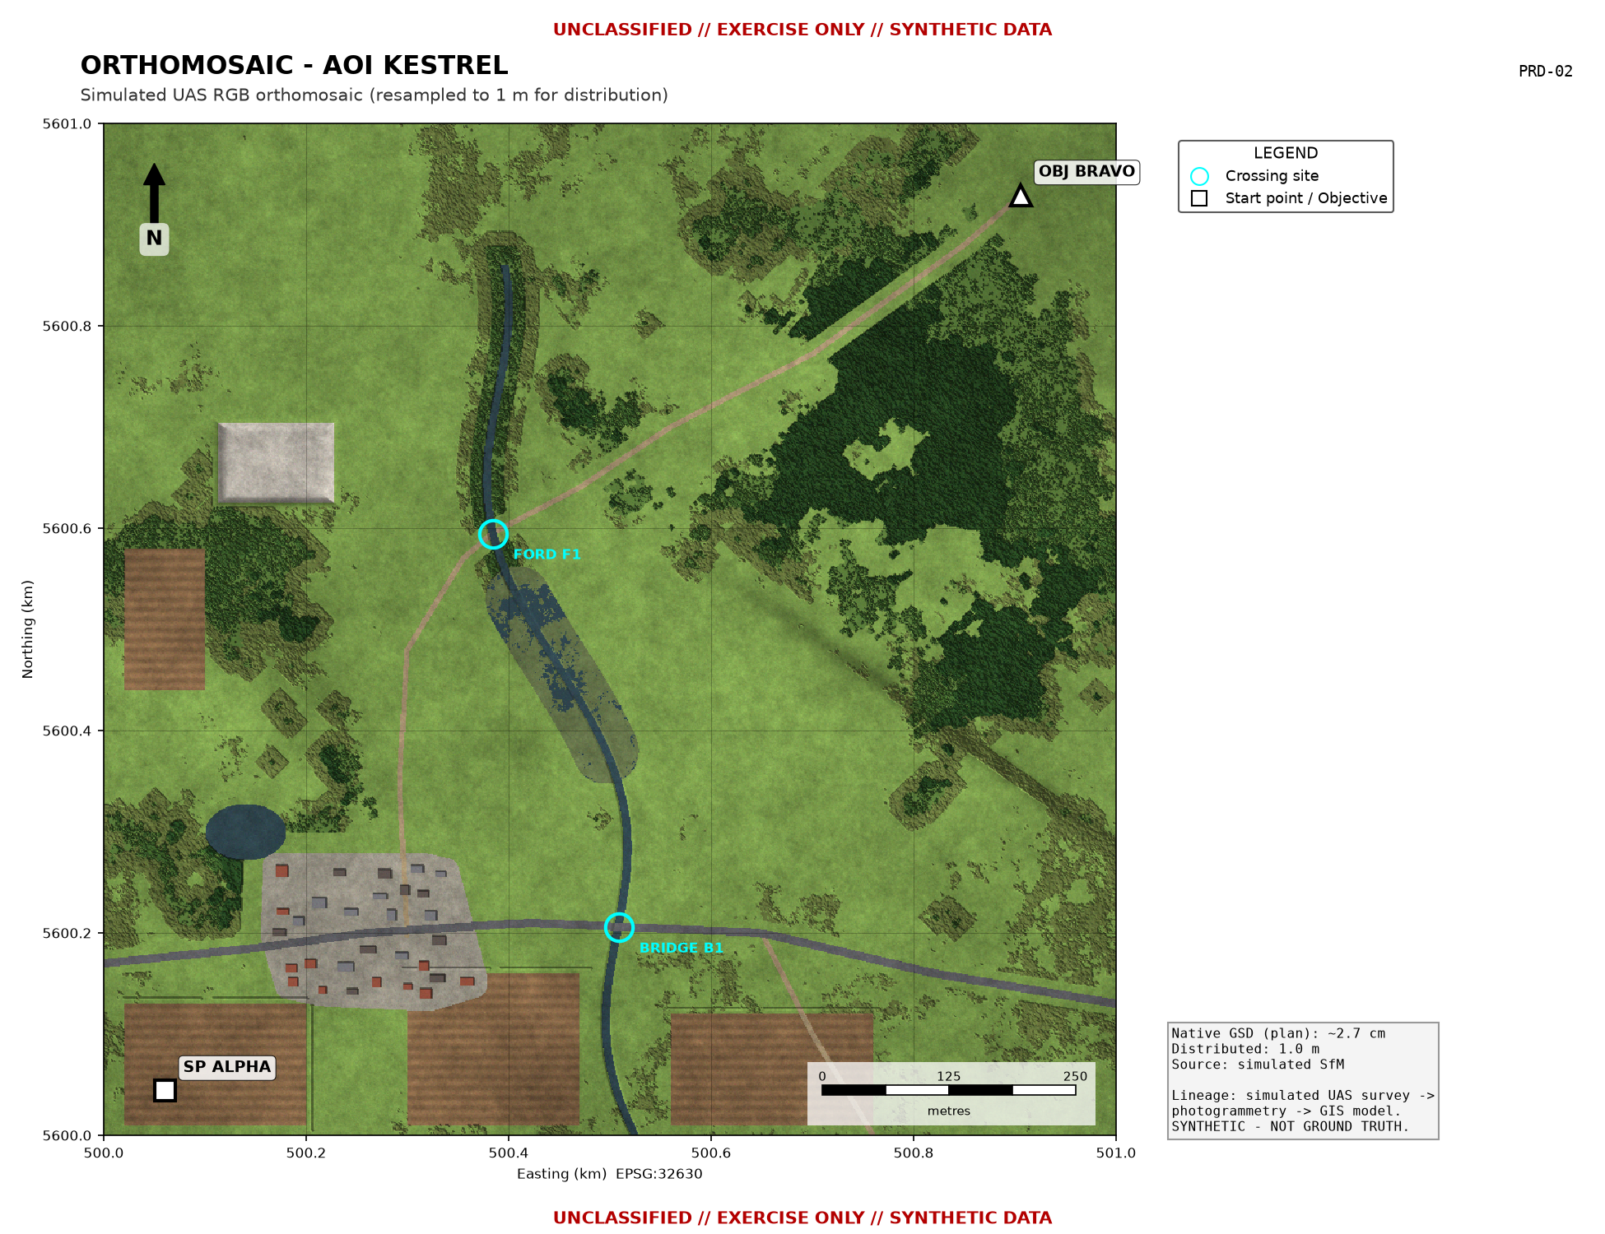
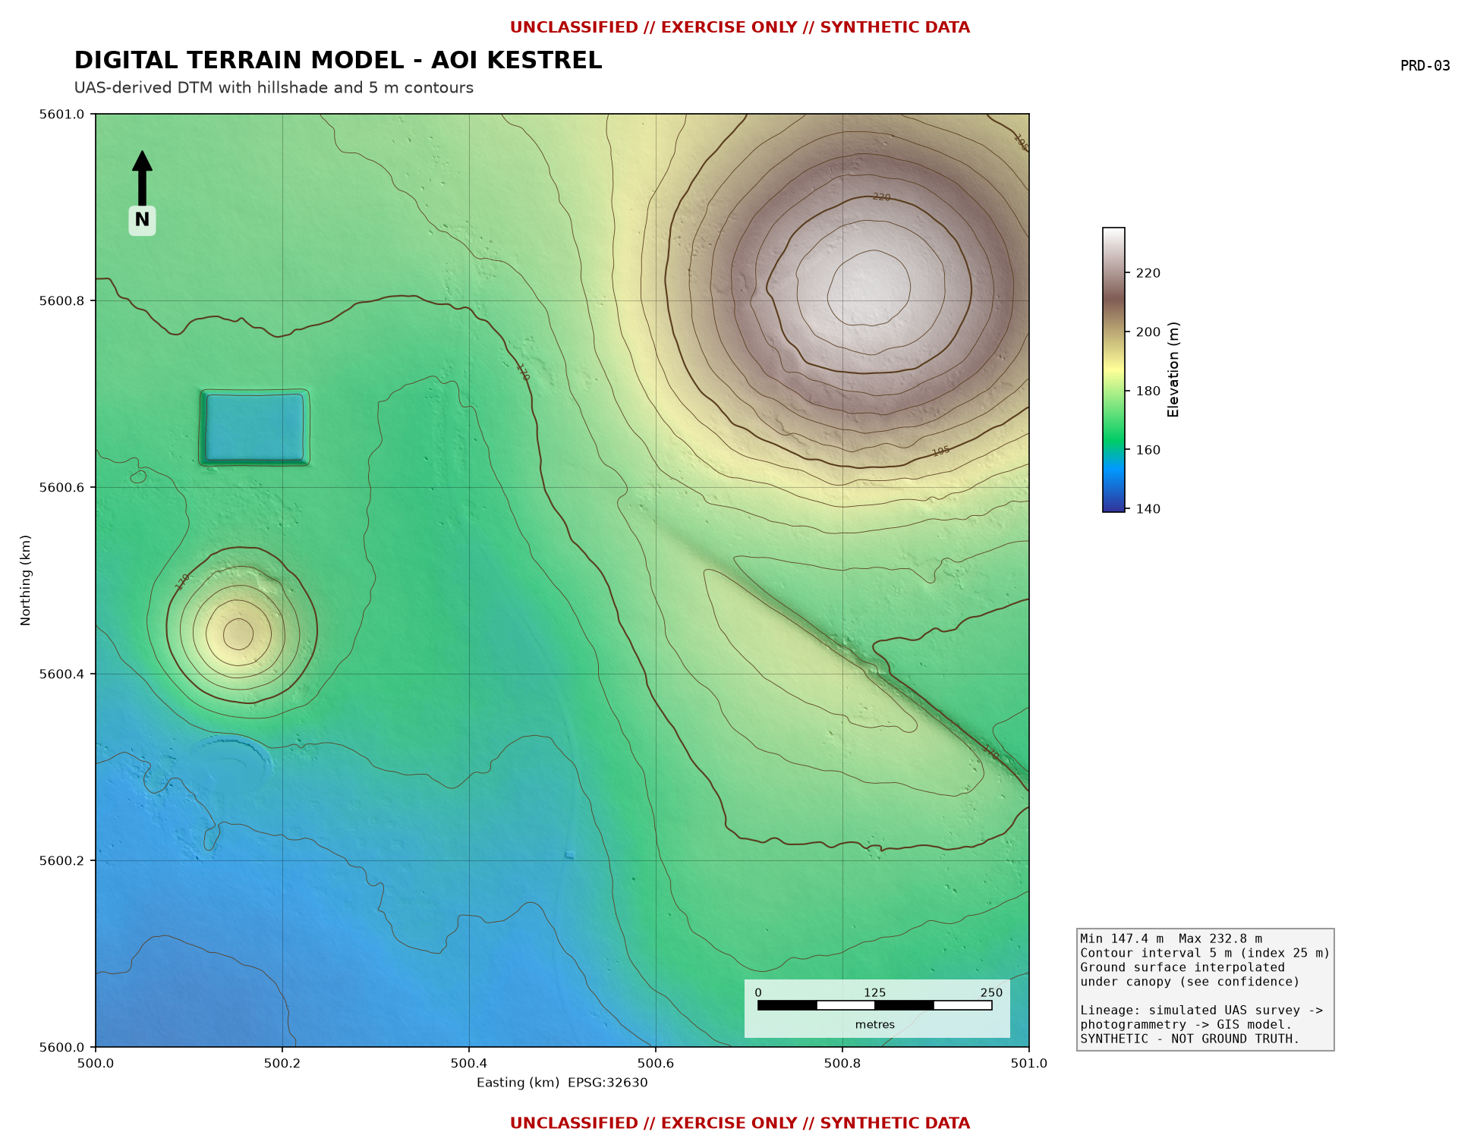
UNCLASSIFIED // EXERCISE ONLY // SYNTHETIC DATA
PHASE 3 - PHOTOGRAMMETRY PRODUCTS
Orthomosaic and DTM (simulated SfM output, 1 m distribution)
7
UNCLASSIFIED // EXERCISE ONLY // SYNTHETIC DATA
Notes:
Products reproduce real SfM behaviour: voids over water, interpolated ground under canopy, few-cm noise in the open. The confidence layer records where the ground was really seen.

Slide 8
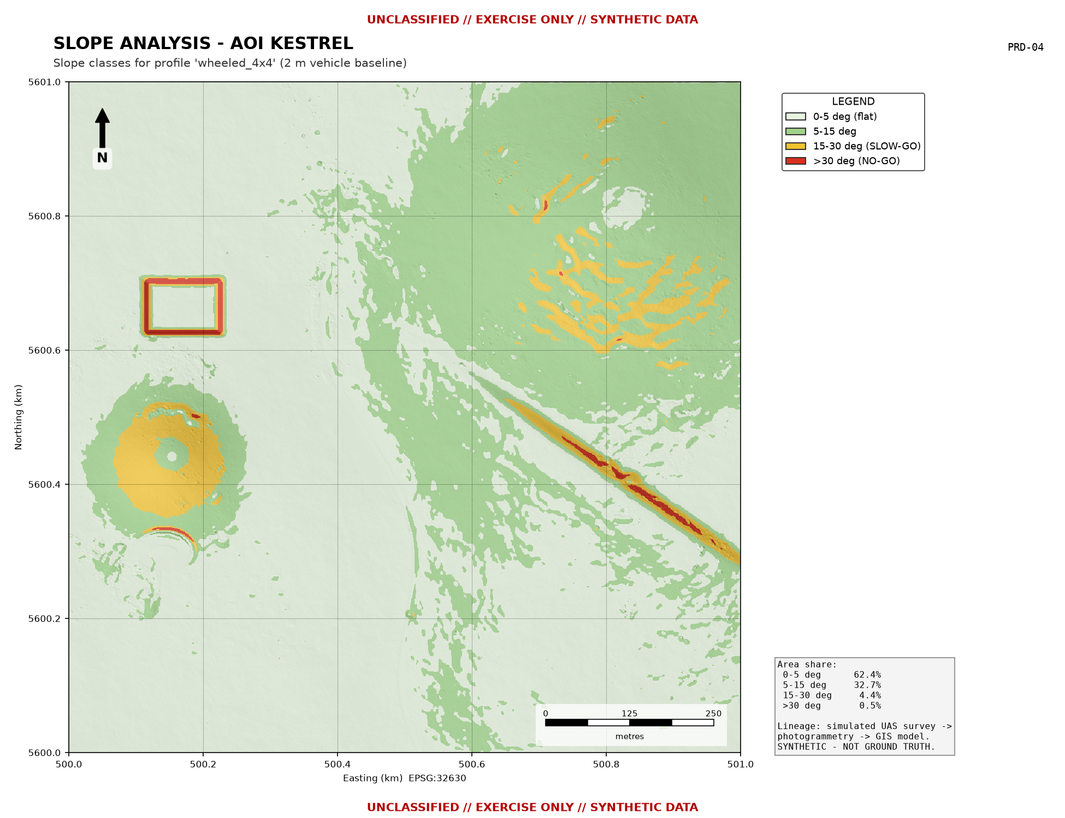
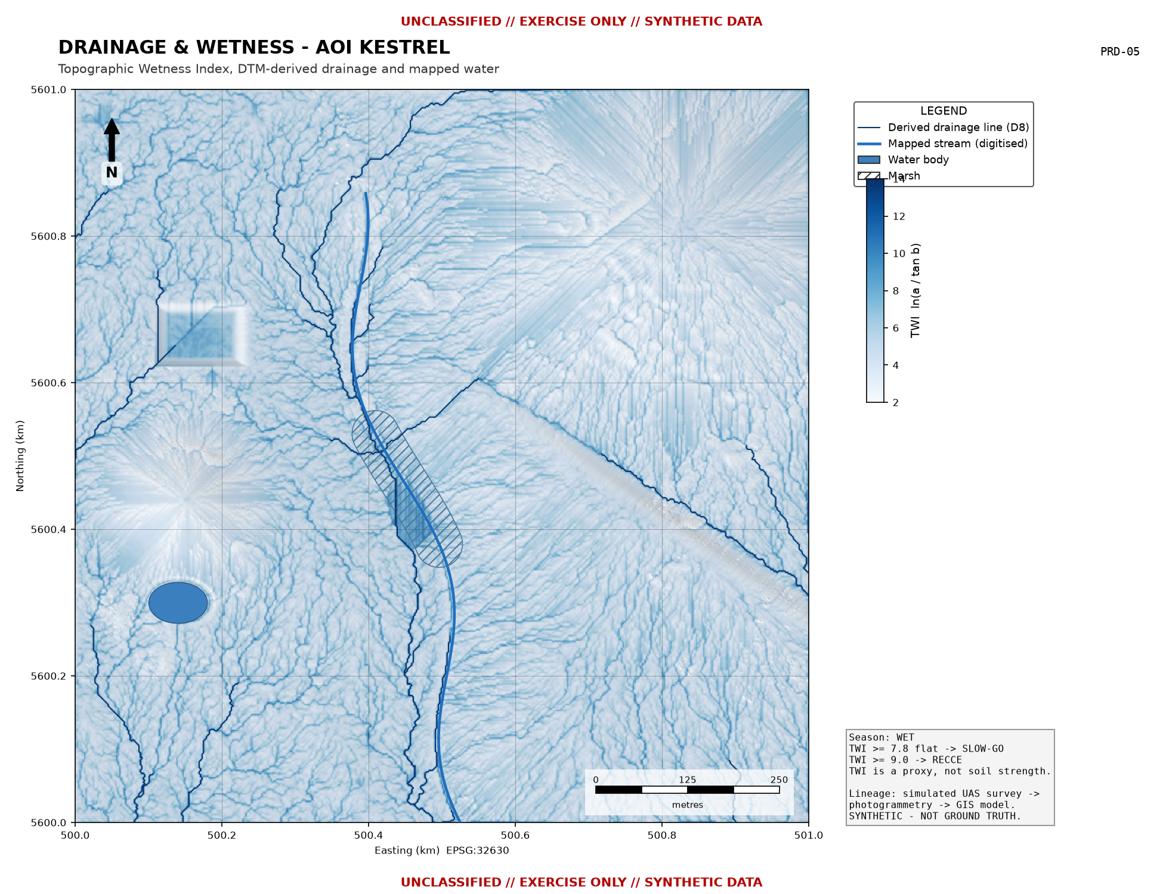
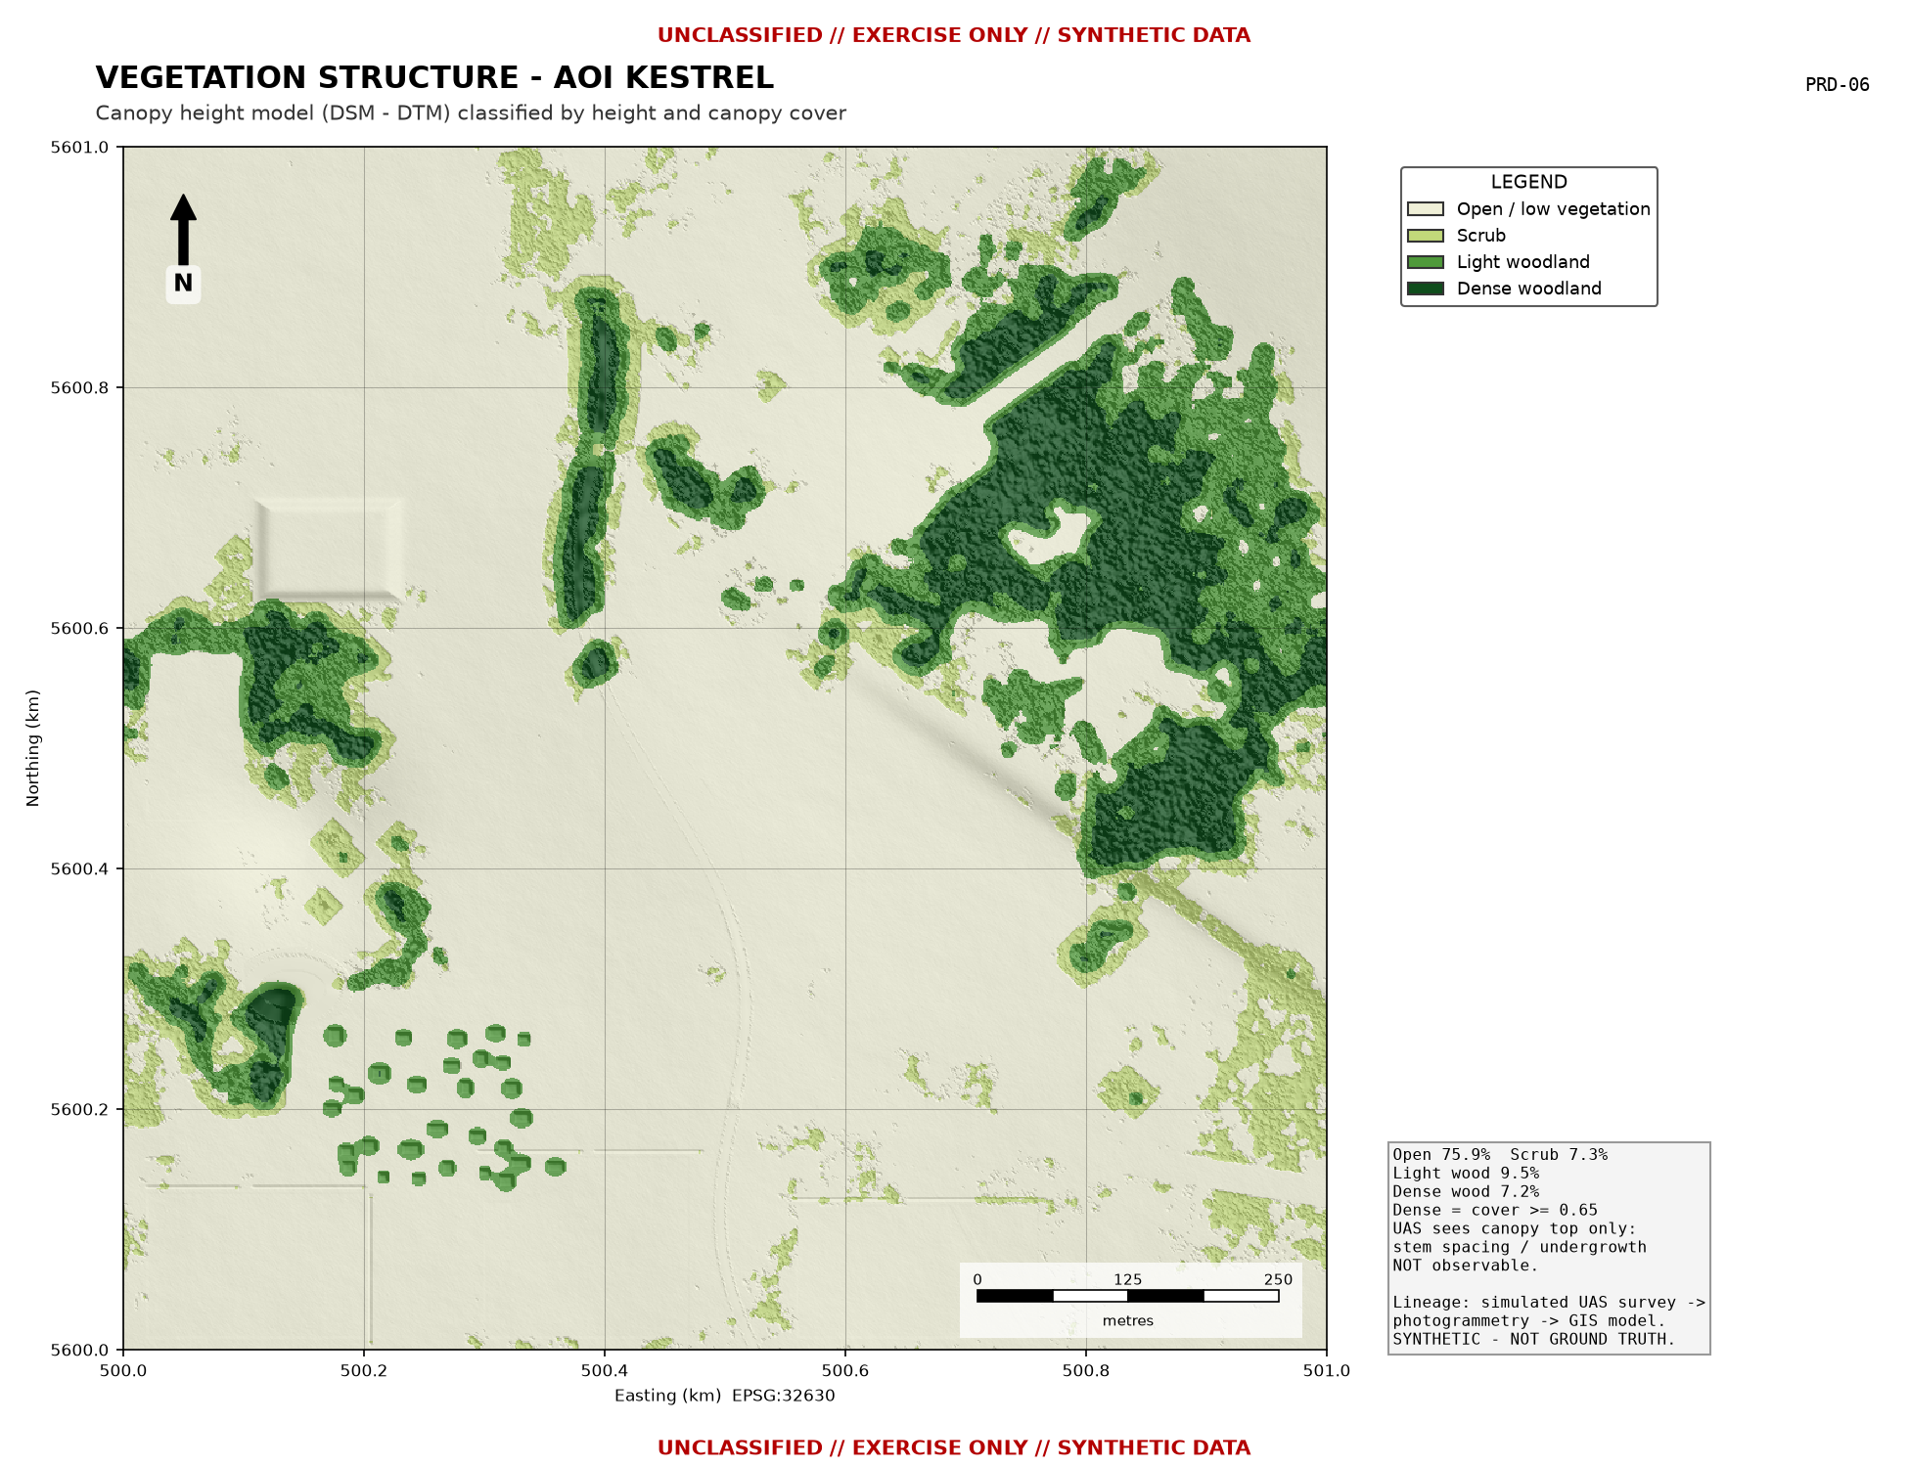
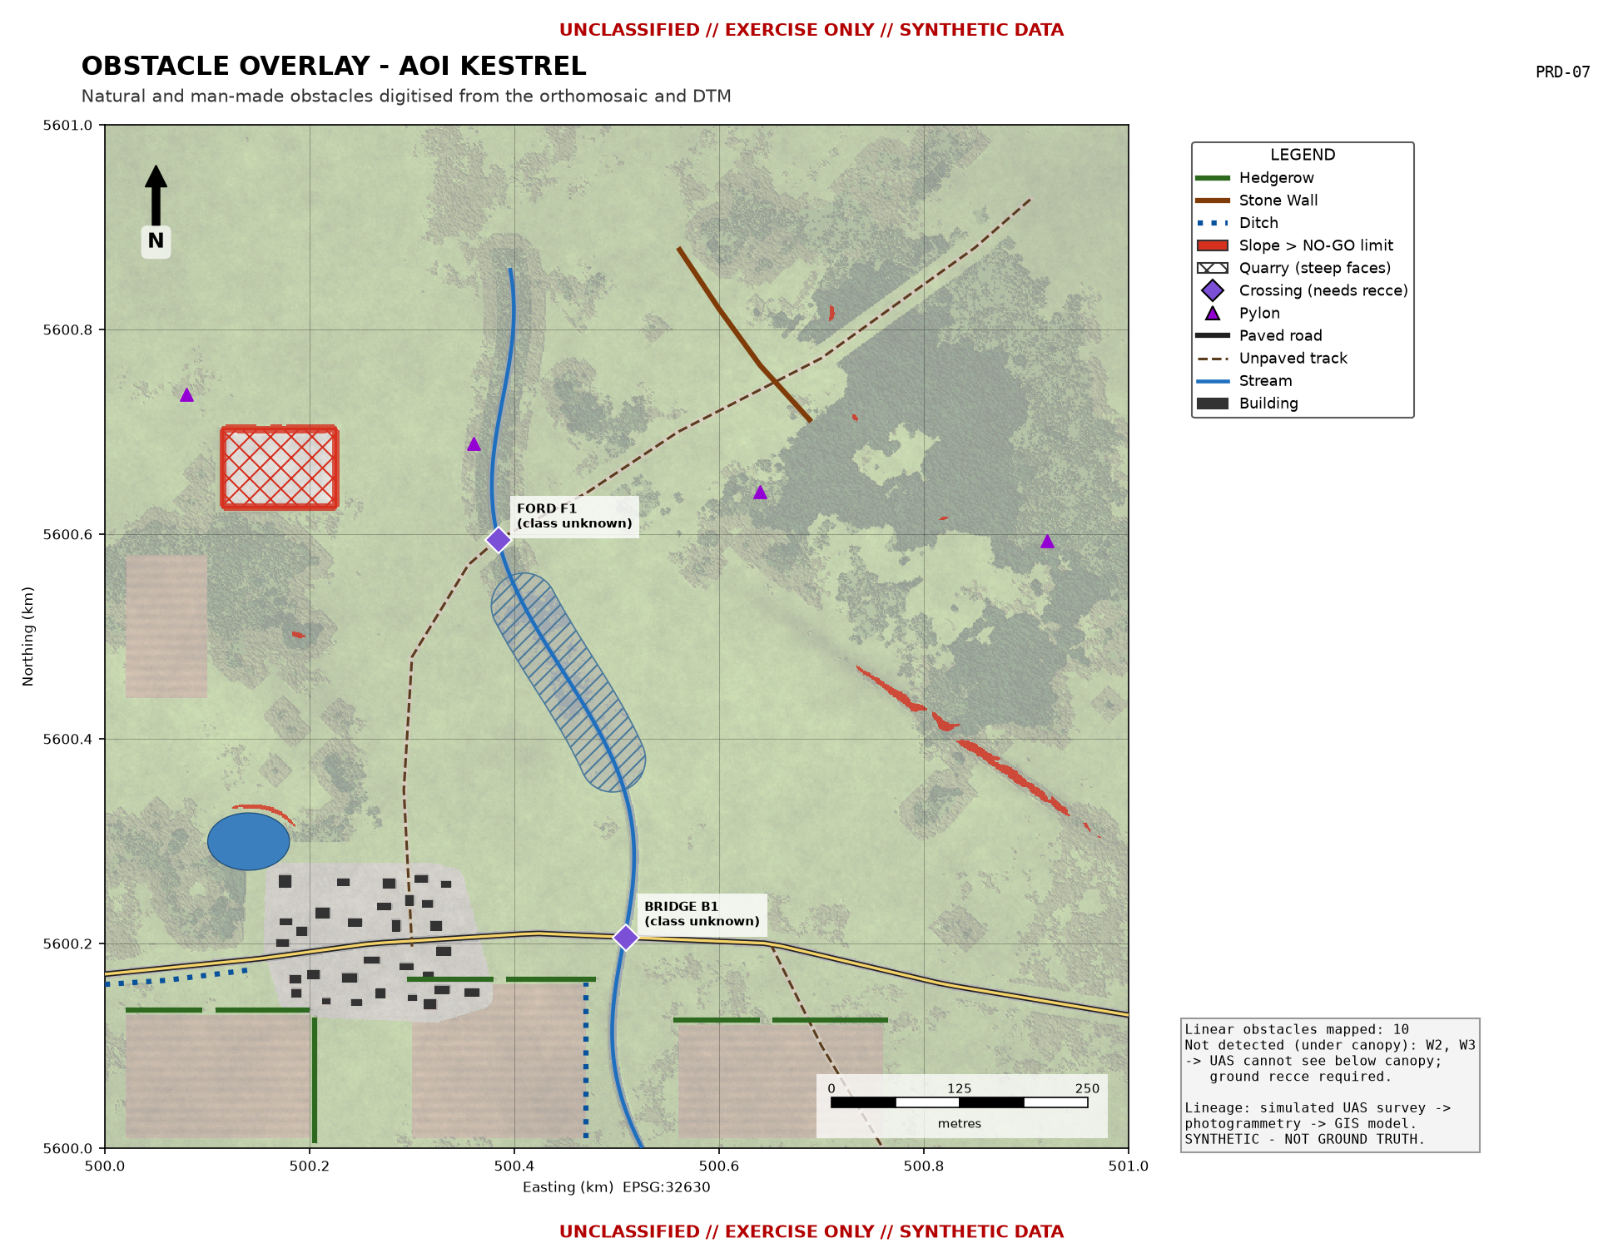
UNCLASSIFIED // EXERCISE ONLY // SYNTHETIC DATA
PHASE 4 - TERRAIN FACTORS IN THE GIS DATABASE
8
UNCLASSIFIED // EXERCISE ONLY // SYNTHETIC DATA
Notes:
Four factor groups feed the model: slope (vehicle baseline), drainage and wetness (TWI), vegetation structure (canopy height and cover) and obstacles (digitised and DTM-derived). They are held together in one GeoPackage with a defined schema.

Slide 9
UNCLASSIFIED // EXERCISE ONLY // SYNTHETIC DATA
CLASSIFICATION CRITERIA (ILLUSTRATIVE)
Wheeled 4x4 profile - precedence NO-GO > RECCE > SLOW-GO > GO
Class | Criteria (any condition) | Effect
GO | Slope < 15 deg; open/low vegetation; firm; roads & tracks | -
SLOW-GO | Slope 15-30 deg; scrub; light woodland; built-up; cultivated (wet); TWI >= 7.8 (wet) / 9.5 (dry); low walls | Speed reduced
NO-GO | Slope >= 30 deg; canopy cover >= 65%; water; buildings; obstacles >= 0.6 m; marsh (wet) | Impassable
REQUIRES RECCE | Crossings of unknown capacity; data confidence < 0.45; TWI >= 9.0 (wet); stream banks under canopy; marsh (dry) | Unverified
9
UNCLASSIFIED // EXERCISE ONLY // SYNTHETIC DATA
Notes:
Thresholds are in config/going_criteria.json, so they can be changed without touching code. Stress that RECCE is an information state: 'we do not know', not a terrain type.

Slide 10
UNCLASSIFIED // EXERCISE ONLY // SYNTHETIC DATA
GOING MAP - WHEELED, WET SEASON
GO 60.7%
SLOW-GO 27.9%
NO-GO 10.2%
RECCE 1.2%
Key NO-GO: Kestrel Brook, marsh, dense wood NE, escarpment, quarry
Crossings: BRIDGE B1, FORD F1 - capacity unknown
10
UNCLASSIFIED // EXERCISE ONLY // SYNTHETIC DATA
Notes:
Walk the map from SP ALPHA to OBJ BRAVO. The brook and marsh split the AOI; only two crossings exist plus the way round the source of the brook in the north.

Slide 11
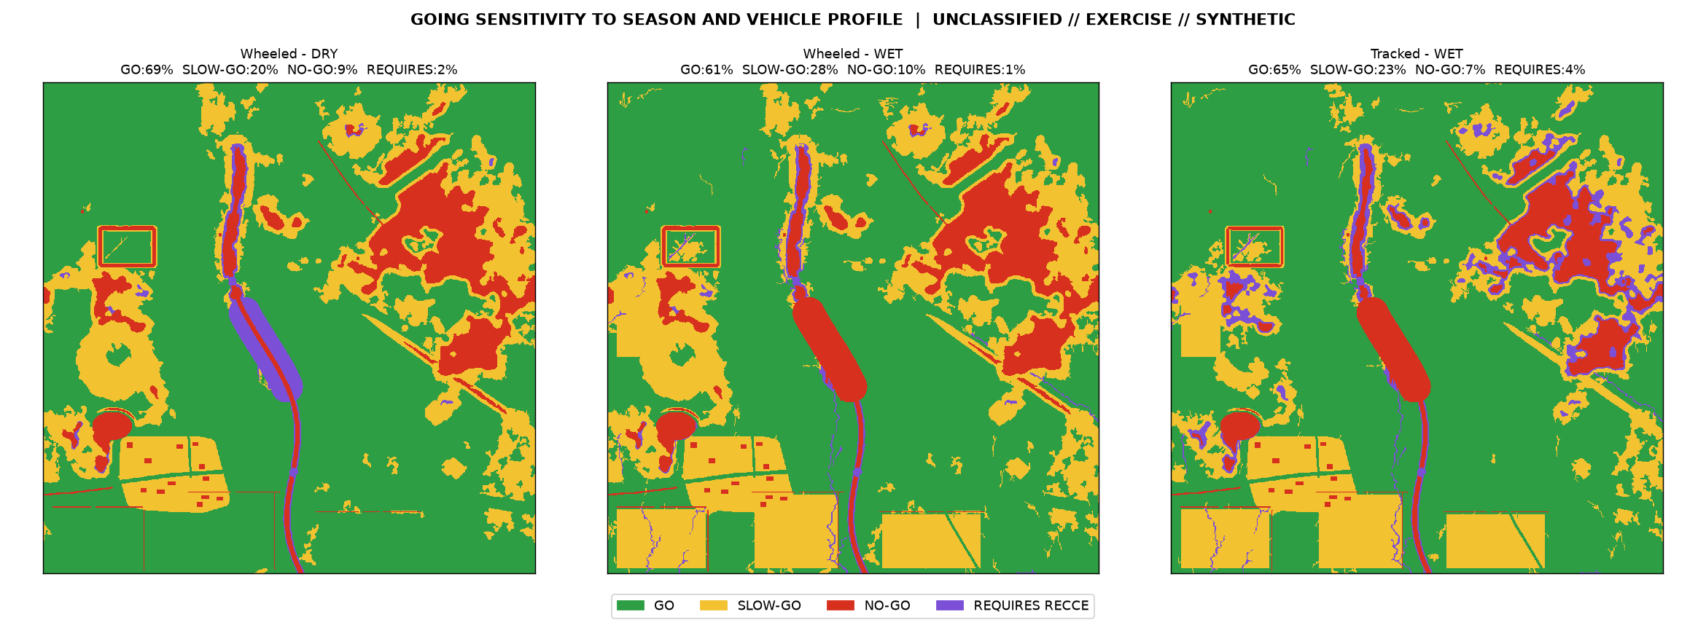
UNCLASSIFIED // EXERCISE ONLY // SYNTHETIC DATA
SEASON & VEHICLE SENSITIVITY
11
UNCLASSIFIED // EXERCISE ONLY // SYNTHETIC DATA
Notes:
The same terrain gives different products depending on season and vehicle. Products must be labelled with both and re-issued when conditions change (see seasonality doc).

Slide 12
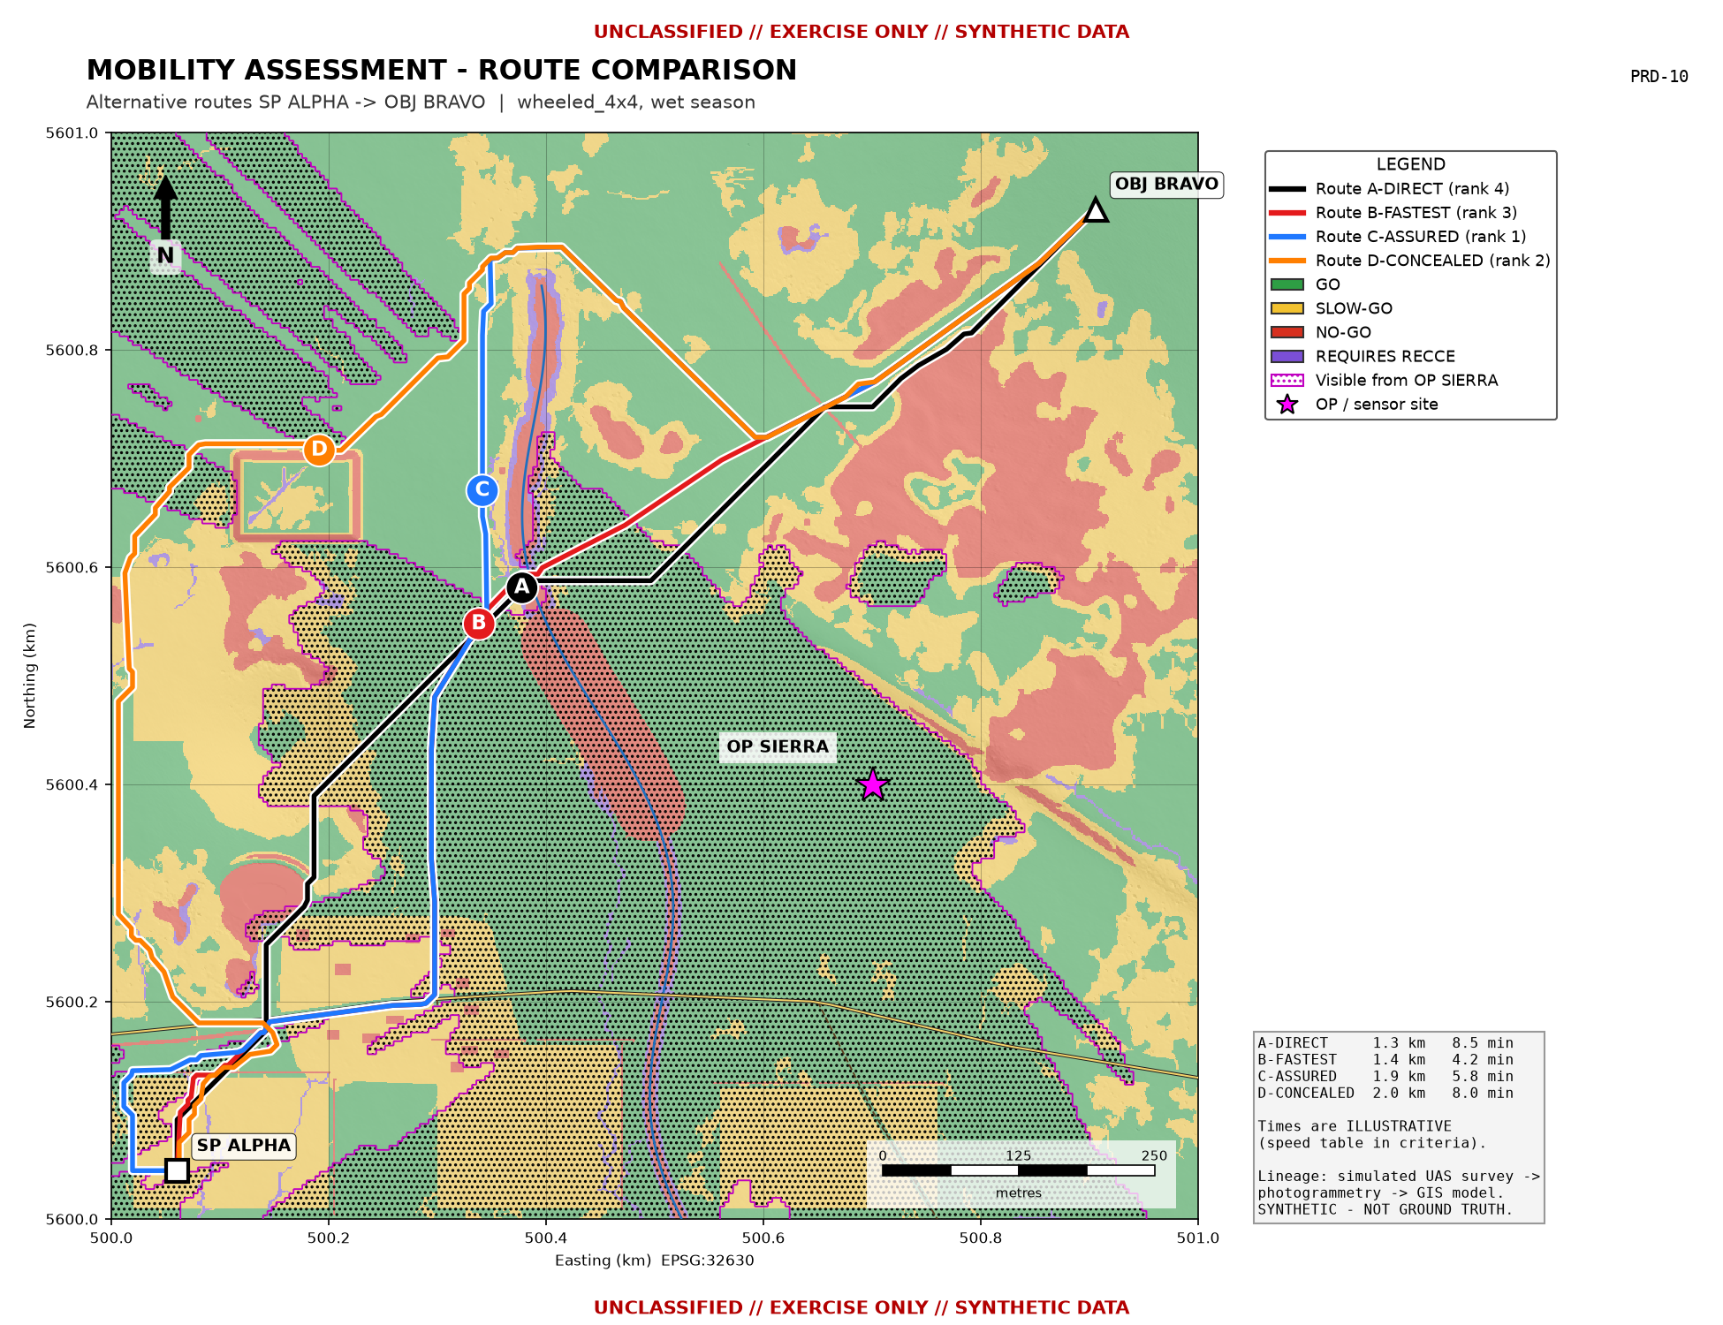
UNCLASSIFIED // EXERCISE ONLY // SYNTHETIC DATA
MOBILITY ASSESSMENT - ROUTE OPTIONS
Route | Length m | Time min | % RECCE | % exposed | Rank
A-DIRECT | 1340.0 | 8.5 | 4.6 | 35.4 | 4
B-FASTEST | 1439.0 | 4.2 | 1.0 | 39.2 | 3
C-ASSURED | 1878.0 | 5.8 | 0.0 | 32.1 | 1
D-CONCEALED | 1957.0 | 8.0 | 0.1 | 2.8 | 2
B fastest: track + FORD F1 (unverified)
C assured: around brook source, no RECCE
D concealed: least exposure to OP SIERRA
Weights = commander's priorities
12
UNCLASSIFIED // EXERCISE ONLY // SYNTHETIC DATA
Notes:
Each route is optimal for a different criterion. The weighted score is decision support only. Recommend tasking a patrol to confirm FORD F1, which would make Route B viable.

Slide 13
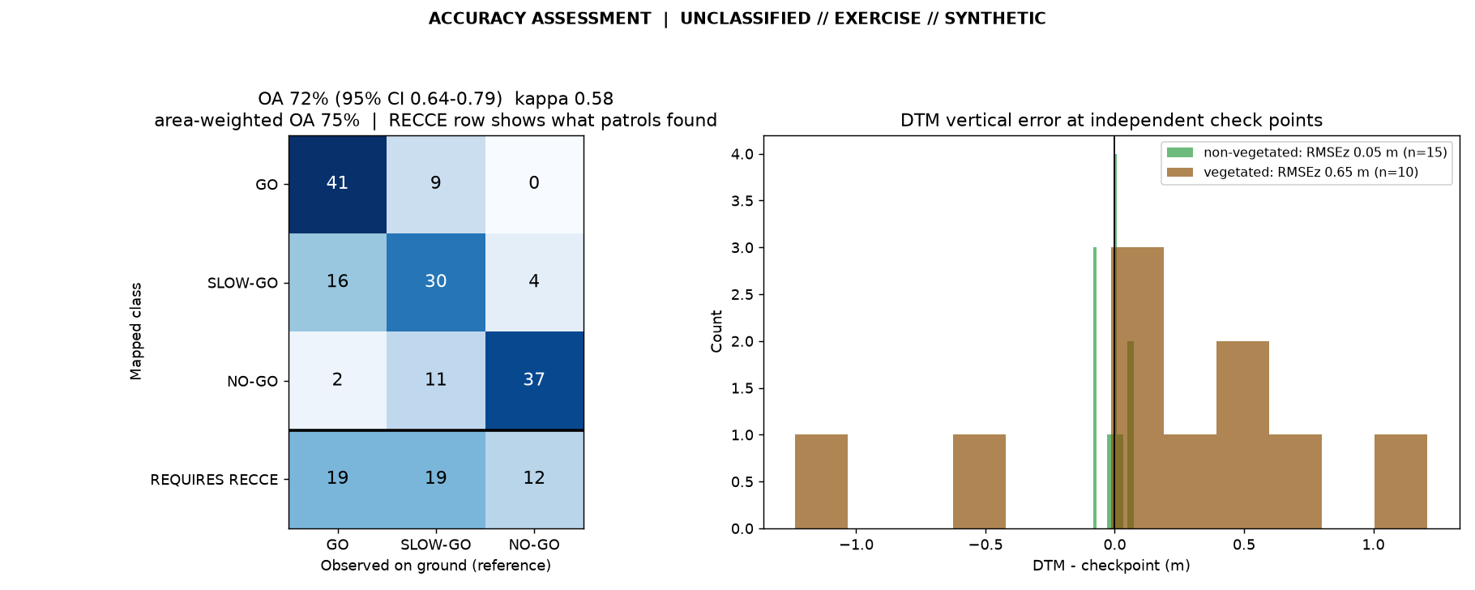
UNCLASSIFIED // EXERCISE ONLY // SYNTHETIC DATA
VALIDATION & ACCURACY (SIMULATED GROUND OBSERVATIONS)
Class | User's acc. | Producer's acc.
GO | 0.82 | 0.695
SLOW-GO | 0.6 | 0.6
NO-GO | 0.74 | 0.902
OA 72% (0.64-0.79), kappa 0.58
Area-weighted OA 75%
Unsafe errors (mapped passable, actually NO-GO): 4
RECCE points that proved SLOW-GO or NO-GO: 62%
Main confusion: GO vs SLOW-GO (soil, undergrowth)
13
UNCLASSIFIED // EXERCISE ONLY // SYNTHETIC DATA
Notes:
Explain stratified sampling, why RECCE points are reported separately, and why the 'unsafe' error count matters more to a commander than overall accuracy.

Slide 14
UNCLASSIFIED // EXERCISE ONLY // SYNTHETIC DATA
LIMITATIONS & SEASONALITY
Sensor & method:
  - RGB photogrammetry cannot see under canopy: stem spacing, undergrowth and hidden walls are missed (W2, W3)
  - No soil strength or bearing capacity - wetness index is a proxy only
  - Water depth, bed material and bridge class cannot be derived
Temporal:
  - Product valid for capture conditions only; rain, flood, harvest, snow or frost change GOING within hours
Model:
  - Illustrative thresholds; class areas change by several percentage points for +/-5 deg slope limits
  - 1 m analysis grid, 100 m2 MMU - not suitable for micro-terrain (< 2 m gaps)
Operational:
  - Weather, airspace, EW / GNSS denial and adversary C-UAS may prevent collection
14
UNCLASSIFIED // EXERCISE ONLY // SYNTHETIC DATA
Notes:
Be candid. These limitations define when the product must not be trusted without ground confirmation.

Slide 15
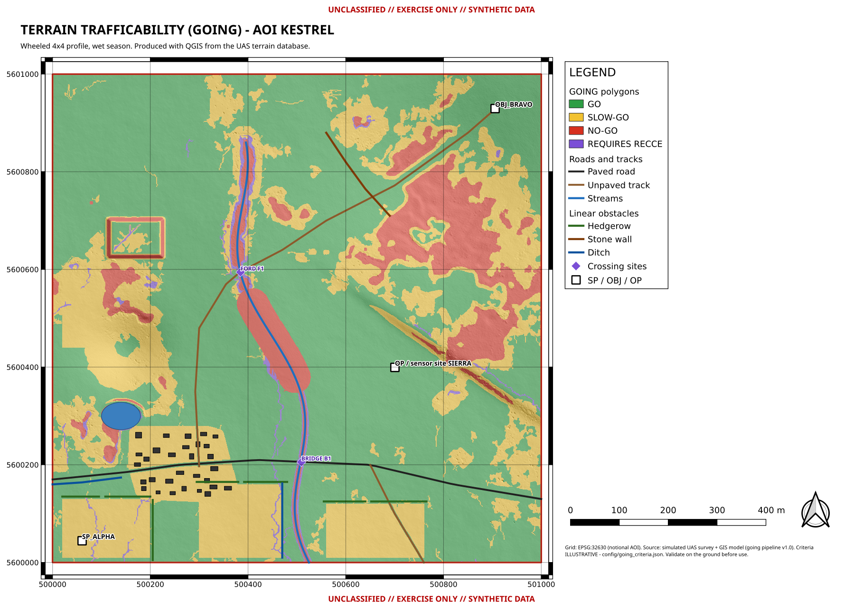
UNCLASSIFIED // EXERCISE ONLY // SYNTHETIC DATA
AUTOMATION & REPEATABILITY
One command rebuilds every product: python run_pipeline.py (fixed seed, config-driven)
QGIS model 'GOING terrain analysis': r.neighbors -> slope -> r.watershed TWI -> GOING script -> polygonise -> label -> class report
QGIS model 'GOING route analysis': reclassify -> r.cost -> r.drain (fastest & assured)
build_project.py writes the styled .qgz and exports A3 PDF layouts
Independent implementation check: QGIS model vs Python agree on 97.0% of cells
Metadata (ISO 19115 subset) + SHA-256 checksums written for every product
15
UNCLASSIFIED // EXERCISE ONLY // SYNTHETIC DATA
Notes:
Demonstrate live if time allows: change the season in the model dialog and re-run - the map updates in seconds.

Slide 16
UNCLASSIFIED // EXERCISE ONLY // SYNTHETIC DATA
SOP, QUALITY & MAP UPDATE CYCLE
Mission-planning SOP: task -> authorise -> plan -> pre-flight -> fly -> post-flight QA (docs/04)
Data-quality checklist: go/no-go checks for collection, processing, analysis and dissemination (docs/08)
Metadata standard: mandatory ISO 19115 fields, marking, lineage, currency, criteria version (docs/05)
Seasonality: season matrix and product validity periods (docs/06)
Update procedure: scheduled + event-triggered (rain > 25 mm/24 h, flooding, works, combat damage) (docs/07)
Version every product: AOI_KESTREL_GOING_<profile>_<season>_v<NN>_<DTG>
16
UNCLASSIFIED // EXERCISE ONLY // SYNTHETIC DATA
Notes:
These documents turn a demonstration into a repeatable capability.

Slide 17
UNCLASSIFIED // EXERCISE ONLY // SYNTHETIC DATA
RECOMMENDATIONS & QUESTIONS
Adopt the workflow for course and exercise terrain support; run a real authorised 1 km2 survey next
Calibrate criteria with vehicle trials and engineer advice before any operational use
Add LiDAR or multispectral payloads to reduce under-canopy and soil-moisture limitations
Integrate the output with the formation's geospatial information management (GIM) catalogue
Task ground reconnaissance of FORD F1, BRIDGE B1 and woodland edges on the selected route
QUESTIONS?
17
UNCLASSIFIED // EXERCISE ONLY // SYNTHETIC DATA
Notes:
Close with clear, actionable recommendations.

