Slide 1
Progress & Technical Roadmap
Custom NMC & LFP Pack Engineering, Field Validation, and Lab Capabilities

Slide 2
Progress Report

Slide 3
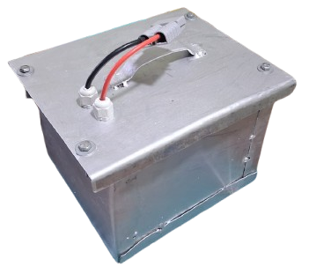
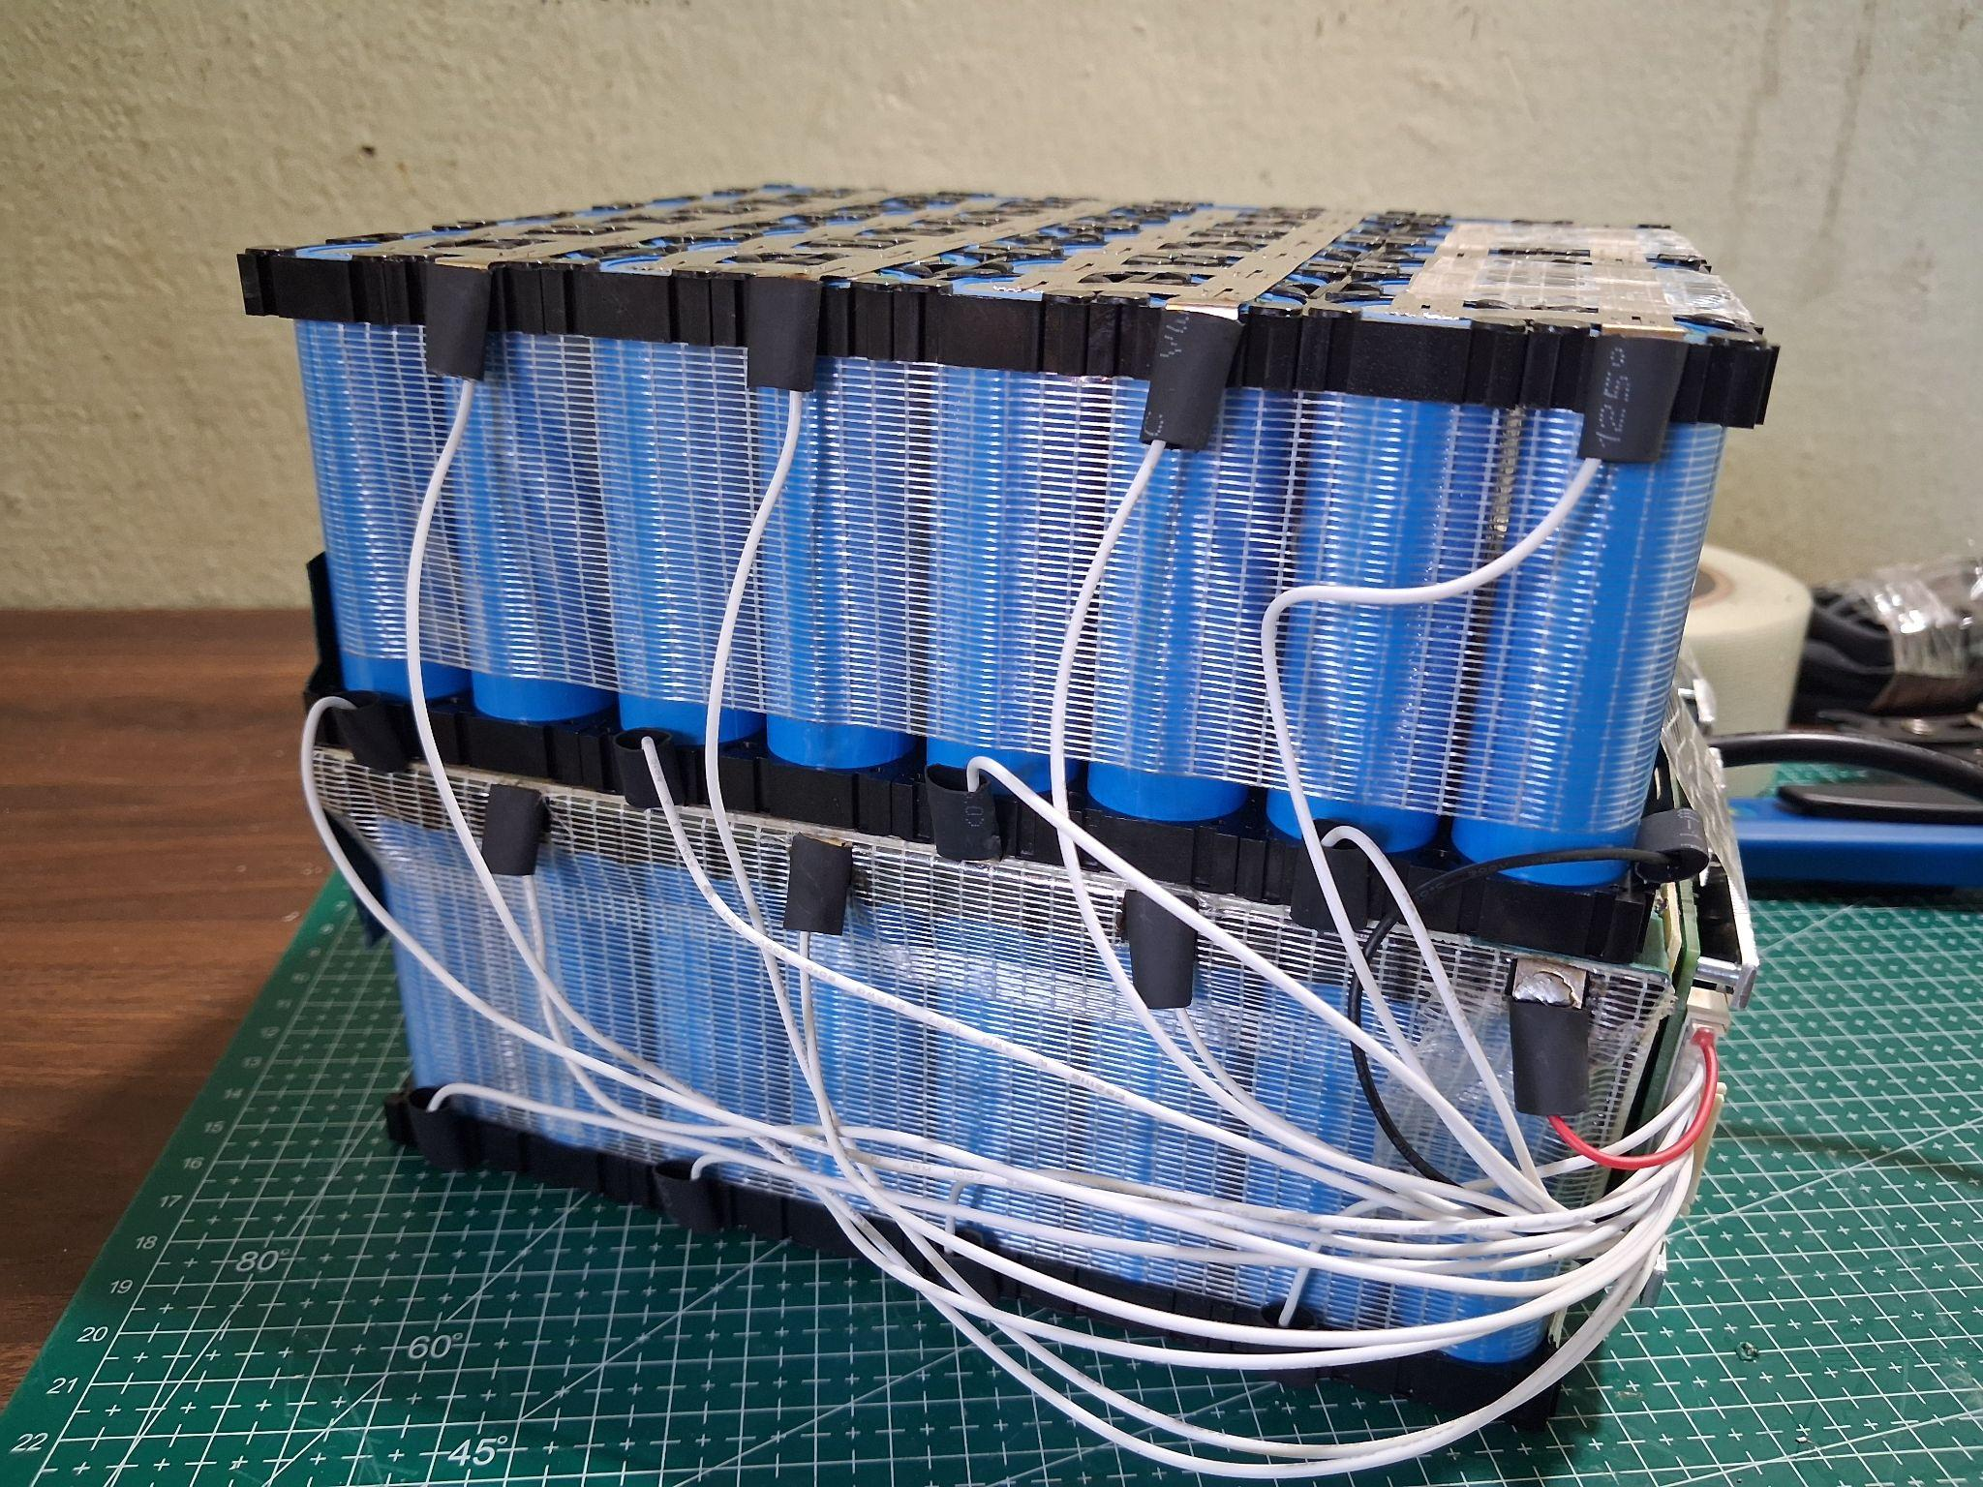
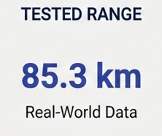
NMC EV Battery Pack
Pricing
Problem statement
Prototyping cost: 31,080 /-
Estimated cost: 26,599 /-
16S7P: 60V 35Ah - 2.1 kWh

Slide 4
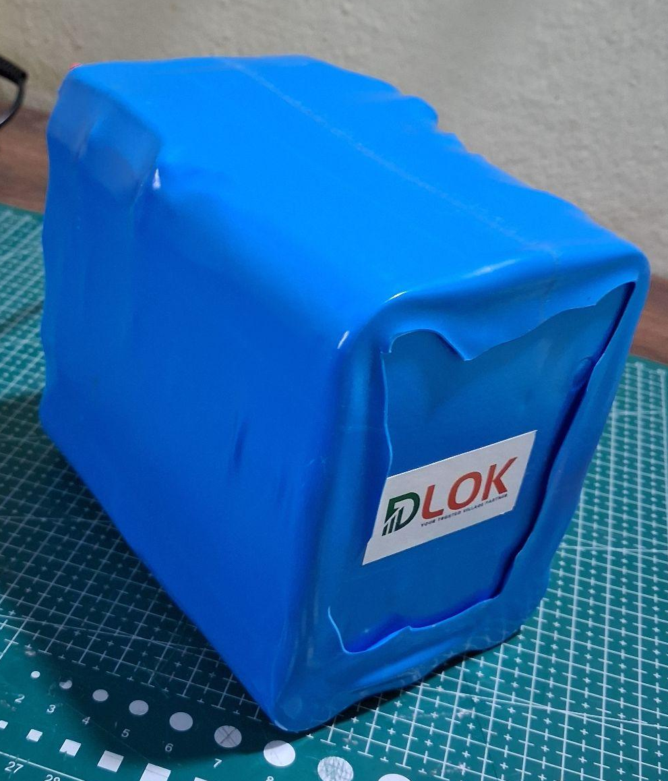
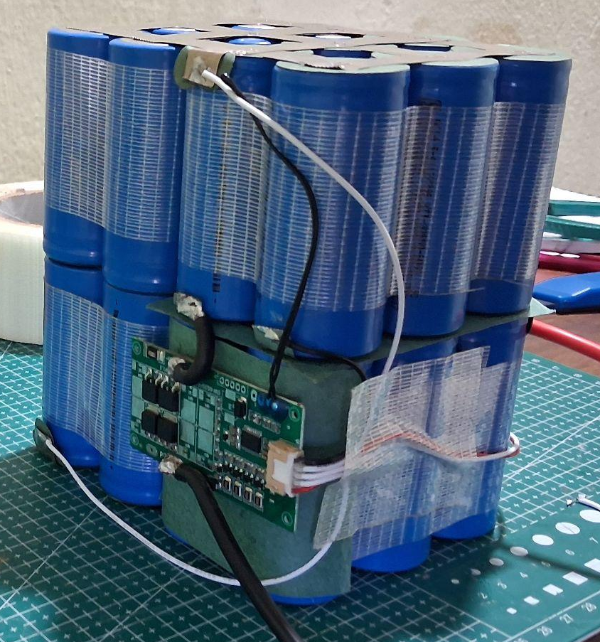
LFP Solar Battery Pack
Pricing
Problem statement
Prototyping cost: 3,949 /-
Estimated cost: 3,800 /-
4S6P: 12.8V 36Ah - 460 Wh
Backup
Calculated Time: 11 Hrs @ 40W

Slide 5
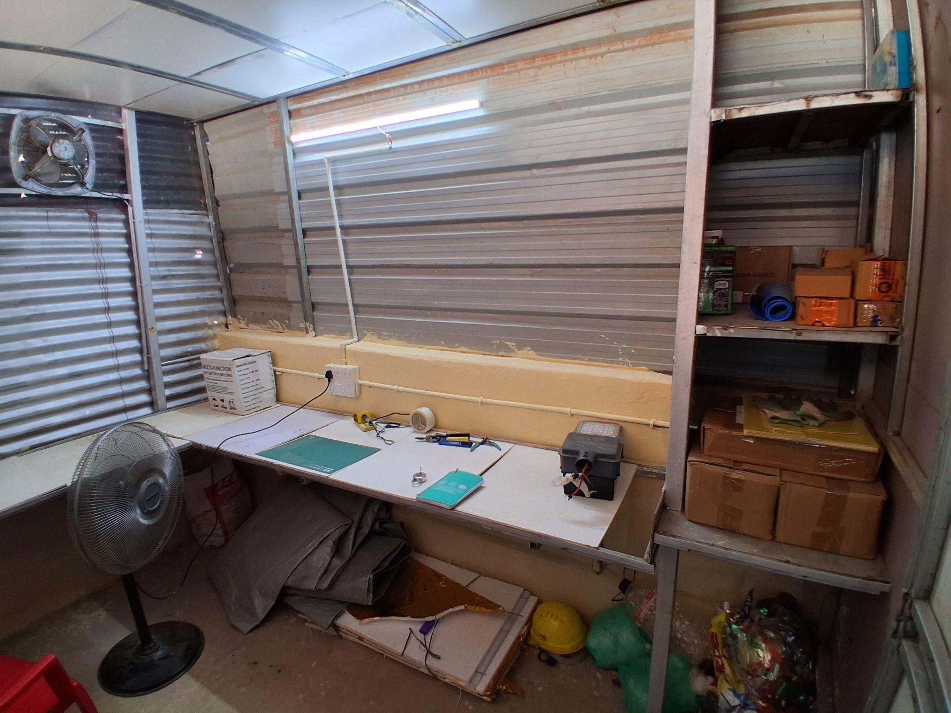
Lab Setup

Slide 6
Upcoming Projects

Slide 7
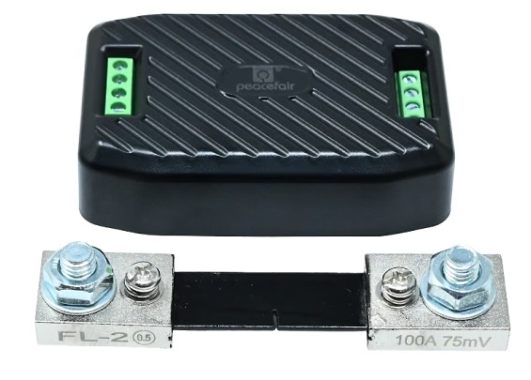
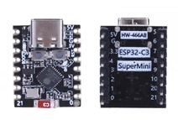
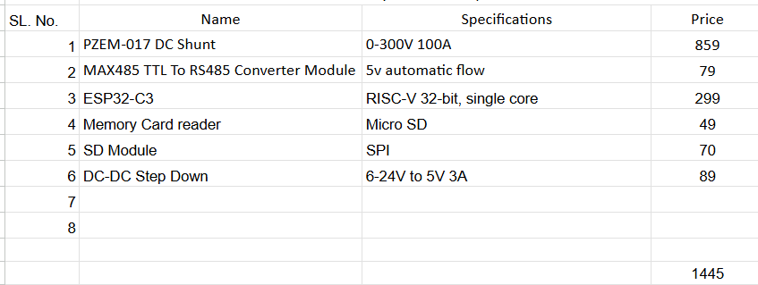
DC Energy Meter & Logger

Slide 8

LFP EV Battery Pack
Pricing
Problem statement
Prototyping cost: 23,500 /-
Estimated cost: 23,000 /-
19S3P: 60V 18Ah - 1.1 kWh
19S6P: 60V 36Ah - 2.2 kWh
Range
19S3P: 60V 18Ah - 1.1 kWh
Calculated Range: 95-100 km

Slide 9
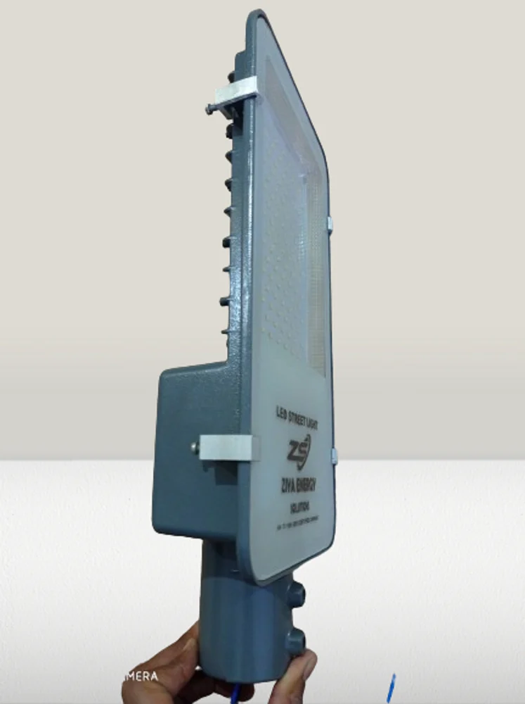
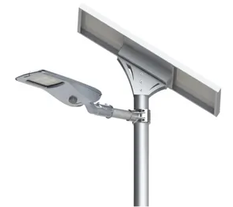
Semi-Integrated Solar Light
Pricing
Problem statement
Prototyping cost: 7,000 /-
Estimated cost: 6,500 /-
4S6P: 12.8V 36Ah - 460 Wh
Backup
Calculated Time: 11 Hrs @ 40W

Slide 10
Suggested Roadmap

Slide 11
Will help to collect Voltage, Current, Power [IN & OUT] data
Run a complete range test with Power Logger
Submit project documentations & SOPs
Power Logger
EV LFP 36Ah Pack
EV Battery pack testing
Solar LFP pack testing
Documentation
Make two packs of 18Ah 60.8V
Run test for few days with Power Logger data

Slide 12
Thank You

