Slide 1
Word Segmentation of Off-line Handwritten Bangla Text Lines
Ayush Agarwal
Dept. of CSE, B.P. Poddar Institute of Management and Technology, WB, India

Slide 2
Overview
Introduction
Challenges
Motivation
Dataset
Block Diagram
Pre-Processing
Word Segmentation
Result and Discussion
Conclusion and Future Plans

Slide 3
Introduction
Segmentation of words is one of the most important prerequisites of the Handwritten Optical Character Recognition (HOCR) system.
The method is developed on the basis of determining the inter and intra word gaps of components before the final identification of segmentation positions.

Slide 4

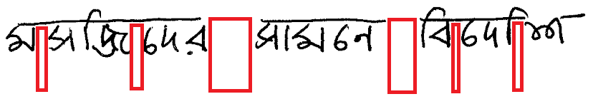

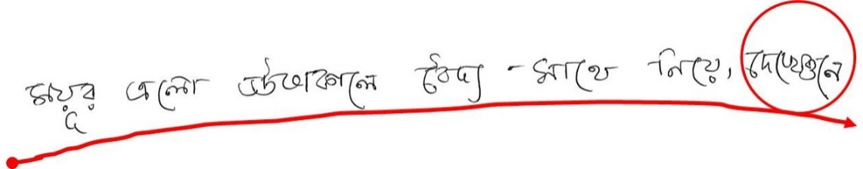
Challenges
Bangla script itself which contains various compound characters and different modified shape patterns
Complex writing pattern of the Bangla script.
Natural variations of handwriting.

Slide 5
Motivation
Working with Bangla script is challenging and it has a social impact in our region.
Considering the task of word segmentation works towards scripts such as Roman, Arabic, Chinese, etc. are extensively available in the literature [3-14] but very little attempt is made on Bangla script.

Slide 6
Dataset
The dataset is a subset of the WBSUBNdb_text dataset.
The WBSUBNdb_text dataset is freely available.
A previously developed line segmentation technique is used.
The study is employed on a dataset of 400 handwritten text lines of Bangla containing 2846 words.

Slide 7
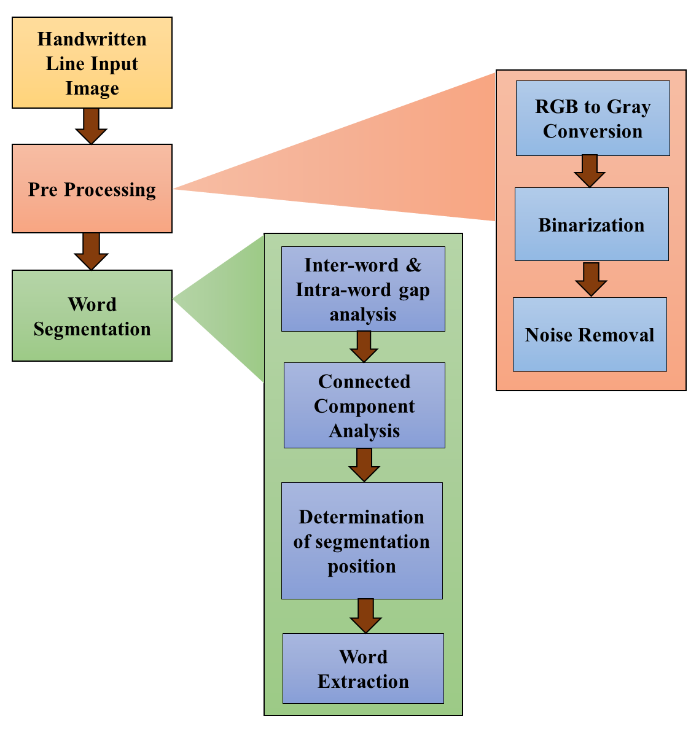
Block Diagram

Slide 8
Pre-processing
The Otsu adaptive binarization is performed on the input image.
The next preprocessing step of noise removal is performed to reduce the salt and pepper noise from the image.
The Gaussian Blur with dynamic kernel value is used.

Slide 9
Inter and Intra word gap analysis
Word Segmentation
Due to natural handwriting variations prior analysis of the inter word and intra word gaps performed dynamically for the line image.
Black run on the image to find out the row with the maximum number of black pixels, then white run on the obtained row is performed.
Connected Component analysis
Required to identify and extract word components from the input text line.
After noise removal a 2D kernel is dynamically computed.

Slide 10
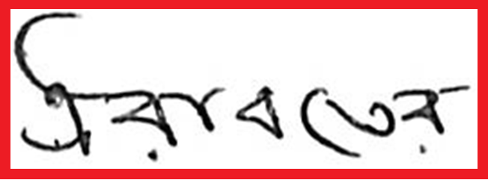
Determination of Segmentation position
Word Segmentation (Cont’d)
Precomputed intra and inter word gaps are used to determine the probable segmentation positions between words.
Connected components are discarded if any of these are coinciding with the connected components.
Final sets of segmentation positions are used.
(x, y)
width (w)
Starting point: (x, y)
Ending point: (x+w, y+h)
height (h)
(x+w, y+h)

Slide 11
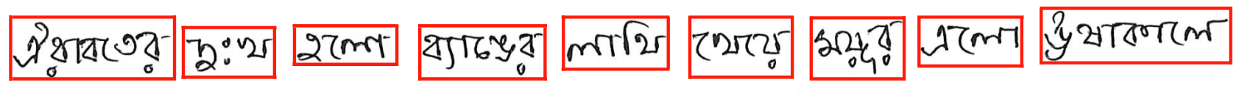
Word Extraction
Words are sequentially extracted from the input text image.
width(w₁)
(x₉, y₉)
width(w₉)
(x₁, y₁)
height(h₁)
height(h₉)
(x₉+w₉, y₉+h₉)
(x₁+w₁, y₁+h₁)

Slide 12
Result and Discussion
Accuracies are calculated manually as no ground truth available.
The 400 pre-segmented lines contain a total of 2846 words out of which the proposed approach has successfully segmented 2654 words with the accuracy of 93.25%.
Total Lines | Total Words | Properly Segmented Words | Over Segmented Words | Under Segmented words | Accuracy (%)
400 | 2846 | 2654 | 116 | 76 | 93.25

Slide 13
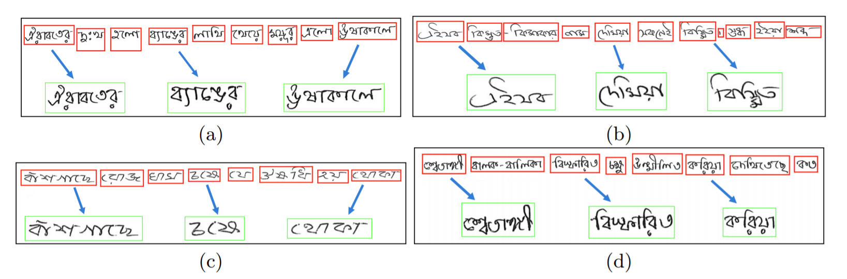
Result and Discussion (Cont’d)
Different sample resultant images, red marked boxes denotes the final identified word components and green boxes shows the words after extraction

Slide 14
Comparative Analysis
Result and Discussion (Cont’d)
Compared with the work of Rakshit et al. [15] as it was also done using the part of the same database.
In their work they have reported word segmentation accuracy of 90.06% on 200 lines whereas from 400 lines we have achieved a better accuracy of 93.25%.
Ref | Total Lines | Total Words | Segmented Words | Accuracy (%)
Rakshit et al. [15] | 200 | 1640 | 1477 | 90.06
Proposed | 400 | 2846 | 2654 | 93.25

Slide 15
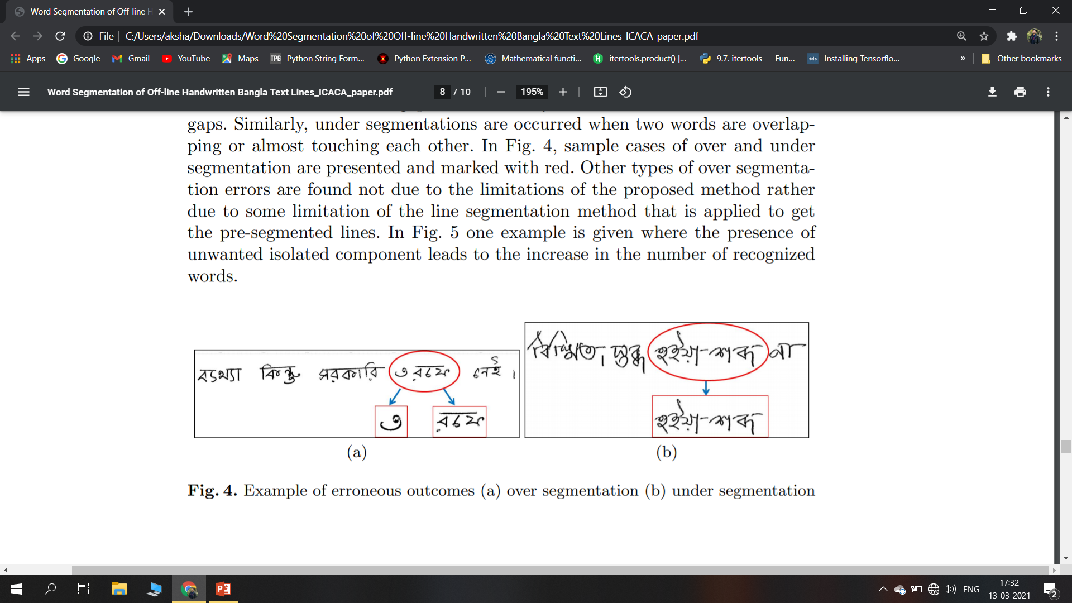
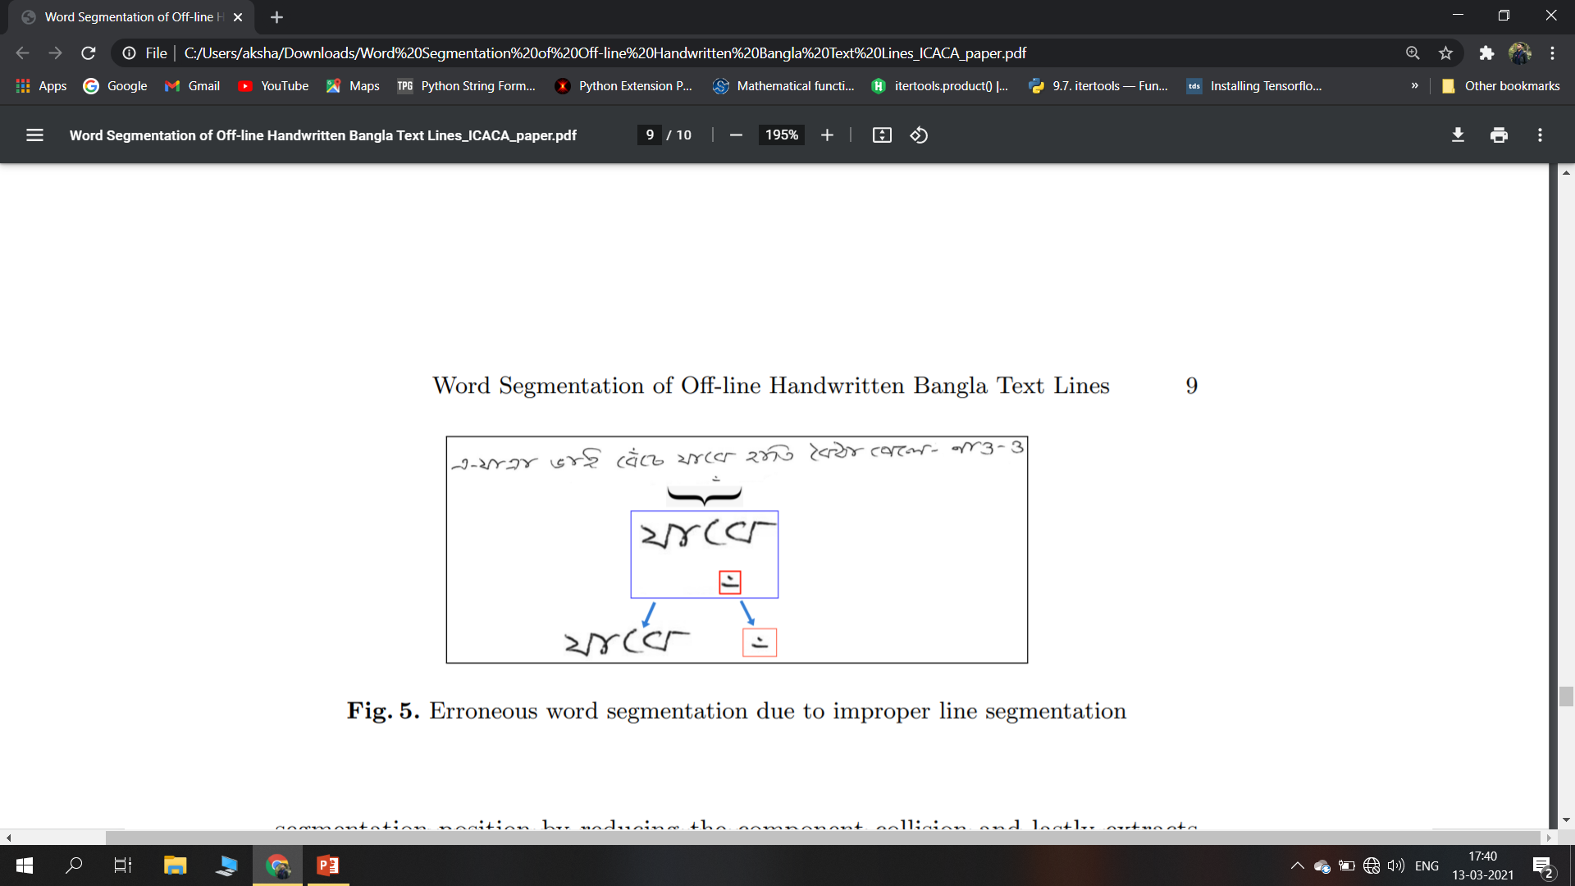
Error Analysis
Result and Discussion (Cont’d)
Over segmentation and Under segmentation has occurred.
Error in line segmentation leads to presence of unwanted components.

Slide 16
Conclusion and Future Plans
Based on dynamic analysis and determination of intra and inter word gaps.
Approach is free from any kind of normalization, skew/slant correction of the input images.
The results are very encouraging and comparative with an existing state-of-the-art method which shows its applicability in real life applications.
This method can further be applied to other Indic scripts viz., Devanagari, Oriya, Malayalam, Gurmukhi, etc.
In future, we will try to incorporate deep learning methods for further improvement.

Slide 17
References
Basu, S., Sarkar, R., Das, N., Kundu, M., Nasipuri, M., Basu, D.K.: A Fuzzy Technique for Segmentation of Handwritten Bangla Word Images. In: International Conference on Computing: Theory and Applications, pp. 427-433, 2007.
. Saha, S., Basu, S., Nasipuri M., Basu, D.: A Hough Transform based Technique for Text Segmentation. In: In Computing Research Repository (2010).
Louloudis, G., Gatos, B., Pratikakis, I., Halatsis, C.: Text line and word segmentation of handwritten documents. Pattern Recognition, 42(12), 3169-3183 (2009).
Sharma, M.K., Dhaka, V.P.: Segmentation of English Offline handwritten cursive scripts using a feed forward neural network. Neural Comput & Applic, 27, 1369-1379 (2016).
. Fischer, A., Keller, A., Frinken, V., Bunke. H.: Lexicon-free handwritten word spotting using character HMMs. Pattern Recognition Letters, 33(7), 934-942 (2012).
. Gatos, B., Stamatopoulos, N., Louloudis, G.: ICDAR2009 handwriting segmentation contest. International Journal on Document Analysis and Recognition, 14(1), 25-33 (2009).
Liu, C., Yin, F., Wang Q., Wang, D.: ICDAR 2011 Chinese Handwriting Recognition Competition. In: International Conference on Document Analysis and Recognition,pp. 1464-1469, 2011.
Grosicki, E., El-Abed, H.: ICDAR 2011 - French Handwriting Recognition Competition, In: International Conference on Document Analysis and Recognition, pp. 1459-1463, 2011.
Sanchez, A., Mello, C.A.B., Suarez, P.D., Lopes, A.: Automatic line and word segmentation applied to densely line skewed historical handwritten document images, Integrated Computer Aided Engineering, 18, 125-142 (2011).
Mehdi, M. M., Riaz, A.: Optimized Word Segmentation for the Word Based Cursive Handwriting Recognition, In: European Modelling Symposium, pp. 299-304, 2013.

Slide 18


