Slide 1
The 2026 Memory Price Surge and the AI Bubble
How AI spending pushed memory prices up, and whether it is a bubble
20×
memory chip price vs its 2023 low
Ayush Bhatt (G2610412E) · Bu Dinglin (G2609929D)
Group 04 · Data Visualisation, NTU CCDS
Notes:
AYUSH BHATT | Intro | target 0:00-0:17
Hi, I'm Ayush Bhatt, and this is Bu Dinglin. Our project looks at one of the strangest price stories of 2026: why computer memory suddenly became so expensive, and what that tells us about the AI boom.

Slide 2
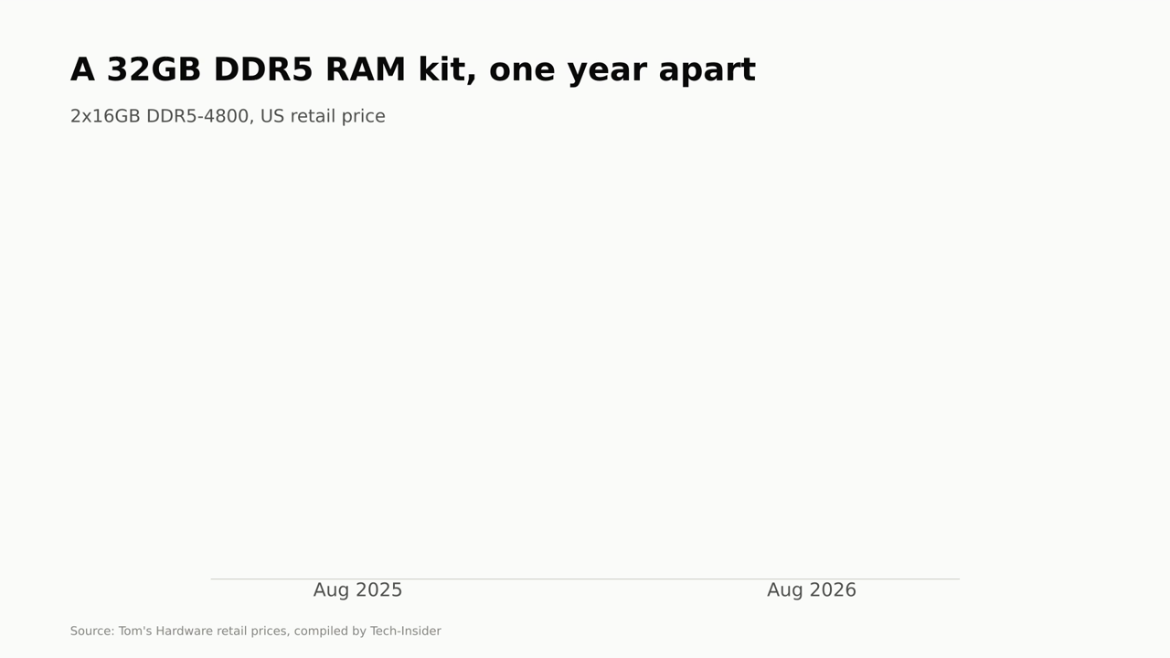
Notes:
AYUSH BHATT | 1. Hook | target 0:17-0:38
A year ago, a 32-gigabyte kit of DDR5 RAM cost about ninety dollars. This August it cost four hundred and twenty-five: nearly five times as much for the same chips. It isn't inflation. It's what happens when artificial intelligence starts eating the world's memory supply.

Slide 3
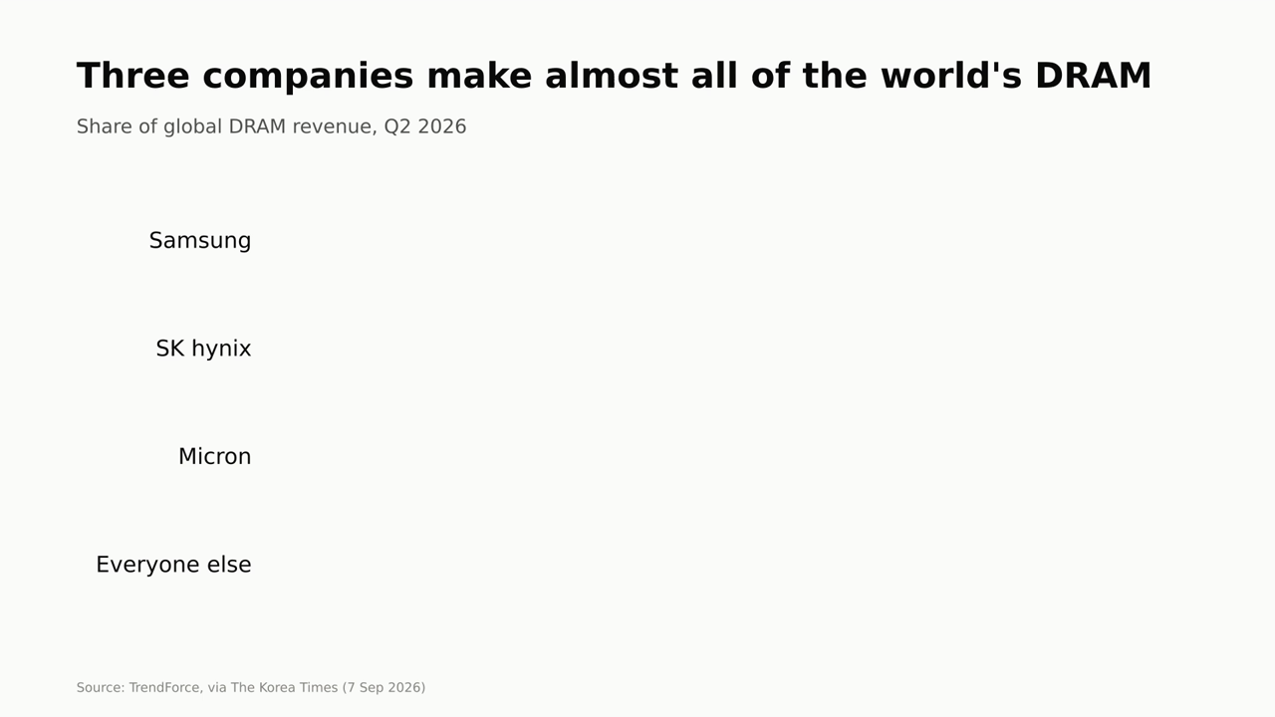
Notes:
AYUSH BHATT | 2. Who makes memory | target 0:38-0:54
Almost all of the world's RAM comes from three companies: Samsung, SK hynix and Micron, with nearly 88% of the market between them. When those three change what they make, prices change for everyone.

Slide 4
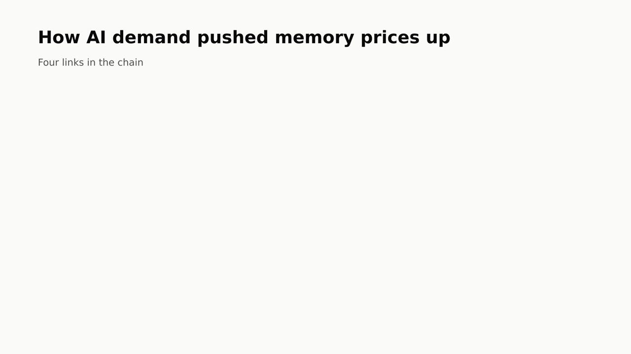
Notes:
AYUSH BHATT | 3. Why prices rose | target 0:54-1:21
Here's the chain. One: AI spending exploded. Two: memory makers followed the money into AI memory, which now takes about half of all DRAM supply. Three: the cloud giants signed long-term deals to lock in their share. Four: SSDs followed, because AI needs fast storage too. The demand comes from data centres, so buying fewer laptops won't fix it.

Slide 5
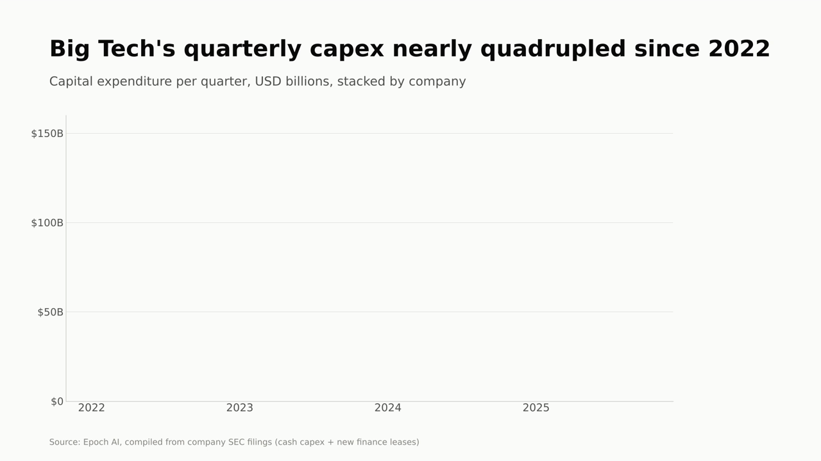
Notes:
AYUSH BHATT | 4. The demand, in data | target 1:21-1:44
Here's link one in real numbers, from the companies' own filings. In early 2022, Microsoft, Amazon, Alphabet, Meta and Oracle spent about 38 billion dollars a quarter on data centres and equipment. By the end of 2025 it was 141 billion: nearly four times as much, with the take-off in 2024.

Slide 6
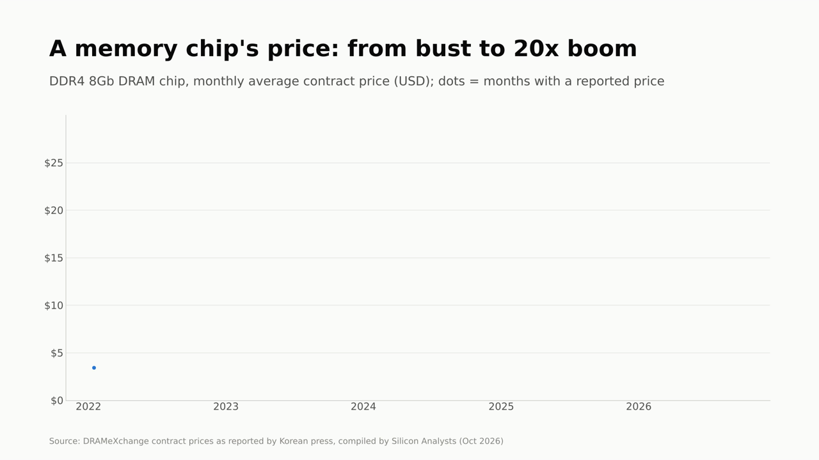
Notes:
AYUSH BHATT | 5. The price cycle | target 1:44-2:36
And here's what happened to the price of one memory chip, month by month. First, the bust: prices fell 62%, to a dollar thirty by August 2023. ChatGPT launched in the middle of it, but AI hadn't reached memory prices yet. Then the boom. In June 2025 the makers announced they were phasing this chip out, and from there the line goes nearly vertical. By December, reports said Nvidia would cut supply of its RTX 50 graphics cards by 30 to 40% because it couldn't get enough memory. Nvidia denied pausing production. By September 2026 the chip cost 26 dollars: twenty times its low. The phase-out exaggerates this chip's spike, but newer memory moved the same way. Over to Dinglin.

Slide 7
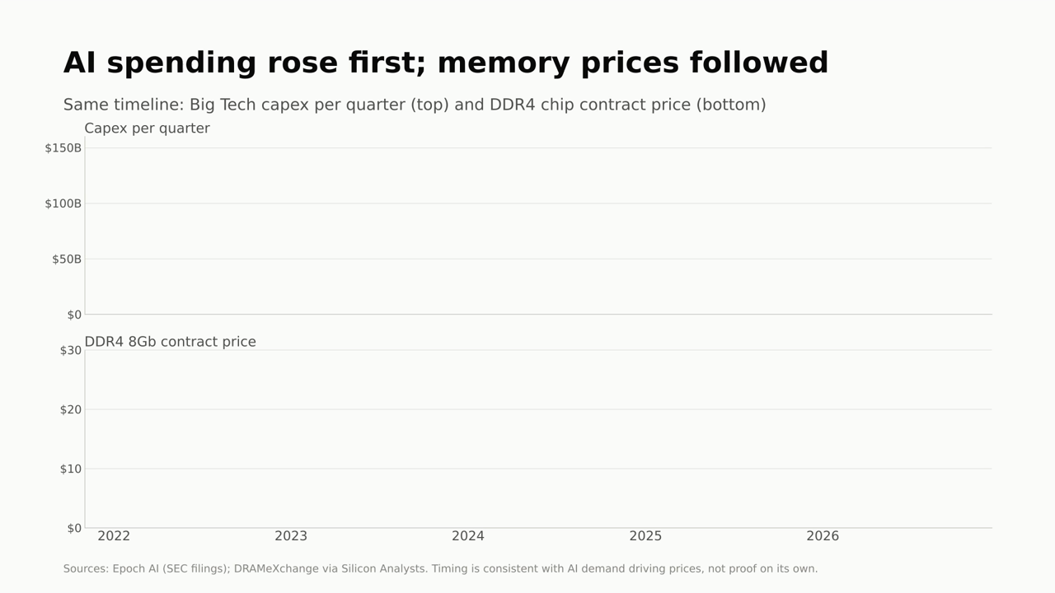
Notes:
BU DINGLIN | 6. Spending first, prices second | target 2:36-3:03
Thanks, Ayush. Put the two side by side and the order is clear. Big Tech's spending takes off in 2024. Memory prices follow about a year later, from mid-2025. Timing alone doesn't prove cause, but it's exactly what you'd expect if AI demand is driving the shortage.

Slide 8
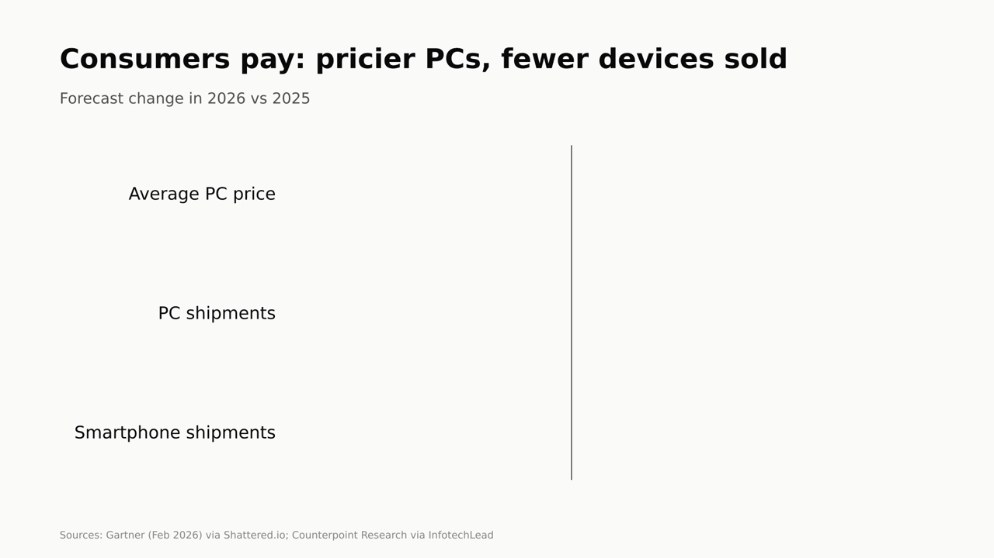
Notes:
BU DINGLIN | 7. Who pays | target 3:03-3:16
Consumers pay. Gartner expects average PC prices to rise 17% this year and PC shipments to fall about 10%. Smartphone shipments are forecast to drop nearly 14%.

Slide 9
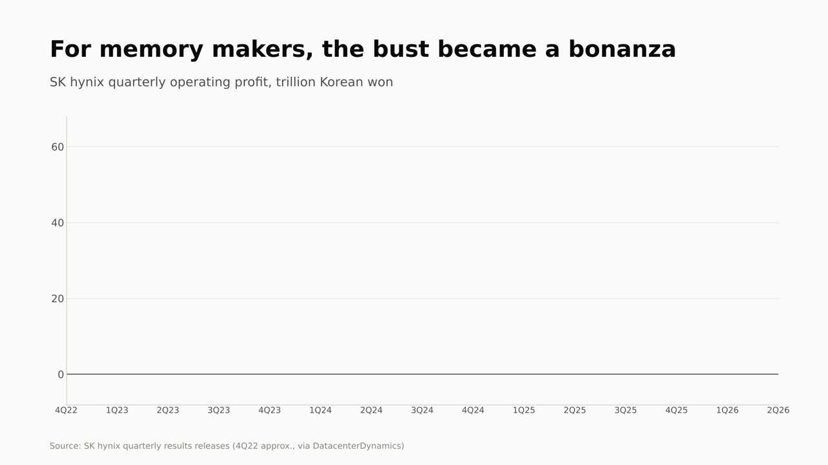
Notes:
BU DINGLIN | 8. Who wins | target 3:16-3:36
Memory makers win. SK hynix lost money for four straight quarters through 2023, up to 3.4 trillion won in a single quarter. In the second quarter of 2026 it made 60 trillion won, at a 76% operating margin. Same company, three years apart.

Slide 10
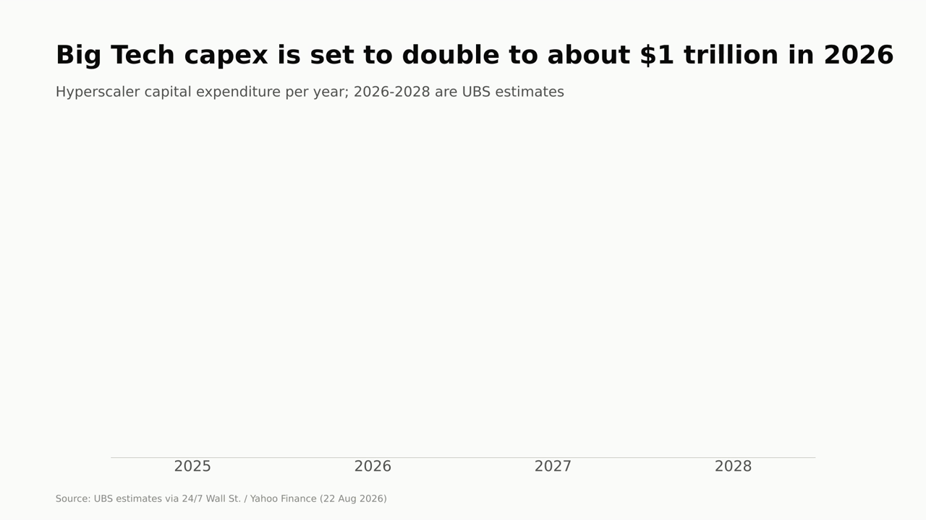
Notes:
BU DINGLIN | 9a. Is it a bubble? | target 3:36-3:56
All of this rests on AI spending, and it's set to double again, to about a trillion dollars this year. For Amazon, Alphabet and Microsoft, that's roughly all of their cloud revenue, and skeptics warn of a huge depreciation bill and rising debt.

Slide 11
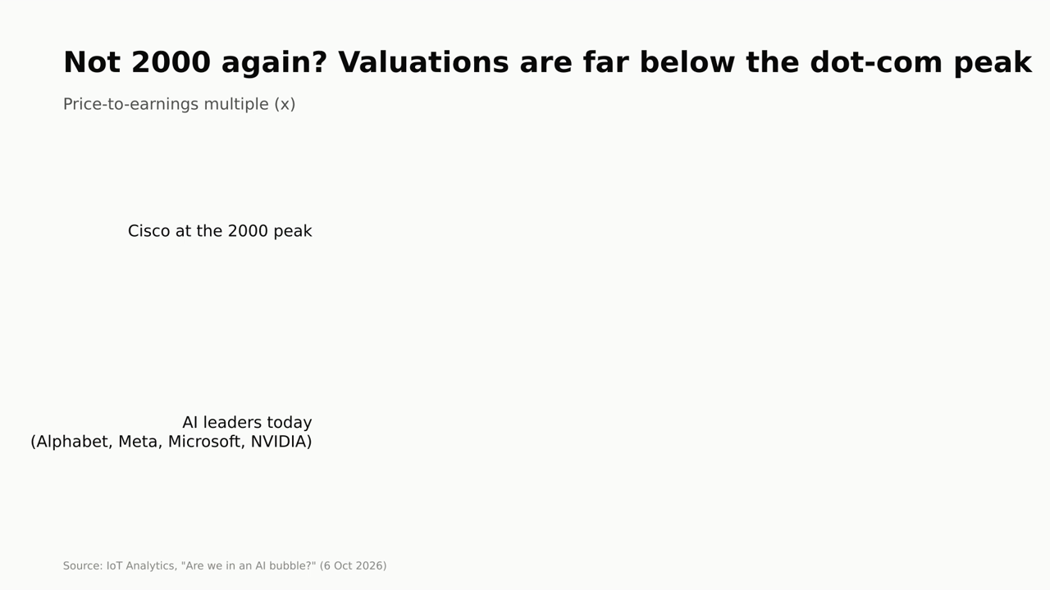
Notes:
BU DINGLIN | 9b. ...or not? | target 3:56-4:17
But this isn't 2000. At the dot-com peak, Cisco traded at around 200 times earnings. Today's AI leaders are around 22 to 25. Our middle view: the technology is real, but they're probably building faster than revenue can justify. Expect write-downs and a slowdown, not a crash.

Slide 12
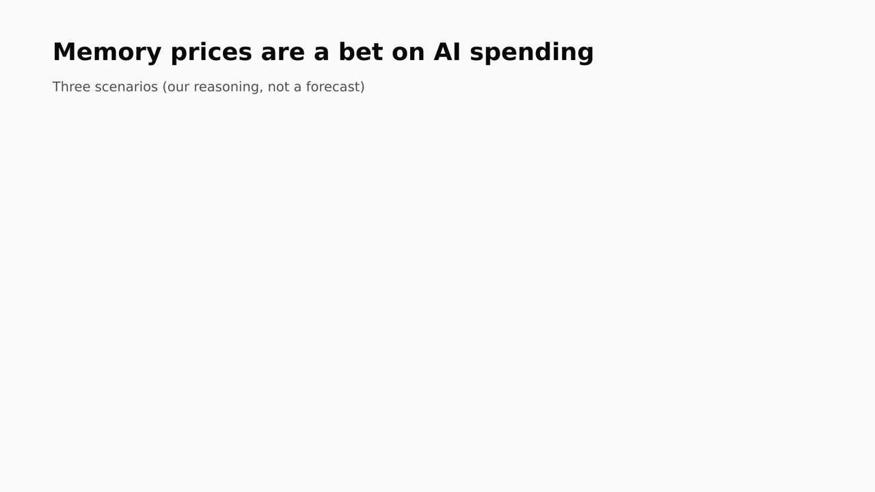
Notes:
BU DINGLIN | 10. What happens next | target 4:17-4:36
So memory prices are a bet on AI spending. If the boom continues, RAM stays expensive through 2027. If it slows, prices drift down. And if the bubble deflates, history says they could crash, as they halved in 2022.

Slide 13
A scoreboard for the AI boom
3.7×
20×
76%
Big Tech capex per quarter,
Q1 2022 to Q4 2025
DDR4 chip contract price,
Sep 2026 vs 2023 low
SK hynix operating margin,
2Q26 (after 2023 losses)
AI demand is real, but the build-out may be ahead of revenue: expect write-downs and a slowdown, not a crash. If AI spending slows, memory prices could fall as fast as they rose.
Notes:
BU DINGLIN | Conclusion | target 4:36-5:04
To sum up: Big Tech's quarterly spending rose almost four times, a memory chip's price rose twenty times from its low, and memory makers now earn margins of 76%. AI demand is real, but the build-out may be running ahead of revenue. So next time you check the price of RAM, you're reading a scoreboard for the AI boom. Thanks for watching.

Slide 14
Data and sources
Datasets we compiled
DDR4 8Gb contract price, monthly, Jan 2022 to Sep 2026: DRAMeXchange via Silicon Analysts
Hyperscaler capex, quarterly, 2022 to 2025: Epoch AI, from company SEC filings
SK hynix operating profit, quarterly, 4Q22 to 2Q26: company results releases
Events on the price chart
DDR4 phase-out: TrendForce, 9 Jul 2025
RTX 50 supply cut (reported): Windows Central, 17 Dec 2025; Nvidia response via Tom's Guide, 22 Jan 2026
Other figures
Prices and market share: TrendForce; The Korea Times; Tom's Hardware via Tech-Insider
PC and phone impact: Gartner; Counterpoint Research via InfotechLead
Capex outlook: UBS via 24/7 Wall St. / Yahoo Finance
Bubble debate: Morgan Stanley via Benzinga; IoT Analytics
Full references with links are in the project report.
Notes:
(Not narrated. Leave on screen for about 3 seconds at the end of the recording, or cut it from the video.)

