Slide 1

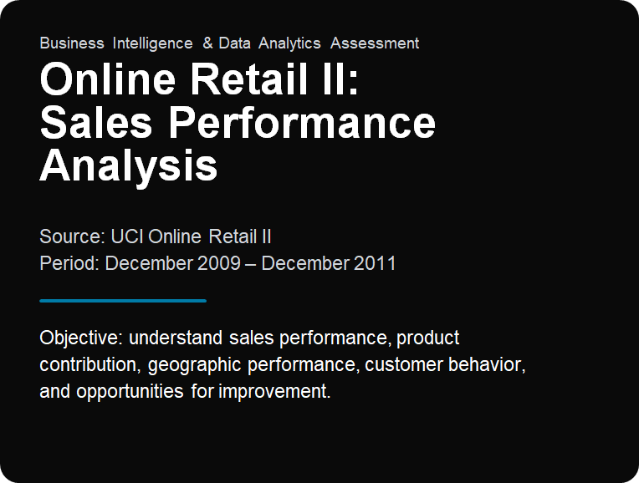
By – Ayush Patel
Notes:
Welcome. Today we examine the UCI Online Retail II dataset covering December 2009 through December 2011, establishing reliable data hygiene and turning sales insights into concrete commercial actions.

Slide 2
DATA HYGIENE & METHODOLOGY
Building a Reliable Foundation for Business Insights
1
2
3
4
5
Raw Data
Data Cleaning
Revenue Calculation
Exploratory Analysis
Dashboard & Recommendations
1,067,371 rows
8 columns
34,335 exact duplicates removed
Revenue = Quantity × Price
Returns & cancellation analysis
1,033,036 cleaned rows
9 columns
Deduplication & Imputation
Integrity & Cancellations
Customer IDs
Excluded missing Customer IDs from customer-level analysis.
Removed 34,335 exact duplicate records. Filled some missing product descriptions using StockCode mappings.
Retained negative quantities for returns and cancellation analysis. Retained zero-price transactions, interpreted carefully.
Notes:
Data cleaning reduced raw volume from 1.067M rows to 1.033M robust transactional records. Deduplication and careful treatment of returns ensure accurate revenue analysis.

Slide 3
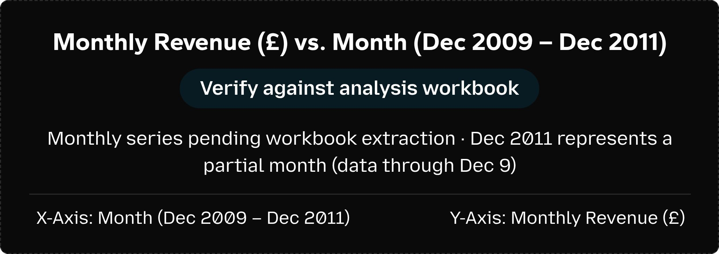
MACRO OVERVIEW · DEC 2009 – DEC 2011
Sales Performance at a Glance: Revenue Varies Over Time
$18.86M
10.41M
53.6K
5.94K
Total Revenue
Total Quantity (units)
Total Invoices
Unique Customers
MONTHLY REVENUE TREND (DEC 2009 – DEC 2011)
TREND TAKEAWAY
Revenue varies over time
Monthly sales exhibit notable peaks toward year-end periods; seasonal patterns need further investigation and structured monthly tracking.
Note: Dec 2011 partial month (closing Dec 9).
Axis: Month vs. Revenue (£) · Source: UCI Online Retail II
Notes:
Overall revenue reaches £18.86M across 53.6K invoices. Monthly revenue fluctuations suggest prominent Q4 retail seasonality, with December 2011 truncated on December 9.

Slide 4
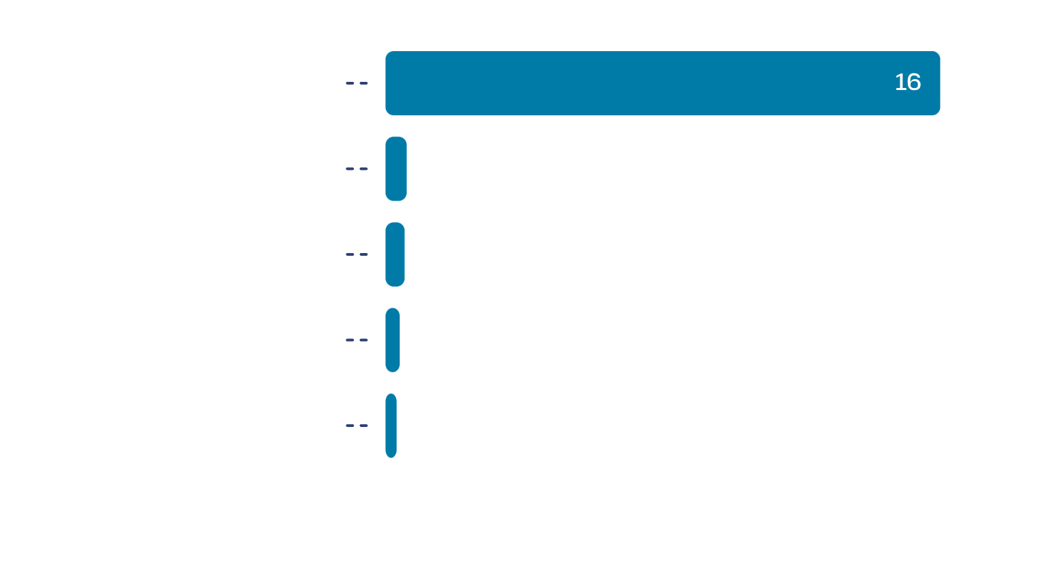
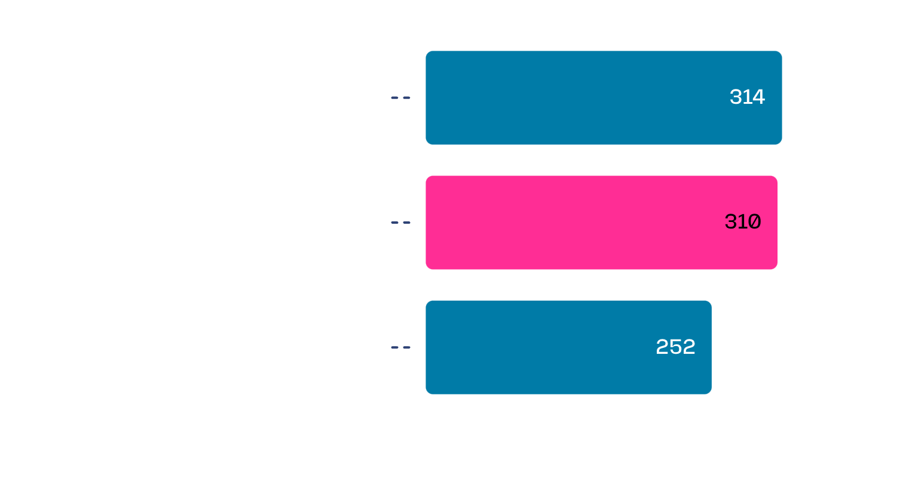
GEOGRAPHIC & MERCHANDISE CONCENTRATION
The UK Dominates Revenue, and a Few Products Lead
TOP COUNTRIES BY REVENUE (£M)
TOP ITEMS BY REVENUE (£K)
The UK is the largest market at about £15.99M; revenue is concentrated in one market.
DOTCOM POSTAGE (about £310K) is a service transaction, not merchandise.
Repeat purchasing appears common among identified customers; no cohort analysis was done, so retention is not claimed. Monthly revenue shows noticeable peaks, so seasonality should be investigated.
Notes:
UK sales make up £15.99M. Product analysis shows Regency Cake Stand and White Hanging Heart leading merchandise, while DOTCOM POSTAGE is a service transaction, not merchandise.

Slide 5

CANCELLATION & AUDIT ANALYSIS
Returns Cut Gross Sales by About £1.46M
RETURN REVENUE DEDUCTION
Direct Mapping: Prefix C
-$1.46M
Cancellation invoices (prefix C): about -£1.46M, the same amount as negative-quantity revenue. Do not double-count.
Returns deducted from gross sales
Dataset Limitations
About 235,151 missing Customer IDs; December 2011 is partial. Zero-price transactions and negative-price accounting adjustments distort revenue; customer-level analysis excludes missing Customer IDs.
Analytical Boundaries
Takeaway: Returns deducted ~£1.46M across 22,496 negative-quantity transactions.
Missing IDs do not prove churn; revenue patterns do not prove causation.
Notes:
Cancellation invoices and negative-quantity revenue represent the same approximately -£1.46M; do not double-count.

Slide 6
Turning Insights into Business Actions
Recommended action | Owner / KPI | Business Impact / Feasibility / Priority
Strengthen UK market performance | Sales / Marketing Revenue growth, repeat purchase rate | High / High / High
Improve product-level decisions; separate merchandise from postage/service | Merchandising Product revenue, gross margin, contribution | High / Medium / High
Monitor returns and cancellations by product, country, month | Operations / Customer Experience Return rate, cancellation rate, net revenue | Medium / High / Medium
Qualitative ratings: For review
Conclusion: Better sales monitoring, product analysis, and returns management support stronger business decisions.
Notes:
Prioritizing core UK accounts and auditing returns will deliver immediate financial clarity. Separating service revenue from merchandise gives genuine SKU profitability.

