Slide 1
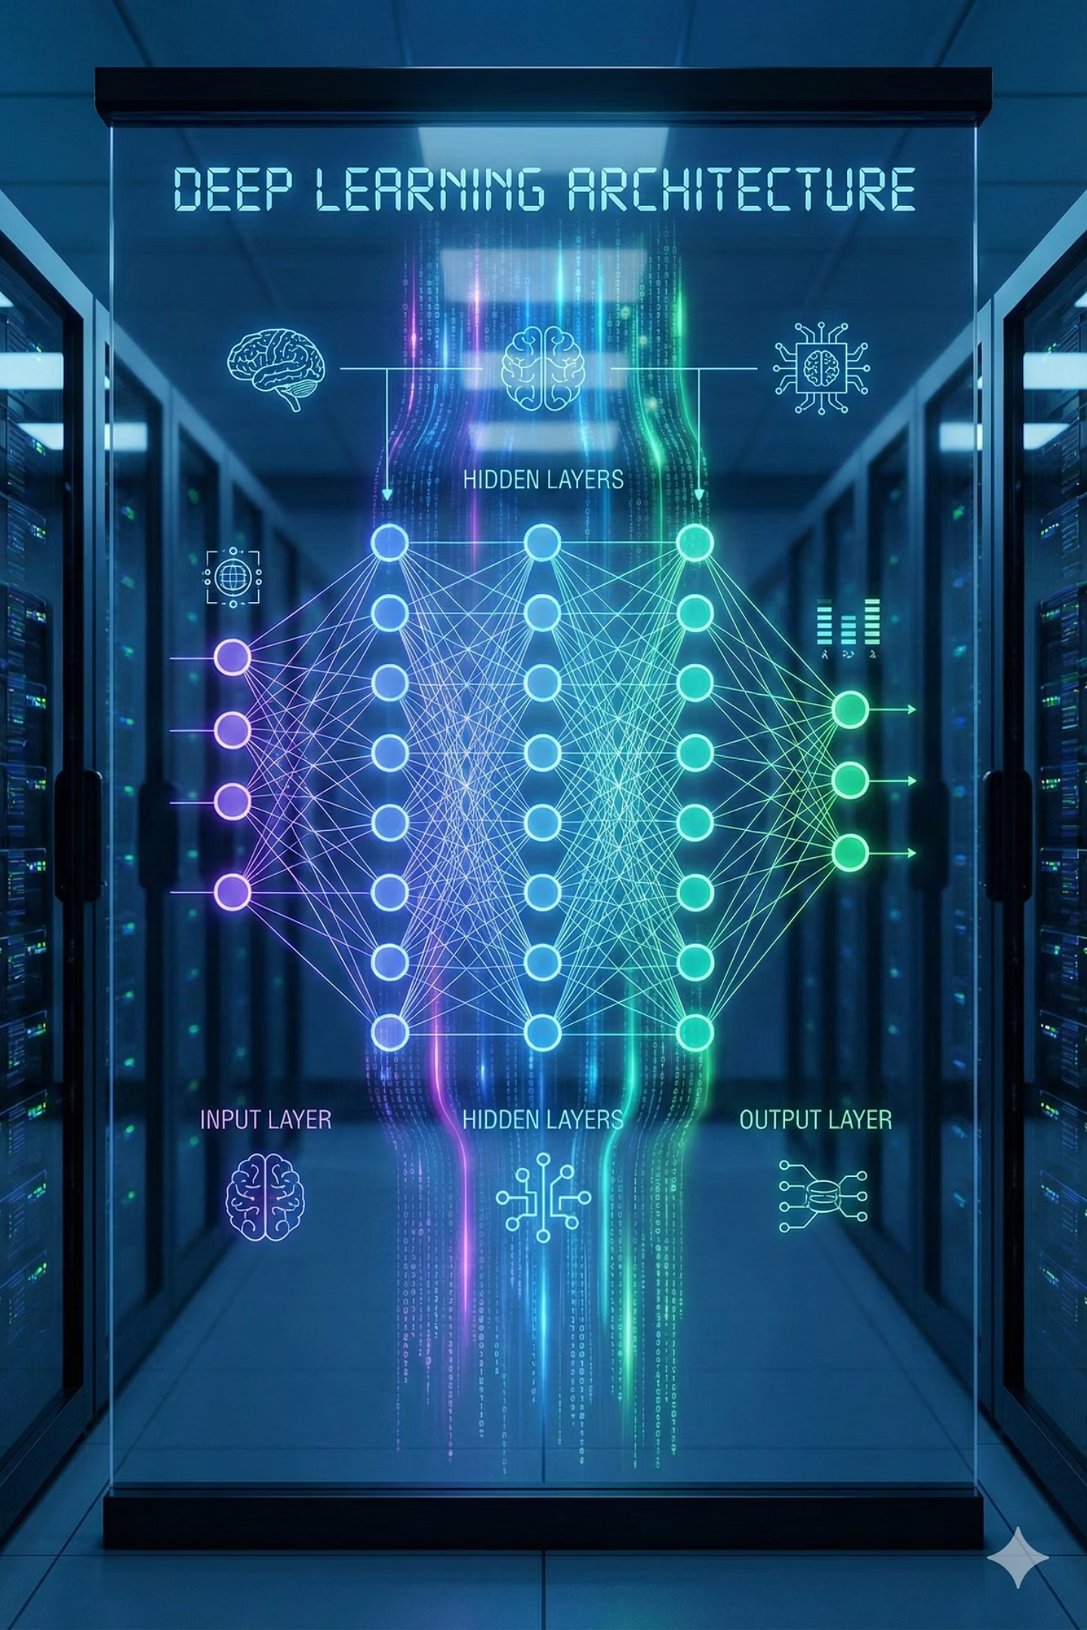

Gesture-Controlled Snake Game Using MediaPipe
School Of Computer Science
Prepared By:
Ayush Gupta SapId: 500125537 Cource: Btech Cse
Arsh Gupta SapId: 500122397 Course: Btech Cse
Anshika Tomar SapId: 500119658 Course: Btech Cse
Bhavya Mittal SapId: 500119005 Course: Btech Cse
Submitted To:
Dr. Santosh Panda

Slide 2
Abstract
This project implements a gesture-controlled Snake Game using deep-learning–based hand-landmark detection. The system uses MediaPipe’s CNN-driven hand model to extract and track hand keypoints in real time, converting fingertip motion into game controls.
Key Deep Learning Features
MediaPipe Hands uses two CNN models:
Palm Detection CNN – detects the hand region
Landmark Regression CNN – predicts 21 hand keypoints in real time
Landmark outputs (x, y, z) serve as deep-learning–generated features for gesture interpretation
No manual feature engineering required — CNN automatically learns hand geometry and spatial patterns
Index Fingertip (Landmark 8) used as the main directional input for gesture control
Smoothing + motion analysis transform raw CNN predictions into stable, usable game commands

Slide 3

Gesture Recognition
Traditional gesture methods:
Used colour/contour detection → unstable and sensitive
Required manual feature engineering
Not reliable for real-time control
Deep-learning shift:
CNNs learn hand features automatically
More robust to lighting & background variations
MediaPipe-based Gesture Recognition:
Uses CNN landmark detection for accurate hand tracking
Tracks index fingertip (Landmark 8) for direction
Fingertip motion → UP / DOWN / LEFT / RIGHT

Slide 4
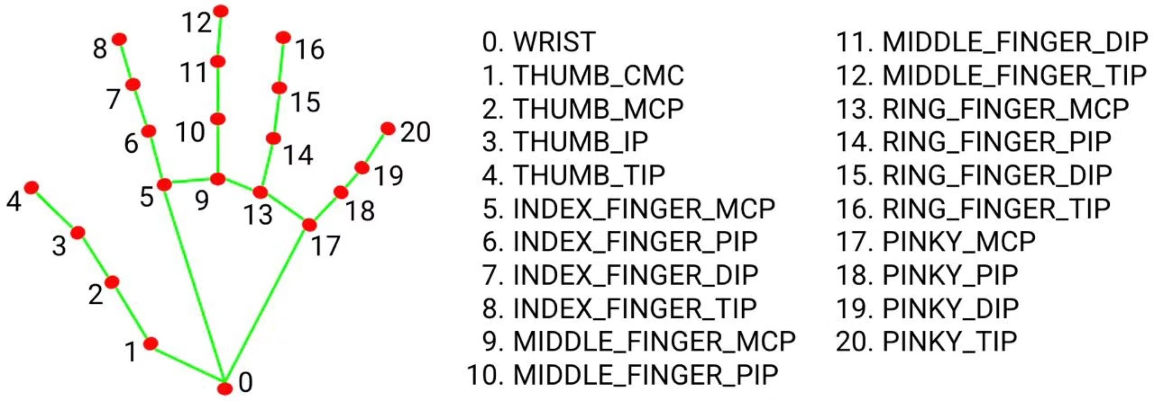
Media-Pipe Model
MediaPipe Hands is a deep-learning–based hand-tracking system that uses a two-stage CNN architecture to detect the hand and estimate 21 precise landmarks in real time. These landmark coordinates act as learned deep-learning features that enable robust, touchless gesture recognition for the Snake game.
Palm Detection (Stage 1)
21-Point Landmark Model (Stage 2)
CNN-based Palm Detector
Regression CNN predicts 21 keypoints
Detects the hand region reliably
Outputs (x, y, z) coordinates for each landmark
Less variation than full hand → higher accuracy
Landmark 8 (index fingertip) used for gesture direction
Generates a stable bounding box
Deep-learning features → no manual feature engineering
Works even with partial hand visibility.
Accurate, real-time keypoint tracking on CPU

Slide 5
Methodology
Webcam Input
1
Capture live video frames using OpenCV
Flip frame for natural interaction
2
Preprocessing
Convert BGR → RGB
3
Prepare frame for deep-learning inference
MediaPipe CNN Inference
Stage 1: Palm Detection CNN
Stage 2: 21-Landmark Regression CNN
4
Gesture Interpretation
Extract index fingertip (Landmark 8)
Calculate fingertip movement across frames
Apply thresholding to remove micro-movements
Game Engine Integration
5
Apply smoothing (buffers) for stability
Send final gesture direction to Snake game
Map motion → UP / DOWN / LEFT / RIGHT
Pygame updates movement, collisions, score
6
Real-Time Output
Render Snake game window
Display webcam feed with landmark overlay
Continuous gesture control loop

Slide 6
Observations and Results
Observations
Results
MediaPipe’s CNN-based palm detector consistently localized the hand across frames
Achieved real-time landmark inference (≈20–30 FPS) on CPU due to lightweight CNNs
The 21-landmark regression CNN predicted keypoints with high spatial stability
Generated precise landmark coordinates suitable for motion-based gesture classification
Index-fingertip (Landmark 8) showed low variance and high positional consistency
Deep-learning predictions enabled accurate directional mapping with minimal misclassification
Smoothing buffers significantly reduced model jitter from frame-to-frame variations
CNN landmark outputs remained robust across lighting and background variations
Model maintained inference stability under changes in hand angle and minor occlusions
Demonstrated how deep-learning feature extraction can fully replace traditional vision heuristics

Slide 7
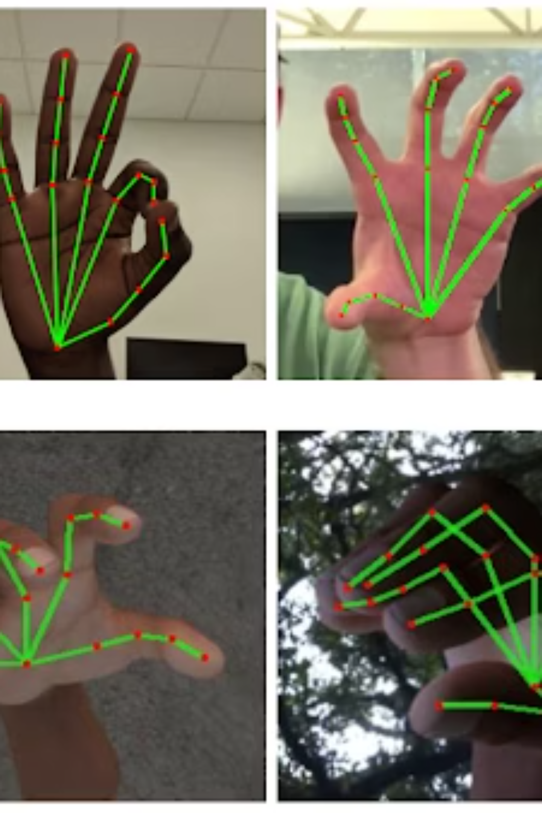
Conclusion
MediaPipe’s dual-CNN model accurately detected 21 hand landmarks in real time.
The index-fingertip landmark provided reliable, stable directional gestures after smoothing.
The system achieved real-time CPU performance, enabling seamless gesture-based control.
Demonstrates that deep-learning landmark detection can effectively drive touchless game interaction.

