Slide 1
How AI Can Assist in Emergency Rooms
(AI-Powered Patient Information Retrieval)
Group members,
Project coordinator

Slide 2



Current Patient-Nurse Interaction
💬 Patient: 'I feel sick...'
👩‍⚕️ Nurse: 'What are your symptoms?'
❌ Delays due to manual processes & communication gaps
I’m sick
Please fill this form

Slide 3
Current Challenges
⏳ Time-consuming process
🗣️ Miscommunication risks
🌎 Language barriers
🖥️ Limited access to patient history
Explain the drawbacks

Slide 4

What are we trying to do?
What’s wrong?
I’m sick

Slide 5

Understanding Large Language Models (LLMs)
🤖 Think of it as a 'Super AI Assistant' trained on medical data.
💡 Example: ChatGPT for healthcare conversations!
Explain briefly about LLM, give the example of Chatgpt

Slide 6
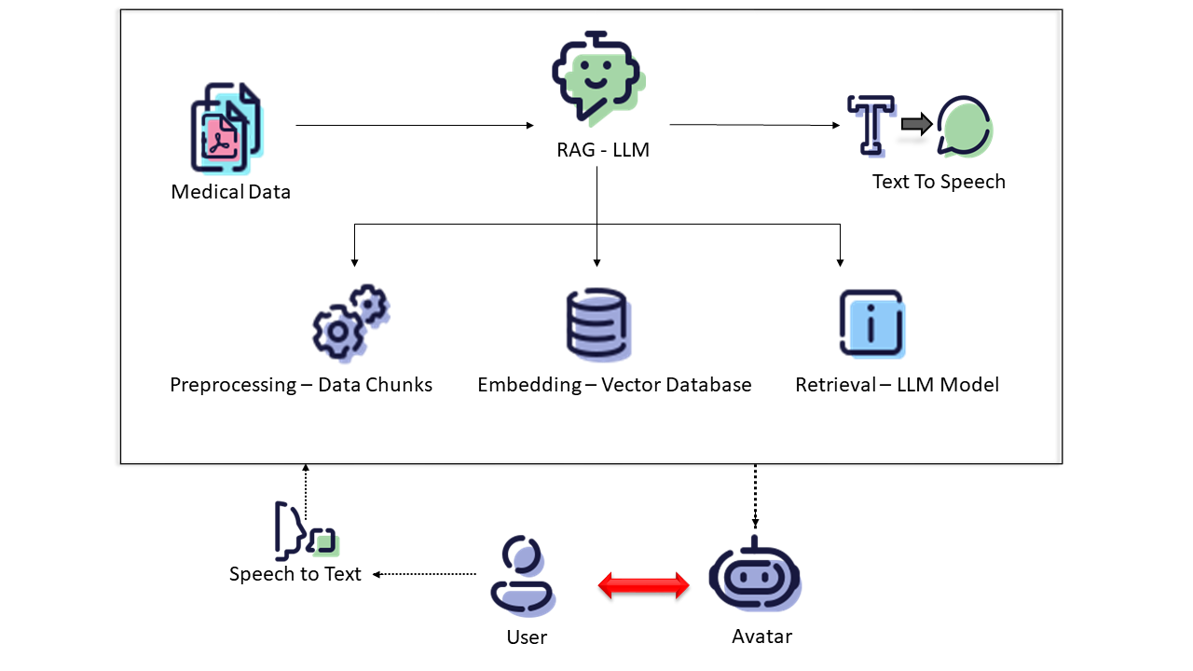
AI-Powered Solution
✅ Listens to the patient
✅ Understands medical context
✅ Assists nurses with faster response

Slide 7
Training the AI Model
📄 Used real medical forms (Patient Consent Forms)
🗣️ Trained in both German & English
🎯 Making the AI multilingual & context-aware
Patient Consent Form Template by Medical Informatics Initiative
Trained the LLM in both German and English documents

Slide 8
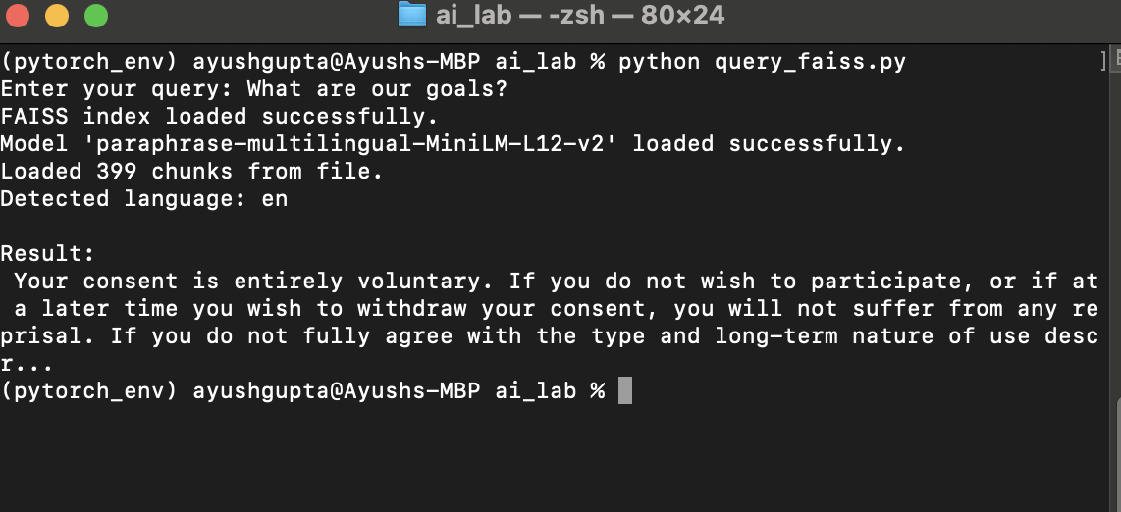
Results & Impact
✅ Faster patient triage
✅ Improved communication
✅ More efficient emergency response

Slide 9
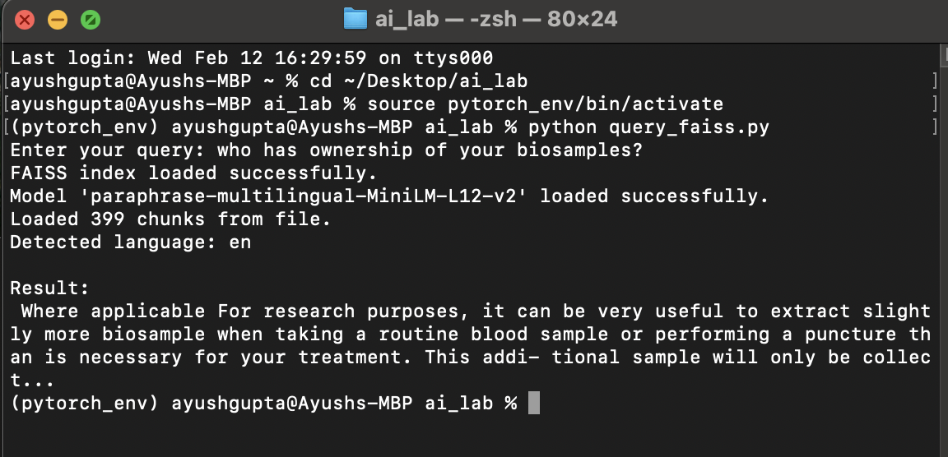

Slide 10
What’s Next?
🔊 AI can listen & speak! (Speech-to-Text & Text-to-Speech)
🦾 Virtual assistant for medical queries
📈 Expanding AI’s knowledge for complex cases
Speech To Text(STT) module: Whisper API
Text To Speech (TTS) module:
Prototyped using PYTTSX.
Better options: Coqui TTS, Bark TTS
Virtual avatar
Train the system to answer a wider range of medical queries

