Slide 1
LLM based patient information retrieval system
Group members,
Project coordinator

Slide 2



How does an patient - ER nurse conversation happens now?
I’m sick
Please fill this form

Slide 3
Drawbacks
Explain the drawbacks

Slide 4

What are we trying to do?
What’s wrong?
I’m sick

Slide 5

Large Language Model
Explain briefly about LLM, give the example of Chatgpt

Slide 6
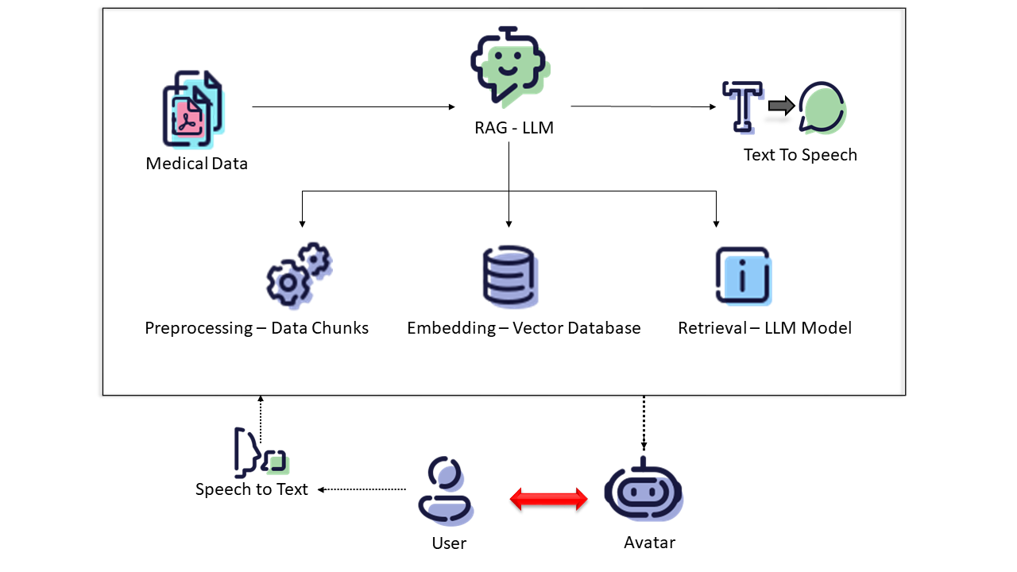
Proposed system

Slide 7
Data we worked on
Patient Consent Form Template by Medical Informatics Initiative
Trained the LLM in both German and English documents

Slide 8
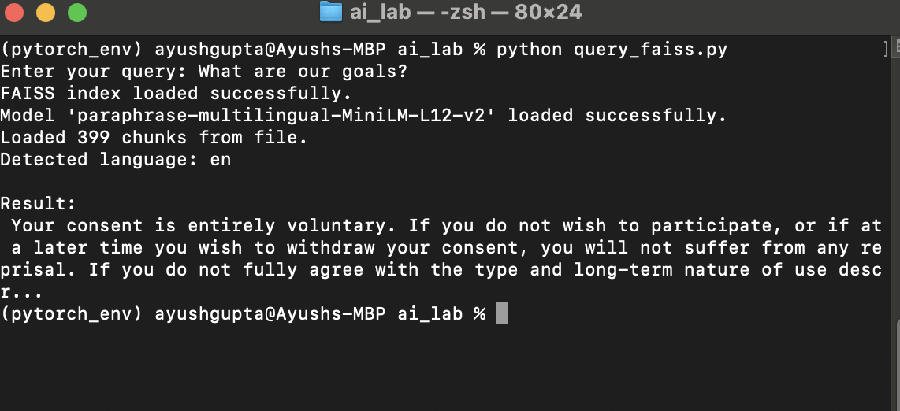
Results

Slide 9
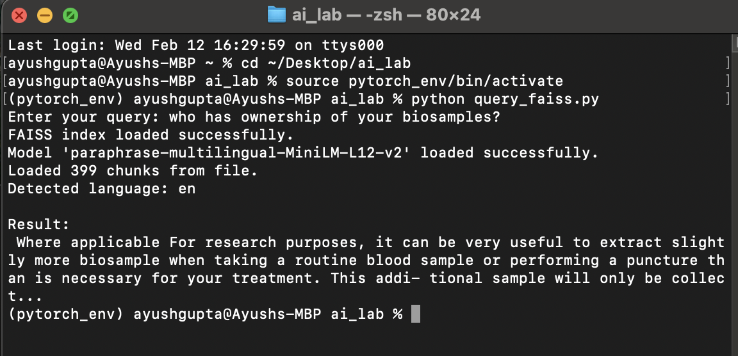

Slide 10
Further developments
Speech To Text(STT) module: Whisper API
Text To Speech (TTS) module:
Prototyped using PYTTSX.
Better options: Coqui TTS, Bark TTS
Virtual avatar
Train the system to answer a wider range of medical queries

