Slide 1
Interview Portfolios
Briana K Keller, PhD
Associate Director
Career Center
kellerb@uw.edu

Slide 2
What is an interview portfolio?
A portable file of examples related to your skills and strengths
Its purpose is to show evidence of your strengths, value, and match to employers
It can be used for job interviews & salary/promotion reviews

Slide 3
Why should I create one?
The process of creating one allows you to reflect on your strengths so you can better communicate them
Using portfolios in job interviews will:
Set you apart from other candidates
Help you show proof of your skills
Help you get jobs!

Slide 4
How do I get started?
Decide on a format (binder, online, etc.)
Start collecting artifacts that demonstrate the skills you might want to discuss in interviews
Photos, charts, reports, certificates, thank you notes, flyers, diagrams, etc.
Store artifacts in file box or electronic files

Slide 5
How do I actually prepare one?
Review job description for key skills
Choose 5-10 skills you want to discuss in the interview
For each skill, choose or create an artifact
For each artifact, create a title and short description
PowerPoint can be an effective platform
Include title page and table of contents
Create targeted portfolio for each interview

Slide 6

Cross-cultural Training
Developed presentation and public-speaking skills through Japanese language and culture presentations to Seattle-area public school students.

Slide 7
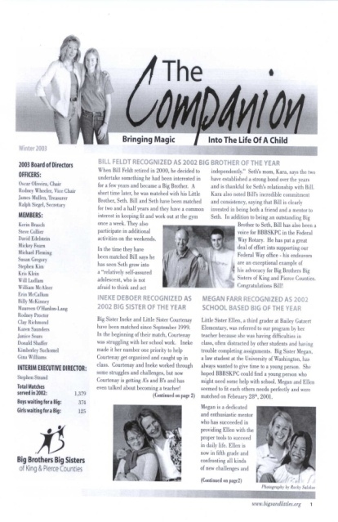
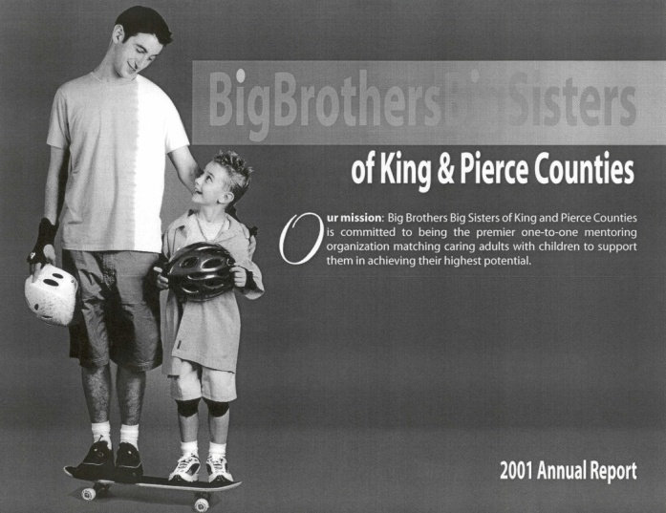
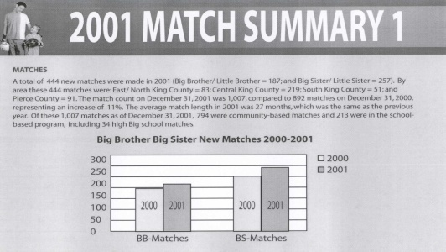
Program Management
Effectively managed program of participants from diverse cultural backgrounds.
Designed and edited newsletter.
Created program recruiting brochure.
Accelerated application process by more than 50% resulting in increased matches.

Slide 8
How do I use one?
At beginning of interview:
Put it on table
Mention what it is
When discussing a skill, turn to the appropriate page and then tell your story describing that skill
Leave portfolio for employer to review; pick up later
(so don’t include only/original copies!)

Slide 9
Creating an online version
Choose an online platform (free & cheap ones are fine)
Draft a homepage message – sort of like a combination of an Objective and a Summary of Qualifications
Create subpages for your different skills
Upload relevant documents/projects/links to each
Create subpages for other things like:
Your contact information
Downloadable resume
References’ contact information
Recommendation/testimonial statements
Sample

Slide 10
Utilizing online versions
Consider adding your portfolio URL to:
LinkedIn profile
Email signature
Business cards
Contact information section of resume
Cover letter
Thank you email after job interview

Slide 11
Using LinkedIn as a portfolio
If your experience is linear, LinkedIn can be a good way to showcase your background
To really function as “proof” of your skills, you need:
Recommendations
Projects
Publications

Slide 12
Where can I learn more?
http://alumni.asu.edu/news/blog/show-em-what-youve-done-why-career-portfolios-work
http://blog.brandyourself.com/career/job-search-career/why-you-need-a-portfolio-in-your-job-career-toolbox/
http://www.ehow.com/how_4746487_online-career-portfolio-free.html
http://careercenter.depaul.edu/resumes/portfolios.aspx
http://www.wikihow.com/Create-a-Career-Portfolio
Participate in a mock interview

