Slide 1


UNIVERSITY INSTITUTE OF COMPUTING
Master of Computer Applications
Project Tittle- Quiz Game in Python
Submitted by:- Submitted to:-
Name- Ayush Mishra Ms. Ritu Sharma
UID-21MCA3033
Class-WC-MCA-7
DISCOVER . LEARN . EMPOWER

Slide 2


Introduction
The Java technology is ;
● a programming language.
● a development environment.
● an application environment.
● a deployment environment.
2

Slide 3
Contents
●It’s the current “hot” language.
●It’s almost entirely object-oriented.
●It has a vast library of predefined objects and operations.
●It’s more platform independent,this makes it
great for Web programming
●It’s more secure
●It’s simple.
3

Slide 4
Goals of JavaTechnology -
of ensuring security by checking loaded code modules.
A language that is easy to program.
An interpreted environment resulting in following benefits:
□speed of development
□code portability
A way for programs to run more than one thread of activity.
A means
4

Slide 5
The java technology architecture uses
the following features to fulfill the listed
goals:
● The JVM
● Garbage collection
● The JRE
● JVM tool kit
5

Slide 6
The Java Virtual Machine
An imaginary machine that is
implemented by emulating it in software
on a real machine.
●Code for JVM is stored in .class files.
●The JVM design enables the creation of
implementations for multiple operating
environments for eg: sun microsystems
provides implementations of JVM for
Solaris,Linux and Ms Windows.
6

Slide 7
Garbage Collection
The user who are participate this game they can enrich their knowledge.
The users thinking level grow high.
To participate this Quiz Game the main advantage is the user patience level will be increased.
7

Slide 8
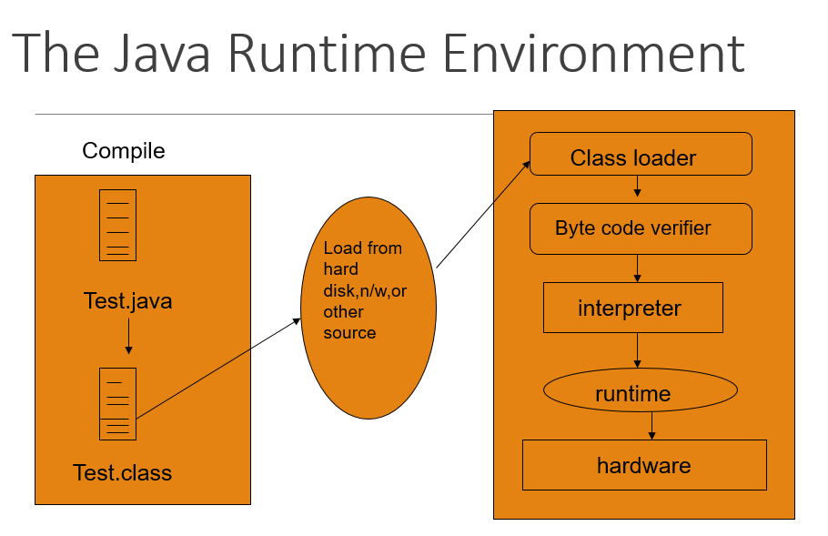
8

Slide 9
PHASES OF SOFTWARE DEVELOPMENT LIFE CYCLE -
Information gathering
Analysis
Design
Implementation
Testing
9

Slide 10
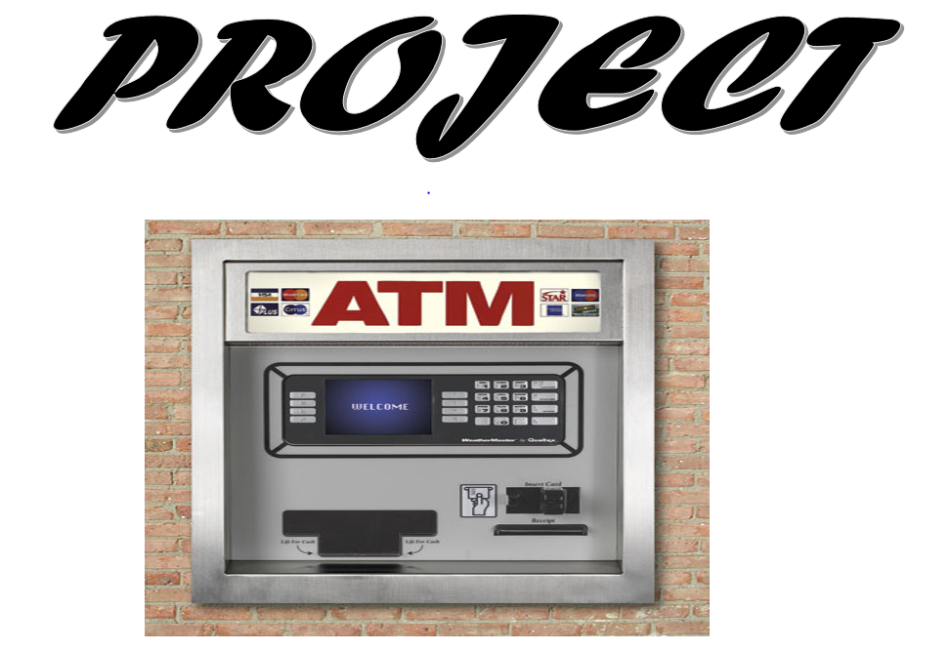
10

Slide 11
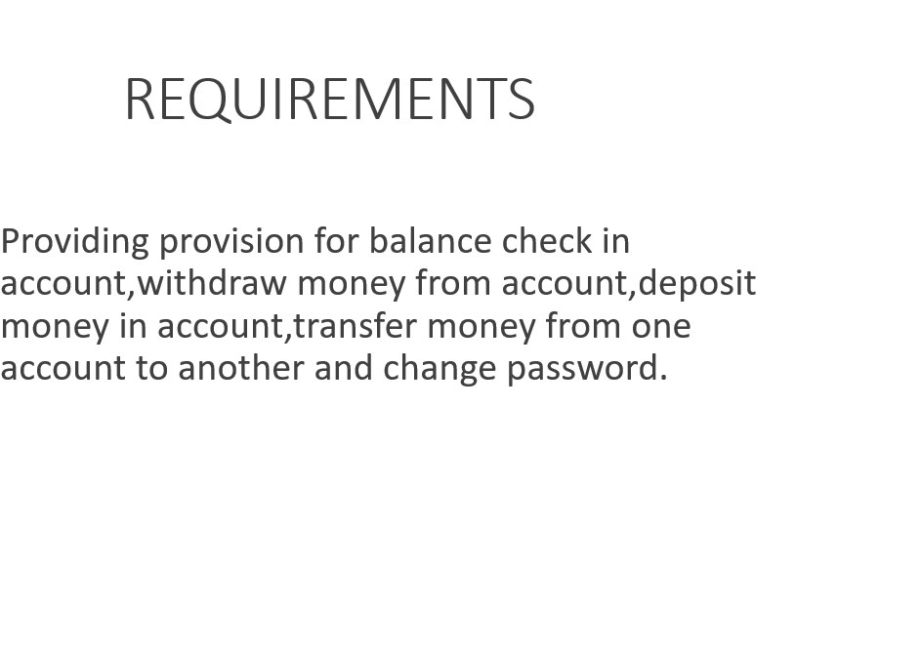
11

Slide 12
DESIGN-
●In order to implement the features as required, a total
of 14 frames are made.
●various panels etc are also designed.
●Some of the frames are shown in the next few slides

Slide 13

13

Slide 14
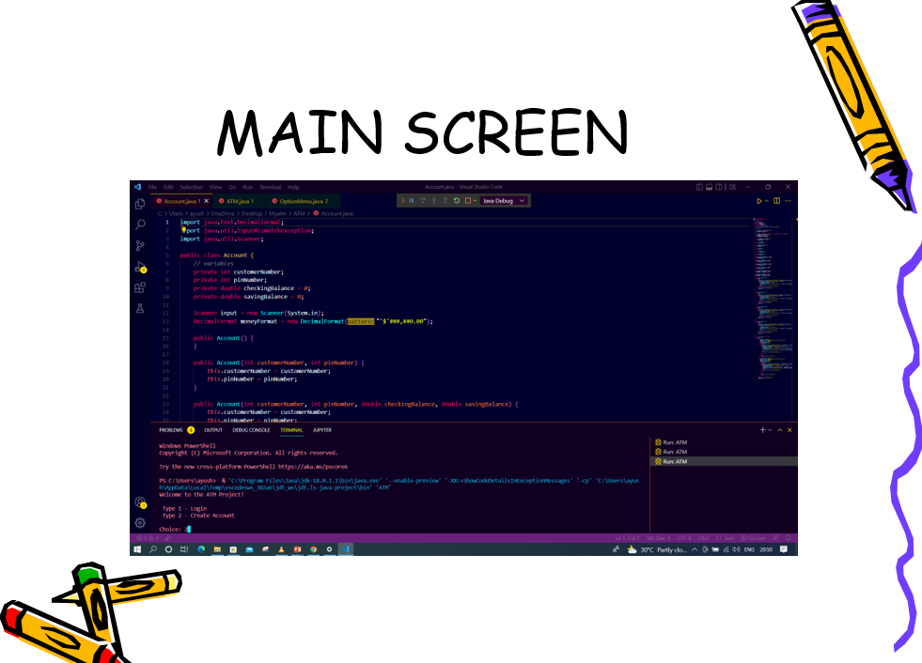
14

Slide 15
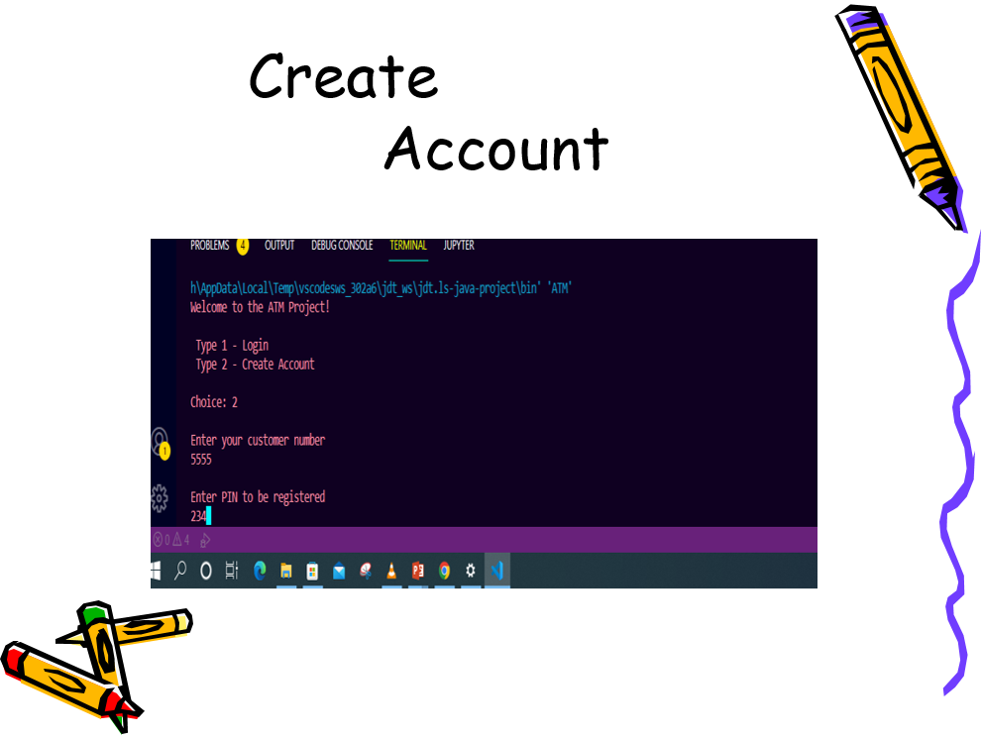
15

Slide 16
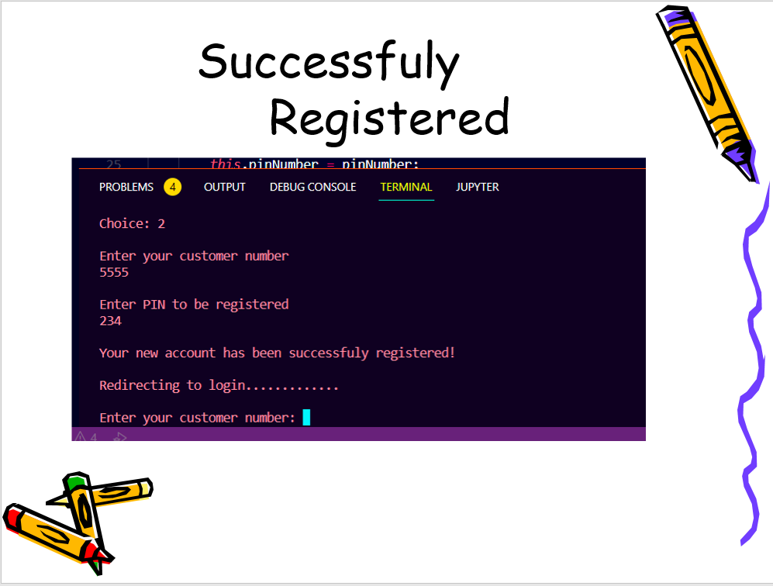
16

Slide 17
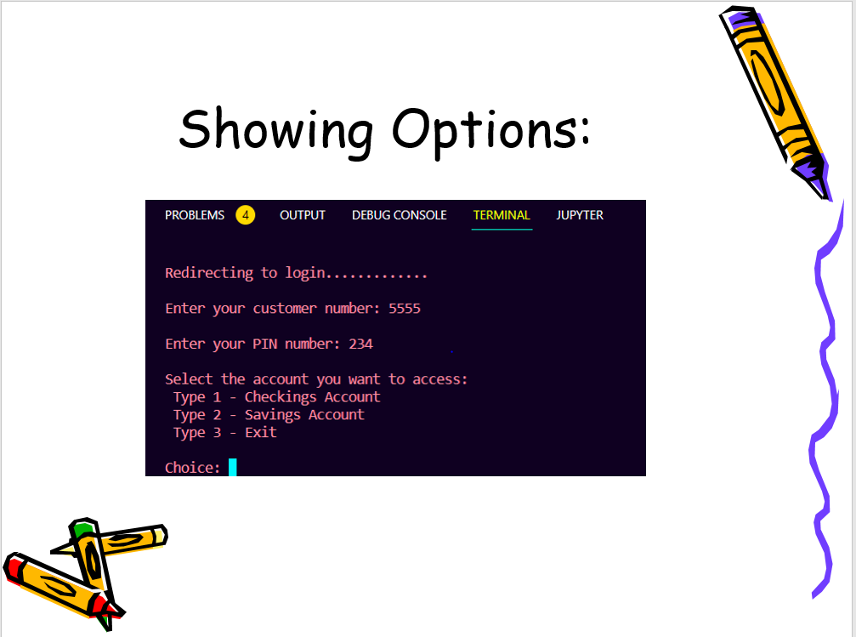


17

Slide 18
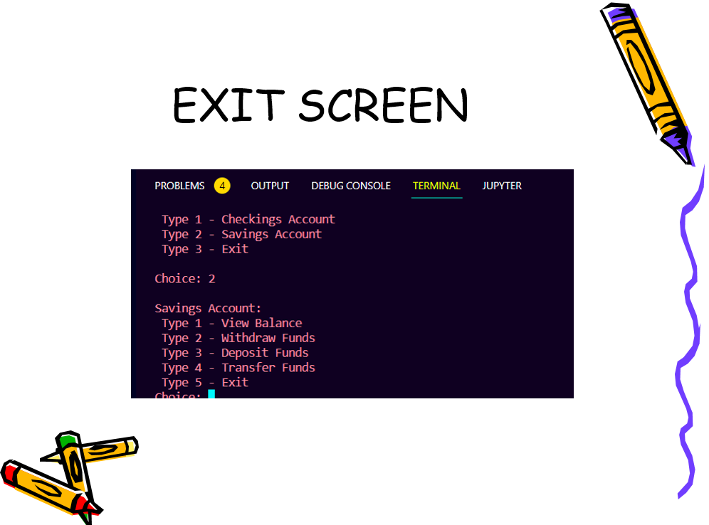
18

Slide 19
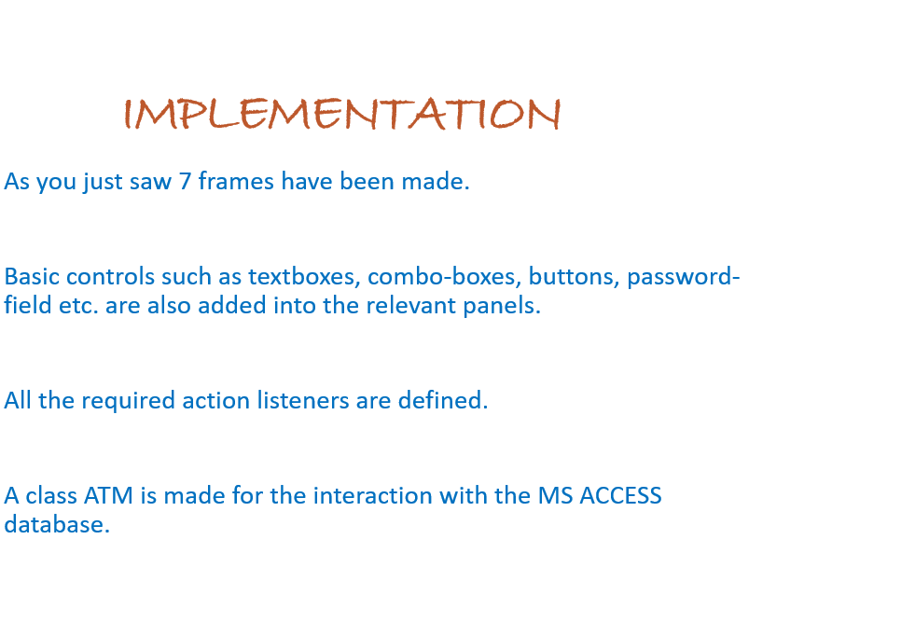
19

Slide 20
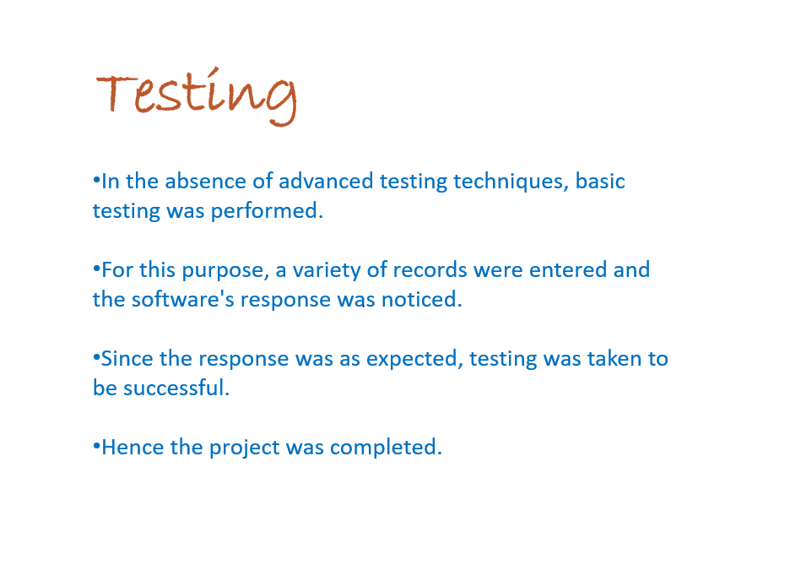
20

Slide 21

21

