Slide 1
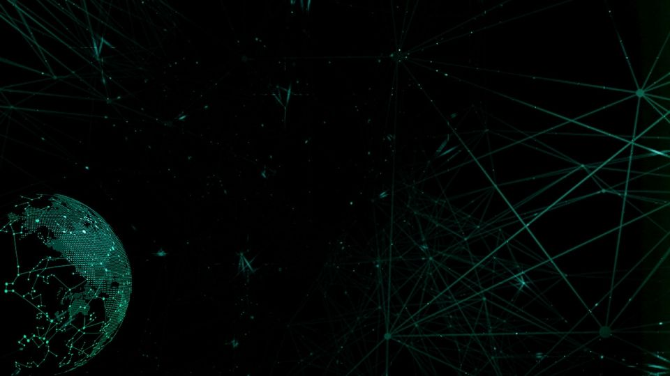

Gesture Control Advancements
Using Hand Landmarks
Group Members:
Srishty Singh
Raj Pratap Singh
Mentor:
Mr. Prashant Agrawal

Slide 2
Introduction
“Have you seen the remote?” “I left it on the table after watching my show”.
“It is not here, I will miss the news again because of you!!!”
In the near future, such heated discussions over remote control won’t disturb the harmony of the house.
Because soon remote controls will be the objects of the past. Technology has finally reached that dimension when our hands will replace them by directly communicating with the computer or television.
Gesture recognition is the ability of a computer to understand gestures and execute commands based on those gestures.

Slide 3
Libraries To Be Used
Open-CV
Google Mediapipe
Tkinter Python Module

Slide 4
Hardware To Be Used
Processor- intel i5 11th generation
Ram- 8 GB.
A Good Quality Webcam.
Minimum 8GB Disk Space.

Slide 5
Applications of Gesture Recognition
Sign language recognition
Media controls
Virtual keyboard
Gaming gestures
Home automation with gesture input
Robotics

Slide 6
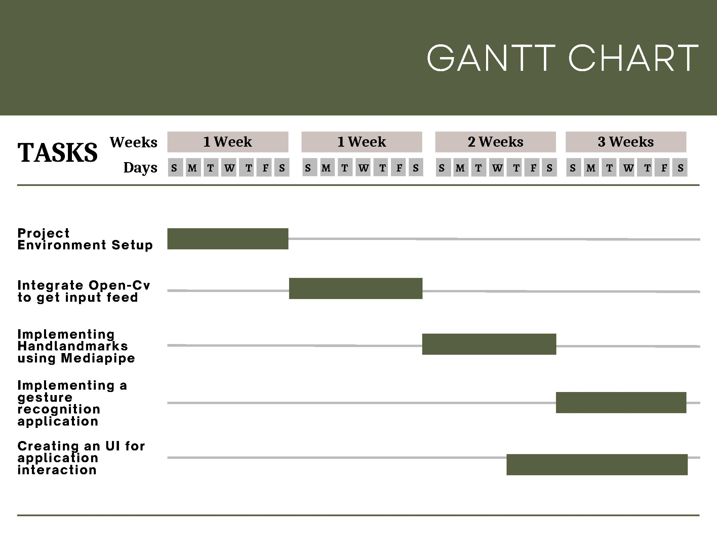

Slide 7
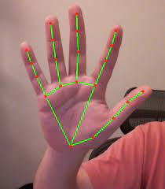
Outcome
The project will introduce an application using computer vision for hand gesture recognition. A camera will take live video stream, and palm detection will be applied. Then hand landmarks will be generated on the input feed. After that the gesture is recognized.

Slide 8
Future Outcome Scope
Research paper describing the implementation method of the project that uses MediaPipe Framework. Along with it’s advantages over predecessing methods.

Slide 9
Thank You!!

