Slide 1
ENSEMBLE METHOD FOR
RECOMMENDATION OF ELECTIVE SUBJECTS

Slide 2
TEAM MEMBERS
ANIKET BHARTI (TEAM LEADER)
SUSHMITA SINGH
MENTOR
PRASHANT AGGRAWAL

Slide 3
INTRODUCTION
This project introduces a recommendation system for university elective courses, which recommends the courses based on their performance and interest on the past curriculum subject. We will store their past results to recommend them new elective subjects.

Slide 4
BENEFITS
Students will able to find right elective subject based on their past performance on other subjects of curriculum.
Will help the student finding elective subject rationally

Slide 5
Hardware requirement / Hardware Used
RAM : 4GB or Higher
System Type : 64-bit operating system, x64-based processor
Operating System : Windows, Linux
Processor : Intel(R) Core(TM) i5-1035G1
Processor Speed : 1.00GHz, 1.19 GHz

Slide 6
Technologies / Software Requirements
Python: Main language of the project
NumPy: Library used for faster matrix manipulation
Pandas: Library used for structure data manipulation
Annoy: Library used for storing embeddings of subject and making recommendations
Jupyter Notebook: Mainly used for making project
Flask: For providing APIs
PostMan: For testing APIs

Slide 7
Control Flow
Student will enter marks of their past subjects along with subject names/ID.
Marks will be pre-processed to required formatting so that compared with stored subject embeddings.
Unique embedding for the student will created and compared with all the other embeddings already stored.
Similarity will be calculated one-by-one for all the embeddings stored in the database.
Subject with higher value will be recommended.

Slide 8
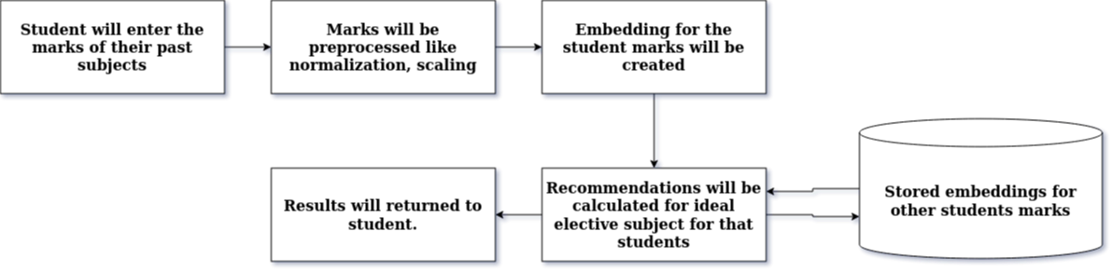

Slide 9
Modules
User Interaction: User Interaction will be provided in this project so the all the uses of the project can get their recommendations interactively. This UI will enable the user for entering their scores of past subjects and get recommendations.
Recommendation Calculation: It will be the place which will work as a backend for the project, where all the marks of the student will sent and embedding for that student will be calculated and will compared with all the other embeddings of the subjects.

Slide 10
Data Preprocessing: Data preprocessing will be done on the marks of the students like data normalization, data scaling so that data can be presented in the required format.

Slide 11
Outcome
The main outcome of this project, which we want to achieve through this project is that any student can get recommendations for their elective subjects in new semester according to their past performance on curriculum subjects like 10th, 12th, Graduation, Post-Graduation. Other parameters like student interest, current trends etc.

Slide 12
Future Outcome
Research Paper: In this paper we will try to explain each and every steps we will perform, all the comparisons done on different different dataset, different different algorithms. It will be a detailed walkthrough of our work in this project for elective subject recommendation system.

Slide 13
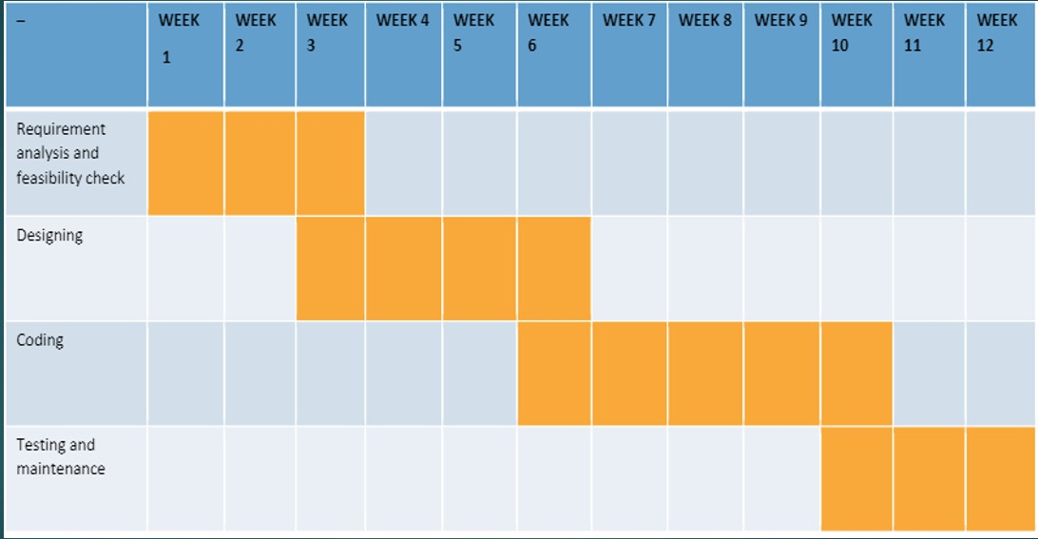
Gantt Chart

Slide 14
Thank You

