Slide 1

INDIAN INSTITUTE OF TECHNOLOGY JODHPUR | B.TECH PROJECT EVALUATION (2026)
Numerical Modelling and Machine Learning Prediction of Single-Particle Crushing Mechanics and Fractal Gradation of Recycled Aggregates
Presented by: Ayush Kumar (Roll No.: B23CI1009)
Supervisor: Dr. Tekcham Gishan Singh, Assistant Professor
Department: Department of Civil and Infrastructure Engineering, IIT Jodhpur
Date: November 2026
Notes:
Good morning/afternoon respected panel members. I am Ayush Kumar, Roll No. B23CI1009, presenting my B.Tech Project supervised by Dr. Tekcham Gishan Singh. My project develops a Physics-Informed Machine Learning framework and Virtual Testing Suite to instantaneously predict single-particle crushing strength, failure force, energy, and post-breakage particle size distribution of recycled construction aggregates.

Slide 2
1. INTRODUCTION
Background & Engineering Motivation
IIT Jodhpur | BTP 2026
The Construction & Demolition (C&D) Waste Crisis
Why Recycled Aggregates Crush Prematurely
▪ Global Aggregate Demand: Over 50 billion tonnes/year of virgin stone & sand mined globally, depleting quarries and riverbeds.
▪ C&D Waste Generation: Exceeds 3.0 billion tonnes/year worldwide; India generates >150 million tonnes/year (CPCB 2024), yet <5% is reused structurally.
▪ Circular Economy Materials: Recycled Concrete (RC), Recycled Mortar (RM), and Recycled Brick (RB) offer sustainable substitutes for highway subgrades & concrete.
▪ Multi-Phase Heterogeneity: Unlike virgin basalt/granite, recycled aggregate retains porous adhered mortar & two weak Interfacial Transition Zones (ITZs).
▪ Flaw & Water Vulnerability: High micro-crack density gives 4–10% water absorption (vs. <1.5% virgin rock) and wide strength scatter.
▪ Compaction Degradation: Under vibratory rollers & traffic loads, grains crush into excess fines (<0.075 mm), causing drainage blockages & rutting.
Core Goal: Screen and predict single-particle crushing mechanics & post-breakage gradation non-destructively in <0.1 seconds before road/concrete placement.
Ayush Kumar (B23CI1009) | Dept. of Civil & Infrastructure Engineering | Supervisor: Dr. Tekcham Gishan Singh
Slide 2 / 14
Notes:
In India, CPCB reports over 150 million tonnes of C&D waste per year, mostly dumped in landfills. Using crushed concrete, mortar, and brick in road subbases saves virgin stone, but engineers avoid them because old adhered mortar makes them crush unpredictably under road rollers. If they crush too much, fine dust clogs road drainage and causes rutting.

Slide 3
2–3. LITERATURE & PROBLEM SCOPE
Problem Definition & Research Objectives
IIT Jodhpur | BTP 2026
Evaluation Aspect | Traditional Lab Testing (UTM + Sieving / IS 2386) | Proposed Physics-Informed ML Suite
Test Nature | 100% Destructive — specimen lost after single crush | Non-Destructive — zero sample destruction
Testing Speed | 16–24 hours per batch (calipers, UTM, mechanical sieving) | < 0.1 seconds per particle (real-time inference)
Occupational Safety | Generates hazardous respirable crystalline silica dust | Completely digital & dust-free screening
Shape Sensitivity | Coarse bulk indices (ACV/LAA) hide 3D shape effects | Captures continuous 3D Sphericity (Φ) & L, I, S axes
Output Completeness | Single aggregate strength or isolated sieve value | Simultaneous Force, Strength, Energy & Fractal Curve
Four Core Project Objectives (Within 4.75–37.5 mm Quasi-Static Scope)
▪ 1. Physics-Coupled Benchmark Dataset: Synthesize N = 3,600 calibrated particles (RC, RM, RB) uniting Hiramatsu-Oka, Bagheri, Cai et al. (2024), and Liang et al. (2025) fracture laws.
▪ 2. Multi-Target ML Benchmarking: Compare 6 regressors (CatBoost, LightGBM, XGBoost, Random Forest, MLP Neural Network, Ridge) across Force, Strength, Energy & Fractal Dimension.
▪ 3. Explainable AI (TreeSHAP) Verification: Quantify physical feature importance on XGBoost models to confirm they obey brittle fracture physics rather than overfitting noise.
▪ 4. Interactive Streamlit Engineering Suite: Deploy a 4-tab tool (Virtual UTM, Scaling Simulator, Auxiliary CV Photo Scanner, AI & Benchmarks) for non-destructive aggregate screening.
Ayush Kumar (B23CI1009) | Dept. of Civil & Infrastructure Engineering | Supervisor: Dr. Tekcham Gishan Singh
Slide 3 / 14
Notes:
Standard laboratory tests like ACV and LAA (IS 2386 / ASTM C131) crush aggregates in bulk, hiding how individual grain size and 3D shape trigger failure. Single-particle UTM testing solves this scientifically, but takes up to 24 hours per batch and creates silica dust. Our four objectives build a fast, explainable virtual twin.

Slide 4
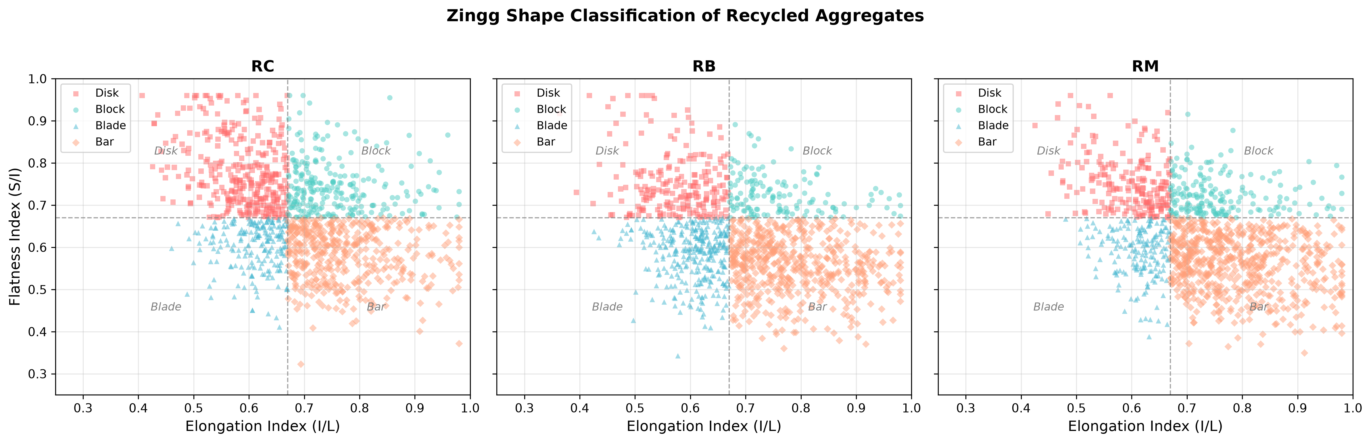
4.1 METHODOLOGY — MECHANICS
Governing Fracture Physics & 3D Morphology
IIT Jodhpur | BTP 2026
Geometry & Tensile Rupture (Bagheri & Hiramatsu-Oka)
Weibull Scaling & Fractal Gradation (Liang / Cai / Turcotte)
▪ Triaxial Dimensions: Longest (L), Intermediate (I), Shortest (S) axes; 3D Sphericity Φ = ∛[(I·S)/L²]
▪ Effective Diameter (Eq. 4.2): d₀ = 0.887 · ∛(L · I · S) [Bagheri et al., 2015]
▪ Peak Force–Strength (Eq. 4.3): Ff = (σf · d₀²) / 0.9 [Hiramatsu & Oka, 1966]
▪ Strength Scaling (Eq. 4.4): σf(d₀, Φ) = [p · Φ^q] × [σf₀(d₀) / σf₀(d_ref)] (Liang Table 2)
▪ Crushing Energy (Eq. 4.5): Ef = c·Φ^d·(d₀/25)³ (Φ<0.8) | Sat. Law (Φ≥0.8) [mJ]
▪ Fractal Gradation (Eq. 4.6): F(d_i) = min[100, (d_i / d₀)^(3 - D) × 100]
Fig. 4.1: Zingg 3D particle shape classification across Disk, Block, Blade, and Bar morphological domains (0.67 cutoffs; N=3,600).
Ayush Kumar (B23CI1009) | Dept. of Civil & Infrastructure Engineering | Supervisor: Dr. Tekcham Gishan Singh
Slide 4 / 14
Notes:
Here are the exact physics laws driving our model. First, we convert L, I, S into Hiramatsu loading diameter d0 and Cai's 3D sphericity Phi. Larger particles are weaker because they contain more internal flaws—captured by Weibull's exponent (-3/m). Flatter or elongated particles fail early due to bending. After fracture, fragment sizes follow Turcotte's fractal dimension D.

Slide 5
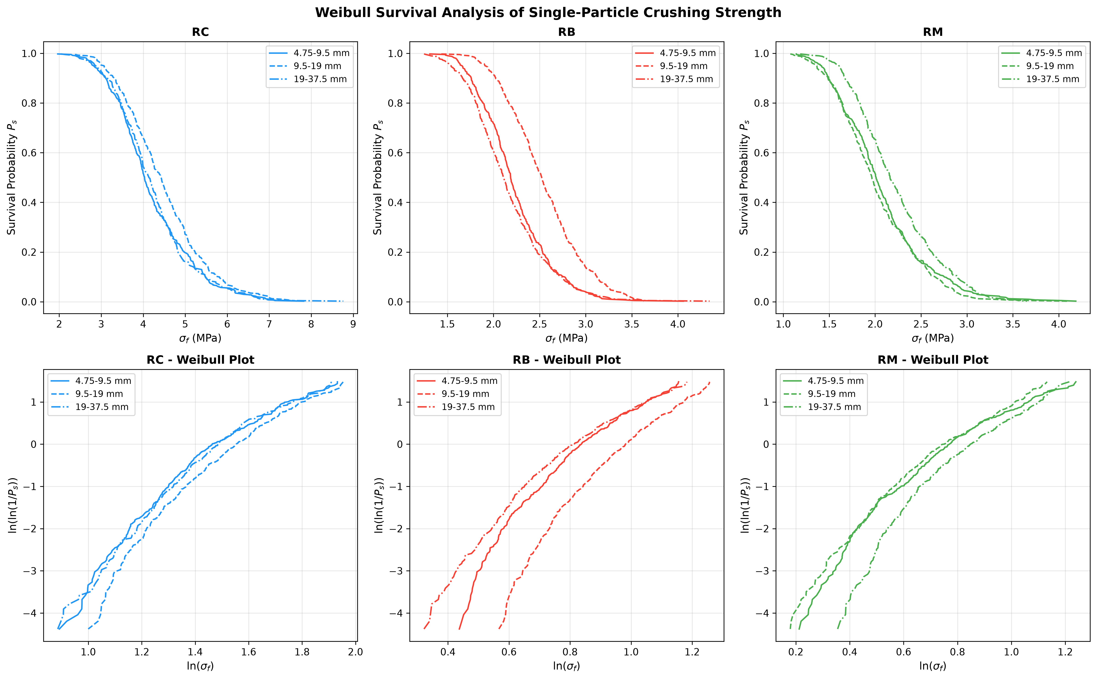
4.1 METHODOLOGY — DATASET
Physics-Coupled Calibration Dataset (N = 3,600)
IIT Jodhpur | BTP 2026
Material Type | σf₀ (MPa) [3 brk] | m [3 brackets] | p , q | c (mJ), d | D_size [3 brk]
Recycled Concrete (RC) | 6.51 / 6.28 / 6.07 | 1.58 / 1.30 / 1.25 | 9.35, 2.13 | 2061, 1.28 | 1.66–1.87
Recycled Mortar (RM) | 3.03 / 2.97 / 2.91 | 2.70 / 2.73 / 2.76 | 4.69, 2.21 | 2041, 2.66 | 1.77–2.11
Recycled Brick (RB) | 6.35 / 6.21 / 4.92 | 2.58 / 2.61 / 3.32 | 3.84, 1.68 | 1511, 2.16 | 1.68–2.01
Benchmark Dataset Architecture (Table 4.1)
▪ Total Samples: N = 3,600 synthetic particles calibrated strictly to Liang et al. (2025) & Cai et al. (2024) tables.
▪ Three Sieve Brackets: 400 particles per bracket × 3 materials across 4.75–9.5 mm, 9.5–19.0 mm, and 19.0–37.5 mm.
▪ Material Ranking: RC has highest shape strength (p = 9.35 MPa, dataset mean 4.30 MPa); porous RB (mean 2.31 MPa) & RM (2.11 MPa) are weaker.
▪ Experimental Noise: Realistic ~7% measurement noise injected across targets matching laboratory UTM dispersion.
Fig. 4.2: Weibull survival distributions and log-linear plots across 3 materials and sieve brackets.
Ayush Kumar (B23CI1009) | Dept. of Civil & Infrastructure Engineering | Supervisor: Dr. Tekcham Gishan Singh
Slide 5 / 14
Notes:
Using published parameters from Liang et al. 2025 and Cai et al. 2024 (Table 4.1), we synthesized 3,600 particles across Concrete, Brick, and Mortar. In Fig 4.2, porous Brick shows strong coarse weakening (19-37.5 mm shifts left because sigma_f0 drops from 6.35 to 4.92 MPa), whereas in Concrete and Mortar the larger particles from Cai Table 1 are slightly more spherical, offsetting the gentle size drop.

Slide 6
4.2 METHODOLOGY — ML PIPELINE
Machine Learning Architecture & Training Pipeline
IIT Jodhpur | BTP 2026
1. 16-D Feature Vector
2. Stratified Partitioning
3. Six Trained Regressors
4. Four Target Outputs
13 Continuous Inputs:
L, I, S, EI, FI, Φ, Sf, d_eq, d₀,
App./Bulk Density, E, ν
+ 3 Label Encoded Classes
80% Training (N = 2,880)
20% Hold-out Test (N = 720)
StandardScaler Z-Score +
Breakage-Mode Stratification
CatBoost, LightGBM,
XGBoost, Random Forest,
MLP Neural Network,
& Ridge Polynomial (deg=2)
Crushing Strength σf (MPa)
Peak Force Ff (kN)
Crushing Energy Ef (mJ)
Fractal Dimension D
Model Architecture | Key Hyperparameters | Loss Function | Regularization | Optimization
CatBoost Regressor | depth=8, iterations=300, lr=0.05 | RMSE | l2_leaf_reg=3.0 | Ordered Boosting
LightGBM Regressor | max_depth=8, n_est=300, lr=0.05 | Squared Error | reg_alpha=0.1, λ=1.0 | Histogram GBDT
XGBoost Regressor | max_depth=8, n_est=300, lr=0.05 | Squared Error | colsample=0.8, sub=0.8 | Hist / Greedy Tree
Random Forest | n_estimators=200, max_depth=15 | Squared Error | min_split=5, min_leaf=2 | Bagging Ensemble
MLP Neural Network | hidden=(128,64,32), ReLU | MSE (Early Stop) | alpha=0.001, batch=64 | Adam (lr=1e-3)
Ridge Polynomial | degree=2, include_bias=False | Squared Loss | alpha=1.0 (L2 Penalty) | Closed-Form Ridge
Ayush Kumar (B23CI1009) | Dept. of Civil & Infrastructure Engineering | Supervisor: Dr. Tekcham Gishan Singh
Slide 6 / 14
Notes:
Our ML pipeline converts 16 particle features into 4 simultaneous mechanical predictions. We split the 3,600 particles 80/20 stratified by breakage mode so there is zero data leakage, applied StandardScaler fitted only on the training fold, and benchmarked 6 regressors with fixed hyperparameters. CatBoost uses depth-8 symmetric trees with ordered boosting to prevent overfitting.

Slide 7
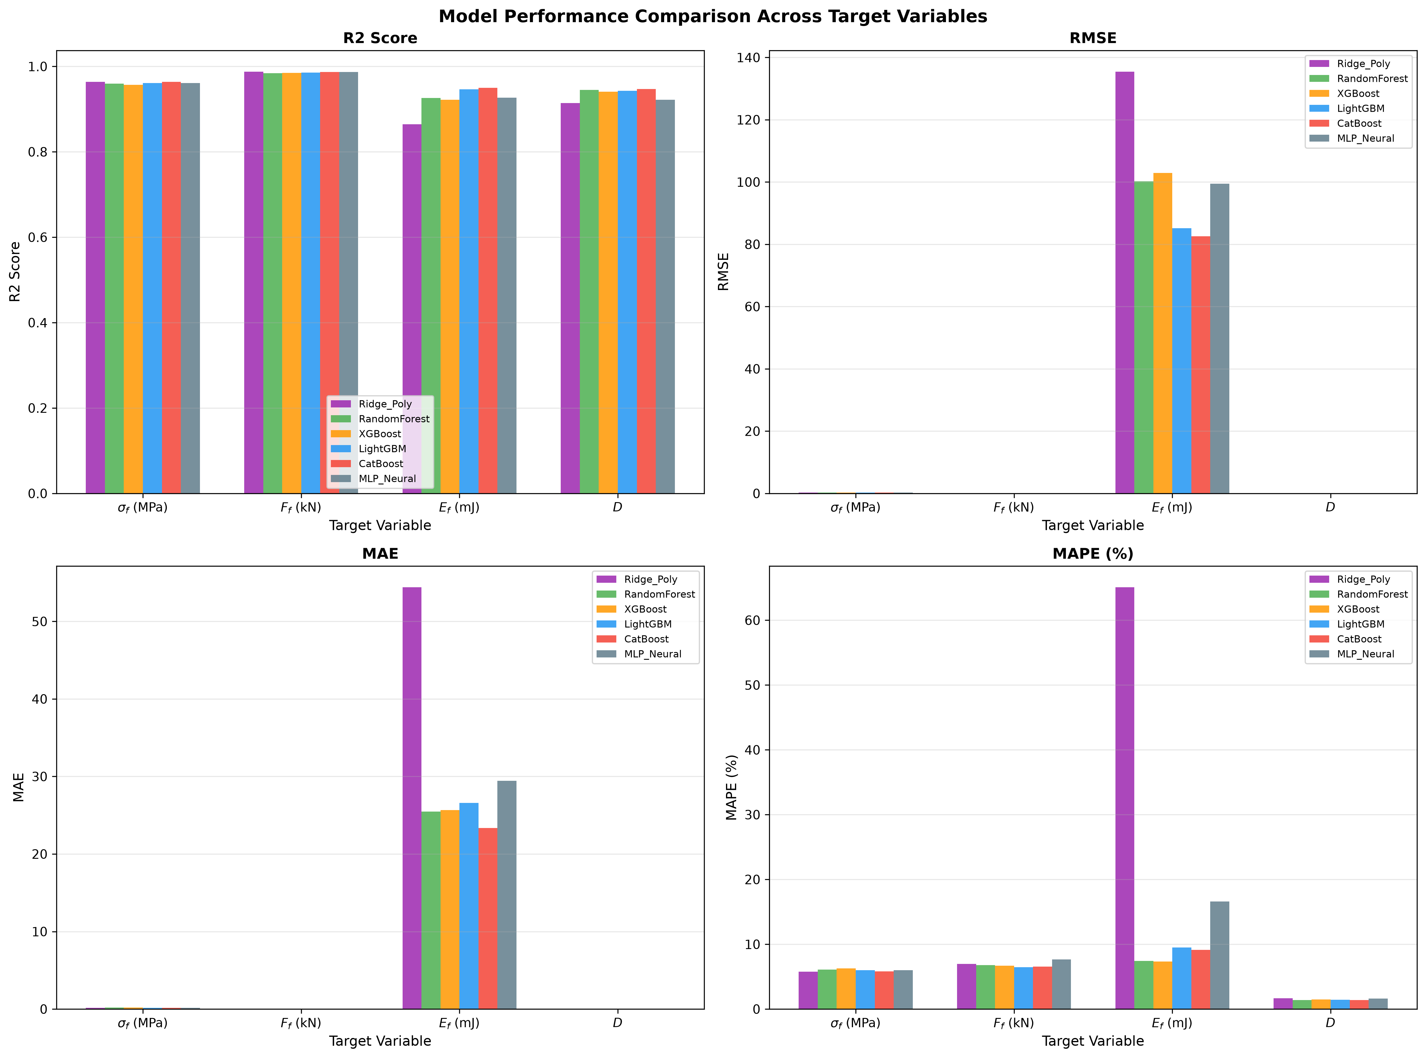
5.1 NUMERICAL FINDINGS
Model Performance Benchmarks on Hold-Out Test Set
IIT Jodhpur | BTP 2026
Model Architecture | Target Variable | R² Score | RMSE | MAE | MAPE (%)
CatBoost Regressor | Peak Force Ff (kN) | 0.9871 | 0.081 kN | 0.050 kN | 6.56%
CatBoost Regressor | Crushing Strength (MPa) | 0.9636 | 0.235 MPa | 0.172 MPa | 5.81%
CatBoost Regressor | Crushing Energy Ef (mJ) | 0.9498 | 82.53 mJ | 23.36 mJ | 9.13%
CatBoost Regressor | Fractal Dimension D | 0.9469 | 0.032 | 0.025 | 1.37%
LightGBM Regressor | Peak Force Ff (kN) | 0.9852 | 0.087 kN | 0.052 kN | 6.48%
XGBoost Regressor | Peak Force Ff (kN) | 0.9847 | 0.089 kN | 0.054 kN | 6.67%
Random Forest | Peak Force Ff (kN) | 0.9840 | 0.091 kN | 0.054 kN | 6.80%
MLP Neural Network | Peak Force Ff (kN) | 0.9866 | 0.083 kN | 0.052 kN | 7.66%
Ridge Polynomial | Energy Ef (Piecewise Fail) | 0.8647 | 135.44 mJ | 54.40 mJ | 65.08%
▪ Why CatBoost Leads Overall: CatBoost achieves top mean R² = 0.9619 (0.9871 Force, 0.9636 Strength). Ridge collapses on piecewise energy Ef (MAPE 65.1%), proving GBDT necessity.
Fig. 5.0: Comparative R², RMSE, MAE, and MAPE across the 6 regression architectures.
Ayush Kumar (B23CI1009) | Dept. of Civil & Infrastructure Engineering | Supervisor: Dr. Tekcham Gishan Singh
Slide 7 / 14
Notes:
On the unseen hold-out test set of 720 particles, CatBoost achieved the best overall average R-squared of 0.9619: 0.9871 for peak force, 0.9636 for crushing strength, 0.9498 for energy, and 0.9469 for fractal dimension. Notice Ridge fails badly on crushing energy (65% MAPE) because energy switches piecewise at sphericity 0.80.

Slide 8
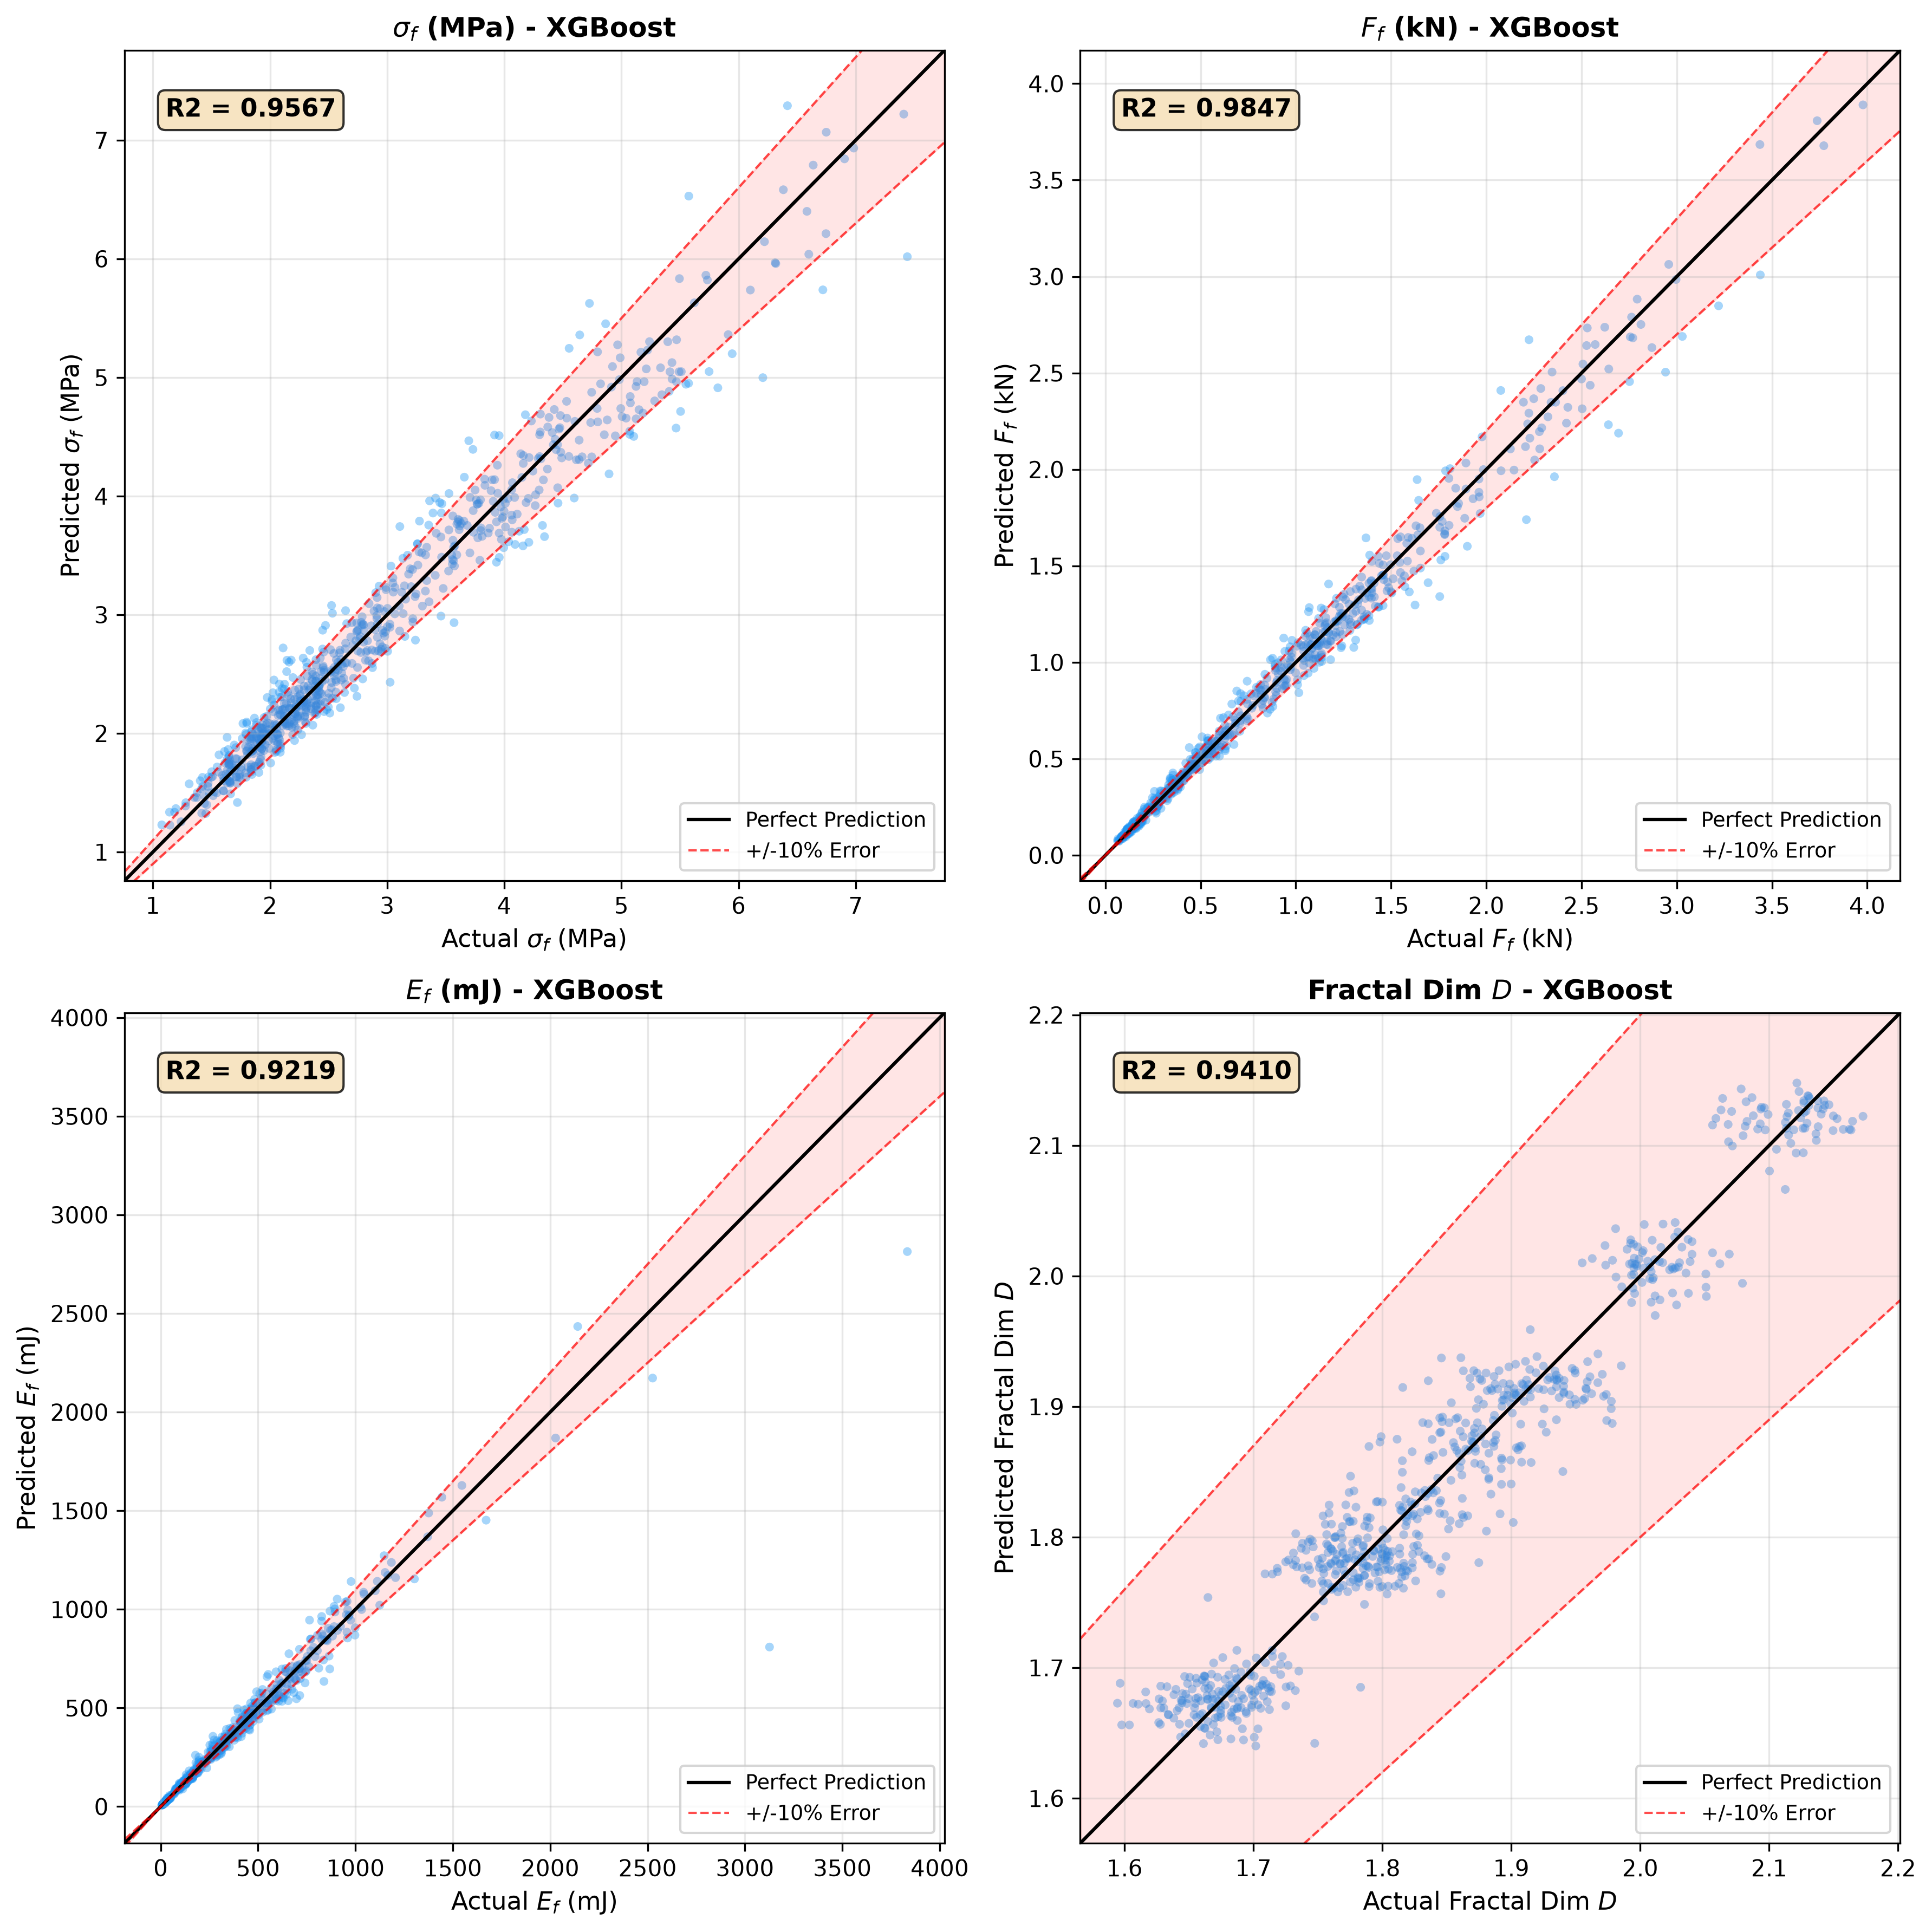
5.2 & 5.4 NUMERICAL FINDINGS
Actual vs. Predicted Parity & Residual Error Analysis
IIT Jodhpur | BTP 2026
Parity Diagnostics (Fig. 5.1 — XGBoost R² = 0.922–0.985)
▪ Tight ±10% Parity: Most test points stay within the ±10% error band across all 3 materials (R² = 0.957 σf, 0.985 Ff, 0.922 Ef, 0.941 D).
▪ Clustered Fractal Tiers: Fractal D plot reflects the 3 calibrated Liang et al. (2025) sieve brackets around 1.66–2.12.
CatBoost Residual Stability across Sieve Brackets (Table 5.2)
Size Bracket | σf Mean / Std | Ff Mean / Std | Variance Check
Fine (4.75–9.5 mm) | -0.013 / 0.230 | -0.001 / 0.018 | σf Homoscedastic
Medium (9.5–19 mm) | +0.002 / 0.245 | +0.001 / 0.067 | σf Levene p = 0.924
Coarse (19–37.5 mm) | +0.043 / 0.228 | +0.020 / 0.120 | Unbiased Mean ~0
Note: Crushing strength σf is strictly homoscedastic (p = 0.924); Ff std scales with d₀² while relative MAPE stays ~6.6%.
Fig. 5.1: XGBoost test-set parity plots across σf, Ff, Ef, and D (±10% band).
Ayush Kumar (B23CI1009) | Dept. of Civil & Infrastructure Engineering | Supervisor: Dr. Tekcham Gishan Singh
Slide 8 / 14
Notes:
On the left, Fig 5.1 shows XGBoost actual vs predicted parity plots within plus-or-minus 10% bands. On the right, Table 5.2 checks CatBoost residuals across Fine, Medium, and Coarse fractions: crushing strength error variance is completely constant at 0.23 MPa (Levene p=0.924), while Peak Force std naturally scales with d0 squared.

Slide 9
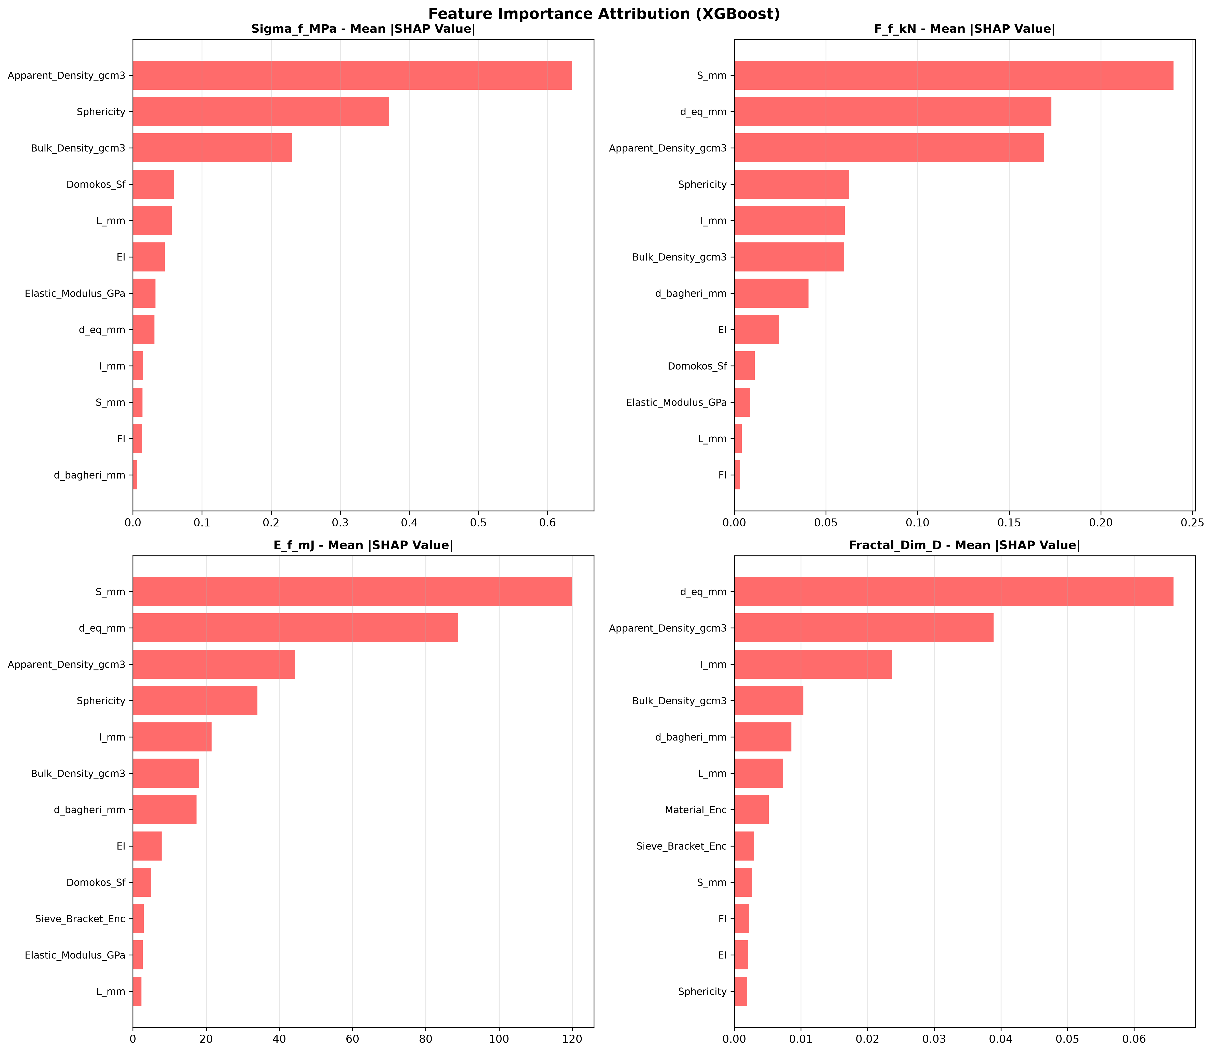
5.3 NUMERICAL FINDINGS — SHAP
Explainable AI: Physical Attribution via TreeSHAP
IIT Jodhpur | BTP 2026
Deciphering the Physics Inside XGBoost (TreeSHAP)
▪ 1. Strength σf — Density & Sphericity Φ: Apparent density (#1) separates strong RC (2.22 g/cm³) from RB/RM, while 3D Sphericity Φ (#2) captures platen stress distribution.
▪ 2. Force Ff & Energy Ef — Size Axes (S, d_eq): Shortest axis S (#1) and d_eq (#2) dominate Ff and Ef directly matching Ff ∝ d₀² area scaling and (d₀/25)³ volume scaling.
▪ 3. Fractal Dimension D — Size & Material: d_eq (#1) and Apparent Density (#2) drive post-breakage D because larger fragments generate more secondary debris.
▪ 4. No Unphysical Shortcut Learning: TreeSHAP confirms the ML splits strictly follow Hiramatsu-Oka, Cai, and Liang fracture mechanics.
Fig. 5.2: XGBoost TreeSHAP Mean |SHAP| feature importance across all 4 targets.
Ayush Kumar (B23CI1009) | Dept. of Civil & Infrastructure Engineering | Supervisor: Dr. Tekcham Gishan Singh
Slide 9 / 14
Notes:
Professors often ask how we know ML isn't a black box. We ran TreeSHAP on our XGBoost models (Fig 5.2). For Crushing Strength sigma_f, Apparent Density and Sphericity rank #1 and #2. For Peak Force and Energy, shortest axis S and nominal diameter d_eq rank #1 and #2 because area and volume drive total force and energy.

Slide 10
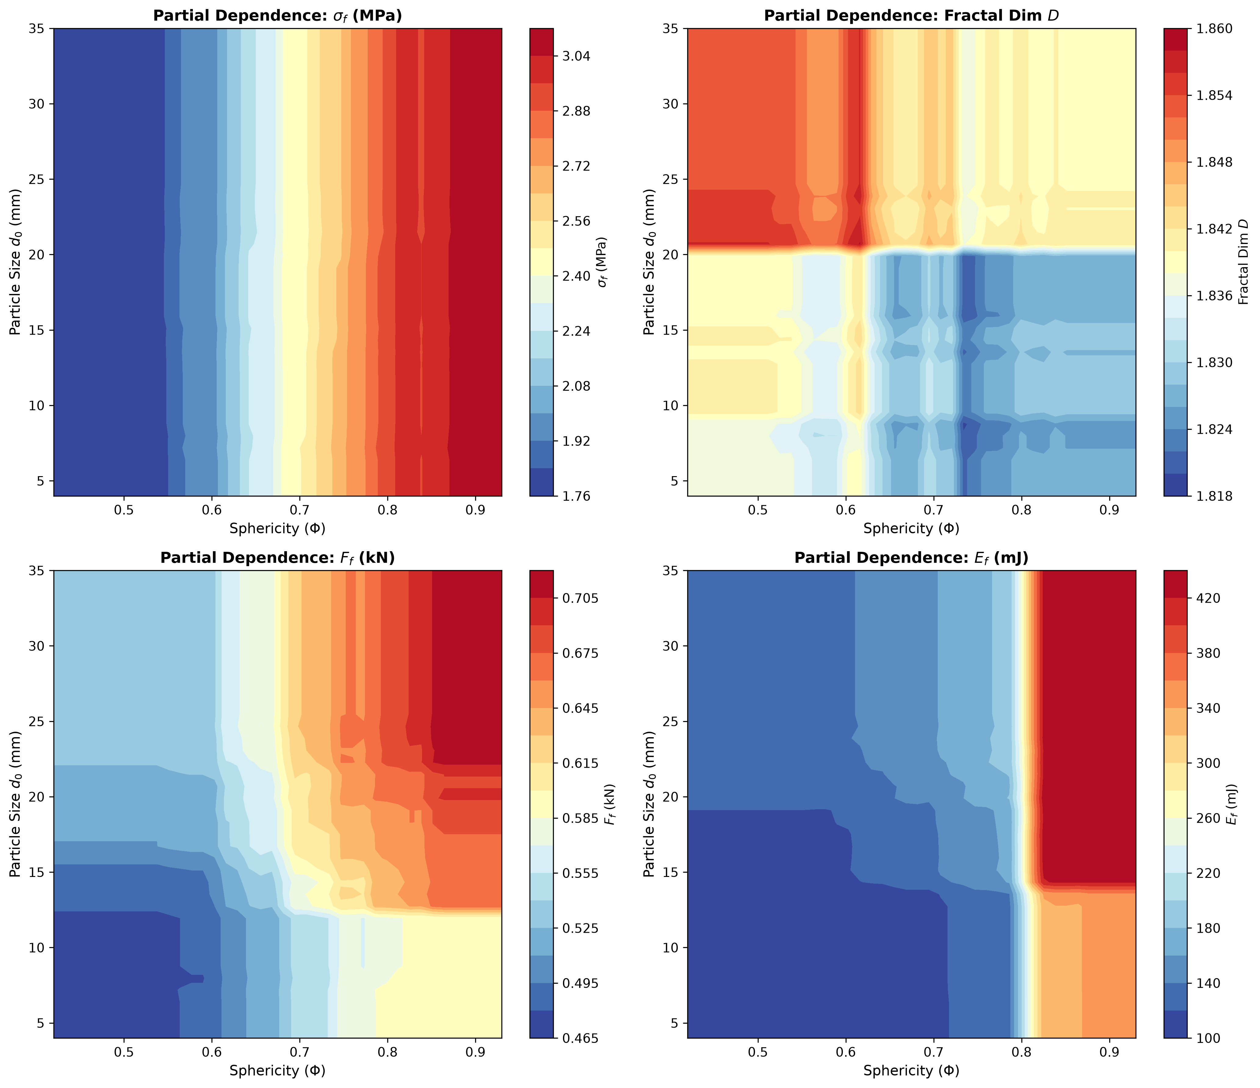
5.5–5.6 NUMERICAL FINDINGS
2D Partial Dependence & Coupled Scaling Surfaces
IIT Jodhpur | BTP 2026
Engineering Design Insights from Contours
▪ Coupled (Φ, d₀) Contours: Strength σf rises steadily with Sphericity Φ (left to right), while Peak Force Ff peaks at upper-right where both size d₀ and Φ are high.
▪ Piecewise Transition at Φ = 0.80: Crushing energy Ef plot exposes the sharp Cai et al. (2024 Eq. 11) jump at Φ = 0.80 learned directly by the ML trees.
▪ Step Boundary at d₀ = 20 mm: Fractal D heatmap reveals the discrete sieve-bracket step at 20 mm in raw training bins—motivating smooth Tab 2 interpolation.
▪ Quality Control Guideline: Avoiding flaky particles (Φ < 0.55) prevents low strength and premature brittle failure.
Fig. 5.3: 2D Partial Dependence contour heatmaps over diameter d₀ and sphericity Φ.
Ayush Kumar (B23CI1009) | Dept. of Civil & Infrastructure Engineering | Supervisor: Dr. Tekcham Gishan Singh
Slide 10 / 14
Notes:
Figure 5.3 maps the combined 2D partial dependence across size d0 (x-axis) and sphericity Phi (y-axis). Notice the critical boundary below sphericity 0.55 where strength and crushing energy plummet. Civil engineers can use these contour zones directly as quality-control acceptance thresholds.

Slide 11
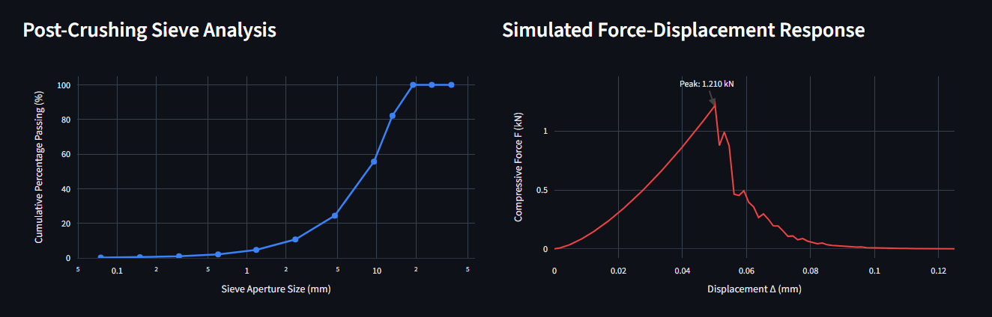
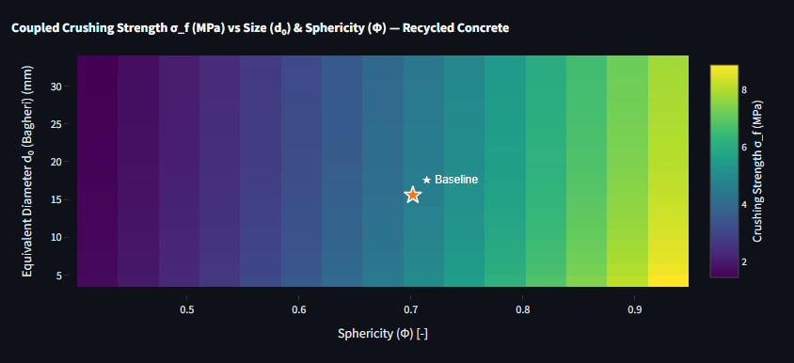
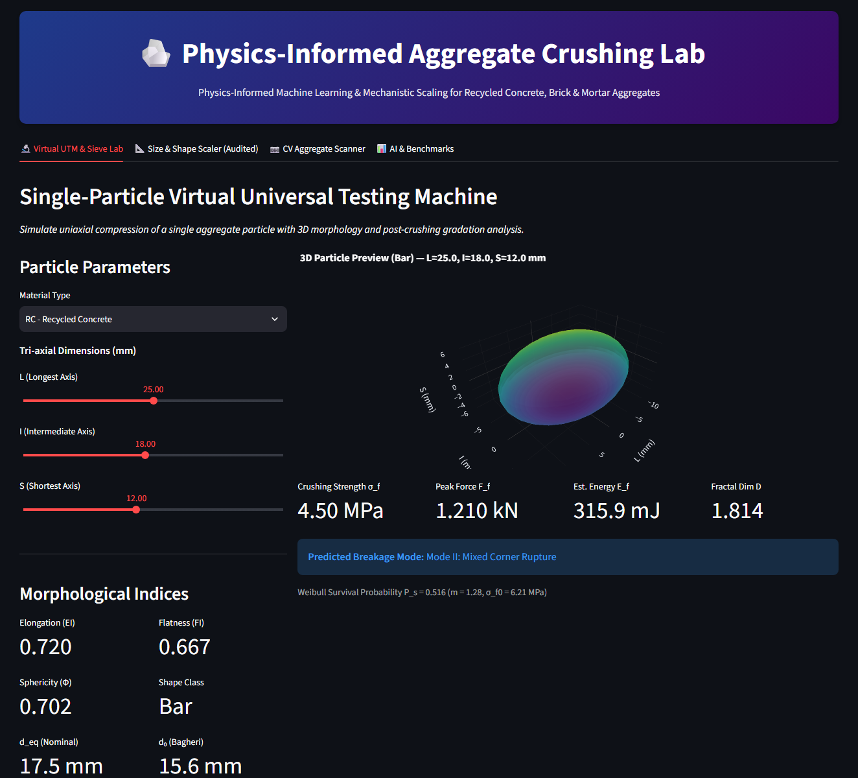
6.1–6.4 SOFTWARE PLATFORM
Interactive Virtual Testing Suite (Streamlit Software Demo)
IIT Jodhpur | BTP 2026
Tab 1: Virtual UTM & Sieve Gradation Curve
Tab 2: Multi-Scale Scaling Contour Simulator
Fig. 6.1: Live single-particle virtual compression & ASTM/IS post-breakage PSD.
Fig. 6.2: Interactive 2D size-scaling response surfaces.
Parametric Console & 3D Preview (Tab 1)
Four Integrated Engineering Modules
▪ Tab 1 — Virtual UTM: Instant σf, Ff, Ef, D, Weibull P_s survival metric, breakage mode, and sieve curve.
▪ Tab 2 — Scaling Simulator: Continuous vs. discrete size-scaling contours benchmarked against lab checkpoints.
▪ Tab 3 — Auxiliary CV Scanner: Optional OpenCV photo sizer estimating 2D L & I (assumes S = 0.65·I) as a convenience helper.
▪ Tab 4 — AI & Benchmarks: Interactive R² bar chart + test metrics tables + all 9 publication plots (SHAP, PDP, Parity).
Material selector, triaxial sliders (25 × 18 × 12 mm RC), and live 3D ellipsoid.
Ayush Kumar (B23CI1009) | Dept. of Civil & Infrastructure Engineering | Supervisor: Dr. Tekcham Gishan Singh
Slide 11 / 14
Notes:
We packaged the project into a 4-tab Streamlit dashboard. Tab 1 acts as a Virtual UTM showing a 3D grain, 4 metrics, breakage mode, and gradation curves. Tab 2 overlays model scaling against lab data from Liang and Cai. Tab 3 is an optional OpenCV photo helper assuming S equals 0.65 times I. Tab 4 displays all regression/classification metrics and publication SHAP/PDP figures.

Slide 12
6.5–6.6 DESIGN APPLICATION
Baseline RC Case Study & Pavement Gradation Screening
IIT Jodhpur | BTP 2026
Output Parameter | Value | Unit | Physical Interpretation
Input Particle Size | 25 / 18 / 12 | mm | Recycled Concrete (L / I / S axes)
Equivalent Diameter d_eq | 17.54 | mm | Equal-volume nominal diameter
Bagheri Diameter d₀ | 15.56 | mm | Roughness-corrected diameter
FI (S/I) | EI (I/L) | 0.667 | 0.720 | — | Zingg Bar/Block boundary (0.67 cutoff)
3D Sphericity (Φ) | 0.702 | — | High sphericity (> 0.65 favorable zone)
Crushing Strength (σf) | 4.50 | MPa | Hiramatsu-Oka tensile splitting strength
Peak Failure Force (Ff) | 1.210 | kN | Catastrophic rupture load
Est. Crushing Energy (Ef) | 315.9 | mJ | Cai piecewise volumetric energy (0.316 J)
Fractal Dimension (D) | 1.814 | — | Single-particle exponent (Mode II rupture)
Gradation & Pavement Screening (Li 2021 & IRC:37-2018)
▪ GSB / WMM Screening: IRC:37-2018 & IS 383:2016 require roadbase aggregates to resist crushing into fine dust under roller compaction.
▪ Over-Pulverization Risk (D > 2.63): Above Li et al. (2021) upper limit D = 2.631, crushing produces excess <0.075 mm fines, hurting permeability & causing rutting.
▪ Baseline RC Verdict (D = 1.814): Single-particle D = 1.814 (composite RC = 2.12, inside Li 1.887–2.631) indicates coarse splitting with minimal fine silt generation.
▪ Failure & Survival Check: Mode II Mixed Corner Rupture with Weibull survival probability P_s = 0.516 (m = 1.28, σ_f0 = 6.21 MPa).
Ayush Kumar (B23CI1009) | Dept. of Civil & Infrastructure Engineering | Supervisor: Dr. Tekcham Gishan Singh
Slide 12 / 14
Notes:
This table matches the exact default Tab 1 live screen for our baseline 25 by 18 by 12 mm Recycled Concrete particle: 4.50 MPa strength, 1.210 kN peak force, 315.9 mJ energy, and single-particle fractal dimension 1.814 (Mode II corner rupture). Low D confirms coarse splitting without excess <0.075 mm silt dust that blocks pavement drainage.

Slide 13
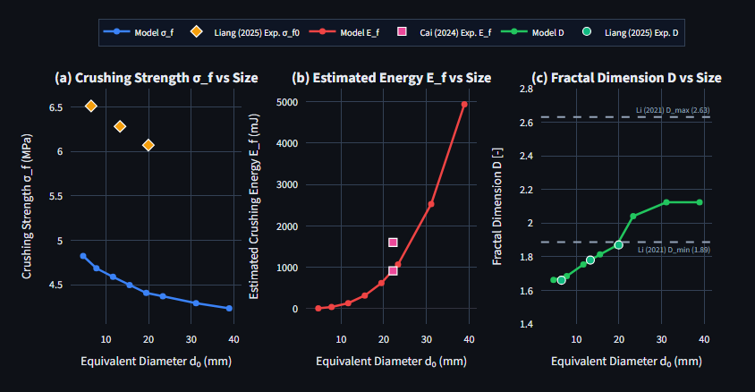
6.7 EXPERIMENTAL VERIFICATION
Validation Against Published Experimental Benchmarks
IIT Jodhpur | BTP 2026
Material Type | Published Experimental Source | MAE (MPa) | RMSE (MPa) | MAPE (%) | Agreement
Recycled Concrete (RC) | Liang et al. (2025) & Cai et al. (2024) | 0.043 | 0.060 | 1.15% | Outstanding
Recycled Mortar (RM) | Liang et al. (2025) & Cai et al. (2024) | 0.030 | 0.047 | 2.02% | Outstanding
Recycled Brick (RB) | Liang et al. (2025) & Cai et al. (2024) | 0.148 | 0.180 | 5.07% | High Fidelity
Fig. 6.3: Tab 2 size-scaling curves vs. experimental markers (Liang et al., 2025; Cai et al., 2024; Li et al., 2021).
Ayush Kumar (B23CI1009) | Dept. of Civil & Infrastructure Engineering | Supervisor: Dr. Tekcham Gishan Singh
Slide 13 / 14
Notes:
To validate against published laboratory data, Table 6.2 reports exact error metrics computed in Tab 2 against Liang et al. (2025) and Cai et al. (2024): MAE is 0.043 MPa (1.15% MAPE) for RC, 0.030 MPa (2.02% MAPE) for RM, and 0.148 MPa (5.07% MAPE) for RB.

Slide 14
7. CONCLUSION
Summary of Contributions & Future Work
IIT Jodhpur | BTP 2026
Key Project Contributions
Known Limitations & Future Work
▪ Unified PIML Dataset: Coupled Weibull size scaling, Hiramatsu-Oka tensile laws, Cai 3D sphericity, and Turcotte fractal gradation into N = 3,600 benchmark particles.
▪ High-Accuracy CatBoost Surrogate: Achieved best average R² = 0.9619 (0.9871 Force, 0.9636 Strength, 0.9498 Energy, 0.9469 D) & homoscedastic σf residuals.
▪ Transparent Explainable AI: Verified physics via XGBoost TreeSHAP (Density & Φ govern strength σf; S & d_eq govern Force & Energy).
▪ Deployable Engineering Suite: Delivered a 4-tab Streamlit app (Tab 1 Virtual UTM: 1.210 kN / 4.50 MPa baseline) cutting test time to <0.1 s.
▪ Current Boundaries: Quasi-static single-particle compression (4.75–37.5 mm); calibrated on literature data; CV assumes S = 0.65·I; mode clf ~54% acc.
▪ Indian C&D Waste Lab Testing: Perform physical UTM crushing on locally processed demolition samples (Delhi, Ahmedabad, Jodhpur) to validate locally.
▪ Bulk DEM Simulation Coupling: Integrate ML breakage criteria into 3D DEM codes (PFC3D / YADE) for full roller compaction & cyclic traffic simulations.
▪ 3D Depth Photogrammetry: Upgrade optional CV helper with multi-view depth sensing to measure shortest axis S directly without assumptions.
Thank You! | Open for Questions & Live Streamlit Virtual UTM Demonstration
Ayush Kumar (B23CI1009) | Dept. of Civil & Infrastructure Engineering | Supervisor: Dr. Tekcham Gishan Singh
Slide 14 / 14
Notes:
In conclusion, we built a physics-informed ML framework achieving R-squared up to 0.9871 (mean 0.9619 for CatBoost), verified its physics with TreeSHAP, validated within 1.15% to 5.07% MAPE against Cai 2024 and Liang 2025, honestly documented limitations like quasi-static scope and stochastic breakage mode overlap, and deployed a 4-tab Streamlit app. Thank you!

