Slide 1
Analyzing Churn Data
Detailed Project Report
By - Ayush Pathania

Slide 2
PROJECT DETAIL
Project Title | Churn Analytics
Technology | Business Intelligence
Domain | Telecom
Project Difficulty Level | Intermediate
Tools | Jupyter Notebook, PowerBI, MS Power Point,

Slide 3
PROBLEM STATEMENT
The primary objective is on the churn in telecom industries to accurately estimate the customer survival and customer hazard functions to gain the complete knowledge of churn over the customer tenure.
Do ETL : Extract-Transform-Load the dataset and find Number of Customers lost, Percent of Customer Lost, Value of recurring Business loss ,Percent of recurring value lost
Find key metrics and factors and show the meaningful relationships between attributes.
OBJECTIVE
Finding Churn of peoples in different Agencies

Slide 4
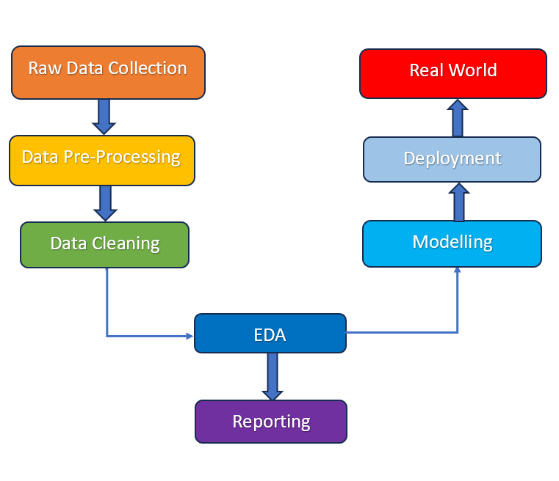
ARCHITECTURE

Slide 5
DATASET INFORMATION
The dataset contains Churn rate
Churn Analytics Data Contains :
Agency, Commendation and Complaint, Subject Matter, Subject Detail, Issue Detail,Year, Quarter , Branch/Line/Route

Slide 6
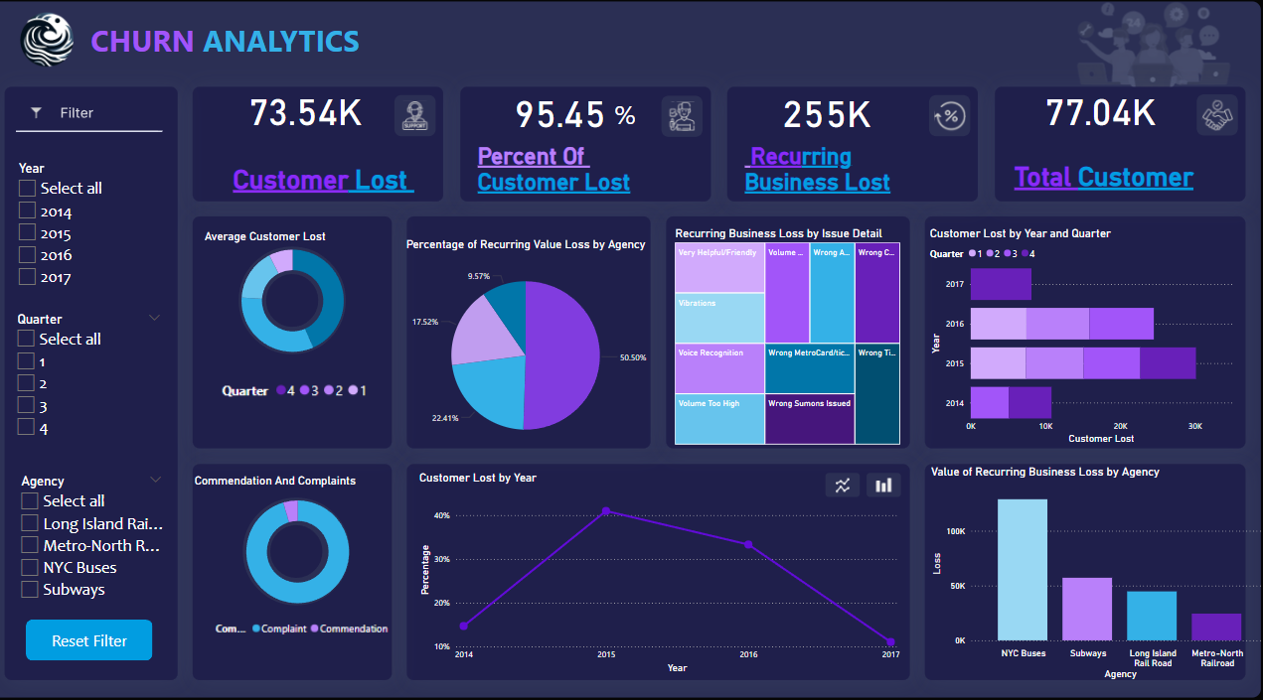
Overview

Slide 7
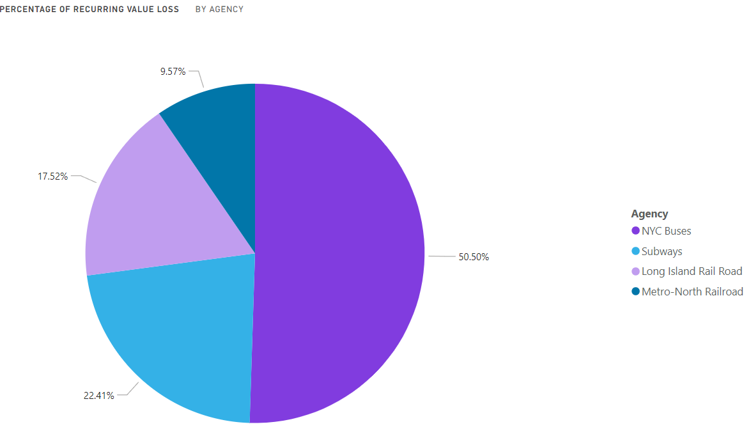
Value Loss

Slide 8
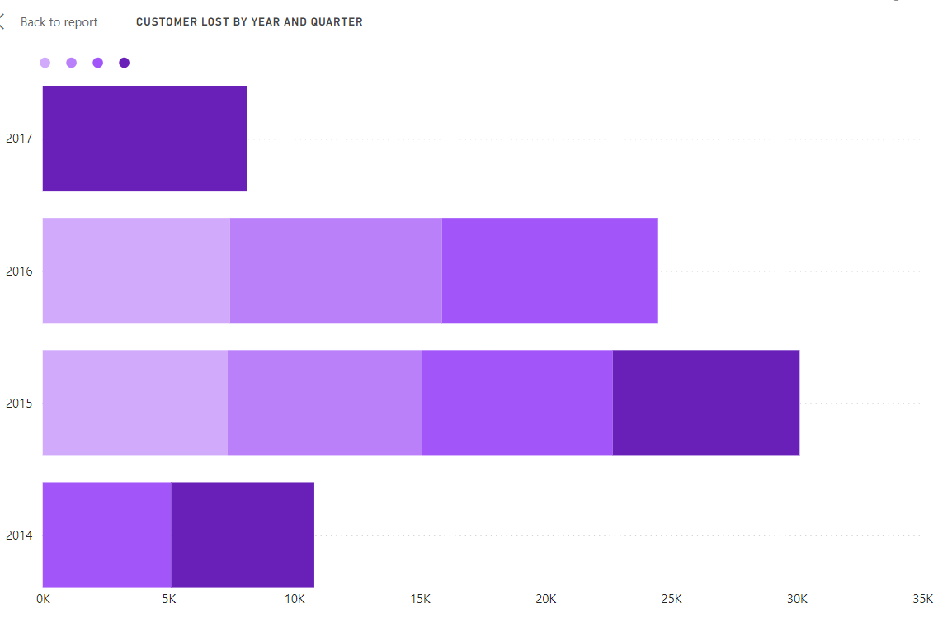

Slide 9
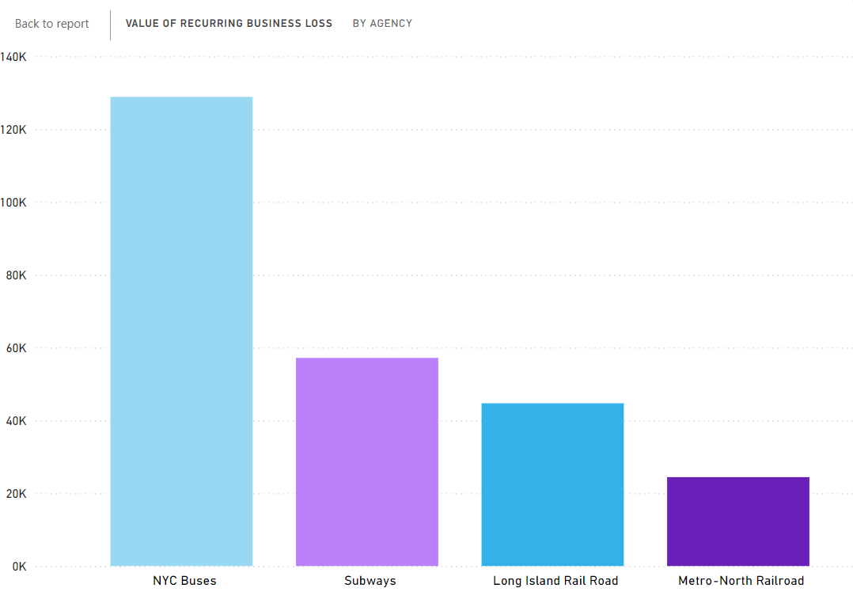

Slide 10
CONCLUSION
The churn rate was calculated by identifying the percentage of complaints out of the total feedback received.
There was a noticeable churn rate indicating customer dissatisfaction, which varied across different agencies and branches.
Financial losses due to customer complaints were calculated based on different rates for each transit service: $3 per complaint for NYC Buses/Subways and $6 per complaint for Long Island Rail Road/Metro-North Railroad.
Long Island Rail Road and Metro-North Railroad showed significant recurring business losses, highlighting the need for targeted interventions in these areas.
The analysis identified specific branches/lines/routes with the highest number of complaints.
By visualizing this data, it was clear which areas require more attention to improve customer satisfaction.
A detailed breakdown of complaints by subject matter and issue detail provided insights into common problems faced by customers.
This data helps in understanding the specific issues that need to be addressed to improve service quality.

