Slide 1

Emergency Response Coordination System
SOEN 6841 : Software Project Management
Instructor : JOUMANA DARGHAM
GROUP 3 - https://github.com/Ayushhpatel04/SOEN-6841-SPM
Harsh Tank 40269370
Ayush Patel 40272388
Zeel Divawala 40272584
Ankush desai 40271170
Mihir Gediya 40272399

Slide 2
1.
Introduction

Slide 3
Overview
This project focuses on addressing a critical gap by developing and commercializing a system that enhances communication and coordination during emergencies.
The system connects first responders, authorities, and the community, serving emergency departments and residents across Canada.

Slide 4
Problem Statement & Opportunity
Problem Statement:
The report identifies critical challenges in the current emergency response systems, which include:
1) Limitations in Real-Time Information
2) Difficulty in Reporting Emergencies
3) Wastage of Time and Resources
4) Lack of Immediate Medical Information
5) Limited Predictive Capability

Slide 5
Problem Statement & Opportunity
Opportunity Statement
The report outlines opportunities to address these issues by creating a modern, scalable Emergency Response Coordination System (ERCS):
1) Unified Communication Platform
2) Real-Time Data and Dashboards
3) Reliable Connectivity Options
4) Optimized Resource Management
5) AI and Predictive Capabilities

Slide 6
2.
Market Analysis

Slide 7
Market Size and Trends
The Emergency and Disaster Response Market size is estimated at USD 166.73 billion in 2024 and is expected to reach USD 229.30 billion by 2029 (CAGR: 6.58%).
North America dominates due to government spending and increased procurement of disaster response equipment and vehicles.

Slide 8
Key Drivers of Budget for ERCS
Recent severe hurricanes and floods.
Forest fires in the past five years.
Increased focus on resilience and recovery.
Hazardous incident in gas or chemical factories
Example:
ICF Awarded New $51 Million Disaster Management Contract in Puerto Rico.

Slide 9
Competitor Analysis
Competition Products/Systems:
SOS Messages: Minimal functionality.
RapidDeploy: Cloud-based CAD and Emergency Response Platform.
CentralSquare Technologies: Public Safety Suite.
Hexagon Safety & Infrastructure: Incident Management Solutions.
ZOLL Medical Corporation: RescueNet Suite for EMS and Fire Services.
Pulsiam, Crisis Track, ESO Solutions.

Slide 10
3.
FEASIBILITY & VIABILITY

Slide 11
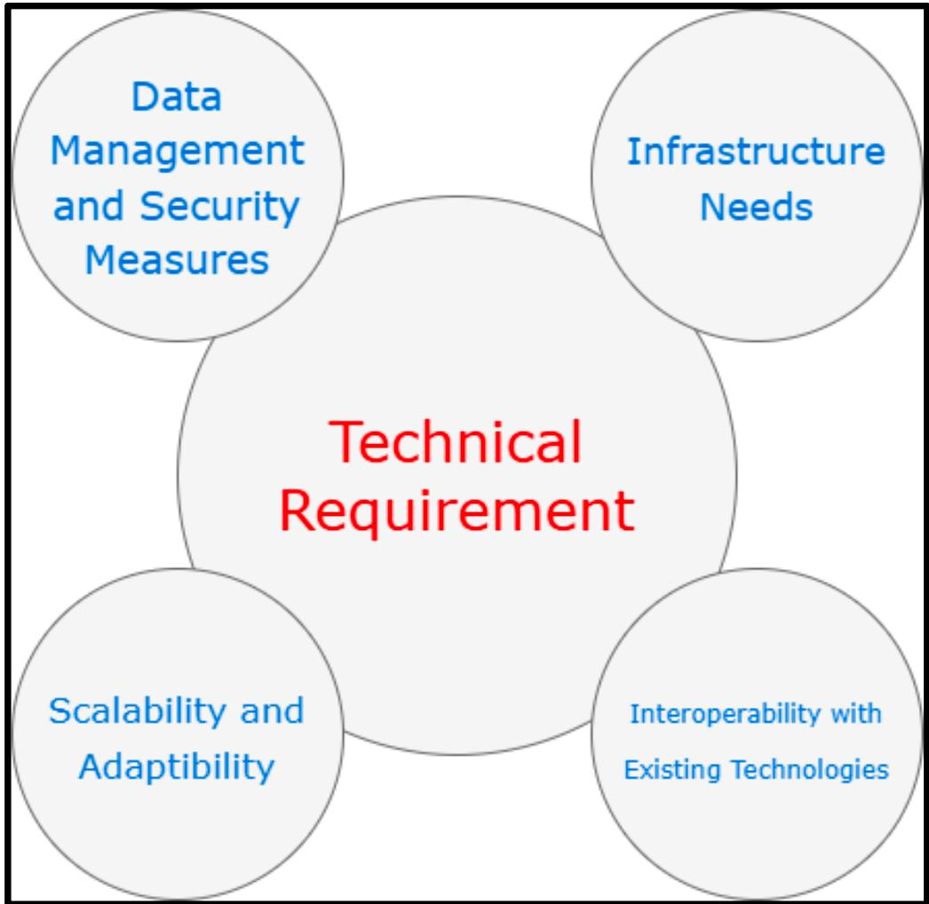
Technical Feasibility
Technical Feasibility:
Infrastructure and API integrations.
Scalability, security, and cloud performance.
Network reliability and third-party integrations.

Slide 12
Operational Feasibility
Operational Feasibility:
Workflow and process changes.
Role and responsibility shifts.
Training requirements and productivity impact.

Slide 13
Economic Feasibility
Economic Feasibility:
Development cost: $1.8M–$2.4M.
Operational cost: $250K–$500K/year.
Training cost: $30K–$60K initial.
Future scaling and upgrade expenses.

Slide 14
4.
SOLUTION HIGHLIGHTS

Slide 15
Key Features
Mobile accessibility for field operations.
Geospatial mapping and analysis tools.
Real-time data analytics and reporting.
Comprehensive incident management.

Slide 16
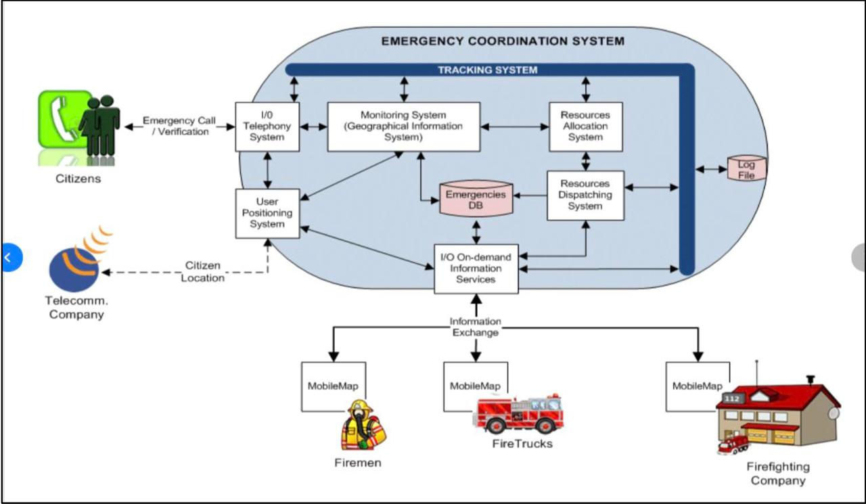
User-Centric Design
For Users to Report Emergencies:
User-friendly mobile and web apps.
Overall Workflow:
1. Event Initiation.
2. Data Analysis.
3. Coordination and Task Management.
4. After-Action Reporting.

Slide 17
Implementation Roadmap
Phase 1: Research and design.
Phase 2: Development and testing.
Phase 3: Deployment and training.
Phase 4: Feedback and scaling.

Slide 18
Anticipated Benefits
Faster response times.
Improved coordination among responders.
Better resource allocation.
Increased community safety.

Slide 19
Challenges and Risks
Integration with existing systems.
User adoption and training challenges.
Technical issues with scaling.
Budget and timeline constraints.

Slide 20
5.
PROJECT PLAN

Slide 21
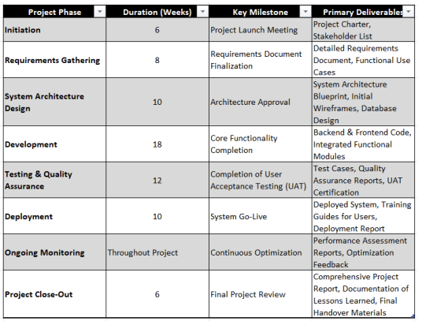
Project Phases, Milestones, and Deliverables:
  Initiation Phase (2 weeks): Define scope, identify stakeholders, and establish project charter.
  Planning Phase (4 weeks): Develop detailed project plan, WBS, Gantt chart, and risk management strategy.
  Execution Phase (12 weeks): System design, development, integration, and testing
  Monitoring & Controlling Phase: Ongoing monitoring, quality checks, and performance tracking.
  Closure Phase (2 weeks): Final reporting, project review, and handover to stakeholders.

Slide 22
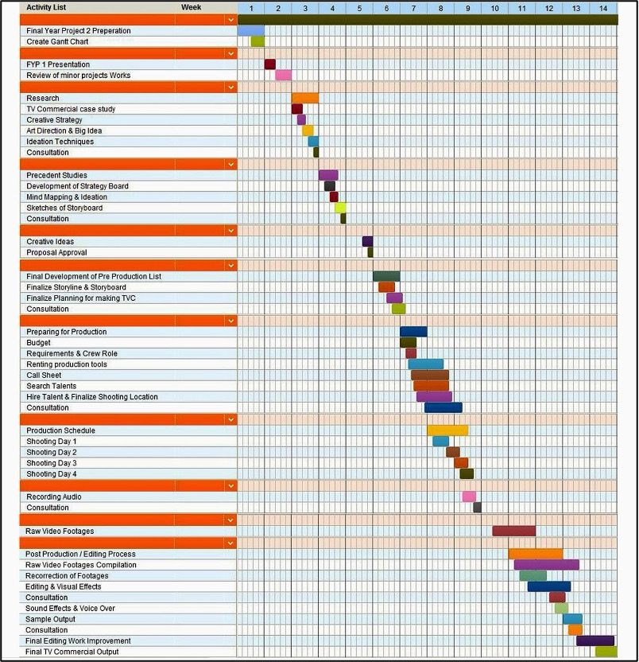
Project Timeline

Slide 23
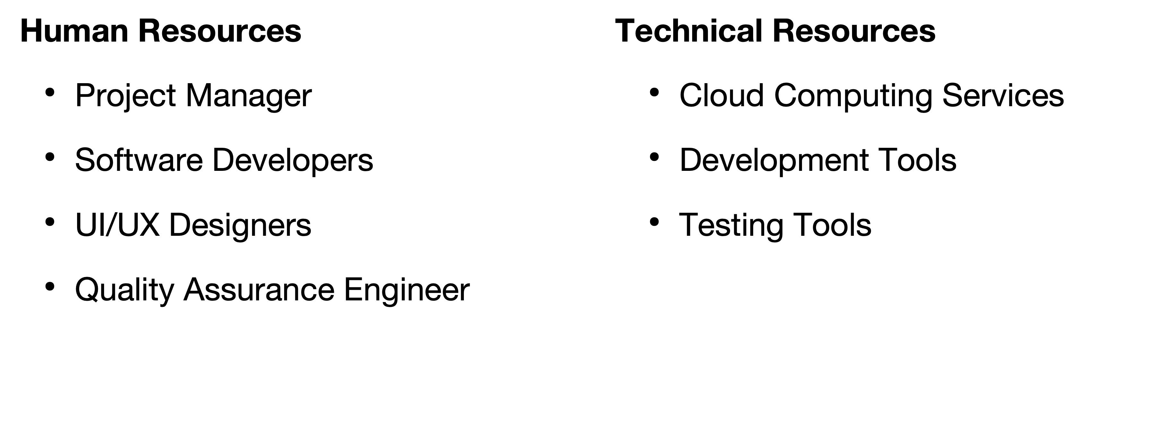
Project Resources Allocation

Slide 24
6.
RISK MANAGEMENT

Slide 25
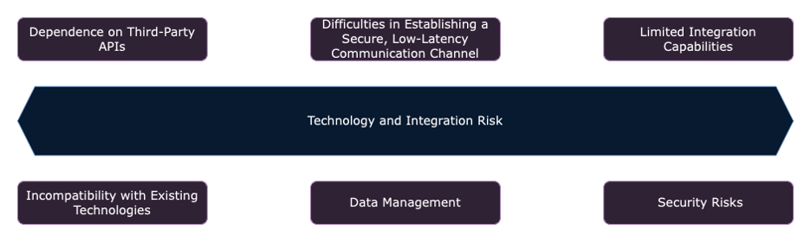
Key Risks Identified:
System Integration Challenges: Difficulty in integrating ERCS with existing emergency systems due to outdated technology or incompatible data formats.
Data Security Concerns: Risks related to unauthorized access, data breaches, and cyber-attacks affecting sensitive data.
System Overload During High-Volume Emergencies: Overwhelming system traffic during large-scale emergencies, risking system failure and delays in emergency response.

Slide 26
Risk Impacts
System Integration Challenges:
Cost Impact: Additional resources may increase project costs by 10–15%.
Time Impact: Project timelines could be delayed by several months due to integration issues.
Quality Impact: Functionality gaps and system unreliability if integration issues persist.
Data Security Concerns:
Cost Impact: Potential legal liabilities and fines, raising costs by up to 20%.
Time Impact: Additional work required to address security breaches.
Quality Impact: Loss of user trust, damaging system effectiveness and reputation.
System Overload During High-Volume Emergencies:
Cost Impact: Additional infrastructure costs for scaling the system.
Time Impact: Delays in emergency response due to system overload.
Quality Impact: Core functionality compromised during critical events.

Slide 27
Mitigation Strategies:
System Integration Challenges :
    Mitigation: Early compatibility assessments, iterative testing, and use of middleware solutions.
    Goal: Reduce risks by ensuring smooth integration.
Data Security Concerns
    Mitigation: Implement end-to-end encryption, multi-factor authentication, and regular security audits.
    Goal: Ensure robust protection against unauthorized access and data breaches.
System Overload During High-Volume Emergencies
    Mitigation: Design a scalable cloud-based infrastructure with load balancing to handle peak demand.
    Goal: Ensure reliable system performance during emergencies.

Slide 28
Strategies to Address Potential Challenges:
Proactive Planning: Developing a risk breakdown structure (RBS) for comprehensive categorization and prioritization.
Ongoing Risk Monitoring: Regular reviews and updates to the mitigation plan based on evolving project needs and external factors.
Continuous Stakeholder Engagement: Regularly engage stakeholders to ensure alignment and early identification of emerging risks.
Agile Response Framework: Establish agile teams to quickly adapt mitigation strategies based on real-time risk assessments.
Data-Driven Decision Making: Leverage data analytics and machine learning to predict potential risks and adjust strategies accordingly.

Slide 29
7.
BUDGET

Slide 30
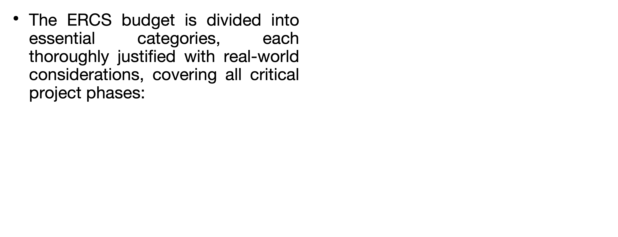
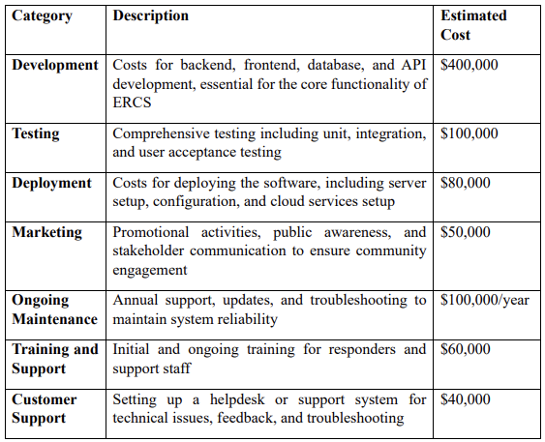
Cost Categories

Slide 31
Resource Costing
Human Resources:
  Project Managers: $50/hour, estimated 1,000 hours = $50,000.
  Developers (frontend and backend): $40/hour, estimated 5,000 hours = $200,000.
  Quality Assurance (QA) Testers: $35/hour, estimated 1,500 hours = $52,500.
  System Architects: $60/hour, estimated 500 hours = $30,000.
  Data Scientists: $50/hour, estimated 600 hours = $30,000.
Technology Costs:
  Software Licenses: Licenses for development tools (e.g., IDEs, testing frameworks) = $30,000.
  Cloud Services (e.g., AWS, Azure): Scalable infrastructure services = $120,000/year.
  Hardware: Servers and networking equipment for robust infrastructure = $150,000.
External Services:
  Consulting and Legal Fees: Compliance, data protection, and industry standard consulting = $30,000.
  Marketing and Outreach Services: For raising community awareness = $20,000.

Slide 32
ADDITIONAL RESOURCE COSTING
Contingency Budget:
  Contingency Allocation: $150,000 (15% of total budget)
  Addresses unforeseen costs, including technological changes, operational adjustments, and scaling infrastructure.

Slide 33
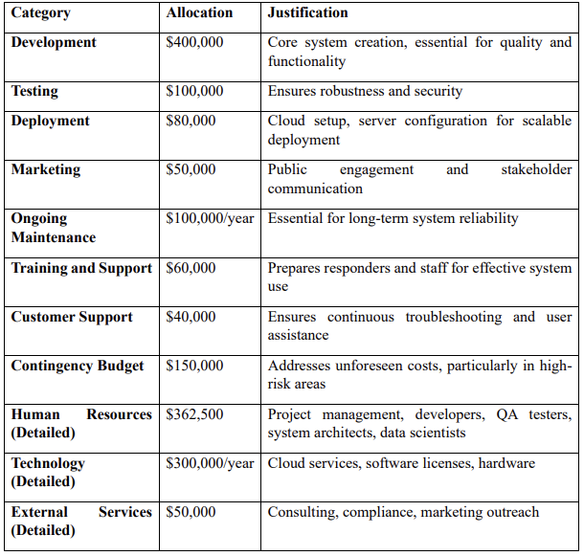
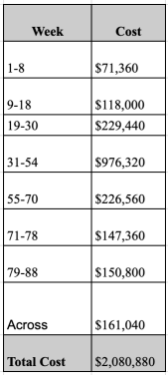
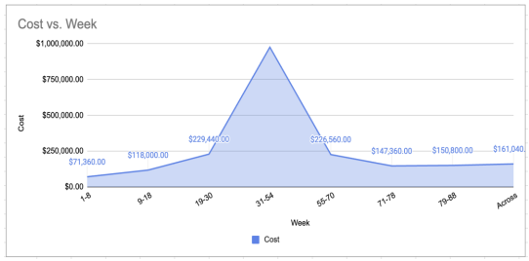
Project Baseline Estimation

Slide 34
8.
CONCLUSION

Slide 35
In conclusion, the Emergency Response Coordination System (ERCS) is a game-changing tool for improving communication and coordination during emergencies. Designed for scalability, it connects first responders, authorities, and the public, enhancing public safety and emergency operations across Canada.
This project addresses critical gaps in emergency response, providing a comprehensive strategy to save lives, protect resources, and build resilience. With careful budgeting and resource allocation, ERCS ensures long-term sustainability and readiness for future challenges.
Looking ahead, we’re excited about ERCS’s potential to revolutionize emergency management and seek continued collaboration from stakeholders to make this vision a reality.

Slide 36
Call to Action:
Next Steps for Stakeholders:
  Review and approve the project plan and budget.
  Align on resource allocation and finalize the team.
  Initiate funding discussions to support project milestones and contingency funds.
  Schedule follow-up meetings to track progress and address any emerging risks.

Slide 37
THANK YOU

