Slide 1


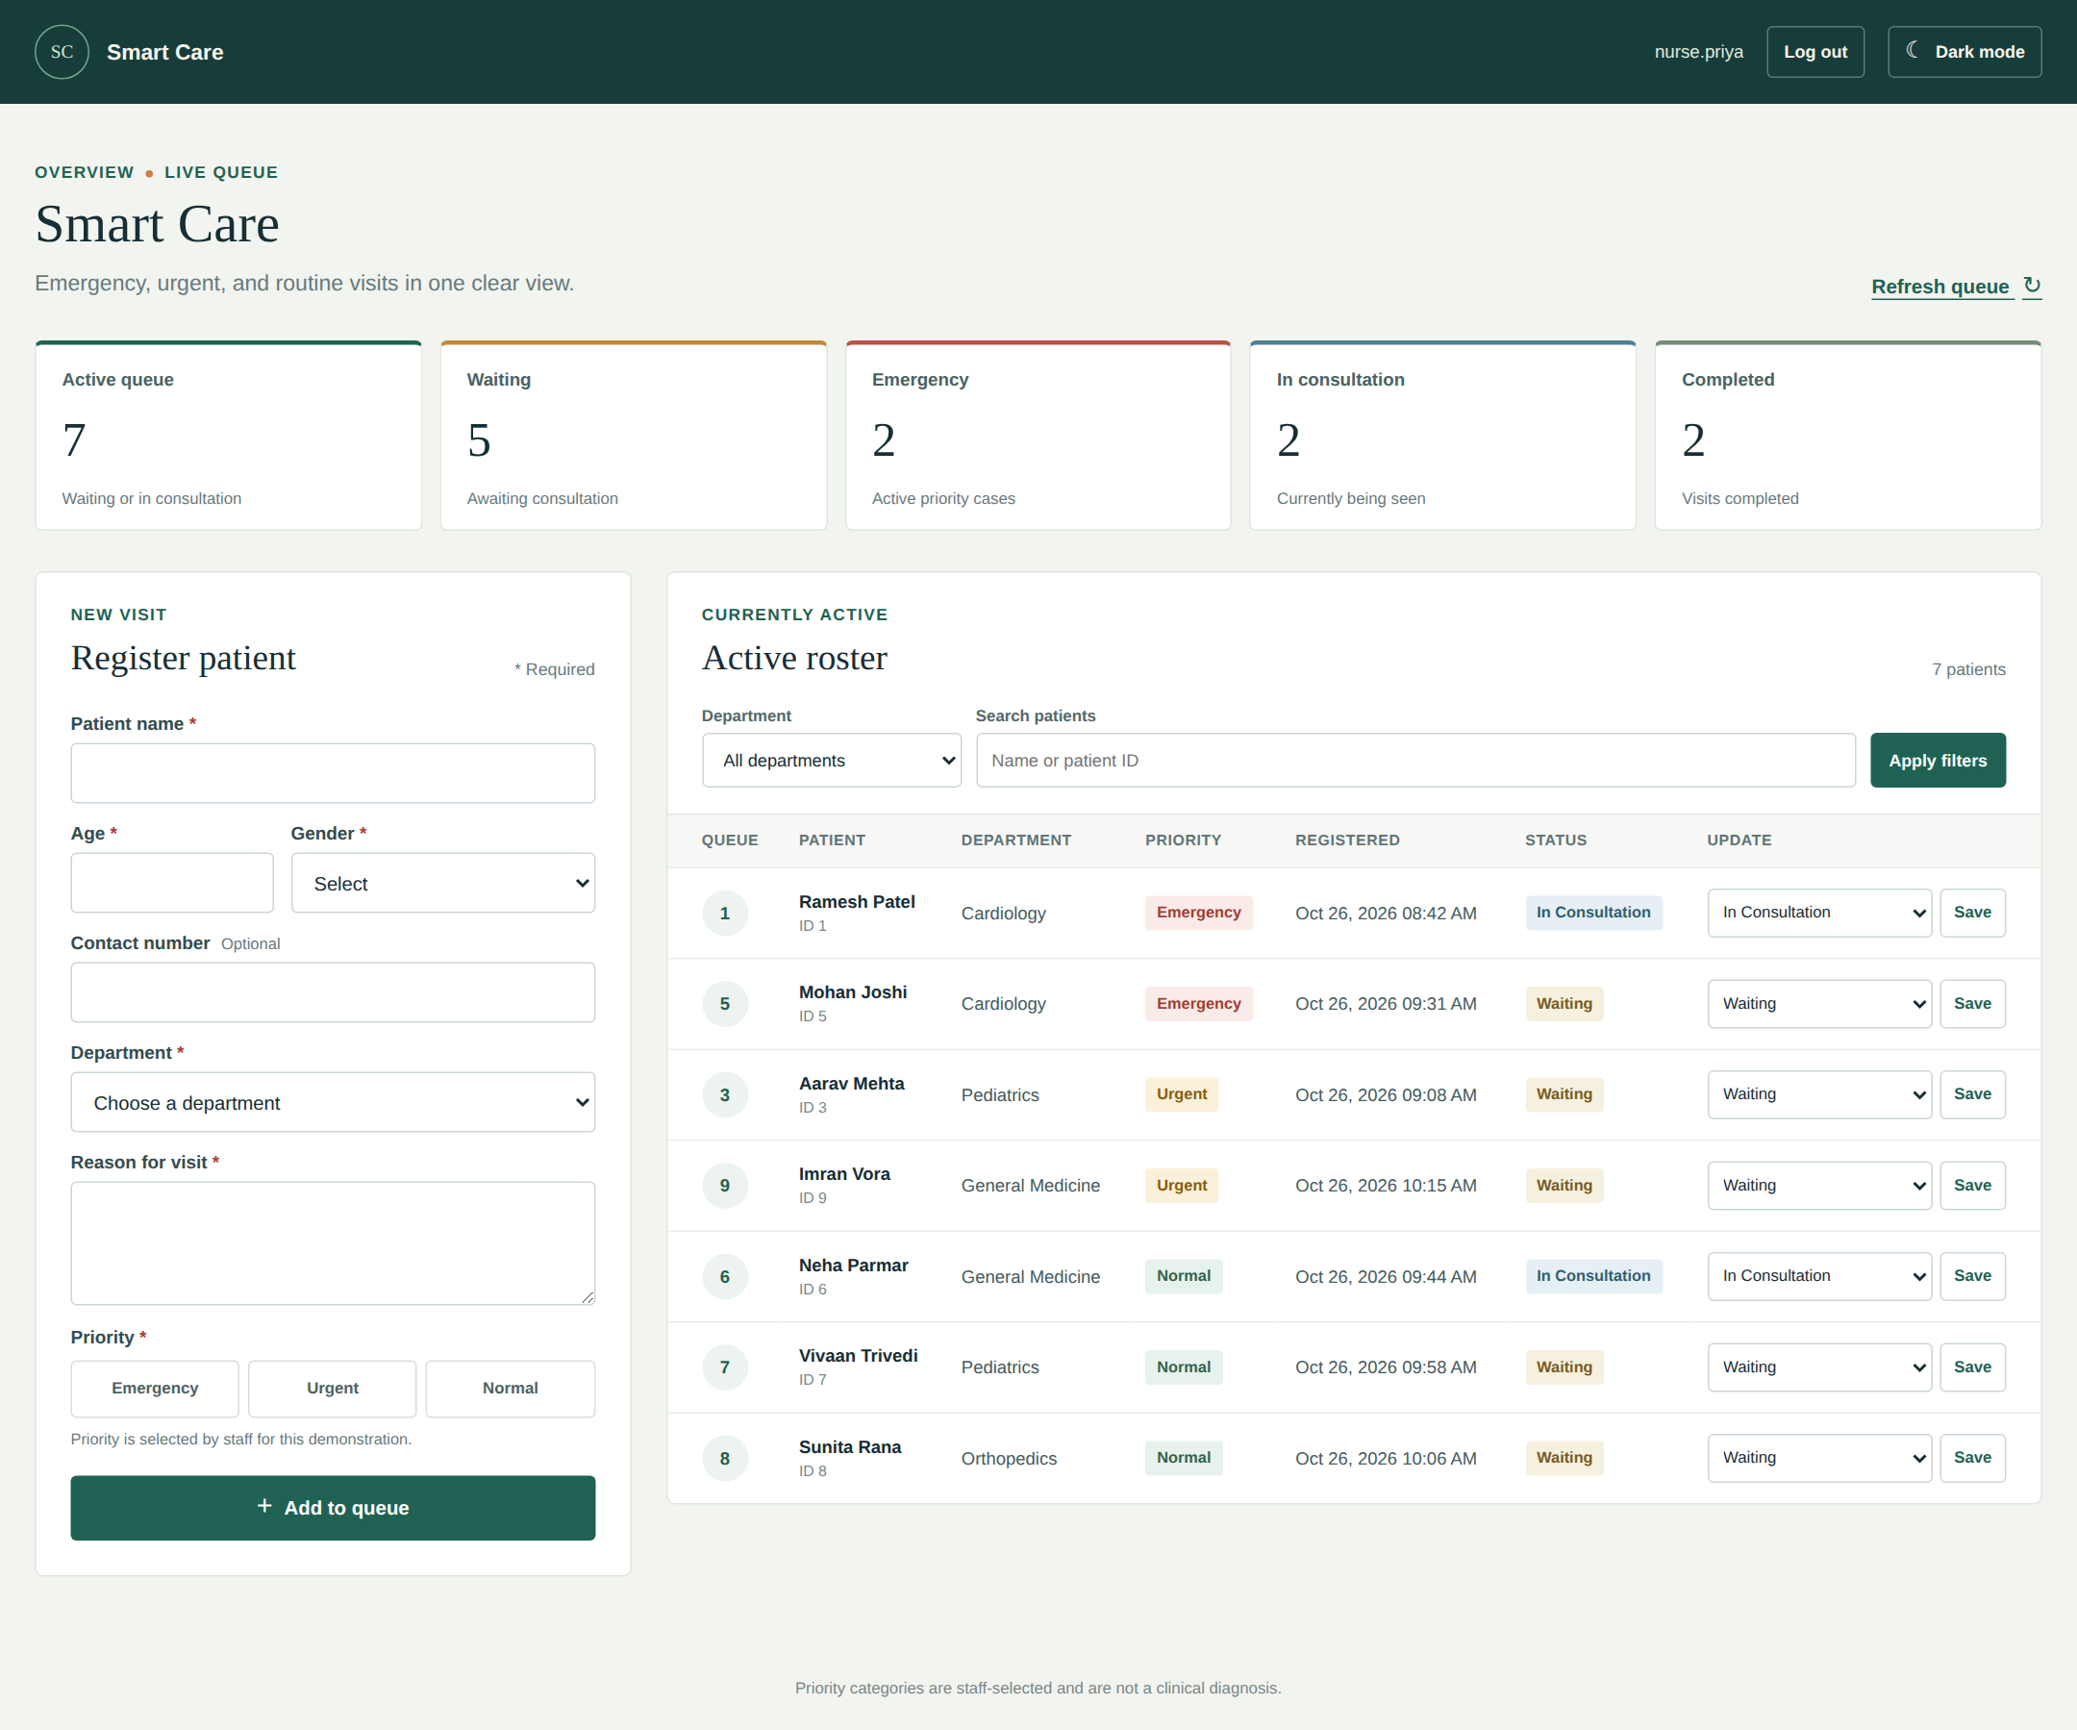
A. D. PATEL INSTITUTE OF TECHNOLOGY
DEPARTMENT OF INFORMATION TECHNOLOGY
Smart Patient Queue System
Emergency prioritization for hospital staff
Presented by: Savani Ayushi (12402080601014)
Branch : IT-A (Sem 5)

Slide 2




Manual queues slow hospitals down
Long, unorganized queues
Emergencies hard to spot
THE MAIN PROBLEM
No single place to register, prioritize and track patients.
Patients wait in the order they arrive, with no clear system.
Critical cases are not identified quickly among the crowd.
Records kept by hand
Slow to find information
Patient details on paper or memory get lost or mixed up.
Searching for one patient's details takes too much time.
No central dashboard for staff.
2

Slide 3







One staff dashboard for the whole queue
Login
Register
Prioritize
Queue
Track
Staff sign in securely
Add patient details
Emergency, Urgent, Normal
Auto queue number
Update consultation status
Objectives
Cut manual paperwork
Serve emergencies first
Give every patient a unique queue number
Search by name or ID in seconds
Track status until completed
3

Slide 4






What makes it different
Secure staff login
Patient registration
3 priority levels
Auto queue number
Registration, login and protected pages
Name, age, gender, department, symptoms
Emergency, Urgent, Normal with color badges
Unique number, never repeated
Department filter
Smart search
Light and dark mode
Show one department's queue
Partial name or patient ID
Comfortable for any shift
4

Slide 5

How the priority queue works
ARRIVAL ORDER
QUEUE ORDER
SQL ORDER BY (simplified)
Aarav Mehta
Urgent
Mohan Joshi
Emergency
ORDER BY CASE priority_level
WHEN 'Emergency' THEN 1
WHEN 'Urgent' THEN 2
ELSE 3
END,
registered_at ASC,
patient_id ASC;
09:08 AM
09:31 AM
Mohan Joshi
Emergency
Aarav Mehta
Urgent
09:31 AM
09:08 AM
Vivaan Trivedi
Normal
Imran Vora
Urgent
09:58 AM
10:15 AM
Mohan arrived later than Aarav but is called first, because Emergency outranks Urgent. Equal priorities go in arrival order.
Imran Vora
Urgent
Vivaan Trivedi
Normal
10:15 AM
09:58 AM
Priority is chosen by staff. The system organizes the queue; it does not diagnose patients.
5

Slide 6









System architecture: simple and secure
Hospital staff
Web interface
Flask backend
Jinja2 templates
MySQL
Uses any browser
HTML, CSS, JavaScript
Routes, sessions, validation
Dynamic HTML pages
patients, staff_accounts
Runs locally
Lightweight
Safe data access
Python + Flask + MySQL on a normal PC
Plain HTML, CSS and JS on the front end
Parameterized SQL stops SQL injection
6

Slide 7
Database design: two focused tables
patients
staff_accounts
Column | Type | Key
patient_id | BIGINT, auto-increment | PK
patient_name | VARCHAR(100)
age | TINYINT (max 120)
gender / contact | VARCHAR(30)
department | VARCHAR(100)
symptoms | TEXT
priority_level | ENUM: Emergency, Urgent, Normal
queue_number | BIGINT | UNIQUE
status | ENUM: Waiting, In Consultation, Completed
registered_at | TIMESTAMP, default now
Column | Key
staff_id | PK
username | UNIQUE
email | UNIQUE
password_hash
created_at
DESIGN NOTES
ENUM allows only valid priority and status
queue_number is UNIQUE, so it never repeats
Index on status, priority and time speeds up the queue query
7

Slide 8
Technology stack and security
Layer | Technology
Frontend | HTML5, CSS3, JavaScript
Backend | Python, Flask
Templates | Jinja2
Database | MySQL
DB access | MySQL Connector (parameterized)
Authentication | Sessions + password hashing
Configuration | python-dotenv (.env file)
Security built in
Password hashing
Parameterized SQL
CSRF tokens
Browser + server validation
Login required for pages
HttpOnly, SameSite cookies
Demonstration project: do not enter real patient data.
8

Slide 9
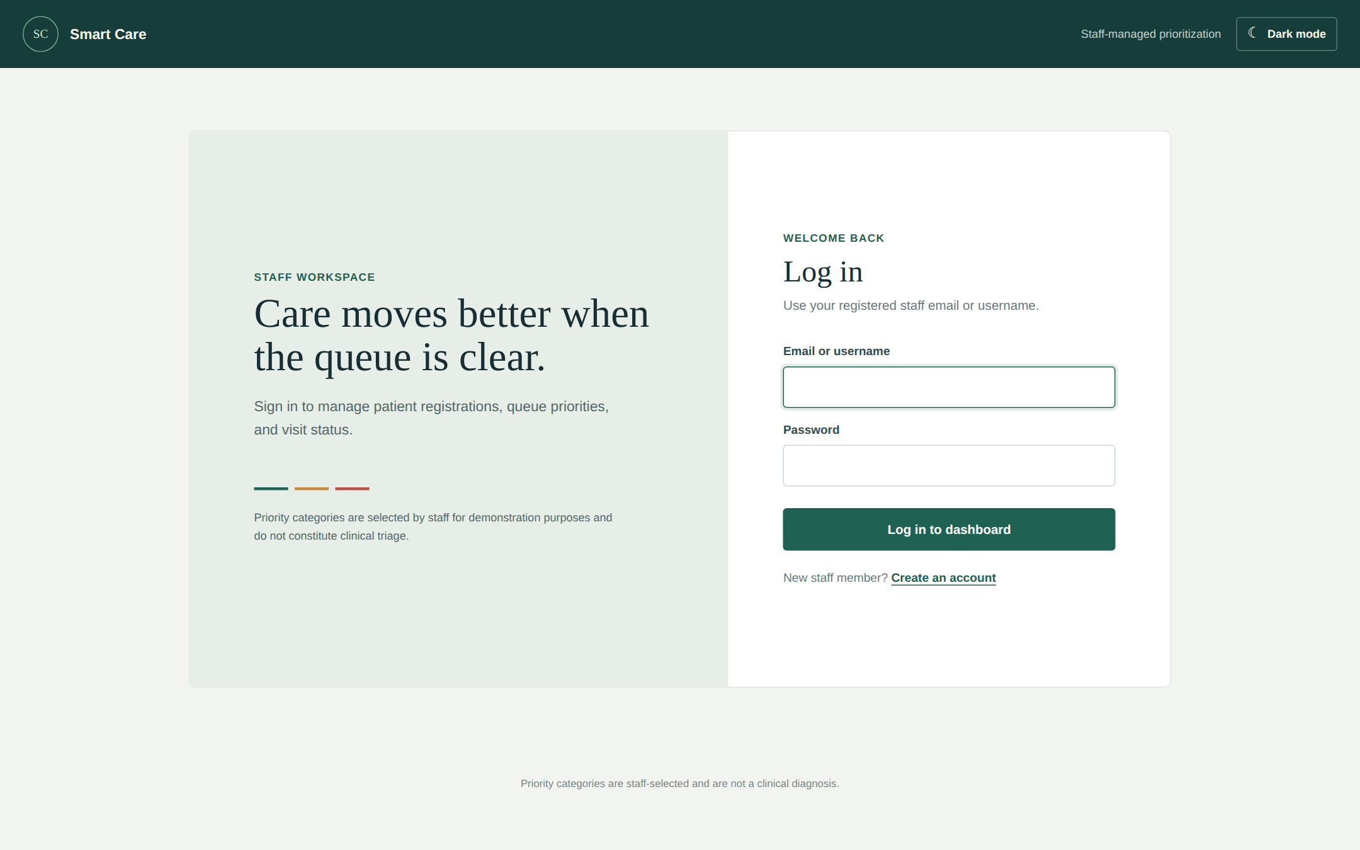
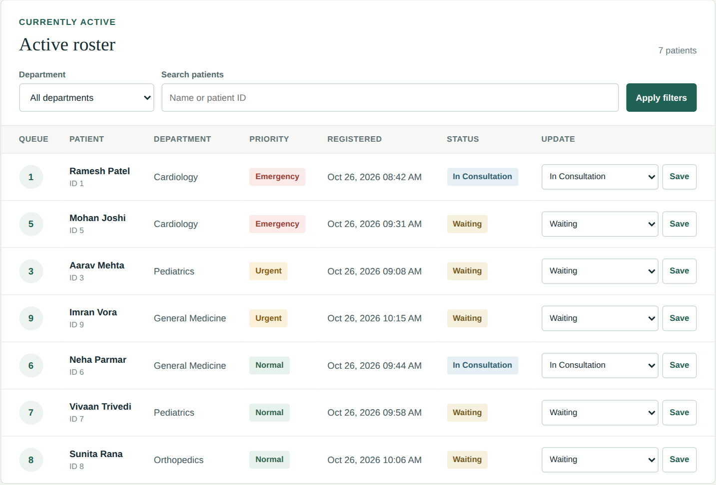
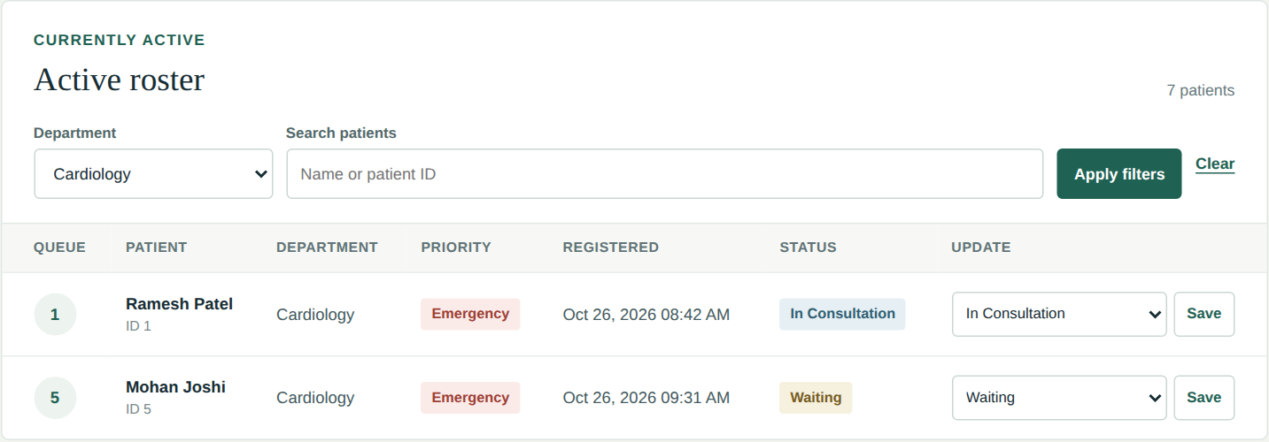
How it works: from login to completion
1
Staff log in with a secure session
2
Register patient with details and priority
3
Patient gets an automatic queue number
Dashboard
Secure login
4
Dashboard orders queue: Emergency first
5
Search or filter by department, open details
6
Update status until Completed
Live queue
Department filter
9

Slide 10



Project Evaluation & Future Prospects
Advantages
Limitations
Future scope
Faster patient registration
Emergency cases stand out
Easy name and ID search
Simple status tracking
Less manual work
Single hospital, demo use
No account approval
No rate limiting or audit log
No notifications yet
Doctor login and roles
SMS / WhatsApp alerts
Waiting-time estimate
Appointments and analytics
Cloud deployment
Conclusion: The Smart Patient Queue System makes hospital queues faster, clearer and better organized. Thank you!
10

