Slide 2
Siddharth Shirvastav
(Shopkeeper App)
Kritika Maheshwari
(Shopkeeper App)
Divya Waghmare
(Shopkeeper App)
Ayushi Sethi
(User App)
Aman Jain
(User App)

Slide 3
The project objective is to deliver the online shopping application into android platform.
Targeted Users
Small Shopkeepers(who not able to connect with customers easily).
Advantages
Future
Scope
Voice Search
AIM
Hindi – English
Progress Graph (Shopkeeper)
Buyers who does not feel comfortable to go out to buy products.

Slide 4
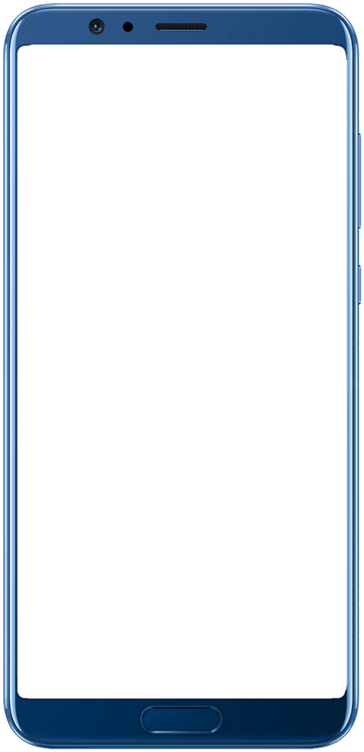
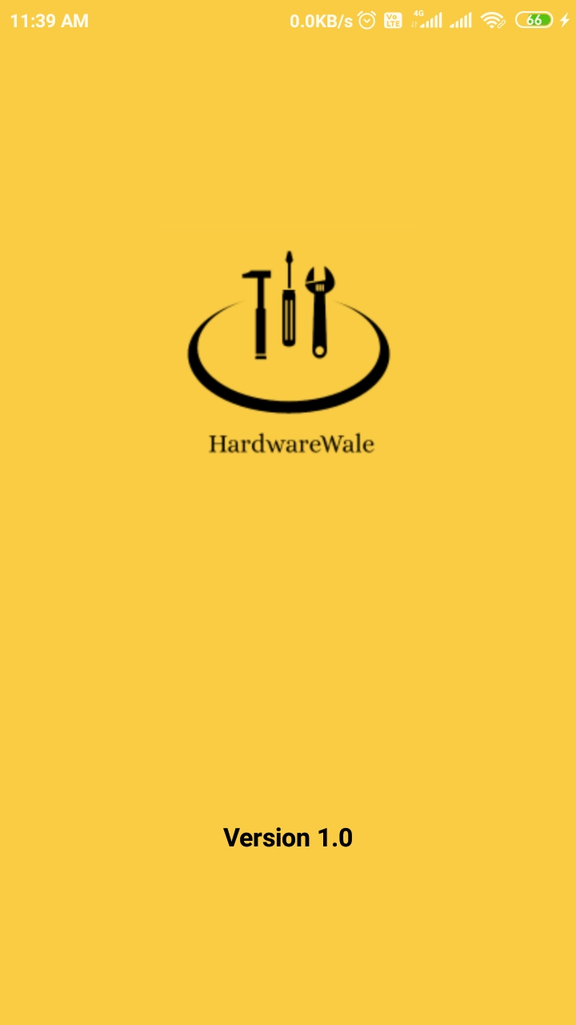
Splash Screen
Screen disappears after 5 seconds.
Check internet connectivity.
Check user already logged in or not.
User logged in send user to home screen and if not then send user to login screen.

Slide 5
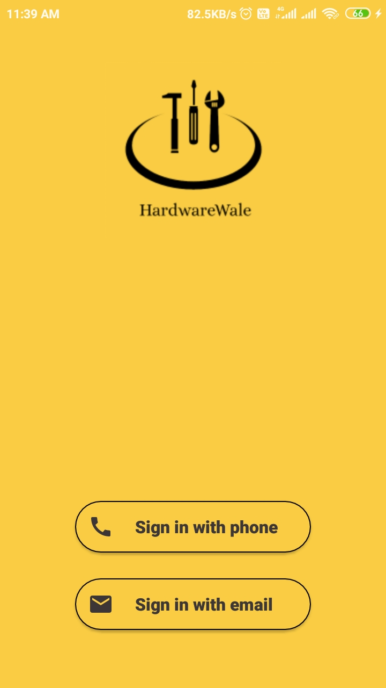


Login Screen
User can login through it’s mobile number
User can login using it’s email address

Slide 6
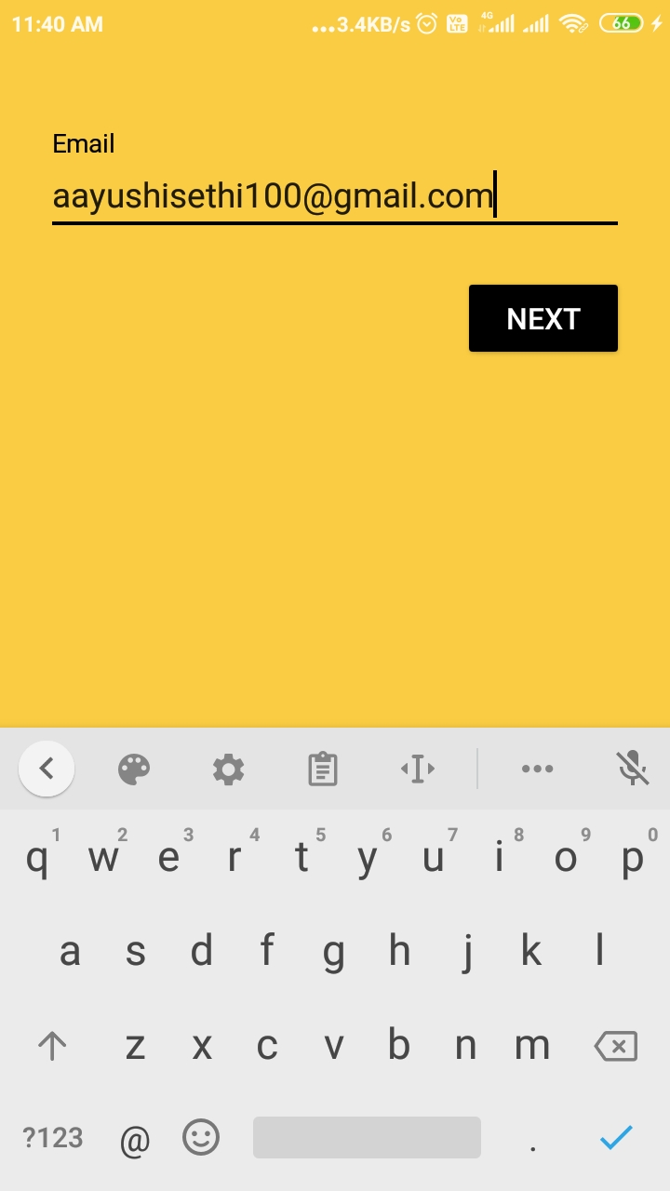
Signup with Email
User enter E-mail.
If already an existing customer, send him to Home Screen.
If not, send him to Create Profile/ Add Store screen.

Slide 7
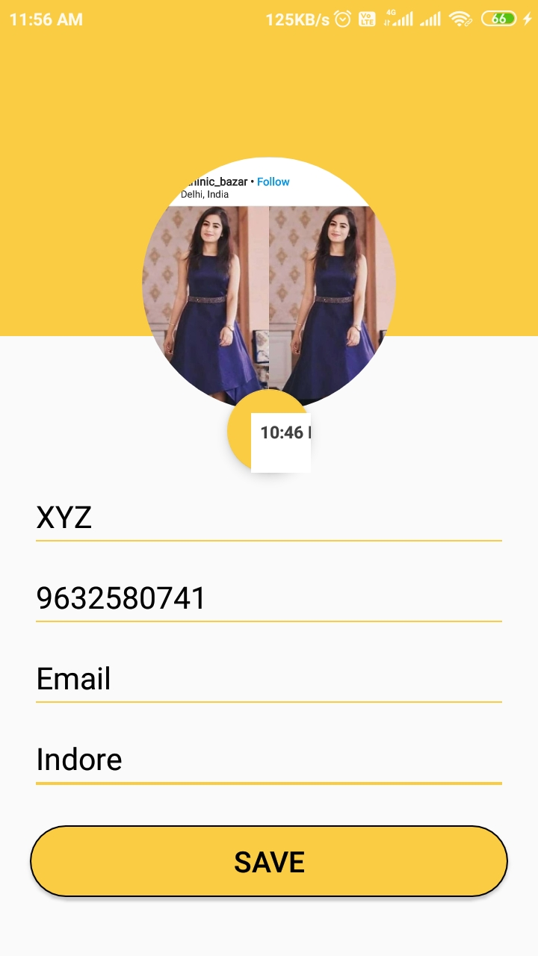
Create Profile
Enter mandatory fields.
Click SAVE, send him to Home Screen.

Slide 8
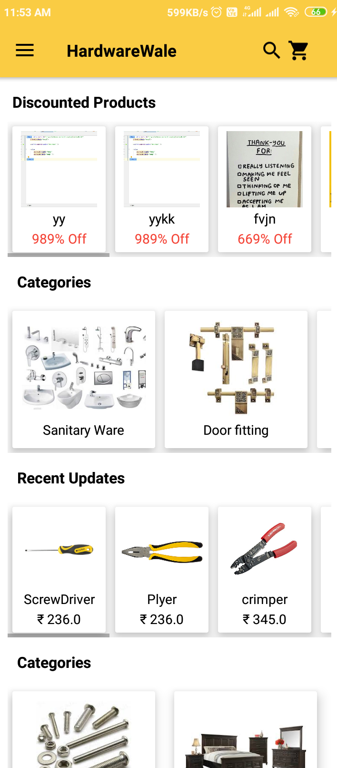



Home Screen
Search Bar
Navigation Drawer
Move into Cart

Slide 9
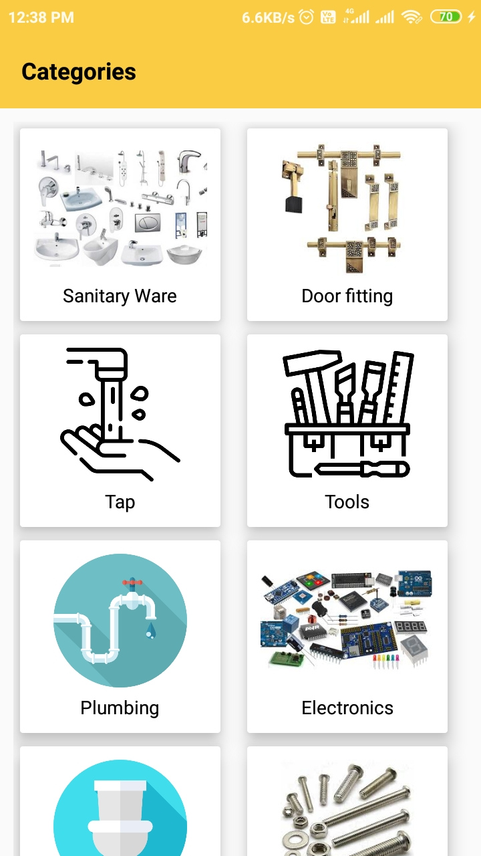
Category List
User Click on Categories at HOME, list of categories Appears.
Choose any category and view list of product with similar category.

Slide 10
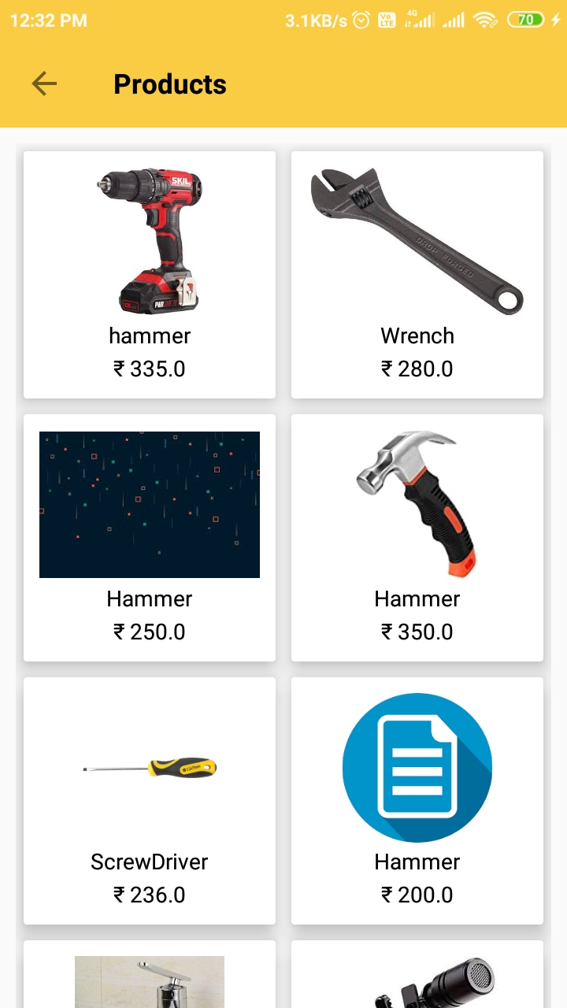
Product List
As user select any product, he will navigate to product details Screen.

Slide 11
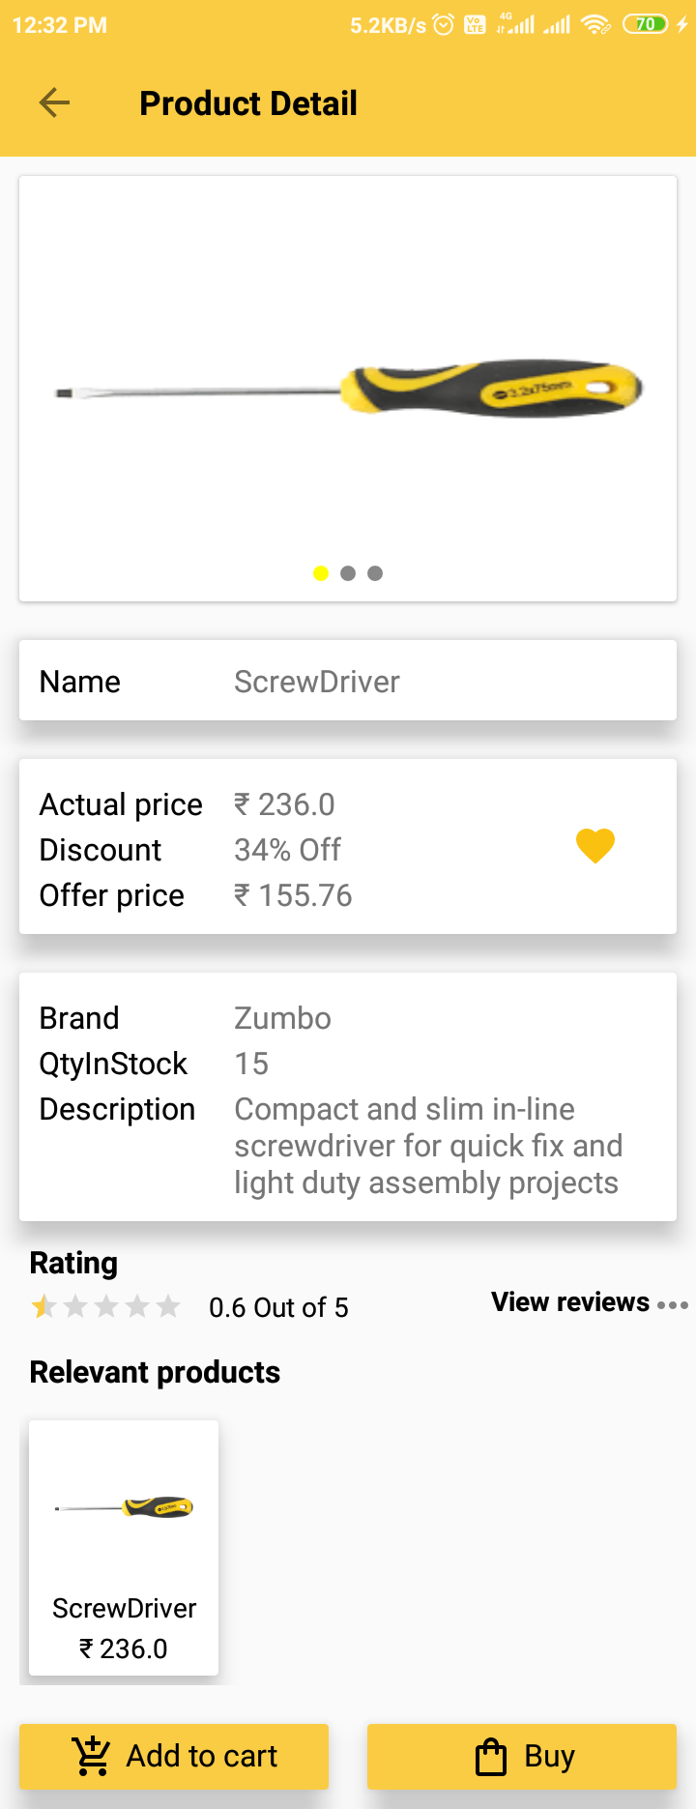




Product Detail
Add Product to favroites
Rate current
product
View early reviews
Add Product to cart
Directly buy the Product

Slide 12
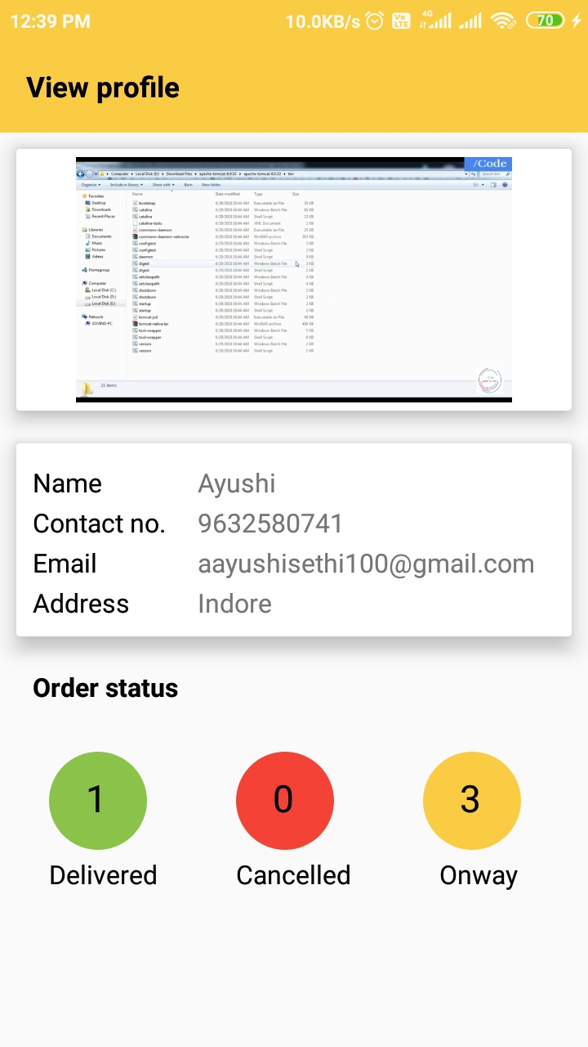
View Profile
User can view its Profile.

Slide 13
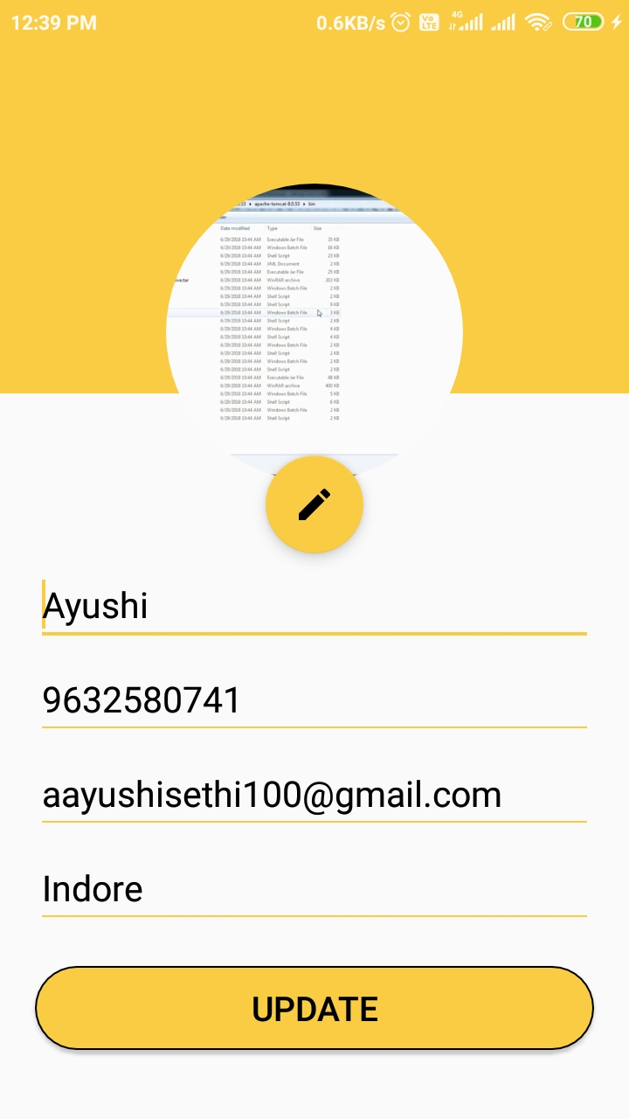
Update Profile
User click on Settings(Navigation Drawer).
User update necessary fields.
User click on UPDATE, Profile will be updated.

Slide 14
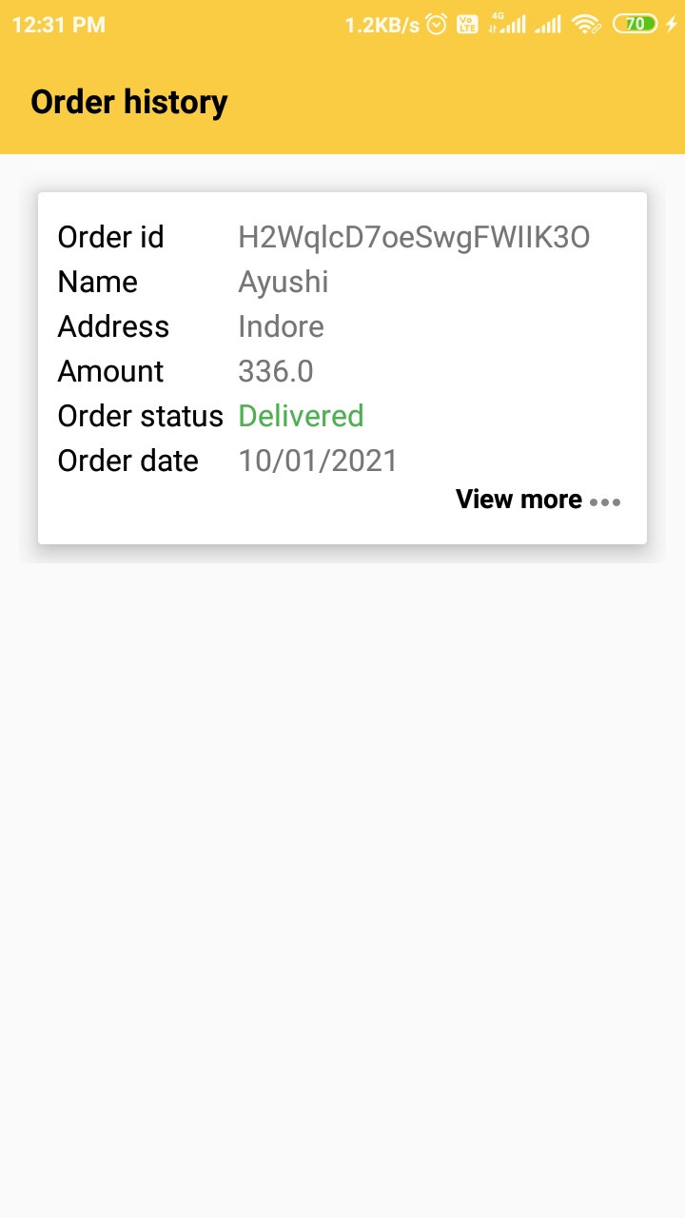
Order History
Order Details

Slide 15
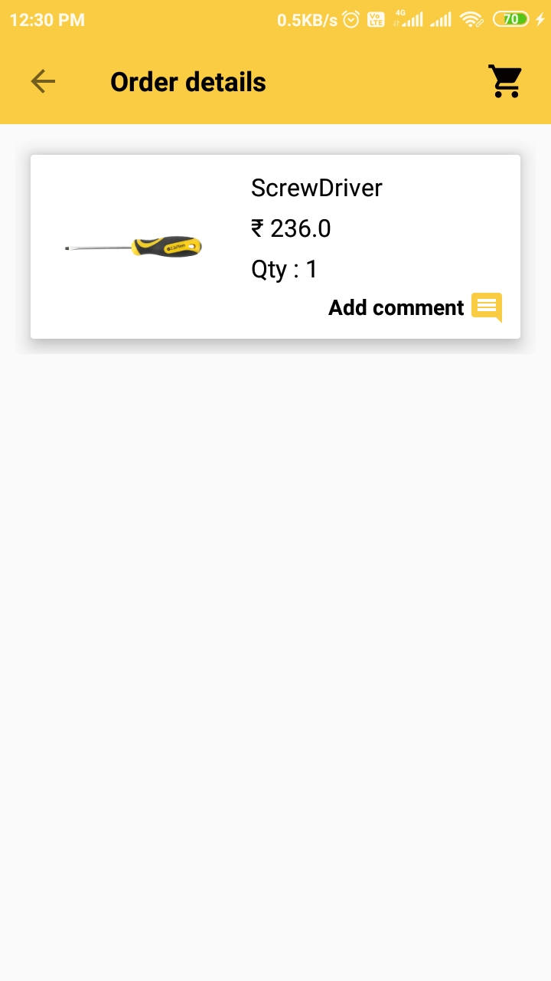

Order Details
Additional details of ordered products.
Add Comments

Slide 16
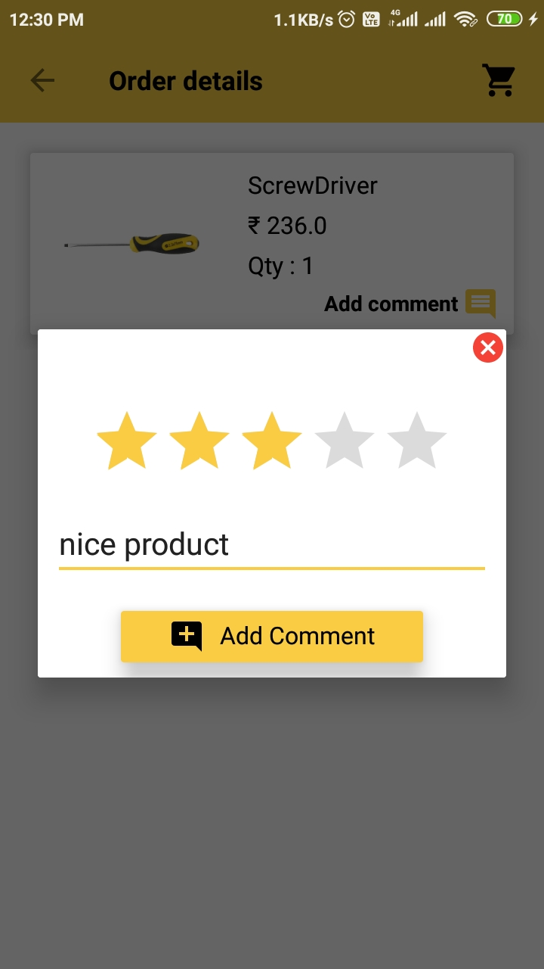
Rate Product
Rate and add comment after purchasing it.
Add Comments to the product

Slide 17
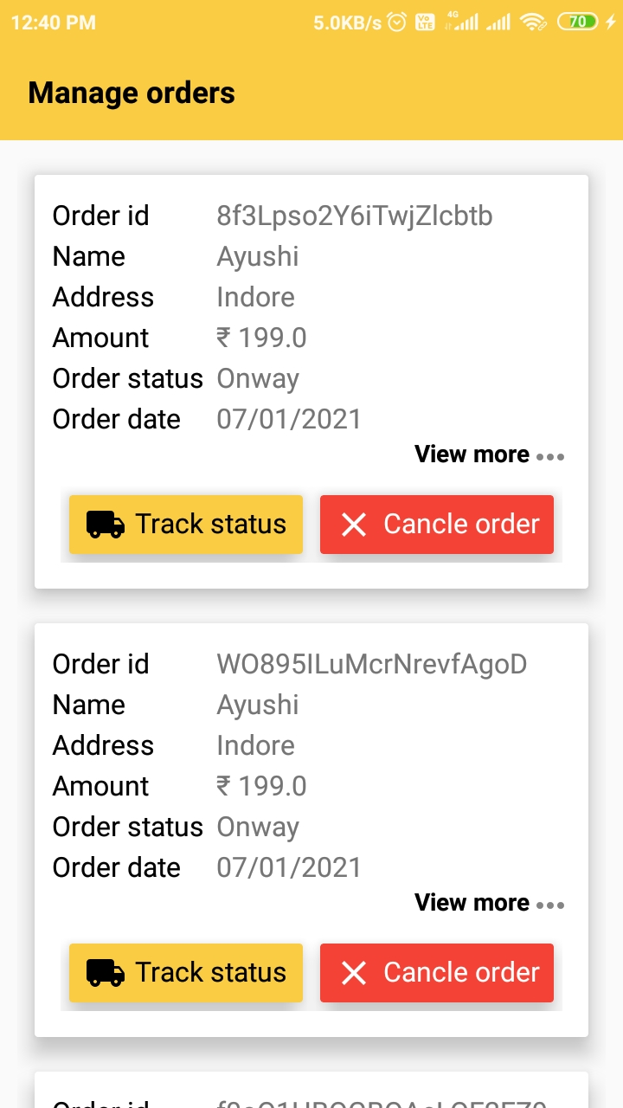


Manage Order
User can manage it’s orders.
Track it’s order status.
Cancel it’s current order.

Slide 18
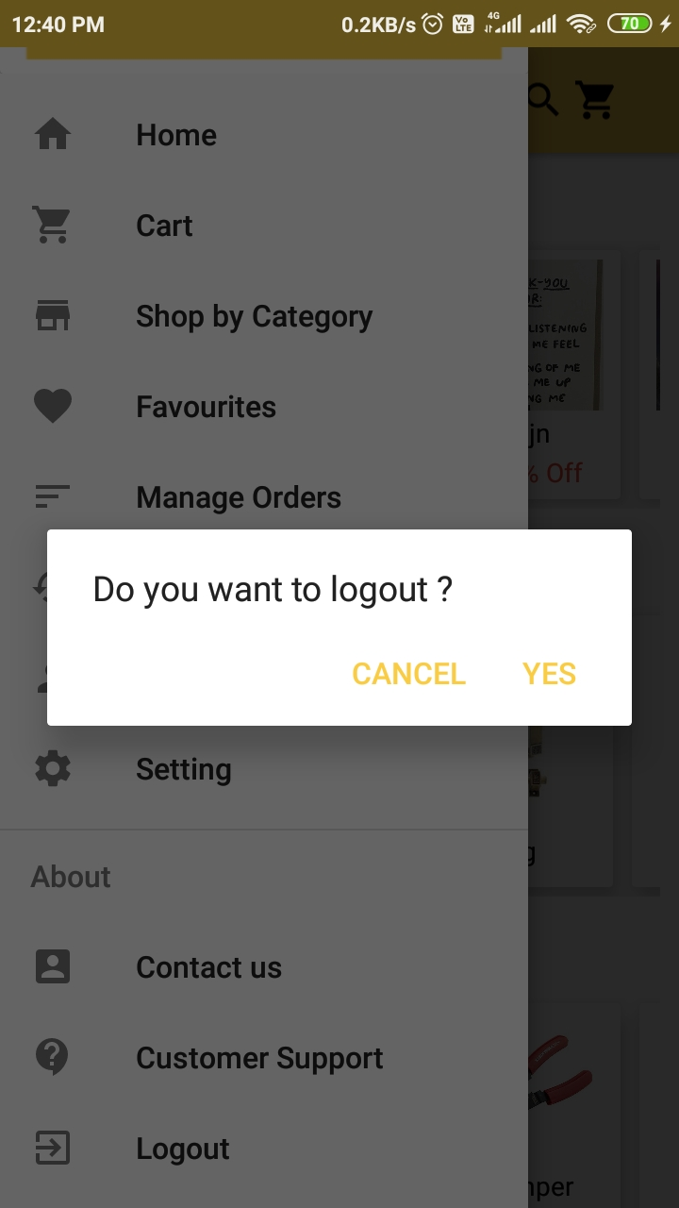
Sign-out
After click on Logout ,if user click on YES he will be logged out

Slide 19


Slide 24
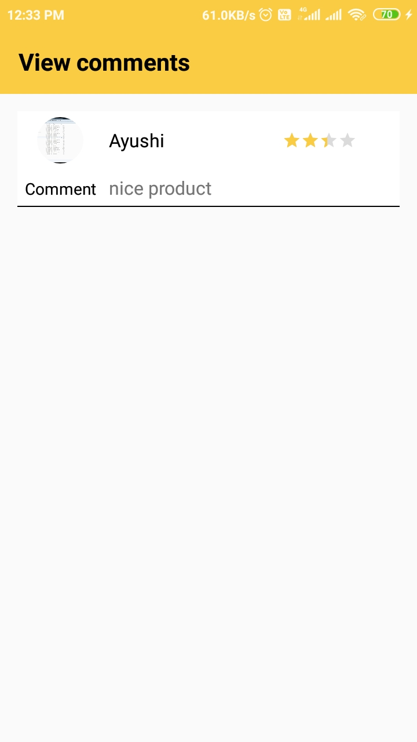

View Comments
User can view comments given by other customers. This help user to build trust and loyalty, and differentiate with other products

Slide 25
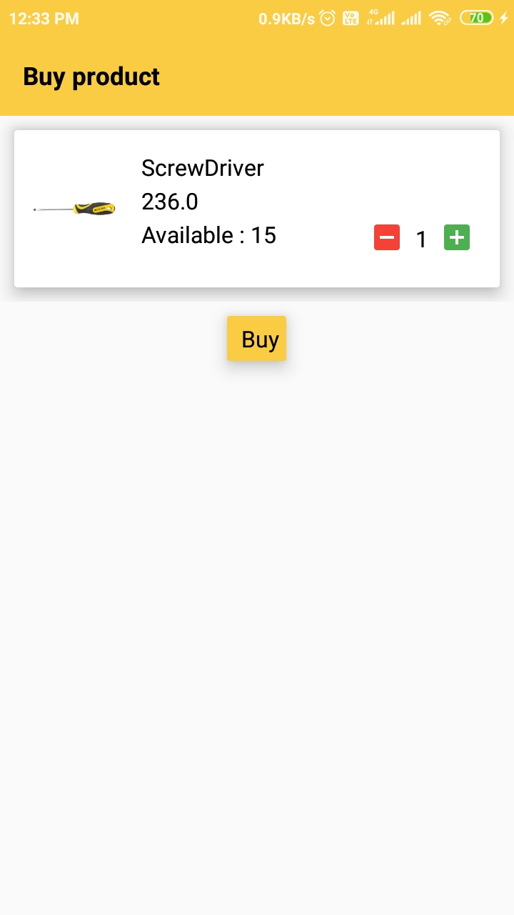


Buy Product
Increase Quantity
Decrease Quantity
Place Order
BUY

Slide 26
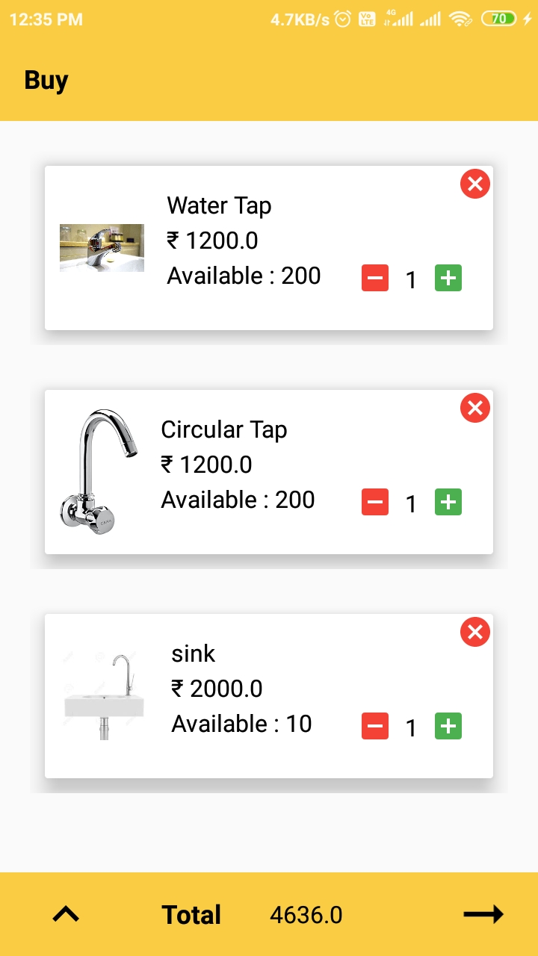

Buy
Cancel Product
Increase Quantity
Decrease Quantity
Place Order

Slide 27
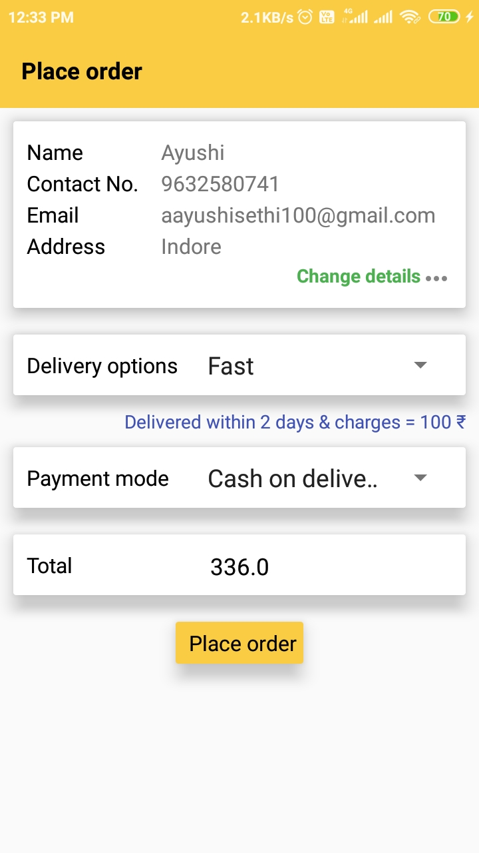
Place Order
User click on place order, order will be placed

Slide 28
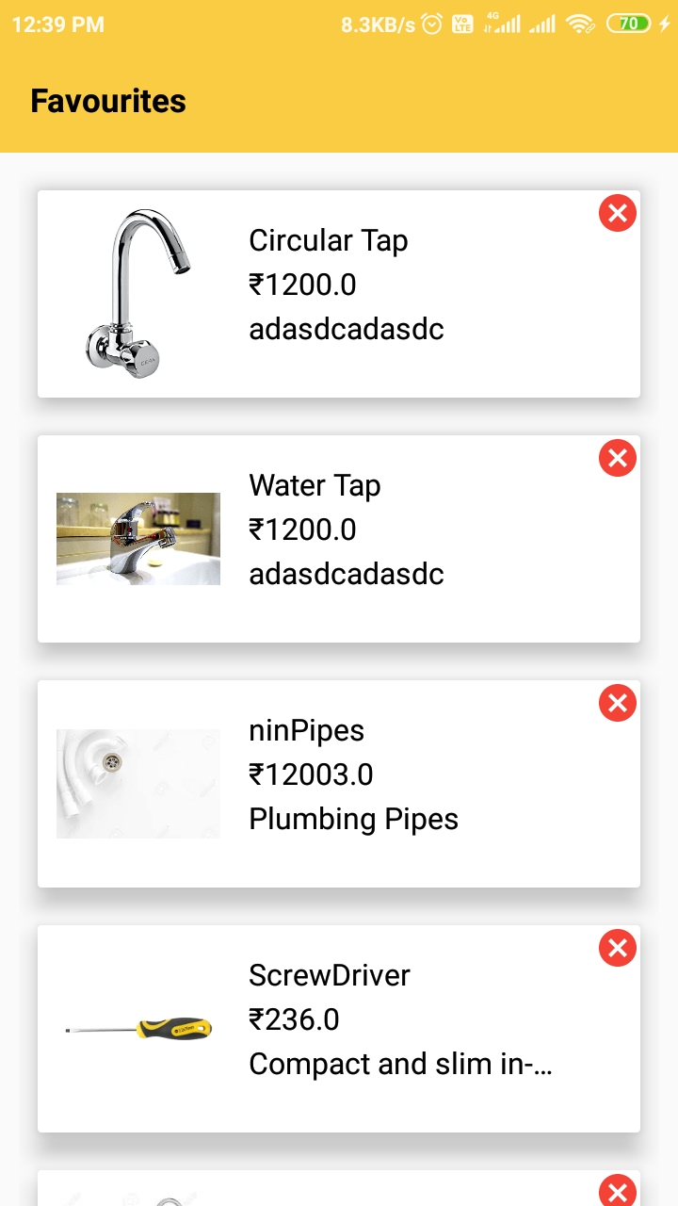
Favorites
Remove product

Slide 29
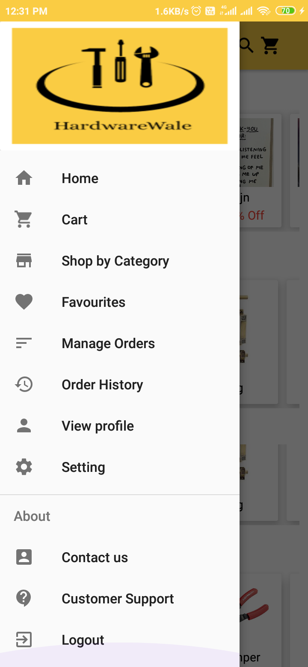
Navigation Drawer
User can easily move to any activity hi wishes to by just clicking on that.

Slide 30
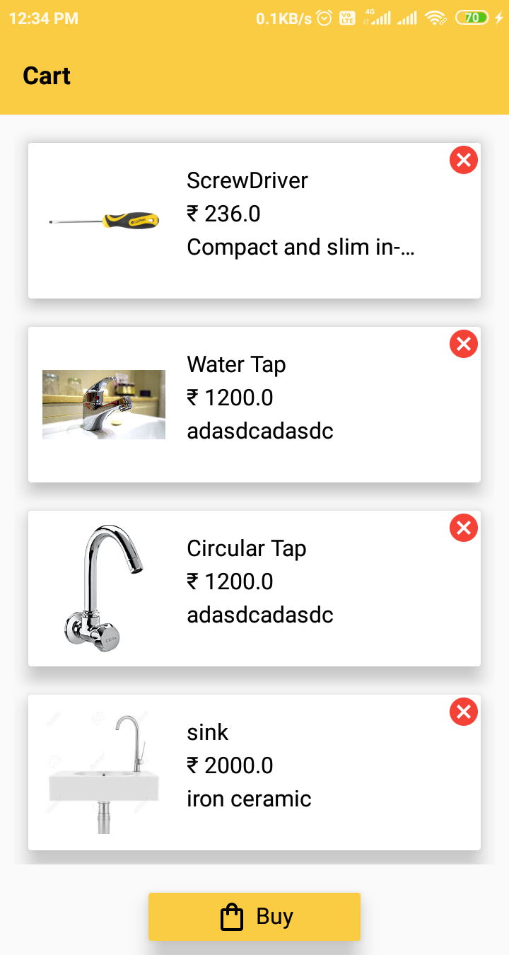
Cart
Cancel Product
Buy All Products

