Slide 1
Indian Institute Of Technology Bombay Project Presentation on Music Genre Classification
Guided By:
Prof. Preeti Rao
Dept. of Electrical Engineering
IIT Bombay
Presented By:
Sunaina Saxena
Roll No. 213070001
Ayushi Thawait
Roll No. 213070011

Slide 2
Introduction : Music Genre Classification
Aim of creating better recommendation playlists.
Classifying in two Genres : Fast/New and Slow/Old
Slow Songs
Slow music is soft and soothing, expresses emotions and have soul-searching characteristics.
Uses violin, cello, drums, trumpets.
Fast Songs
Fast music is loud and mind blowing. It is mainly is a dance music.
Uses electric string instruments accompanied by drum beats.

Slide 3
Outlines:
Introduction
Methodology
Dataset Preparation
Features Details
Classification Model
Performance Analysis
Conclusion
Scope for future work
References

Slide 4
Methodology: Block Diagram
Mp3 Songs Playlist
Converting to .wav and Taking frames
Feature Extraction
Creating CSV file
Classification model
Classified Playlist
Feature Analysis
Accuracy/Error analysis

Slide 5
Dataset Preparation:
3 Frames of 30 second from each song is taken.
36 features are extracted from these frames using libROSA audio analysis library.
Mean and standard deviation of extracted feature array is taken.
Mean and SD of each feature is thrown into CSV file along with their corresponding labels.

Slide 6
Features used for classification:
Zero Crossing Rate (ZCR)
Spectral Centroid
Spectral Contrast
Spectral Bandwidth
Spectral Roll-off
Mel Frequency Cepstral Coefficients (MFCC)

Slide 7
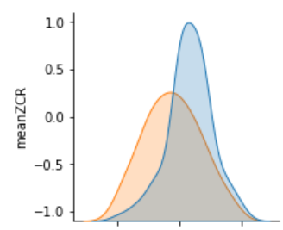

Feature Details:
1. Zero Crossing Rate :
Number of times the amplitude of the signal passes through a value of zero, within a given time interval.
It is commonly used as a measure of the smoothness of an audio signal.
From the extracted feature we got, slow/old songs have low zero crossing rate as compared to fast/New songs. Therefore slow/old songs are comparatively smoother.

Slide 8
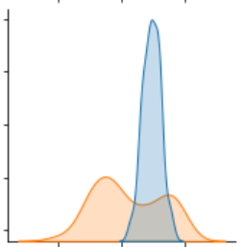
Feature Details:
2. Spectral Centroid:
Spectral centroid relates to the brightness of a signal’s sound.
A higher value of SC corresponds to more energy of the signal being concentrated within higher frequencies.
From the extracted feature we got, fast/New songs have high spectral centroid then slow/old songs which signifies that fast/New songs are more bright and more energy of the signal being concentrated within higher frequencies.

Slide 9
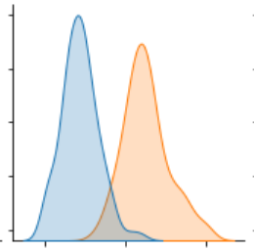

Feature Details:
3. Spectral Contrast :
High contrast values generally correspond to clear, narrow-band signals, while low contrast values correspond to broad-band noise.
From the extracted feature we got, slow/old songs have high spectral contrast then fast/New songs which signifies that Slow/old songs are relatively more clear and narrow-band signals than fast/New songs.

Slide 10
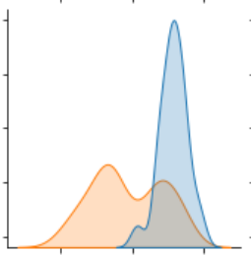
Feature Details:
4. Spectral Bandwidth :
From the extracted feature we got, fast\new songs have more spectral bandwidth than slow\old songs.

Slide 11
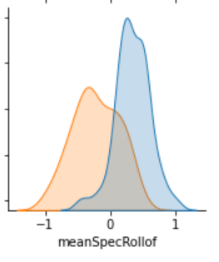

Feature Details:
5. Spectral Roll off:
Spectral Roll off indicates the frequency below which a specified percentage of the total spectral energy (nearly 85%) lies.
From the extracted feature we got, fast\new songs have relatively large spectral Roll off frequency then slow/old songs which signifies that spectral energy of fast/new songs is spread relatively over large frequency range than for slow/old songs.

Slide 12
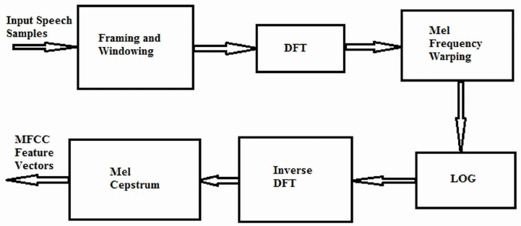
Feature Details:
6. MFCC Coefficients :
MFCC’s are used to represent timbrel information of signal.
First 13 MFCC Coefficients were taken.
Positive valued MFCC represents a sonorant sound. If a MFCC has a negative value, it represents a fricative sound.
Fig: Block Diagram MFCC Coefficients Extraction
Source: https://www.researchgate.net/publication/3908339_Computing_Mel-frequency_cepstral_coefficients_on_the_power_spectrum

Slide 13
Classification Model:
K Nearest Neighbor Classifier
This algorithm is useful when the datapoints are distributed in a non linear manner.
This algorithm assumes the similarity between the new data and available data by calculating Euclidean distance between two points.
Here we select K number of neighbors and calculate Euclidean distance of new datapoint with each neighbor and assign the new data points to that category for which the number of the neighbors is maximum.

Slide 14
Performance :
Configurations for Classification:
Using Zero crossing rate, spectral centroid, spectral contrast, spectral bandwidth and spectral roll-off.
Using lower 6 MFCC coefficients.
Using higher 7 MFCC coefficients.
By taking all the extracted features together.

Slide 15
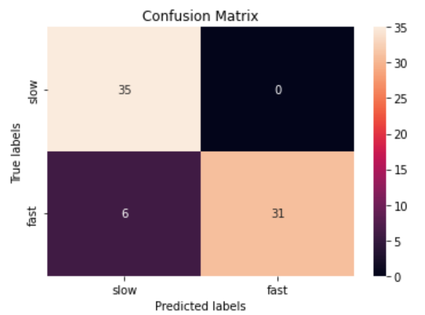
Performance Analysis:
1. Using Zero crossing rate, spectral centroid, spectral contrast, spectral bandwidth and spectral roll-off.
With these features we are getting test accuracy of 91.7%.

Slide 16
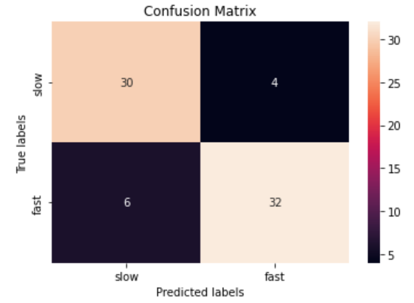
Performance Analysis:
2. Using lower 6 MFCC coefficients.
With these features we are getting test accuracy of 86.1%.

Slide 17
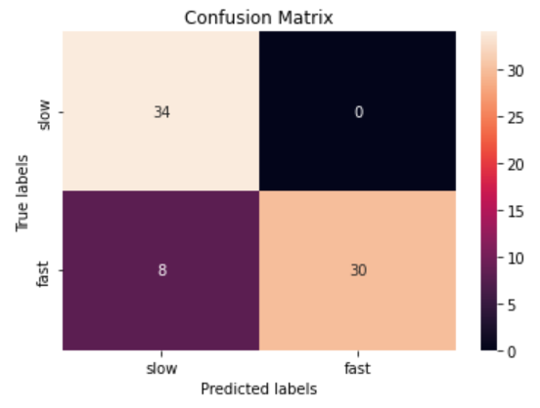
Performance Analysis:
3. Using higher 7 MFCC coefficients.
With these features we are getting test accuracy of 88.9%.

Slide 18
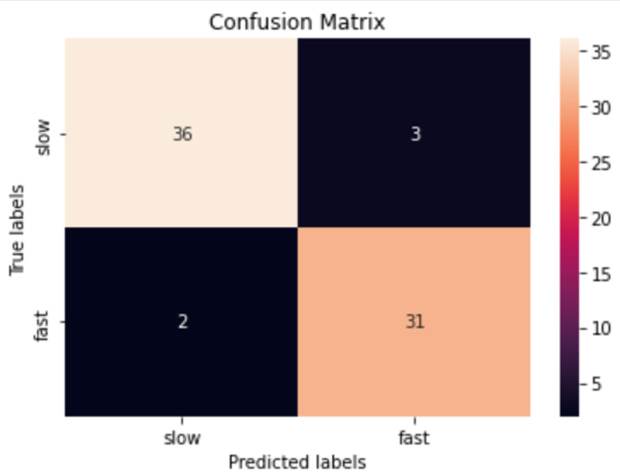
Performance Analysis:
4. By taking all the extracted features together.
With these features we are getting test accuracy of 93.1%.

Slide 19
Conclusion:
Classification was based upon 36 features extracted from each song of the dataset using KNN as a Classifier .
From the 4 configurations we got comparatively better accuracy for first and fourth configuration.
We observed that the features used in first configuration are more important as compared to MFCC coefficients.
Spectral Contrast, Spectral Bandwidth and Spectral Roll-off are the most important features.

Slide 20
Scope for Future Work:
No. of genre can be increased for making the classification task more reliable.
We created our own playlist so our data set was comparatively small (180 frames). This can be increased to make classification more robust.
In the availability of large dataset, Deep Learning Model can also be implemented for classification.

Slide 21
References:
[1] https://data-flair.training/blogs/python-project-music-genre-classification/
[2] https://github.com/alikaratana/Music-Genre-Classification

