Slide 1
Website DELICIOUS BITES
Adarsh Dev
22BCA10050
Susher Pragyan Swain
22BCA10061
Dushyant Chauhan
22BCA10071
Ayushi Sharma
22BCA10072
Deepanshu Yadav
22BCA10075

Slide 2
AGENDA
Difference between website and software
Explaining our website : Delicious bites
Concept used in Delicious Bites
Steps in making of our website
Problems we faced
How we deal with it
Qualities of good website according to us
SDLC usage by us

Slide 3
Difference between website and software
Software | Website
Software generally runs on local computer. | Website generally runs on server.
Software usually consists of set of data or instructions. | Website usually consists of various web pages that are linked together.
It is a program or any operating information that is used by computer. | It is collection of web pages located under single domain name.
Features of software includes efficiency, maintainability, portability, functionality, etc. | Features of website includes easy navigation, product visuals and descriptions, intuitive design, etc.
List of software includes google chrome, adobe acrobat professional, Microsoft internet explorer, etc. | List of website includes YouTube, Google Search, Wikipedia, amazon, etc.

Slide 4
Idea behind our website
Delicious Bites
Basically, our website is for the people like us who love to eat.
The idea behind food network is that to help the people make it easy to eat and save time by connecting them to the best restaurants or cafes near depending on there way to eat food and the type of food they would like to eat whether its Non-Vegetarian, Vegetarian , Chinese or Italian dishes.

Slide 5
Concept used in Delicios bites
HTML : In our website we have used HTML to construct the basic structure our website.
CSS : CSS stands for Cascading Style Sheets that are displayed with the help of HTML to make the website visually beautiful.
Java script :JavaScript (JS) is a cross-platform, object-oriented programming language used by developers to make web pages interactive. It allows developers to create dynamically updating content, use animations, pop-up menus, clickable buttons, control multimedia, etc.

Slide 6
Qualities of a good website
Well Designed and Functional
Easy to Use
Optimized for Mobile
Fresh, Quality Content
Readily accessible
Clear calls to action
Optimized for Search and the Social Web

Slide 7
SDLC Usage
Planning
Defining
Designing
Building
Testing
Deployment
Maintainability

Slide 8
Here, we list all the user requirements . We also included observation view point of the existing workplace.
Here, our user requirements is to list out the restaurants keeping the choice of the user in mind.
Planning

Slide 9
The next step consist of the defining of what we are going to build . It consist between the discussion about the end product between the development team.
In this project we are going to build a website that helps us to find best restaurants according to our taste.
Defining

Slide 10
It is to design individual project with various technical aids . Here , we prepare the architecture of the final project.
Here , we prepare the flowcharts and ERD models of the project we want to develop .
Designing

Slide 11
Now, we are converting flowcharts and ERD models prepared in designing stage into programming language.
We use HTML , CSS and JavaScript in the building portion.
Building

Slide 12
In testing , we apply some use cases to test the working of software at the user end . It checks the validation and verification . Validation is at developer and but verification is at user end .
We validate by cross-checking the code again and again and then verifies it by trying it as a user .
Testing

Slide 13
When we hand over the software to the user for working .
Here , we can’t let our project for deployment process but we can use it ourself only.
Deployment

Slide 14
It is the future updates to meet the user requirement in the future.
We have builded the code such as to make it maintainable.
Maintainability

Slide 15
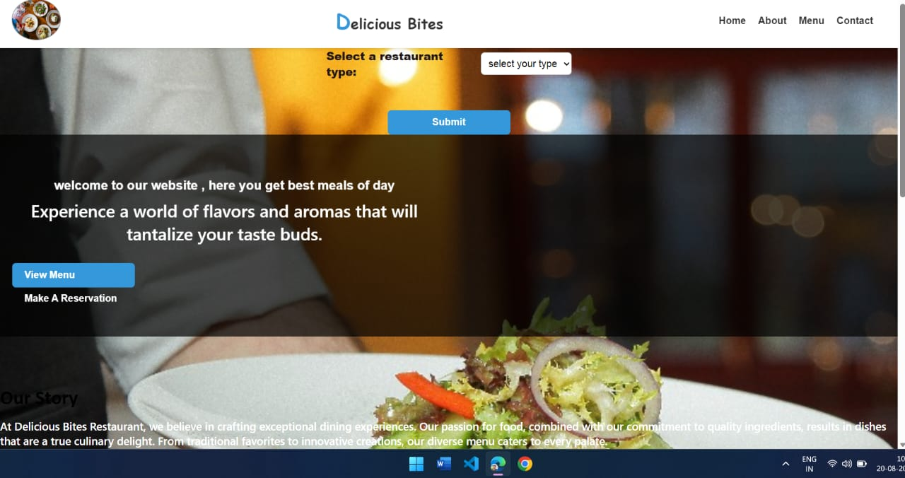
Here, we have our page first look

Slide 16
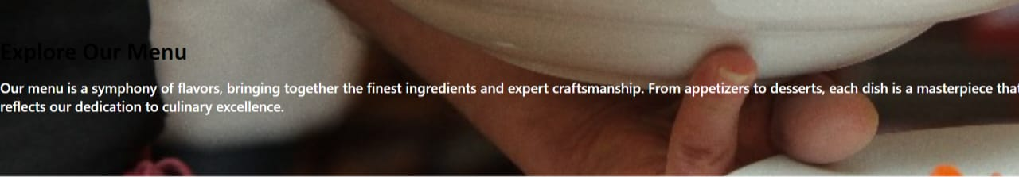
Clicking on the menu will navigate us to
Clicking on the home will give us the same page . Now, let’s see what will it display when we click on the other options shown……

Slide 17
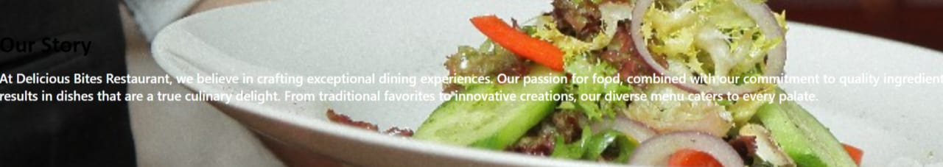
Clicking on the home will give us the same page . Now, let’s see what will it display when we click on the other options shown……
About will navigate to

Slide 18
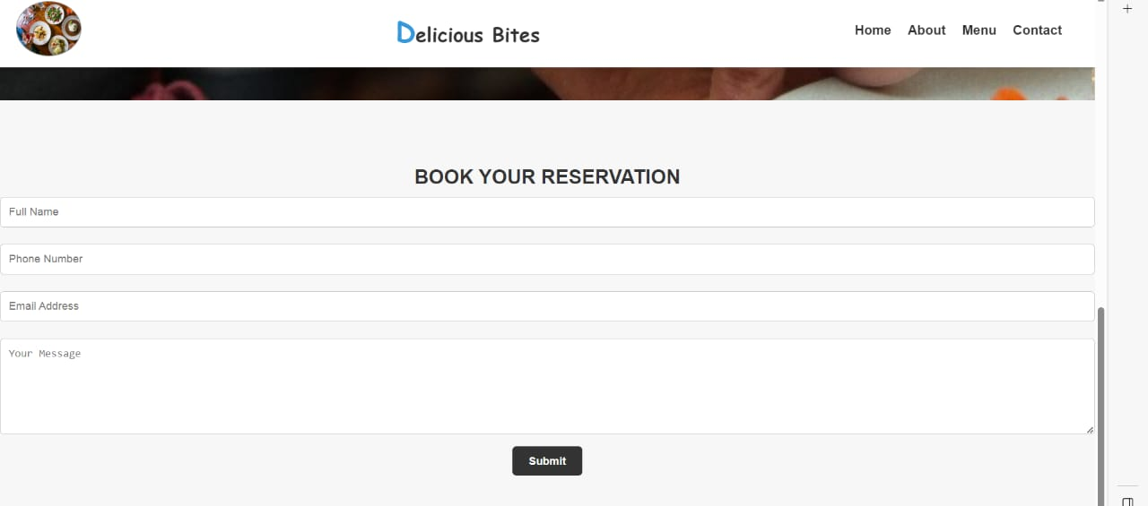
Make a reservation will display…

Slide 19
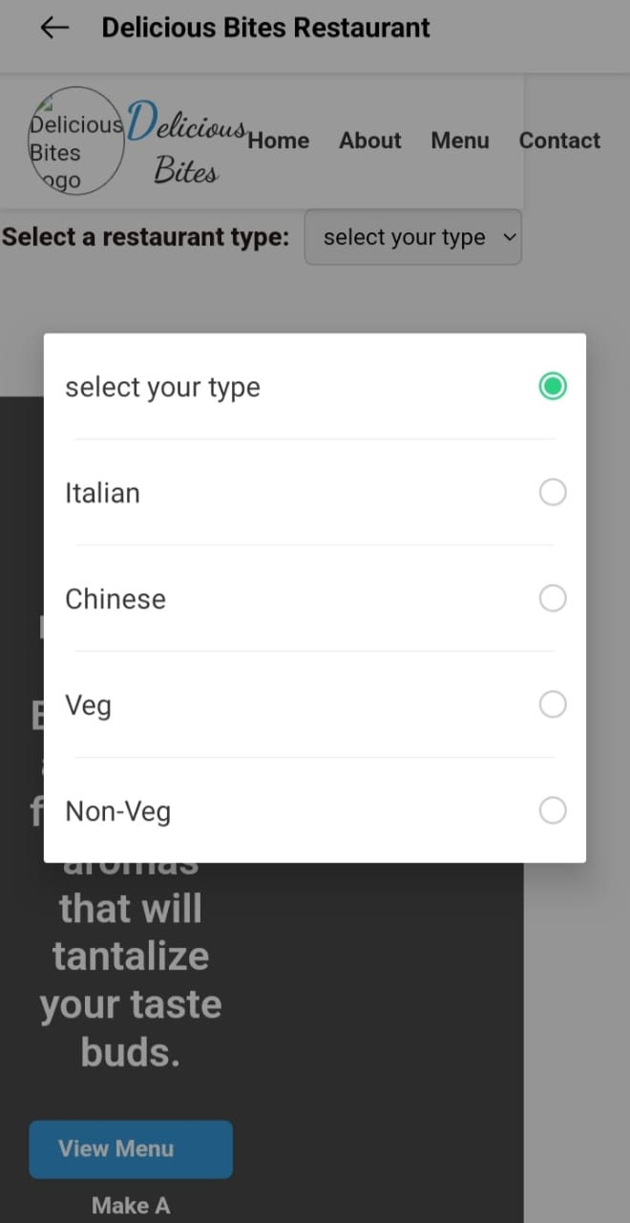
NOW, talking about the select option will display…..

Slide 20
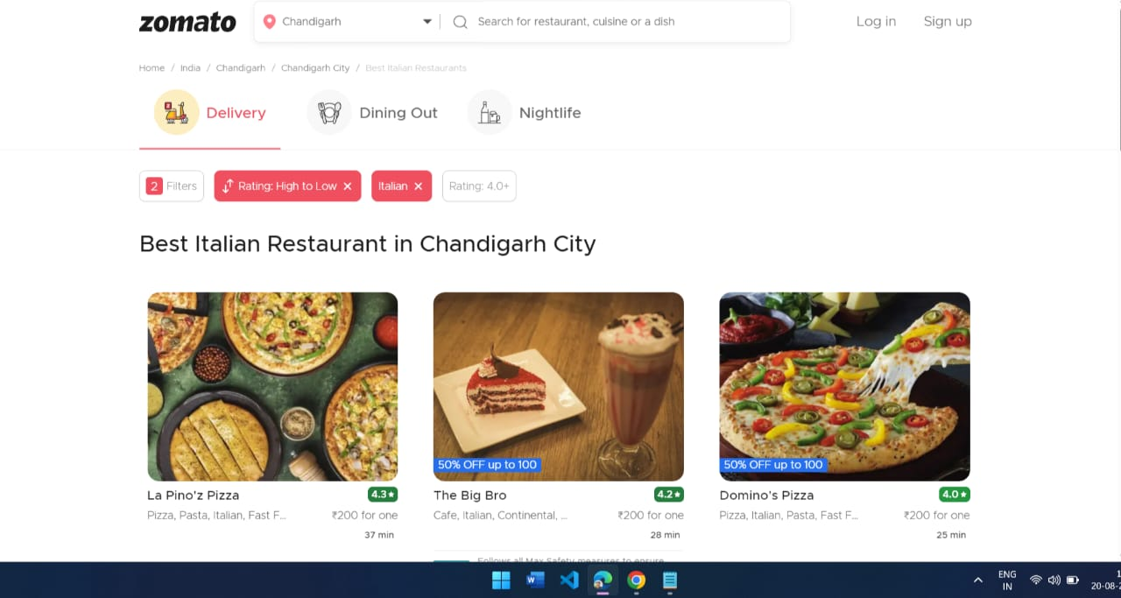
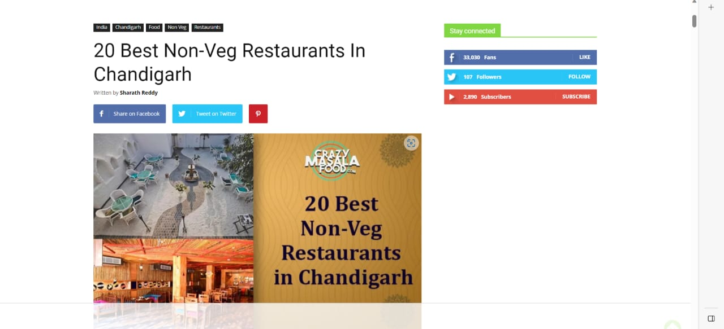
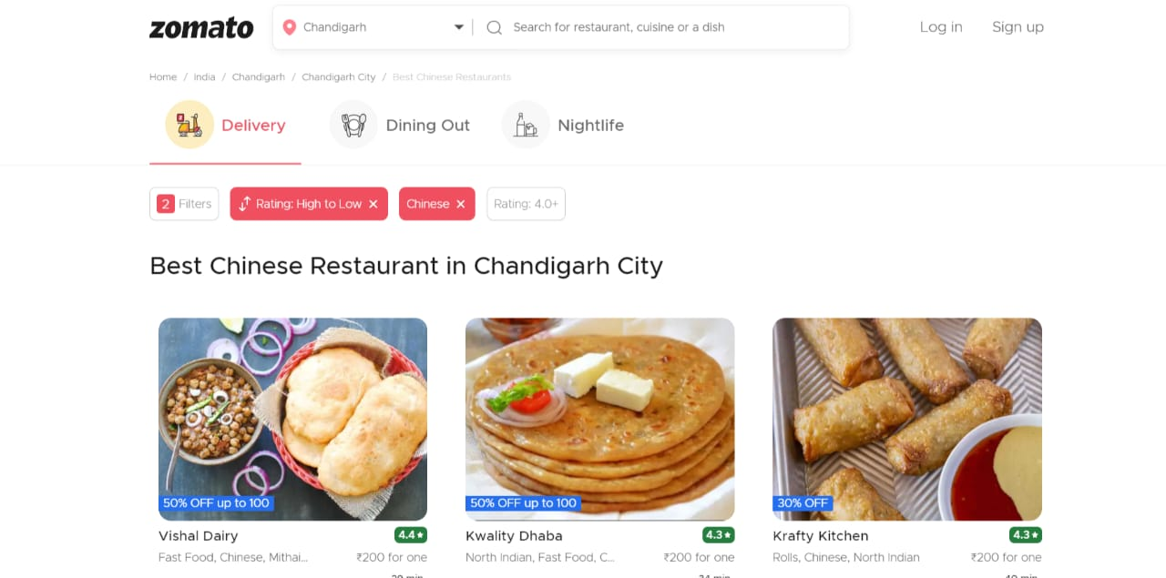
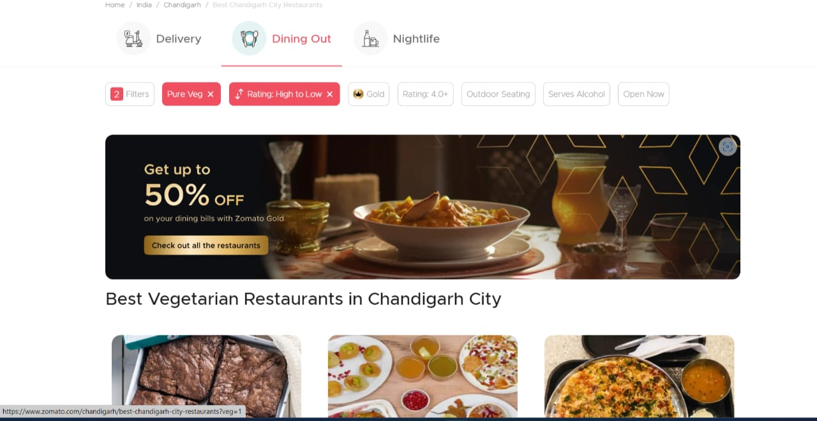
Now, choosing the four will lead to a different webpage like….
Italian
Non-Veg
Chinese
Veg

Slide 21
Thank You
for your time and attention

