Slide 1
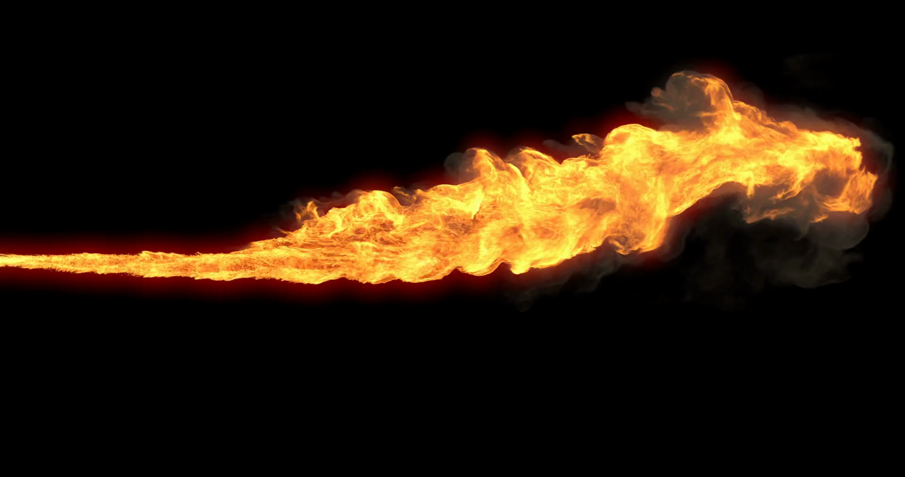
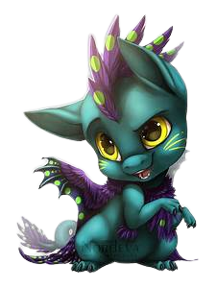
DRAGON ARENA

Slide 2
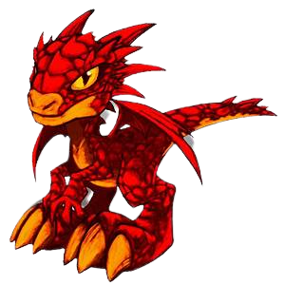
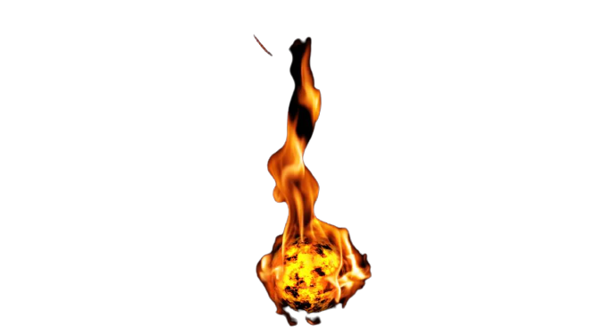
ABOUT OUR GAME:
Concept : Game which runs in loop with objective of player to dodge the obstacles OR kill the enemy!!
NAME | ROLL NO. | GR.NO.
Ayushi Ahuja | 423004 | 21810872
Sandip Patil | 421074 | 17u318
Mohit Mishrikoti | 4230034 | 21810928

Slide 3
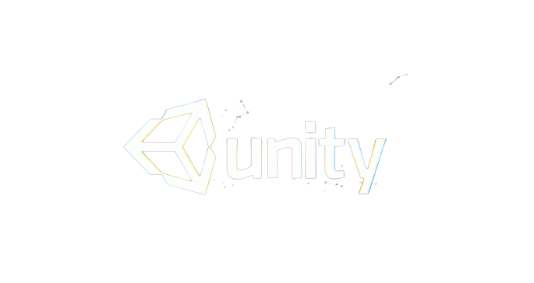
UNITY GAME ENGINE
Unity is a cross-platform game engine developed by Unity Technologies
It is considered easy to use for beginner developers and is popular for indie game development
Engine has been adopted by industries outside video gaming, such as film, automotive, architecture, engineering, construction, and the United States Armed Forces.
Unity was initially released for Mac OS X, later adding support for Microsoft Windows and Web browsers.

Slide 4
2D- PLATFORMER
2D platform games, are a variation of platform video games that were a very popular genre of video games. 2D platformers originated in the early 1980s and in the mid 1990s, platformers made the transition to 3D.
At first, platformers took place on a single screen, where the player would have to overcome certain obstacle
the 2D platform games began to introduce scrolling levels, where the players scrolled left to right, with the playable character viewed from a side angle

Slide 5
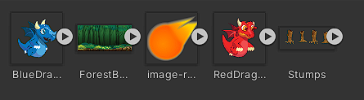



ASSETS- ART
A main player
with physics (Rigidbody component)
and collisions (Collider component)
Character
Only polygon collider used
with physics (Rigidbody component)
and collisions (Collider component)
Fire ball weapon

Slide 6
RIGID BODY -2D
A Rigidbody 2D component places an object under the control of the physics engine
Many concepts familiar from the standard Rigidbody
component carry over to Rigidbody 2D; the differences are that in 2D, objects can only move in the XY plane and can only rotate on an axis perpendicular to that plane.

Slide 7
COLLIDER-2D
Collider components define the shape of a GameObject for the purposes of physical collisions.
A collider, which is invisible, does not need to be the exact same shape as the GameObject’s mesh .
A rough approximation of the mesh is often more efficient and indistinguishable in gameplay

Slide 8
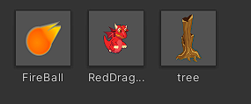
PREFABS
When you want to reuse a GameObject configured in a particular way – like a non-player character (NPC), prop or piece of scenery – in multiple places in your Scene, or across multiple Scenes in your Project, you should convert it to a Prefab.
This is better than simply copying and pasting the GameObject, because the Prefab system allows you to automatically keep all the copies in sync.

Slide 9
------------SCRIPTS-------------
Dragon Killer
Enemy
Fireball
Move-left
Enemy Move Up – Down
Shooter
Jump
Dragon Killer
Enemy
Fireball
Move-left
Enemy Move Up – Down
Shooter
Jump

Slide 10
THANK YOU

