Slide 1


APEX INSTITUTE OF TECHNOLOGY
DEPARTMENT OF COMPUTER SCIENCE & ENGINEERING
Agile Practices (22CSH-292)
Faculty: Mamta Sharma(E15565)
TOPIC2.1: Product Development
DISCOVER . LEARN . EMPOWER
APEX INSTITUTE OF TECHNOLOGY COMPUTER SCIENCE AND ENGINEERING

Slide 2

Learning Outcome of this lecture
Unit | Name | Outcome
I | Understanding common Agile Practices in DevOps | Introduction to Product Management, Product Design and Requirement gathering, Product Design Challenges, UX Design, Product Development Methodologies,
CO 1 Apply the Agile Methodology and comparing various other software development models with agile
T
APEX INSTITUTE OF TECHNOLOGY COMPUTER SCIENCE AND ENGINEERING

Slide 3
overview
Responsible of product manager (PM).
Differences between product and general marketing management.
Marketing organization:
  Product-focused organizations.
  Market-focused organizations.
  Functionally-focused organizations.
Critical skills of PM.
Changes in marketing organizations.

Slide 4
Product manager
The planning activities related to the management of product(s) or product line.
  Analyzing the market & turning this information into marketing objectives & strategies for the product.
Obtaining organizational support for the marketing plan.
  Involve coordinating with other areas of the firm.
  Involve in internal marketing of the product – obtain assistance & support of more senior managers in the firm.
Analyzing potential partner relationship for the product.

Slide 5
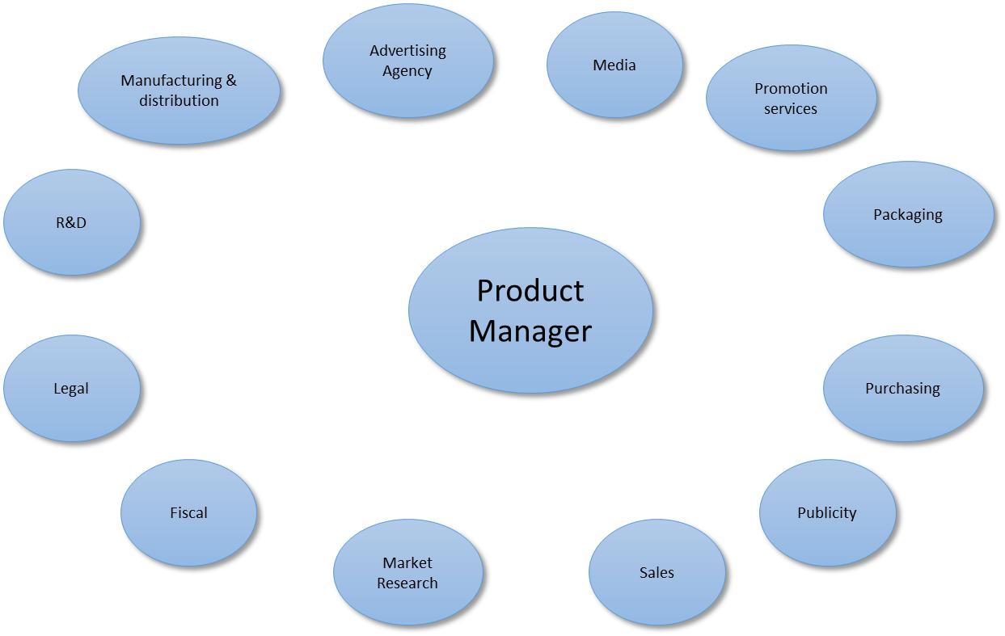
A Product manager’s potential interactions

Slide 6
Product vs general marketing management
 | Product Management | General Marketing Mgmt
Scope of responsibility | Narrow: Single product or product line | Broad: Portfolio of products
Nature of decision making | Mainly tactical | Mainly strategic
Time horizon | Short-run(annual or shorter) | Long-run

Slide 7
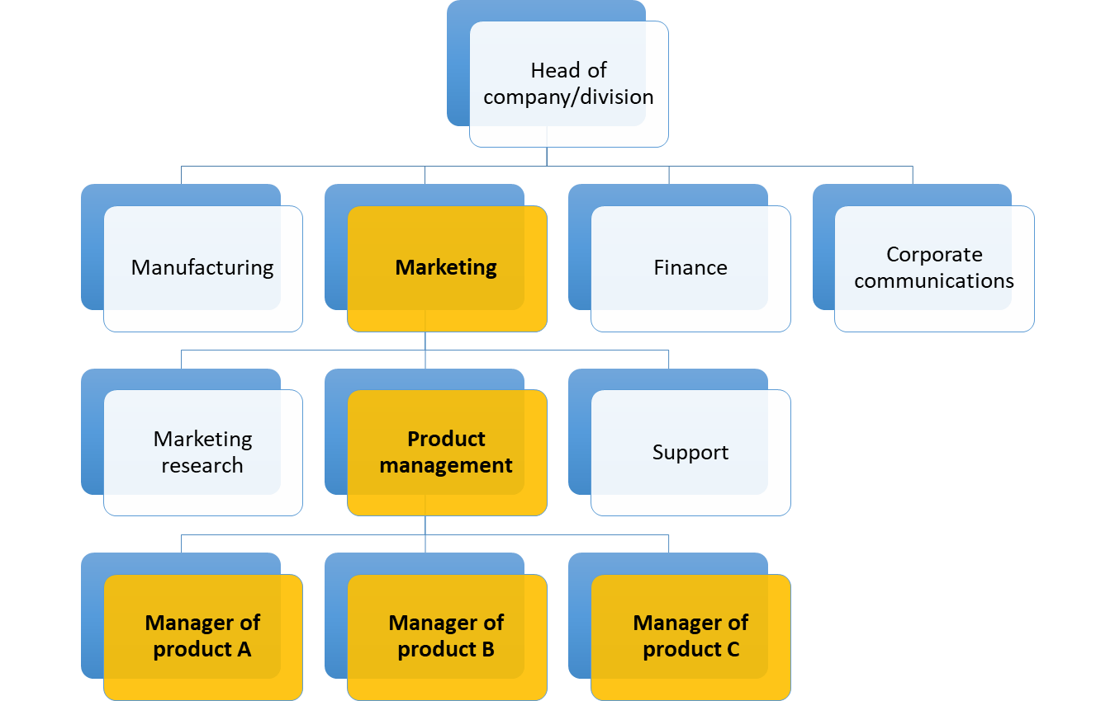
Marketing organization product-focused organizations

Slide 8
PRODUCT-FOCUSED ORGANIZATIONS
Used where different products use the same channel distribution.
Product Manager acts as a “mini-CEO” by taking responsibility for the overall health of the brand.
A well-defined hierarchy within the product management system will developed. (refer to the hierarchy structure)
Key roles are assigned to assistant and associate product managers
  Assistant PM - market & share forecasting, budgeting, coordinating with production, executing promotion, packaging, etc.
  Associate PM – more freedom to develop brand extension.

Slide 9
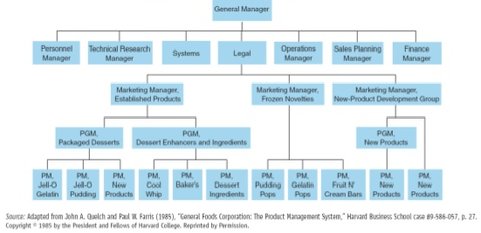
General foods corporation: desserts division organizational chart

Slide 10
PRODUCT-FOCUSED ORGANIZATIONS
Lead to the “death of the product manager system” and widespread burnout among them.
This burnout are:
focus on short term - stifles innovation
an explosion of marketing data leading into information overloads,
corporate downsizing; and
more responsibility and pressure with less autonomy.

Slide 11
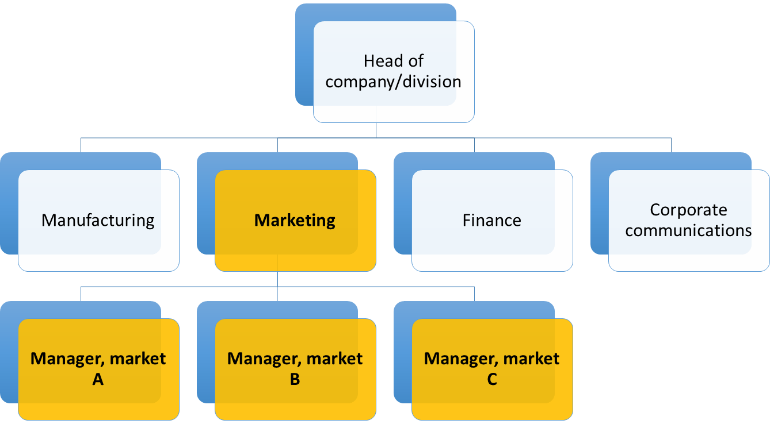
Marketing organization market-focused organizations

Slide 12
MARKET-FOCUSED ORGANIZATIONS
Defines marketing authority by market segment(s).
Useful when there are differences in buyer behavior – different marketing strategies and tactics are used.
Example – banks define their segment into corporate vs consumer business (customer size).

Slide 13
MARKET-FOCUSED ORGANIZATIONS
Advantages:
  Focus on customer – modification/elimination of a product.
  Resource & knowledge sharing – easier to get the PM to pull together.
  Work well for ‘system’ or bundle sale – different segment with different strategy or tactic.
Disadvantages:
  Potential conflict within the product management structure – different internal system to serve different segments.
  Less sharing of resources across division.

Slide 14
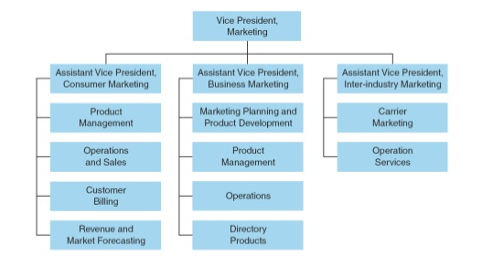
REGIONAL BELL OPERATING COMPANY

Slide 15
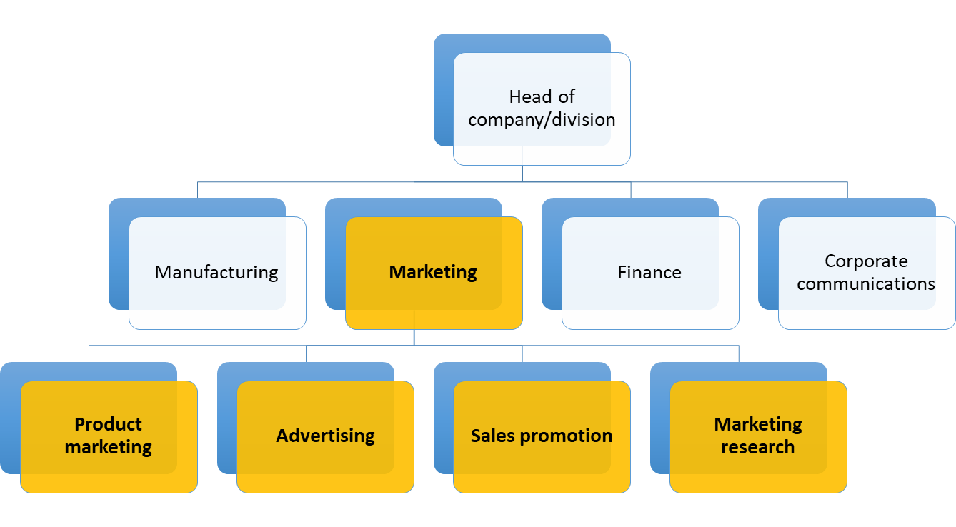
Marketing organization functionally-focused organizations

Slide 16
FUNCTIONALLY-FOCUSED ORGANIZATIONS
Align the company by marketing functions.
No single person is responsible for the day-to-day health of a product.
CEO and VP make marketing strategy decisions.
Strategies are implemented through discussion and coordination among the functional areas.
Works well when the company is producing only two products.

Slide 17
FUNCTIONALLY-FOCUSED ORGANIZATIONS
Advantages:
  Administrative simple – the groups are designed to be parallel to normal marketing activities.
  Specialization.
  Well-coordinated.
Disadvantages:
  Who is ultimately responsible for the product?
  Substantial time in solving problems.
  Focused only on functional development.

Slide 18
Marketing Organization:
Toy Manufacturer
Vice president, marketing
Marketing
support
Advertising and public relations
Publications
Consumer administration
Merchandising

Slide 19
Critical skills of product management
Negotiation
  Product manager must be persuasive & able to influence the management.
Teamwork
  Product manager must synthesize information from a variety departments.
Communication skills
  Product manager communicates the product/brand to internal & external parties.
Analytical ability
  Product manager needs to analyze & interpret all the figures such as sales targets, share vs competition, e.g.

Slide 20
Changes affecting product management
The web
  New channel distribution, communication medium, & creating a community around a brand.
  customer acquisition and retention.
  part of the brand building and will affect many facets of the product manager’s job.
The data explosion
  Increase the use of IT - effective marketing today requires sophisticated information management.
  For consumer goods better time for market shares, sales and distribution. (Eg: Scanner ).
  Laptop computer guide transmission of competitor information.
  Use of “data mining’ software and traffic data.

Slide 21
Changes affecting product management
The increased emphasis on brands
  Brand is the greatest assets of a company.
  Focus on brand equity.
Changes in the balance of market power
  Involvement in IT partners between manufacturers and sellers both has equal access to sales and market share data.
  The balance power in distribution channels has shifted from the manufacturer to retailer.
  Consumers & retailers hold bigger marker power.

Slide 22
Changes affecting product management
Increased importance of customer retention programs
  Company focus on the lifetime-value-of-a-customer concept.
  Customer services and satisfaction programs, advertising and promotion programs.
Increased global competition
  Not appropriate organization structure .
  Obtain experience & knowledge about how a variety of cultures conduct business.
  Forming trade blocks (Eg: European Union, South America, economy free – trade zone).

Slide 23
Coming class – customer analysis
What we need to know about customers?
  Who buys & uses the product?
  What customers buy & how they use it?
  Where customers buy?
  When customers buy?
  How customers choose?
  Why they prefer a product?
  How they respond to marketing program(s)?
  Will they buy it (again)?
Segmentation.
  Desirable criteria for segments.
  Methods for market segmentations.

Slide 24
Main Text:
  Lehmann, D. R. & Winer, R. S. (2005). Product management. (4thed.).New York: McGraw-Hill.
  Keller, K. L. (2012). Strategic Brand Management: Building, Measuring, and Managing Brand Equity. (4th ed.). Prentice Hall.

Slide 25
THANK YOU
APEX INSTITUTE OF TECHNOLOGY COMPUTER SCIENCE AND ENGINEERING

