Slide 1

APEX INSTITUTE OF TECHNOLOGY
DEPARTMENT OF COMPUTER SCIENCE & ENGINEERING
Agile Practices (22CSH-292)
Faculty: Mamta Sharma(E15565)
Lecture 1.2.2: Loop drive in Agile Approach
DISCOVER . LEARN . EMPOWER

Slide 2
Learning Outcome of this lecture
CO1 | Understand the Agile Methodology and comparing various other software development models with agile.
CO2 | Examine Scrum and test driven development
CO3 | Apply the various tools available to agile teams to facilitate the project
CO4 | Analyze the method to improve results for a specific circumstance
CO5 | Evaluate likely successes and formulate plans to manage likely risks or problems

Slide 3
Learning Outcome of this lecture
Unit | Name | Outcome
I | Understanding common Agile Practices in DevOps | Introduction to Product Management, Product Design and Requirement gathering, Product Design Challenges, UX Design, Product Development Methodologies, Product Marketing and Presentation, Traditional Software Development Methodologies, Problem/issues with traditional approach, Agile Development, Agile Manifesto, Scrum Model, Agile Estimations and Planning, Soft skills in agile
CO 1 Apply the Agile Methodology and comparing various other software development models with agile
T

Slide 4
Outline
Loop Drive
Empathy Map
As-Is Scenario
Big Idea Vignettes

Slide 5
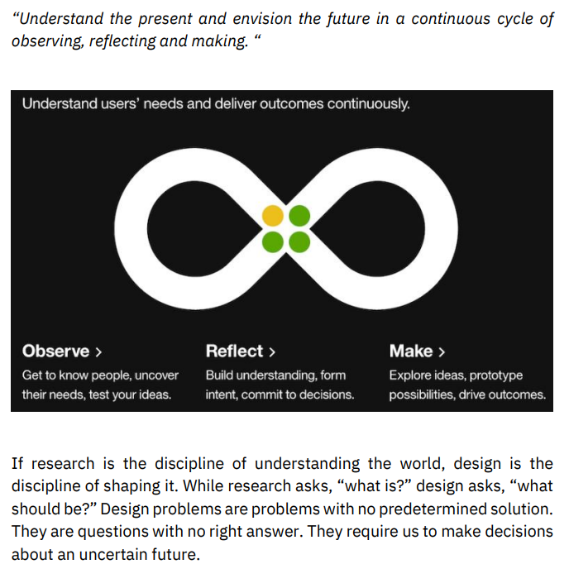
The Loop Drive

Slide 6
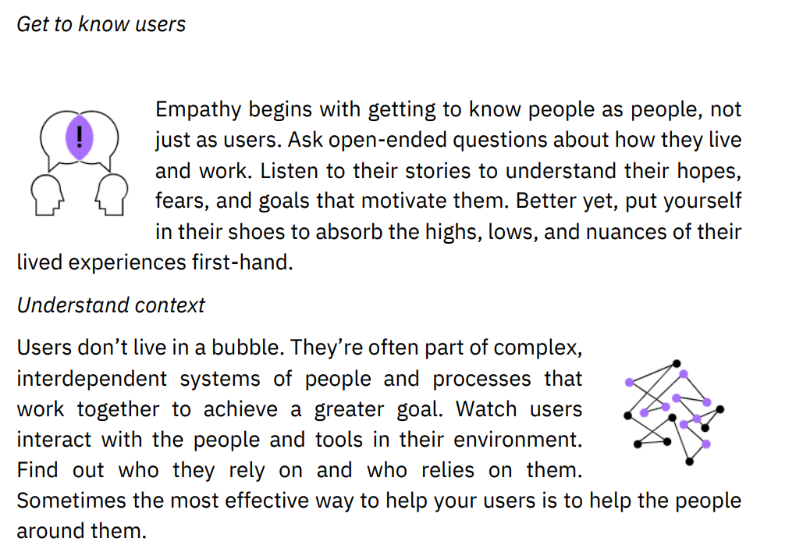
The Loop Drive

Slide 7
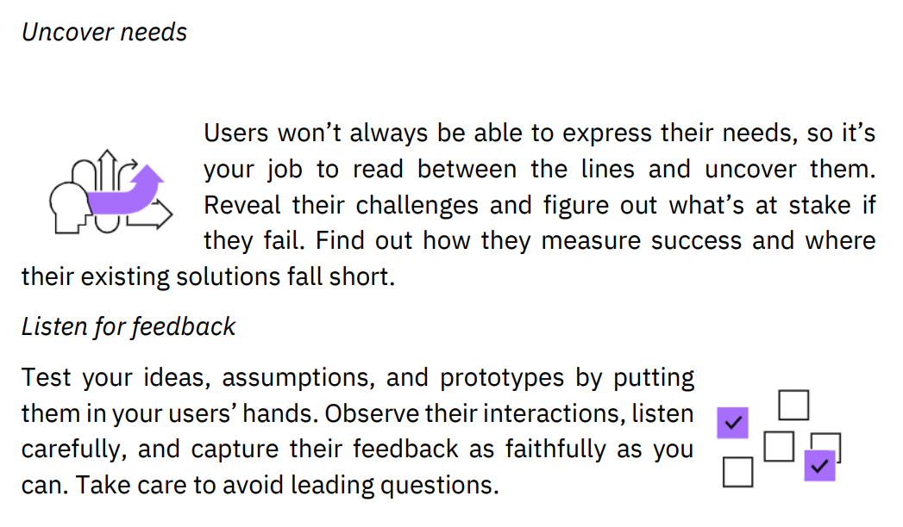
The Loop Drive

Slide 8
Empathy Map
It’s the first principle of IBM Design Thinking that we must focus on our users. And the second principle of IBM Design Thinking compels us to work in multidisciplinary teams.
Empathy Maps tie these principles together, taking advantage of our multidisciplinary teams to improve our understanding of the user. At any given moment, you may find yourself working with a group of people that have, through research or personal experience, various perspectives of the user. Whenever client teams, implementers, salespeople, or any of the many other roles in an organization need to better understand a user, they can do this exercise together.

Slide 9
Empathy Map
Instructions
1. Come prepared with observations Empathy mapping is only as reliable as the data you bring to the table, so make sure you have defensible data based on real observations (for example, from an interview or contextual inquiry). When you can, invite users or Sponsor Users to participate.
2. Set up the activity Draw a grid and label the four essential quadrants of the map: Says, Does, Thinks, and Feels. Sketch your user or stakeholder in the center. Give them a name and brief description of who they are and what they do.
3. Capture observations Have everyone record what they know about the user or stakeholder. Use one sticky note per observation. Place it on the appropriate quadrant of the map

Slide 10
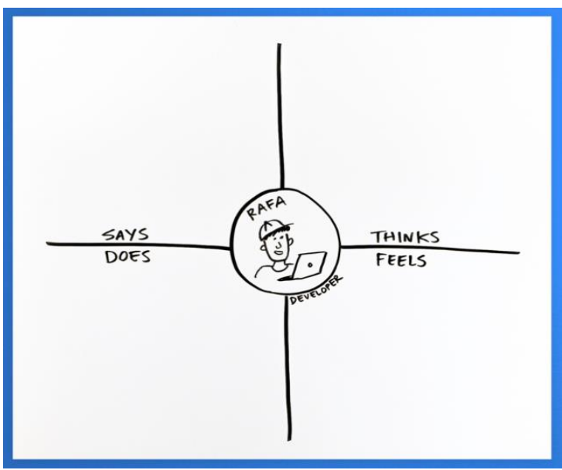
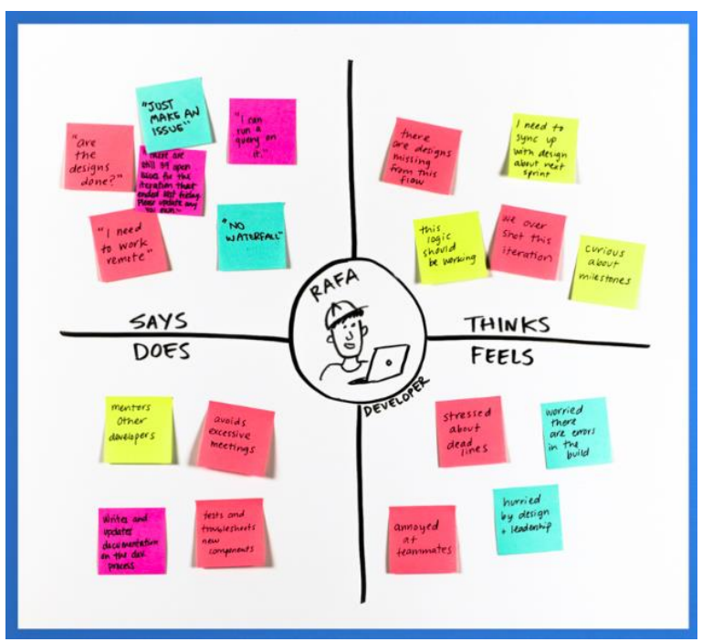
Empathy Map

Slide 11
Empathy Map
Instructions
4. Find patterns and identify unknowns Within each quadrant, look for similar or related items. If desired, move them closer together. As you do, imagine how these different aspects of your user’s life really affect how they feel. Can you imagine yourself in their shoes?
5. Playback and discuss Label anything on the map that might be an assumption or a question for later inquiry or validation. Look for interesting observations or insights. What do you all agree on? What surprised you? What’s missing? Make sure to validate your observations with a user or Sponsor User if they weren’t involved in the activity.

Slide 12
As-Is Scenario
After you understand your persona and have a reasonable amount of empathy for them, it's time to take a closer look at the problem or opportunity space that you want to impact. You probably have an idea of the area that you want to target.
As-is Scenario Maps help to document collective understanding of user workflows and are best used as precursors to exploring new ideas or for finding the right problem to solve.

Slide 13
As-Is Scenario
Set up the activity Draw four rows and label each: Phases, Doing, Thinking, and Feeling
Brainstorm individually Ask yourselves: “What is our user doing, thinking, and feeling throughout their experience?” Fill in the corresponding rows, using one sticky per answer.
Review and identify phases Use this time to cluster similar stickies, refine the order, and draw rough columns that represent the unique phases of your user’s current experience. Be sure to name the phases
Identify the highs and lows Circle and label areas that are particularly positive or negative for your user, as well as blank areas where you need to learn more.

Slide 14
Big Idea Vignettes
Set up the prompt Begin the activity with a good prompt, such as a needs statement, a user story, a Hill, or just a pain point identified in an As-is Scenario Map. Write this prompt somewhere everyone can see it.
Generate ideas, not features A big idea describes the experience a user might have with the solution. Features describe the implementation of a solution. If you find that your ideas are starting to depict features, try using metaphor: “It’s kind of like...”
Diverge Create many big ideas and quickly share them with each other. Build off others’ ideas but stay out of the weeds and avoid drifting into features or talking about implementation details.
Cluster, title, & discuss Look for similar ideas and natural affinities. Move them physically closer together. As you do, name the clusters. Identify any clusters or individual ideas that stand out. Converge on a set that you would want to advance

Slide 15
Text Books and Reference Books
T1 Agile Project Management with Kanban - Book by Eric Brechner
T2 Agile Foundations: Principles, Practices and Frameworks – Peter Measey
Reference Books:
1 Agile Project Management with Kanban Eric Brechner 2nd Microsoft Press 2021
2 Agile Foundations Peter Measey(4th BCS,) The Chartered Institute for IT 2015

Slide 16
References
https://www.mygreatlearning.com/blog/importance-of-design-thinking/
https://www.interaction-design.org/literature/article/5-stages-in-the-design-thinking-process
https://en.wikipedia.org/wiki/Design_thinking

Slide 17
THANK YOU
For queries
Email: pavandeep.e15947@cumail.in

