Slide 1
8085
Microprocessor

Slide 2
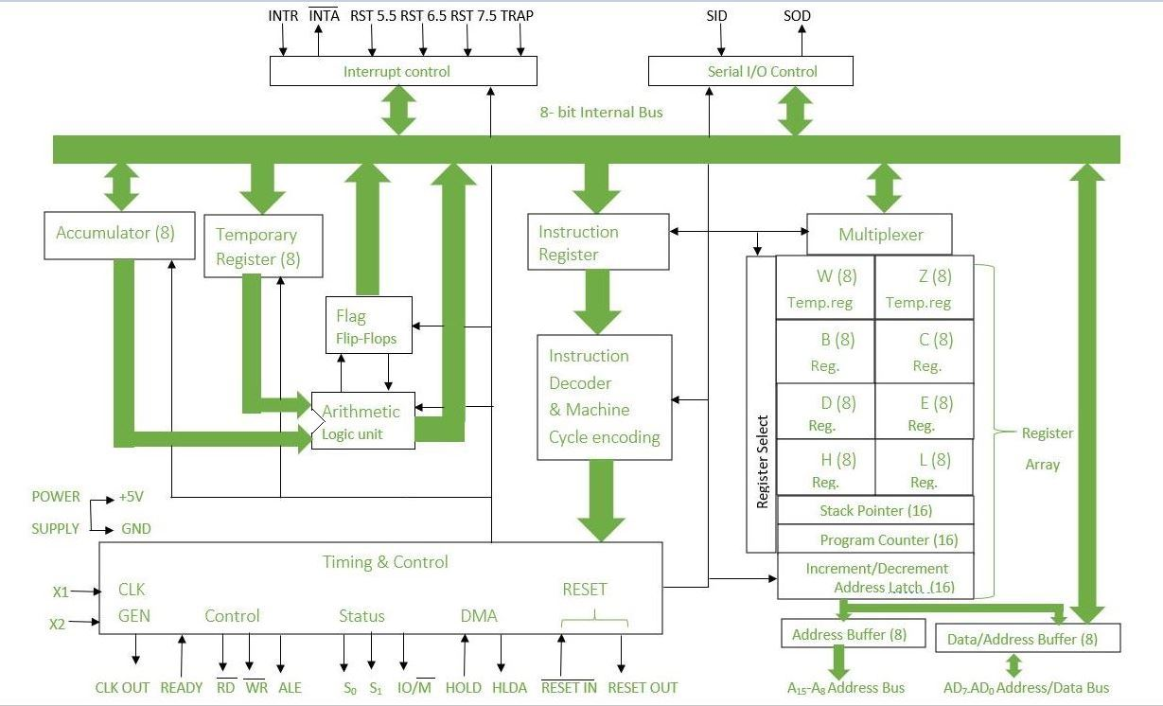
Architecture

Slide 3
Arithmetic and Logic Unit (ALU) :
It is used to perform mathematical operations like addition, multiplication, subtraction, division, decrement, increment, etc. Different operations are carried out in ALU: Logical operations, Bit-Shifting Operations, and Arithmetic Operations.
Flag Register:
It is an 8-bit register that stores either 0 or 1 depending upon which value is stored in the accumulator. Flag Register contains 8-bit out of which 5-bits are important and the rest of 3-bits are “don’t Care conditions”. Different Fields of Flag Register:
Carry Flag
Parity Flag
Auxiliary Carry Flag
Zero Flag
Sign Flag

Slide 4
Accumulator:
Accumulator is used to perform I/O, arithmetic, and logical operations. It is connected to ALU and the internal data bus.
The accumulator is the heart of the microprocessor because for all arithmetic operations Accumulator’s 8-bit pin will always there connected with ALU and in most-off times all the operations carried by different instructions will be stored in the accumulator after operation performance.
General Purpose Registers:
There are six general-purpose registers. These registers can hold 8-bit values. These 8-bit registers are B,C,D,E,H,L. These registers work as 16-bit registers when they work in pairs like B-C, D-E, and H-L.
Here registers W and Z are reserved registers. We can’t use these registers in arithmetic operations. It is reserved for microprocessors for internal operations like swapping two 16-bit numbers.

Slide 5
Program Counter :
Program Counter holds the address value of the memory to the next instruction that is to be executed. It is a 16-bit register.
Stack Pointer :
It works like a stack. In stack, the content of the register is stored that is later used in the program. It is a 16-bit special register. This pointer is very useful in stack-related operations like PUSH, POP initiated by Microprocessor. It reserves the address of the most recent stack entry.
Instruction register and decoder:
It is an 8-bit register that holds the instruction code that is being decoded. The instruction is fetched from the memory.

Slide 6
Timing and control unit:
The timing and control unit comes under the CPU section, and it controls the flow of data from the CPU to other devices. It is also used to control the operations performed by the microprocessor and the devices connected to it. There are certain timing and control signals like Control signals, DMA Signals, RESET signals and Status signals.
Interrupt control:
Whenever a microprocessor is executing the main program and if suddenly an interrupt occurs, the microprocessor shifts the control from the main program to process the incoming request. After the request is completed, the control goes back to the main program. There are 5 interrupt signals in 8085 microprocessors: INTR, TRAP, RST 7.5, RST 6.5, and RST 5.5.
Priorities of Interrupts: TRAP > RST 7.5 > RST 6.5 > RST 5.5 > INTR

Slide 7
Address bus and data bus:
The data bus is bidirectional and carries the data which is to be stored. The address bus is unidirectional and carries the location where data is to be stored.
In the 8085 microprocessor, the address bus and data bus are two separate buses that are used for communication between the microprocessor and external devices.
The Address bus is used to transfer the memory address of the data that needs to be read or written. The address bus is a 16-bit bus, allowing the 8085 to access up to 65,536 memory locations.
The Data bus is used to transfer data between the microprocessor and external devices such as memory and I/O devices. The data bus is an 8-bit bus, allowing the 8085 to transfer 8-bit data at a time.

Slide 8
Serial Input/output control:
It controls the serial data communication by using Serial input data and Serial output data.
Serial Input/Output control in the 8085 microprocessor refers to the communication of data between the microprocessor and external devices in a serial manner, i.e., one bit at a time.

Slide 9
8085 PIN DIAGRAM

Slide 10
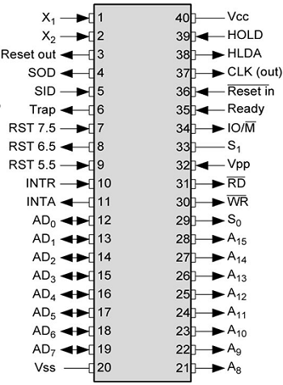

Slide 11
Address bus
A15-A8, it carries the most significant 8-bits of memory/IO address.
Data bus
AD7-AD0, it carries the least significant 8-bit address and data bus.
Multiplexed Address /Data Bus
The signal lines AD₀-AD₇ are bidirectional: they serve a dual purpose. They are used as the low-order address bus as well as data bus.
In executing an instruction, during the earlier part of the cycle, these lines are used as the low-order address bus.
During the later part of the cycle, these lines are used as the data bus.
This is known as multiplexing the bus.

Slide 12
RD − This signal indicates that the selected IO or memory device is to be read and is ready for accepting data available on the data bus.
WR − This signal indicates that the data on the data bus is to be written into a selected memory or IO location.
ALE − It is a positive going pulse generated when a new operation is started by the microprocessor. When the pulse goes high, it indicates address. When the pulse goes down it indicates data.

Slide 13
Three status signals are IO/M, S0 & S1.
IO/M
This signal is used to differentiate between IO and Memory operations, i.e. when it is high indicates IO operation and when it is low then it indicates memory operation.
S1 & S0
These signals are used to identify the type of current operation.
Power supply
There are 2 power supply signals − VCC & VSS. VCC indicates +5v power supply and VSS indicates ground signal.

Slide 14
Clock signals
There are 3 clock signals, i.e. X1, X2, CLK OUT.
X1, X2 − A crystal (RC, LC N/W) is connected at these two pins and is used to set frequency of the internal clock generator. This frequency is internally divided by 2.
CLK OUT − This signal is used as the system clock for devices connected with the microprocessor.

Slide 15
Interrupts & externally initiated signals
Interrupts are the signals generated by external devices to request the microprocessor to perform a task. There are 5 interrupt signals, i.e. TRAP, RST 7.5, RST 6.5, RST 5.5, and INTR.
INTA − It is an interrupt acknowledgment signal.
RESET IN − This signal is used to reset the microprocessor by setting the program counter to zero.
RESET OUT − This signal is used to reset all the connected devices when the microprocessor is reset.
READY − This signal indicates that the device is ready to send or receive data. If READY is low, then the CPU has to wait for READY to go high.
HOLD − This signal indicates that another master is requesting the use of the address and data buses.
HLDA (HOLD Acknowledge) − It indicates that the CPU has received the HOLD request and it will relinquish the bus in the next clock cycle. HLDA is set to low after the HOLD signal is removed.

Slide 16
Control and status signals
These signals are used to identify the nature of operation. There are 3 control signal and 3 status signals.
Three control signals are RD, WR & ALE.
Address Latch Enable - This is a positive going pulse generated every time the 8085 begins an operation; it indicates that the bits AD7-AD0 are address bits. This signal is primarily used to latch the low-order address from multiplexed bus and generate a separate set of eight address lines.

