Slide 1
Human Activity Recognition System using Smartphone Sensors
Group 4:
1. Ayushi Mishra (21111262)
2. Rakesh (21111051)

Slide 2
Related Work
1. Majority of the Systems in past have adopted many fixed accelerometer in different places of the human body. However they are not applicable to daily life for long term monitoring due to many sensors attached in human body or lot of cable connections.
2. Some used fixed accelerometer in waist , but they could not show good accuracy in complex situations such as transitional activities (sit to stand, lie to stand, and stand to sit)
3. Other used Body Sensors network , or a combination of sensors like gyroscope, temperature, heart rate sensors. It was also observed that using Gyroscope, the recognition performance was improved when combined with accelerometer.
4. So , the smartphone is an alternative for activity recognition due to the support of diversity of sensors in it.
5. Handling sensors with fast processing capabilities , made smartphone a very useful tool in Smart Home environment.

Slide 3
6. [1] proposed a HAR system for 12 different activities, focussing on three main components: Sensing, Feature Extractions and Recognition.
7. They used the accelerometer and gyroscope sensor for sensing. For feature extraction, they remove noise such as gravity from triaxial acceleration using filters like median and low-pass butter worth filter.
8. The Recognition was finally performed with ANN, SVM and Deep Belief Networks. So, the DBN gives the best result.
9. [2] proposed a HAR system for 6 different activities using Deep convolutional Neural Networks. One of the drawback they explained was that in traditional machine learning models, the feature extraction is a time consuming and complex task.
10. Also, in Activity Recognition different person performs same kind of activity in different ways.
11. So, the Convolutional Neural Networks (Convnets) characterizes the features easily using convolution and pooling operation.

Slide 4
Dataset Collection and Description
By using the sensors(Gyroscope and accelerometer) in a smartphone, they have captured '3-axial linear acceleration'(tAcc-XYZ) from accelerometer and '3-axial angular velocity' (tGyro-XYZ) from Gyroscope with several variations
Accelerometer readings are divided into gravity acceleration and body acceleration readings, which has x, y and z components each.
Jerk signals are calculated for Body Acceleration readings.
Fourier Transforms are made on the time readings to obtain frequency readings.
These sensor signals are preprocessed by applying noise filters and then sampled in fixed-width windows(sliding windows) of 2.56 seconds each with 50% overlap. i.e., each window has 128 readings.
30 subjects(volunteers) data is randomly split to 70% training data and 30% test data.
Each window of readings is a datapoint of 561 features

Slide 5
Time Domain Signals
Frequency Domain Signals
Vectors for other signals
Labels
tBodyAcc-XYZ
tGravityAcc-XYZ
tBodyAccJerk-XYZ
tBodyGyro-XYZ
tBodyGyroJerk-XYZ
tBodyAccMag
tGravityAccMag
tBodyAccJerkMag
tBodyGyroMag
tBodyGyroJerkMag
fBodyAccJerk-XYZ
fBodyGyro-XYZ
fBodyAccMag
fBodyAccJerkMag
fBodyGyroMag
fBodyGyroJerkMag
fBodyAcc-XYZ
gravityMean
tBodyAccMean
tBodyAccJerkMean
tBodyGyroMean
tBodyGyroJerkMean
WALKING as 0
WALKING_UPSTAIRS as 1
WALKING_DOWNSTAIRS as 2
SITTING as 3
STANDING as 4
LAYING as 5

Slide 6
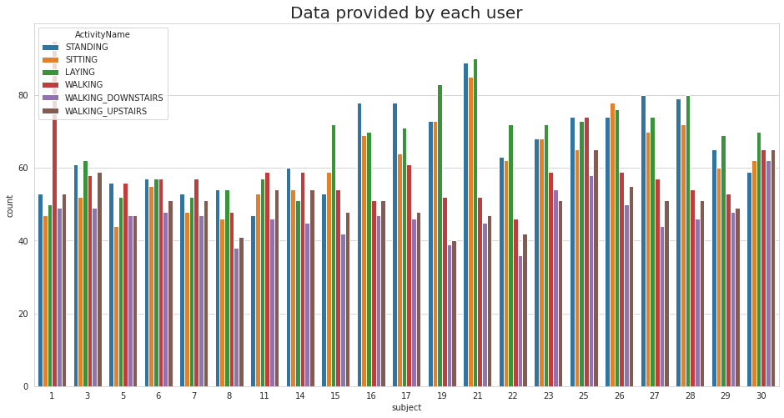
Data Analysis
We have got almost same number of reading from all the subjects

Slide 7
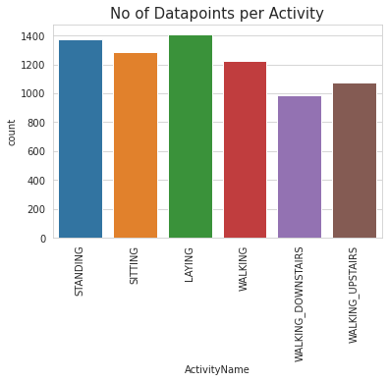
Our data is well balanced (almost)

Slide 8
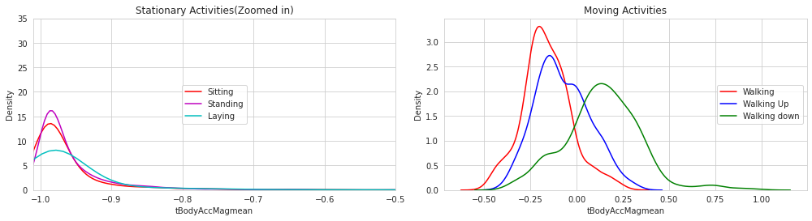
Data Analysis

Slide 9
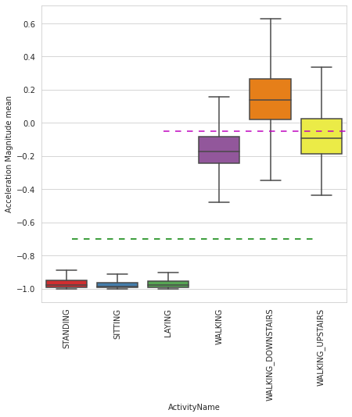
Box Plot
Observations:
If Mean Acceleration magnitude is < -0.8 then the Activities are either Standing or Sitting or Laying.
If Mean Acceleration magnitude is > -0.6 then the Activities are either Walking or Walking_Downstairs or Walking_Upstairs.
If Mean Acceleration magnitude > 0.0 then the Activity is Walking_Downstairs.

Slide 10
Proposed Method
70 : 30
Dataset
Data Preprocessing
(Cleaning, Transformation
Exploratory
Data Analysis
Sampling
Testing
Data
Machine Learning / Deep Learning Model
Training
Data
Predictions of Activity
(Standing , Sitting, Laying, walking, Walking upstairs and walking downstairs
Test Set
Model Classifier

Slide 11
Machine Learning Models
1. We have trained different ML models : Decision Trees, Random Forest and Support Vector Machine and Logistic Regression.
2. For SVM model, linear kernel which gave the accuracy of 84.11%.
3. Logistic Regression gave the highest accuracy of 85%
ML Models | Accuracy | Training Time
Decision Trees | 68.7% | 14.78sec
Random Forest | 71.39% | 42.27sec
Support Vector Machine | 84.11% | 2.64sec
Logistic Regression | 85% | 4.77sec

Slide 12
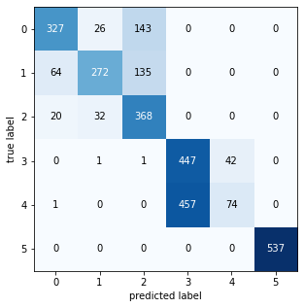

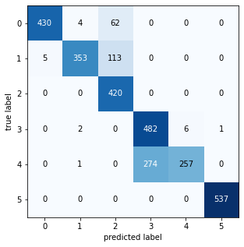

Decision Trees
Random Forest
SVM
Logistic Regression

Slide 13
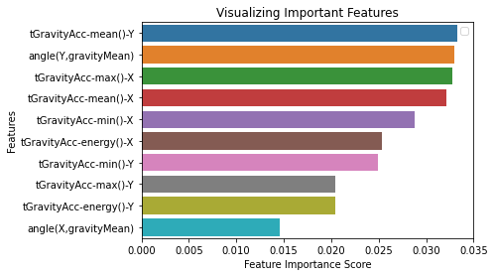
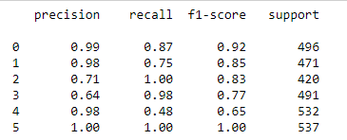
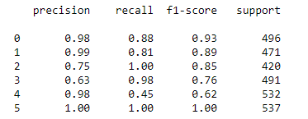
SVM
Logistic Regression

Slide 14
Deep Learning Models
Artificial Neural Network (ANN)
1. The ANN model consists of 5 hidden layers with first 2 layers with 64 hidden units, third hidden layer then contains 128 hidden units followed with 196 hidden units layer. The last hidden layer consists of 32 units.
2. All the hidden layer used ReLu function. The output layer uses Softmax function.
Epoch | 10
Batch Size | 20
Loss | Categorical Cross entropy
Optimizer | Adam
Accuracy | 88.3%
Training Time | 21sec

Slide 15
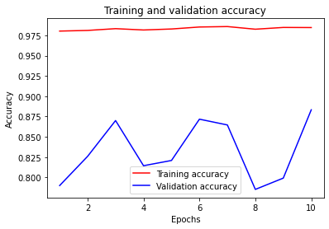
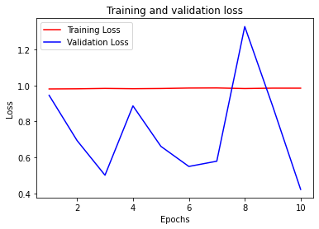

Slide 16
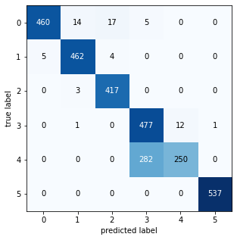
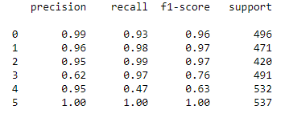

Slide 17
1D Convolutional Neural Network (1D CNN
x1
CONV 1D
CONV 1D
x2
MaxPooling
Layer
FLATTEN
OUTPUT LAYER
x3
DENSE LAYER
x4
xn
ReLu and Softmax Function
Filters=64
Filters=64

Slide 18
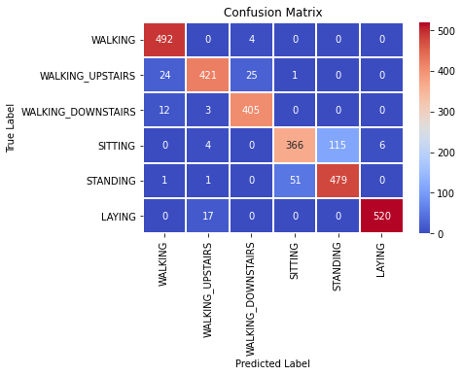
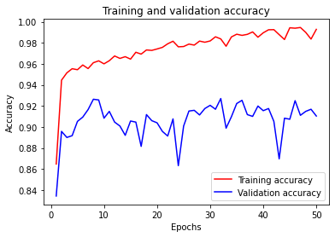
Accuracy | 91.04%
Training Time | 8min 51sec
Epoch | 50
Batch Size | 20

Slide 19
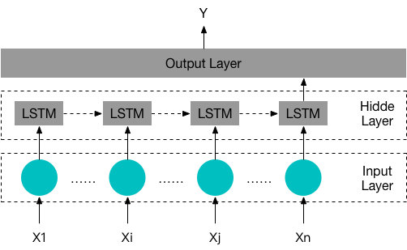
Long-Short Term Memory (LSTM)

Slide 20
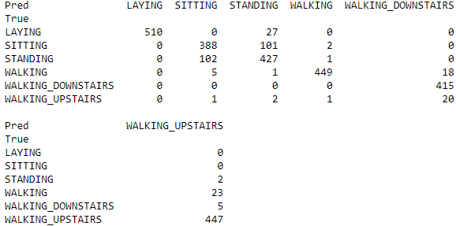
Accuracy | 89.45%
Training Time | 19min 43sec
Epochs | 30
Batch Size | 16
Hidden units | 32
Loss | Categorical Cross Entropy
Optimizer | rmsprop

Slide 21
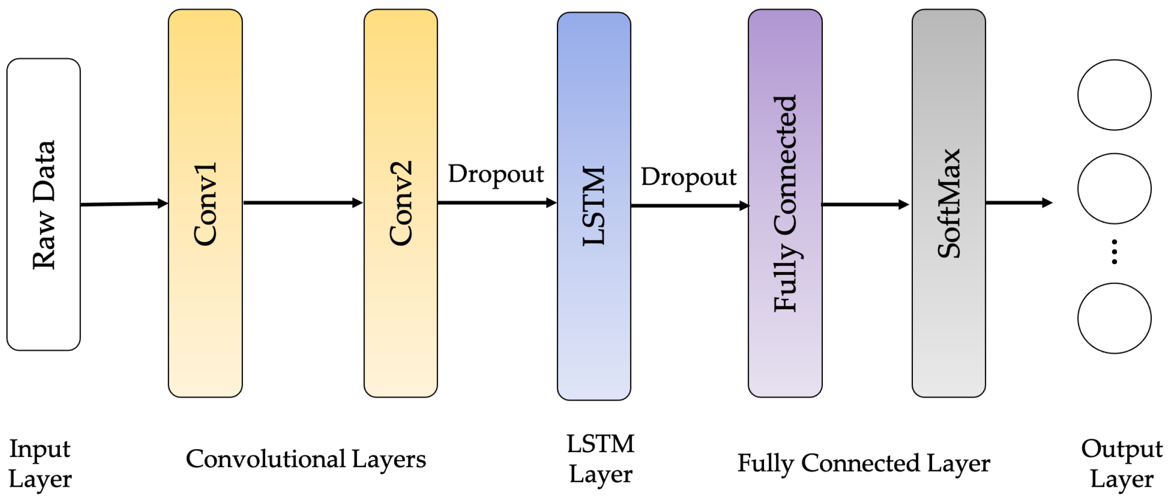
CNN-LSTM

Slide 22
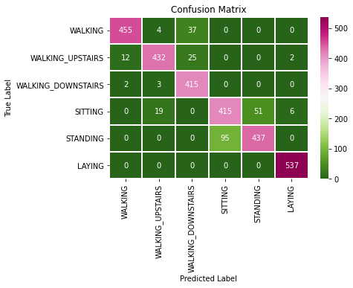
Accuracy | 91.31%
Training Time | 38 min 30sec
Epoch | 50
Batch Size | 20

Slide 23
Results
Algorithms | Accuracy | Training Time
CNN-LSTN | 91.31% | 39min 30sec
CNN | 91.04% | 8min 51sec
LSTM | 89.45% | 19min 43 sec
ANN | 88.3% | 21sec
Logistic Regression | 85% | 4.77sec
SVM | 84.11% | 2.644sec
Random Forest | 71.39% | 42.27sec
Decision Trees | 68.7% | 14.78sec

Slide 24
Challenges
1. There is a diversity of age, gender, and number of subjects
2. A lot of postural transitions.
3. They can only be applied to certain fixed locations
4. Having Similar postures. So, it is difficult to differentiate in that case.
5. The cost for the full deployment of such sensors is often very high

Slide 25
Future Work
1. Human Activity Recognition can be done with Image and Video data.
2. Collection of Diverse Data to get more generalized results.

Slide 26
References
1. Ronao, C. A., & Cho, S. B. (2016). Human activity recognition with smartphone sensors using deep learning neural networks. Expert Systems with Applications, 59, 235-244. https://doi.org/10.1016/j.eswa.2016.04.032
2. Hassan, Mohammad & Uddin, Md. Zia & Mohamed, Amr & Almogren, Ahmad. (2017). A robust human activity recognition system using smartphone sensors and deep learning. Future Generation Computer Systems. 81. 10.1016/j.future.2017.11.029. https://doi.org/10.1016/j.future.2017.11.029

Slide 27
Thank You

