Slide 1
Applied Data Science Capstone Finding the best location for a coffee shop in Bangalore
By – Ayushi Tomar

Slide 2
Business Problem
The objective of this capstone project is to analyze and select the best neighborhood in the city of Bangalore to open a new coffee shop.
Using data science methodology and machine learning techniques like clustering, this project will aim to provide a solution to the question: Which neighborhood in the city of Bangalore would a stakeholder of a coffee shop look to open a business.

Slide 3
Data Cleaning and Acquisition
Data source was Bangalore Zomato kaggle dataset. This data set contains the required information. And we will use this data set to explore various locality of city.
Initially there were 17 columns in the Zomato Dataset of Bangalore after cleaning 8 columns were there. They were address, name, rate, votes, location, rest_type, cuisines, and listed_in.

Slide 4
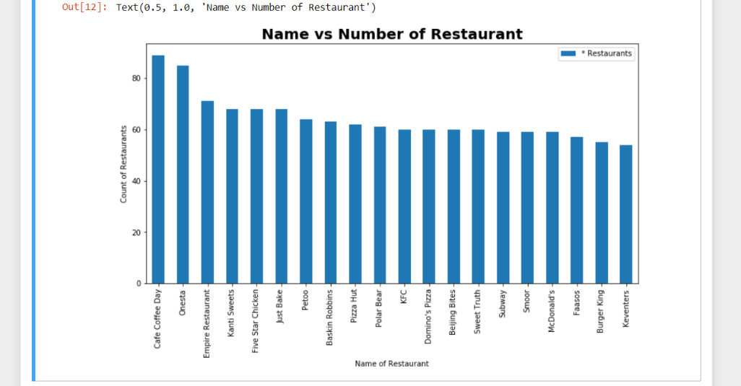
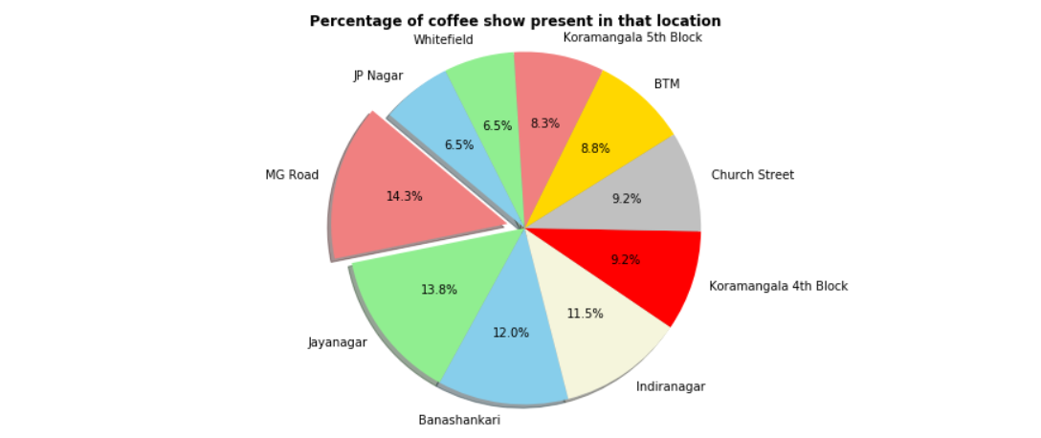
Methodology
From that columns and rows we discovered the count of maximum restaurant that are presently in Bangalore. And we discovered that Café Coffee Day was having 89 branches in total in Bangalore. Onesta, Empire restaurant, kanti sweets and five star chicken were after CCD.
From the required dataset I took out the rows which only have coffee shops detail so that I can get the 5 most crowded areas where potential traffic is highest.

Slide 5
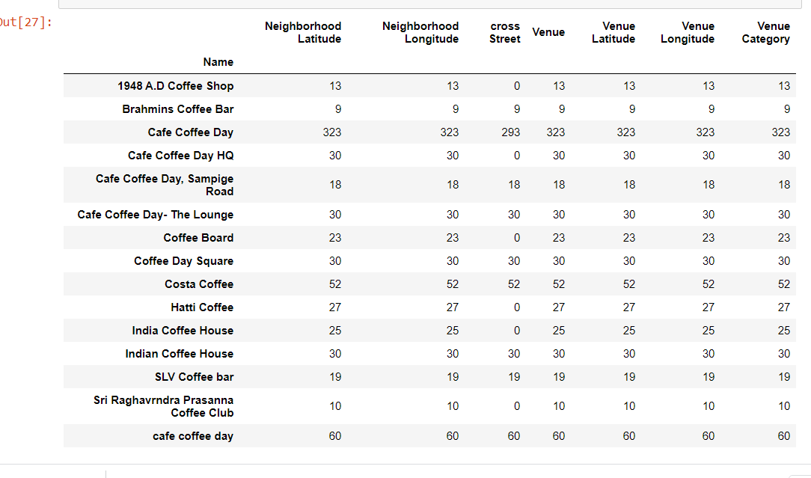
Continued.. Using Foursquare API
Grouping the data using ‘name’ column for better understanding of which coffee shop is present in which location.

Slide 6
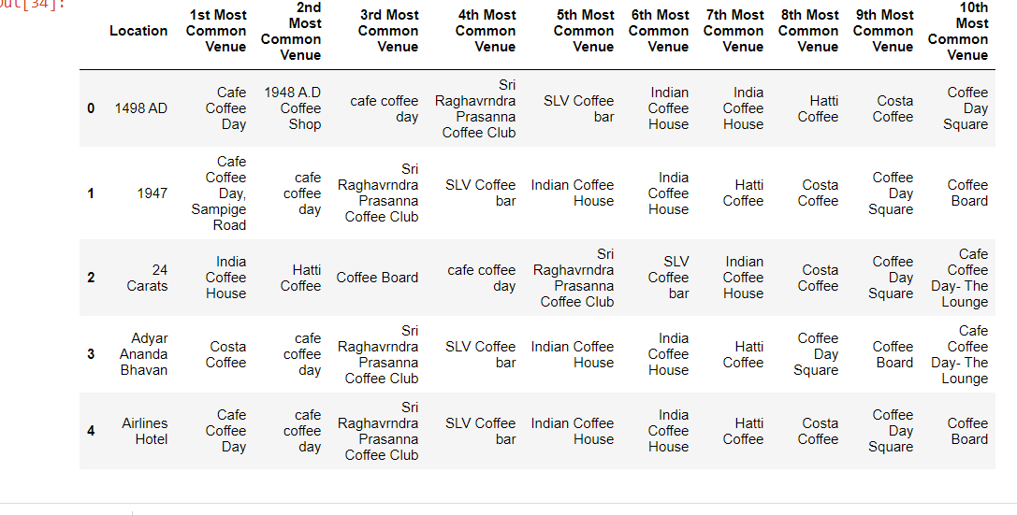
Continued… Dataframe along with location and their 10 most common venues(coffee shops)

Slide 7
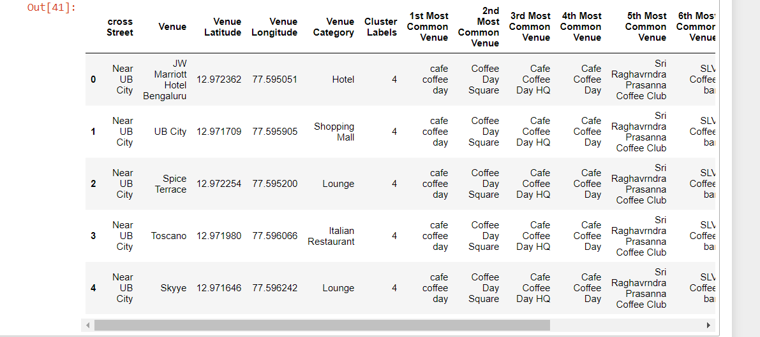
Putting into pandas Dataframe

Slide 8
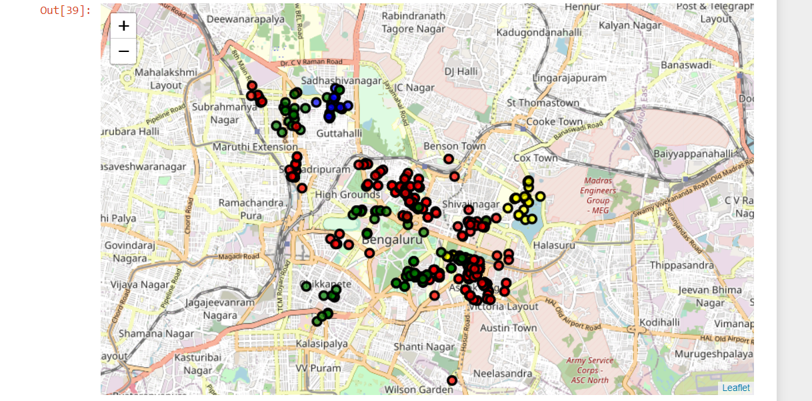
Result
From the following graph you can see MG Road, Church Street, Banshakari, VV puram, Kormangala, shivajinagar and Ashok Nagar have maximum number of coffee shops in Bangalore. So the potential traffic for coffee is maximum here. Someone who is entrepreneur and who is looking for a location to open coffee shop in Bangalore he/she can check the availability of space in these areas or around this.

