Slide 1

IILM UNIVERSITY, GREATER NOIDA
INTERNSHIP REPORT PRESENTATION
AWS Gen AI
Virtual Internship
AICTE – EduSkills Virtual Internship Program | Curriculum Provided by AWS Academy
Ayushi Singh
Roll No. 2410030704 | B.Tech CSE
April – June 2026

Slide 2






ABOUT THE STUDENT
Candidate Profile
ROLL NUMBER
2410030704
Ayushi
Singh
INSTITUTE
IILM University, Greater Noida, U.P.
B.Tech – Computer Science & Engineering
PROGRAMME
B.Tech CSE, Batch 2024–2028
INTERNSHIP DOMAIN
AWS Gen AI
DURATION
8 Weeks | April – June 2026
AWS Gen AI Virtual Internship • Ayushi Singh
02

Slide 3



ABOUT THE PROGRAM
EduSkills, AICTE & AWS Academy
EduSkills Academy is an ISO 9001:2015 and ISO/IEC 20000-1:2018 certified organization working under the theme “Nation Building Through Skills.” It partners with the All India Council for Technical Education (AICTE) to run the AICTE–EduSkills Virtual Internship Program under the patronage of the AICTE National Internship Portal. For the AWS Gen AI track, EduSkills collaborates with AWS Academy to deliver an industry-aligned, week-wise curriculum covering machine learning, computer vision, NLP, and Generative AI foundations.
ISO Certified
AICTE Patronage
AWS Academy
ISO 9001:2015 & ISO/IEC 20000-1:2018 certified organization.
Run under the AICTE National Internship Portal.
Industry curriculum delivered via AWS Academy.
AWS Gen AI Virtual Internship • Ayushi Singh
03

Slide 4




PROBLEM STATEMENT
Bridging Theory and Applied Cloud AI
Although many engineering students learn the theoretical foundations of machine learning during coursework, very few get structured, hands-on exposure to building and training models on an industry-standard cloud platform such as Amazon Web Services. Concepts such as managed forecasting, computer vision, NLP, and Generative AI are often understood only theoretically — with little practice using cloud-based tools or applying prompt engineering and responsible-AI principles.
This internship addressed that gap — practically learning the full AWS-based ML & Gen AI workflow:
→
→
→
Train with SageMaker
Vision & NLP
Apply Generative AI
Govern Responsibly
AWS Gen AI Virtual Internship • Ayushi Singh
04

Slide 5





PROJECT OBJECTIVES
What the Internship Set Out to Achieve
ML with SageMaker
Computer Vision
NLP Fundamentals
Solve ML problems and train models using Amazon SageMaker and XGBoost.
Explore computer vision for image and video analysis, and forecasting with managed services.
Learn text processing, sentiment analysis, information extraction, and topic modeling.
Generative AI
Responsible AI
Final Assessment
Explore prompts, prompt engineering, and foundation models with AWS Academy.
Understand security, governance, and compliance for using Generative AI responsibly.
Clear the Final Assessment Test and Internship Grade Point Assessment.
AWS Gen AI Virtual Internship • Ayushi Singh
05

Slide 6



TECHNOLOGIES & TOOLS
The Toolkit Behind the Internship
Amazon SageMaker
XGBoost
Amazon CodeWhisperer
AWS Documentation
ML problem-solving & training
Data splitting & model training
AI-assisted development
Reference & best practices
Computer Vision
NLP Toolset
Generative AI
Governance & Compliance
Image & video analysis
Sentiment & topic modeling
Prompts & foundation models
Responsible AI practices
AWS Gen AI Virtual Internship • Ayushi Singh
06

Slide 7


SYSTEM ARCHITECTURE
From Cloud Training to Responsible AI
Model Layer
ML models trained and evaluated using Amazon SageMaker
↓
Training Layer
Data splitting and model training performed using XGBoost
↓
Forecasting Layer
AWS managed services used to explore forecasting scenarios
↓
Vision & NLP Layer
Computer vision, text processing, sentiment & topic analysis
↓
Generative AI Layer
Foundation models directed via prompts and prompt engineering
↓
Governance Layer
Security, governance & compliance for responsible AI use
AWS Gen AI Virtual Internship • Ayushi Singh
07

Slide 8
METHODOLOGY
The 8-Week Learning Journey
1
WEEK
2
WEEK
3
WEEK
4
WEEK
ML Foundation I
ML Foundation II
ML Foundation III
NLP Fundamentals
SageMaker demos, data splitting, training with XGBoost
Forecasting, computer vision overview, NLP overview
Generative AI, Amazon CodeWhisperer, AWS documentation
AWS Academy NLP, text processing techniques
5
WEEK
6
WEEK
7
WEEK
8
WEEK
NLP Applications
NLP Wrap-up
Gen AI Foundations I
Gen AI Foundations II
Sentiment analysis, information extraction, topic modeling
Working with languages, generative AI solutions
AI fundamentals, prompts, prompt engineering, Foundation Model
Responsible AI, security, governance & compliance
AWS Gen AI Virtual Internship • Ayushi Singh
08

Slide 9

EXPECTED OUTCOMES
Skills & Capabilities Gained
Ability to solve ML problems and train models using Amazon SageMaker and XGBoost
Working understanding of forecasting with AWS managed services and computer vision overview
Practical exposure to NLP — text processing, sentiment analysis, information extraction & topic modeling
Understanding of Generative AI foundations, including prompts, prompt engineering & foundation models
Awareness of security, governance & compliance for using Generative AI responsibly
Cleared the Final Assessment Test and Internship Grade Point Assessment with an “Outstanding” grade
AWS Gen AI Virtual Internship • Ayushi Singh
09

Slide 10
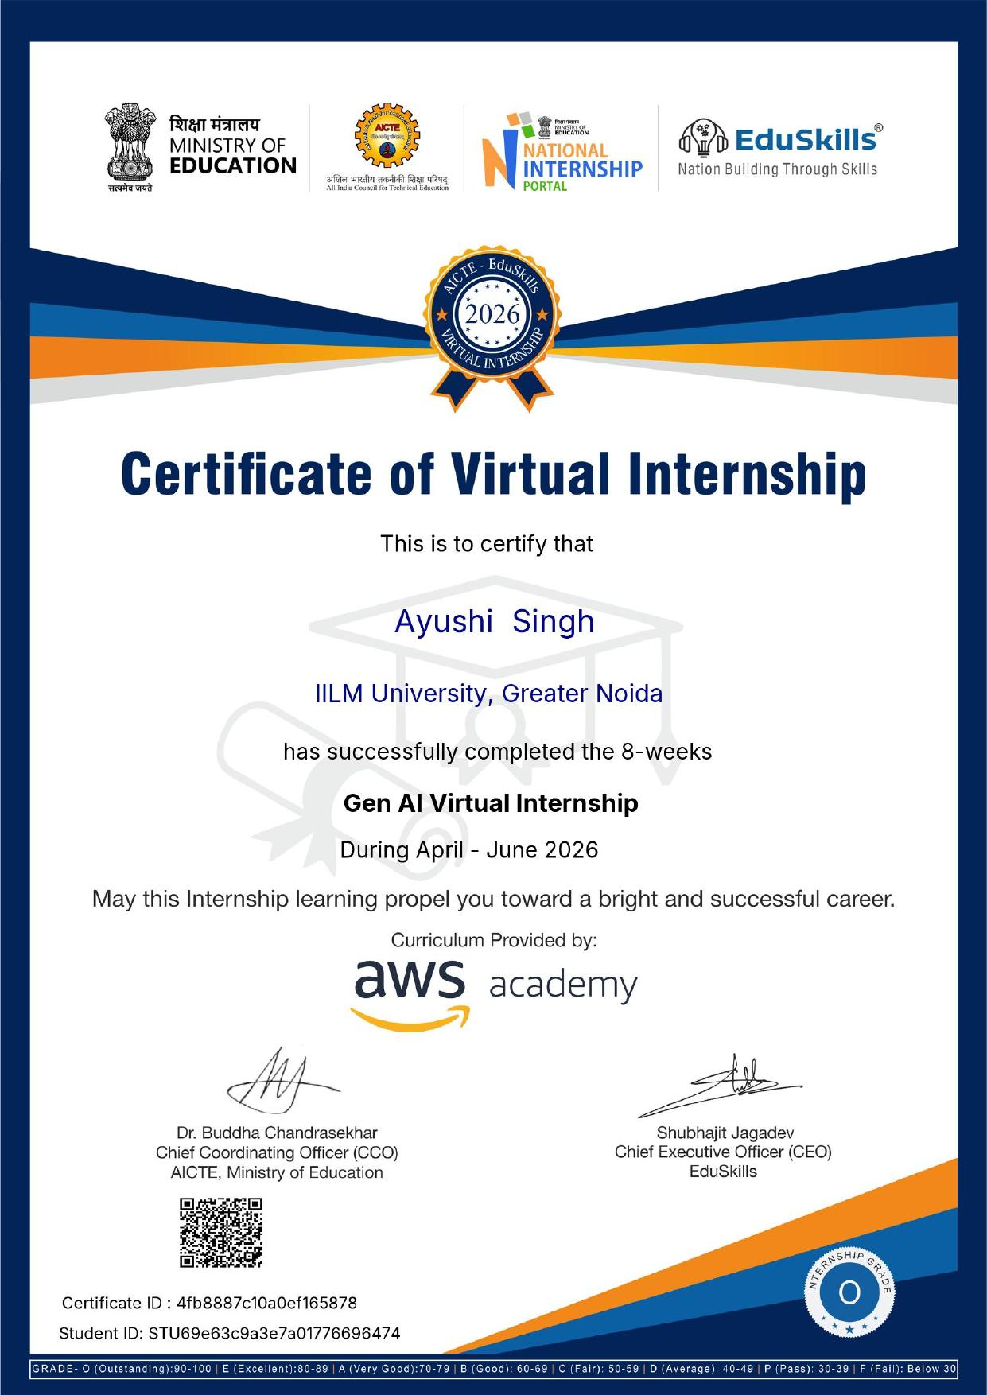



CERTIFICATION
Successfully Completed
GRADE
O – Outstanding
CERTIFICATE ID
4fb8887c10a0ef165878
STUDENT ID
STU69e63c9a3e7a01776696474
DURATION
8 Weeks | April – June 2026
AWS Gen AI Virtual Internship • Ayushi Singh
10

Slide 11
Thank You
AWS Gen AI Virtual Internship | AICTE – EduSkills Program
Ayushi Singh
Roll No. 2410030704 | IILM University, Greater Noida

