Slide 1
Testing Object-Oriented Programs:
Current Research
Durga Prasad Mohapatra
Associate Professor
Department of Computer Science and Engineering
National Institute of Technolgy, Rourkela

Slide 2
Plan of the Talk
Introduction
Challenges in testing OO programs
Test suite design using UML models
Test design patterns
Conclusion

Slide 3
Introduction
More than 50% of development effort is being spent on testing.
Quality and effective reuse of software depend to a large extent
  on thorough testing.
Most research on OO paradigms focus on
  Analysis and design
We discuss some research issues in testing object-oriented systems

Slide 4
Fault Model
Number of places to look for bugs
  infinite for practical purposes
A fault model is a map of possible fault locations
  A fault model is necessary to guide any rational testing strategy
A fault model may be constructed from analysis of failure data

Slide 5
Places To Look For Faults
Some places can trivially be omitted from a fault model:
  I cannot be committing spelling mistakes while reading a book
  I cannot make grammatical errors in French when I am writing in English.
A test strategy:
  yields a test suite when applied to a unit under test

Slide 6
Challenges in OO Testing
What is an appropriate unit for testing ?
Implications of OO Features:
  Encapsulation
  Inheritance
  Polymorphism & Dynamic Binding
State-based testing
Test coverage analysis
Integration strategies
Test process strategy

Slide 7
What is a Suitable Unit for Testing?
Fundamental unit of testing conventional programs:
  Function
Weyukar's Anticomposition axiom:
  Adequate testing of individual methods does not ensure that the class has been tested
Class level:
  concerns testing interaction between attributes and methods.
  State of the object must be considered

Slide 8
Suitable Unit of Testing
Cluster level:
  tests the interactions among a group of cooperating classes.
System level:
  tests an entire operational system.

Slide 9
Encapsulation
Encapsulation is not a source of errors
  however an obstacle to testing
  it prevents accessing attribute values by a debugger
While testing
  precise current state information is necessary

Slide 10
Solving Encapsulation-Related Problems
Several solutions are possible:
  Built-in or inherited state reporting methods
  Low level probes to manually inspect object attributes
  Proof-of-correctness technique (formal)
Most feasible way: State reporting methods
Reliable verification of state reporting methods is a problem

Slide 11
Inheritance
Should inherited methods be retested?
  Retesting of inherited methods is the rule, rather than an exception
Retesting required:
  because a new context of usage results when a subclass is derived
Correct behavior at an upper level
  Does not guarantee correct behavior at a lower level

Slide 12
Inheritance --- Overriding
In case of method overriding:
  need to retest the classes in the context of overriding
  An overridden method must be retested even when only minor syntactic changes are made.

Slide 13
Deep Inheritance Hierarchy
A subclass at the bottom of a deep hierarchy
  may have only one or two lines of code,
  but may inherit hundreds of features
This situation creates fault hazards similar to
  unrestricted access to global data in procedural programs
Inheritance weakens encapsulation

Slide 14
Deep Inheritance Hierarchy cont..
A deep and wide inheritance hierarchy can defy comprehension:
  lead to bugs and reducing testability
  Incorrect initialization and forgotten methods can result
  Class flattening increases understandibility
Multiple Inheritance
  increases the number of contexts to test

Slide 15
Abstract and Generic Classes
Unique to OO programming
  provide important support for reuse.
Must be instantiated to be tested.
May never be considered fully tested

Slide 16
Polymorphism
Each possible binding of a polymorphic component requires a separate test:
  Often difficult to find all such bindings
  Increases the chances of errors
  An obstacle to reaching coverage goals
Polymorphism complicates integration planning,
  many server classes may need to be integrated before a client class can be tested

Slide 17
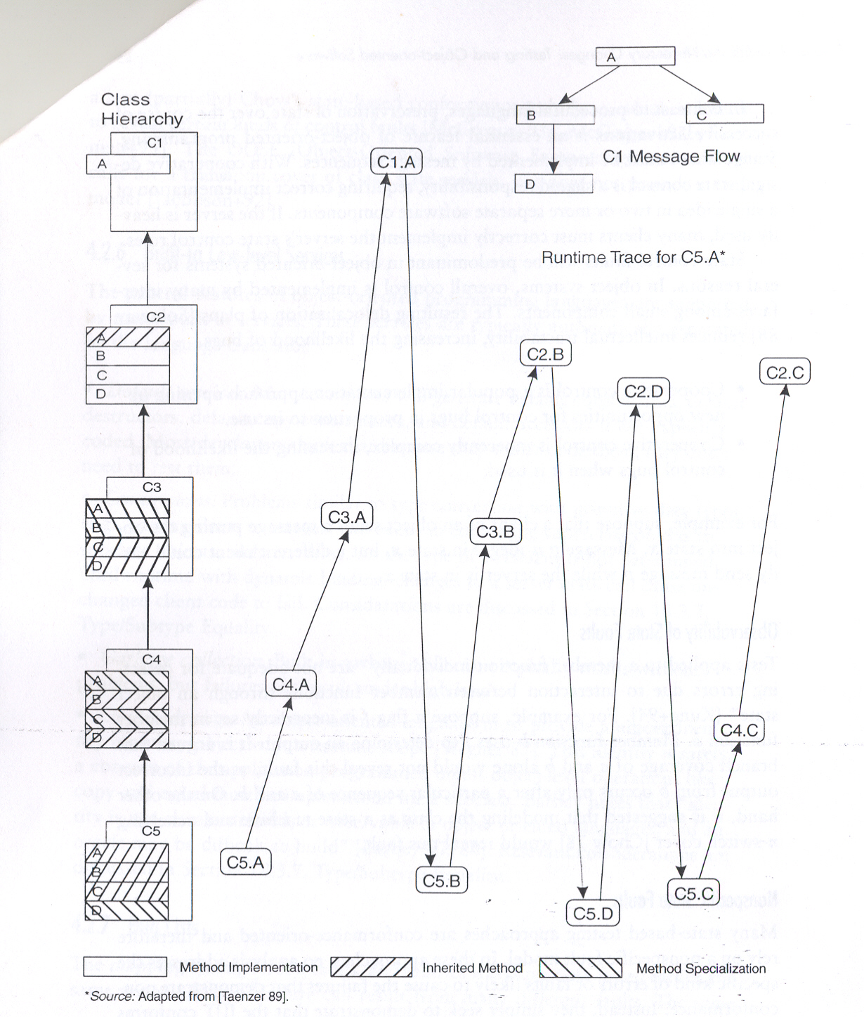
Yo-Yo Problem

Slide 18
Dynamic Binding
Dynamic binding implies:
  the code that implements a given function is unknown until run time.
  static analysis cannot be used to identify the precise dependencies in a program.
It is difficult to prepare test stubs

Slide 19
State-Based Testing
The concept of control flow of a conventional program
  Does not map readily to an OO program
In a state model we specify how the object's state would change under certain conditions
Flow of control in OO programs:
  message passing from one object to another
  causes the receiving object to perform some operation, leading to an examination or alteration of its state

Slide 20
State-Based Testing cont...
The state model defines the allowable transitions at each state
Test cases can be derived from the state machine model of a class:
  Methods result in state transitions
  Test cases are designed to exercise each transition

Slide 21
State-Based Testing cont...
Jacobson's OOSE advocates:
  Design test cases to cover all transitions.
The transitions are tied to user-selectable activation sequences --- Use Cases
State can be constructed:
  Using equivalence classes defined on the instance variables

Slide 22
Difficulties With State Based Testing
The white-box state model becomes intractable for even moderately complex classes
The locus of state control is distributed over an entire object-oriented application.
  Cooperative control makes it difficult to verify a class in isolation
A global state model is needed to show how classes interact

Slide 23
Test Coverage
Test coverage analysis
  helps determine the “thoroughness” of testing achieved.
Several coverage metrics based on the traditional approaches have been proposed
  Statement coverage is not appropriate due to inheritance and polymorphism

Slide 24
Test Coverage cont...
Tests that are adequate w.r.t a criterion
  Cover all elements of the domain determined by that criterion.
  But, what are the elements that appropriately characterize an object-oriented program?
Appropriate test coverage criteria are needed

Slide 25
Integration Strategies
Essentially two approaches exist
  Thread-based
  Use-based

Slide 26
Thread-based integration Strategies
A thread consists of
  All the classes needed to respond to a single external input.
Each class is unit tested,
  then each thread is exercised

Slide 27
Use-based integration Strategies
Use-based integration begins by testing classes that use few or no server classes
Next, classes that use the first group of classes are tested,
  followed by classes that use the second group, and so on

Slide 28
Test Process Strategy
Object-oriented development tends toward
  shorter incremental cycles
Development characterized as
  design a little, code a little, test a little
The distance between OO specification and implementation is
  typically small compared to conventional systems

Slide 29
Test Process Strategy cont...
The gap between white-box/black-box test is diminished.
  Therefore lower importance of code-based testing
Conventional white-box testing can be used for method testing.

Slide 30
Testing Based on UML Models
UML has become the de facto standard for OO modeling and design
Though UML is intended to produce rigorous models:
  Does incorporate many flexibilities
  incomplete, inconsistent, and ambiguous models often result.
Never the less:
  UML models are an important source of information for test design.

Slide 31
Test Approaches for UML Designs
Two Approaches:
  Interpret the generic test strategy to develop the test suite.
  Apply the related test design pattern.

Slide 32
Testing Relations Among Classes
Relations among classes are :
  Inheritance, Association, Composition, and Dependency.
Each relationship has corresponding generic test requirements
  For example, a generalization relation is
    not Reflexive(R) and not Symmetric(S) but is Transitive(T)

Slide 33
Testing Relations cont...
For any relation, we can ask which of the three (R, S, T) properties is required, excluded, or irrelevant
The answers leads to a simple but effective test suite.
For example, when reflexivity is excluded,
  Any x that would make xRx true should be rejected.
Example: Student is member of Dept-Library and Dept-Library is a part of Dept.
  The relation is member of is not R, not S but is T

Slide 34
Use Case Diagram
Use cases roughly capture system level requirements .
A collection of use cases defines
  complete functionality of the system.

Slide 35
Use Case Diagram cont...
Several general kinds of tests can be derived from use cases:
1. Tests for basic courses-- “the expected flow of events”
2. Tests of odd courses-- “all other flows of events”
3. Tests of features described in user documentation traceable to each use case.

Slide 36
Use Case Diagram cont...
Generic test requirements include:
  At least one test case should exercise
    Every Use Case when actor communicates with Use Case
    Every extension combination such as Use Case 1 extends Use Case 2
    Every uses combination such as Use Case 1 uses Use Case 2

Slide 37
Class Diagram
Represents the entities and relationships
Documents the structure of classes
Test cases should exercise:
  Each association
  Independent creation and destruction of the container and the component in an aggregation relation
  Each inherited method should be retested

Slide 38
Sequence Diagram
A sequence diagram documents message paths in time dimension
Generic tests include:
  All end-to-end paths should be identified and exercised.
  At least one test case should exercise each
    Client calls Server
    Client calls more than one server
    Client recursively calls Client

Slide 39
Difficulties with Sequence Diagrams
Representing complex control is difficult
  For example notation for selection and iteration is clumsy
  It becomes difficult to determine whether all scenarios are covered
Dynamic binding and the consequent superclass/subclass behavior
  Cannot be represented directly.
A Sequence diagram shows only a single collaboration
Different bindings are shown on separate sheets

Slide 40
Activity Diagram
This model is based on:
  flow charts, state transition diagrams, flow graphs and Petri nets.
Can be considered to be a flow chart that can represent two or more threads of execution
Supports all features of a basic flow graph,
  Can be used to develop test models for control flow based techniques

Slide 41
Activity Diagram cont...
Activity diagram can be used to
  construct decision tables
  composite control flow graph representing a collection of sequence diagrams
  control flow graph at method scope.
    this may be useful to analyze path coverage.

Slide 42
Activity Diagram cont...
Generic test requirements:
  At least one test case should exercise each different path:
    Action 1 is followed by Action 2
    Synch Point is followed by Action
    Action is started after Signal
    Synch Point is reached after Action

Slide 43
Statechart Diagram
Represents state-based behavior of a class, subsystem, or system
UML definition of a statechart provides most of the information necessary for state-based testing

Slide 44
Collaboration Diagram
Represents interactions among objects
A collaboration diagram specifies
  the implementation of a use case
May also depict the participants in design patterns

Slide 45
Collaboration Diagram cont...
At least one test case should be designed
  Client sends a message to Server
  Client repeats a message to Server
Each collaboration diagram represents only one slice of the IUT
A composite collaboration diagram would be necessary
  To develop a complete test suite for the implementation.

Slide 46
Component Diagram
Shows the dependency relationships among
  components,
  physical containment of components,
  interfaces and calling components
The basic testing practice should apply to component diagrams:
  All call paths should be identified and exercised

Slide 47
Deployment Diagram
Represents hardware, software, and network architecture
Deployment diagrams are useful in integration planning
When a component runs on a node,
  test cases should exercise whether component can be loaded & run on each designated host node
When a node communicates with another node,
  test cases should exercise open, transmit, and close communication for each remote component

Slide 48
Test Coverage Criteria Based on UML Models
Generalization criterion
Class attribute criterion
Condition coverage criterion
Full predicate coverage criterion
Each message on link criterion
All message paths criterion
Collection coverage criterion

Slide 49
Generalization (GN) Criterion
Given a test set T and a system model SM, T must cause
  every specialization defined in a generalization relationship to be created
GN criterion fault model:
  likely to reveal faults that can arise from violation of the substitutability principle
Substitutability principle:
  An instance of a subclass can be used anywhere an instance of its superclass is expected

Slide 50
Class Attribute Criterion
Given a test set T , a system model SM, and a class C, T must cause
  a set of representative attribute value combinations in each instance of class C to be created.
The value space of attributes provides an opportunity to develop test criteria.
The value space of an attribute can be restricted by OCL constraints.
Example: age attribute in Customer class can have a constraint age >18

Slide 51
Condition Coverage Criterion
Each message in a collaboration diagram occurs only under certain conditions.
Given a test set T and collaboration diagram CD, T must cause
  each condition in each decision to evaluate to both TRUE and FALSE.

Slide 52
Full Predicate Coverage Criterion
Given a test set T and collaboration diagram CD, T must cause:
  each clause in every condition in CD to take the values of TRUE and FALSE
A condition may consist of more than one clause connected by Boolean operators (e.g., AND, OR)

Slide 53
Message On Each Link Criterion
Given a test set T and collaboration diagram CD, T must cause
  message on each link connecting two objects in CD to be exercised at least once
This criterion ensures that all possible messages between two objects occur during tests.

Slide 54
All Message Paths Criterion
Given a test set T and collaboration diagram CD, T must cause
  Each possible message path (sequence of message numbers) in CD to be taken at least once.
A message path is a sequence of messages.
All message paths is a stronger criterion than message on each linjk criterion.

Slide 55
Collection Coverage Criterion
Given a test set T and collaboration diagram CD, T must test
  each interaction with a collection objects of various representative sizes at least once.
Example: An object Staff can be an aggregation of Office staff, Faculty and Technical Staff

Slide 56
Test Design Pattern
A design pattern is a generalized (reusable) solution to a recurring problem
It is based on common sense and some good practices
It provides a concise description of:
  common elements,
  context, and
  essential requirements for a solution
Test design patterns are to testing what software design patterns are to programming

Slide 57
Test Design Pattern cont...
Patterns developed under different scope of testing:
Scope Example Pattern
Method scope Polymorphic Message Test
Class Scope Modal Class Test
Reusable Components Abstract Class Test
Subsystem Round-trip Scenario Test
Integration Collaboration Integration
Application Scope Extended Use Case Pattern
Regression Test Retest Within Firewall

Slide 58
Extended Use Case (EUC)Test Pattern
Difficulties with use case :
– No variable definitions required
– No business rules required
– No input/output constraints
– Narrative can be ambiguous
In a test-ready model we need to
– Define all input/output relationships
– Define all operational variables

Slide 59
EUC Intent
Model the input output relationships in a use case using a decision table
It then becomes possible to develop test cases
  by considering specific inputs for a use case and corresponding expected results.

Slide 60
EUC Context cont...
Unless test points are systematically selected based on use cases’s implicit constraints and relationships,
  all fundamental relationships would not be exercised
Example: A Use Case “Pay-Fees” can be a generalization of “Pay-by-Credit-Card” and
“Pay-by-Cash” Use Cases

Slide 61
EUC Fault Model
What kind of bugs can EUCs help detect?
  Domain bugs.
  Logic bugs.
Example: Customer registers with a Supermarket
  Domain error: Incorrect Pincode
  Logic Error: Sales registered against an invalid customer code

Slide 62
EUC Fault Model cont...
  Generic system-scope faults
    Incorrect output.
    Abnormal termination.
    Inadequate response time.
    Omitted capability.
    Extra capability

Slide 63
EUC Test Model
An Extended Use Case consists of the following:
  A complete inventory of operational variables
  A complete specification of domain constraints for each operational variable
  An operational relation for each use case
  The relative frequency of each use case (optional)

Slide 64
EUC Test Procedure
A test suite is developed in 4 Steps
  1. Identify the Operational Variable
  2. Define the domains of the operational variables
  3. Develop the Operational Relations
  4. Develop Test cases

Slide 65
1. Identify Operational Variables
Operational variables:
  Factors which vary from one scenario to the next
  determine different system responses.
Operational variables include:
  Explicit inputs and outputs
  Environmental conditions which result in significantly different behavior
  Abstractions of the state of the system

Slide 66
2. Define the Domains of the Operational Variables
The domains are developed by defining
  The valid and invalid values for each variable

Slide 67
3. Develop the Operational Relation
Operational variables
  May determine distinct classes of system responses
Express them in the form of a decision table:
  When all the conditions in a row are true, the expected action is to be produced

Slide 68
4. Develop Test Cases
Every variant is made true once and false once
Oracle
  Expected results are typically developed by inspection

Slide 69
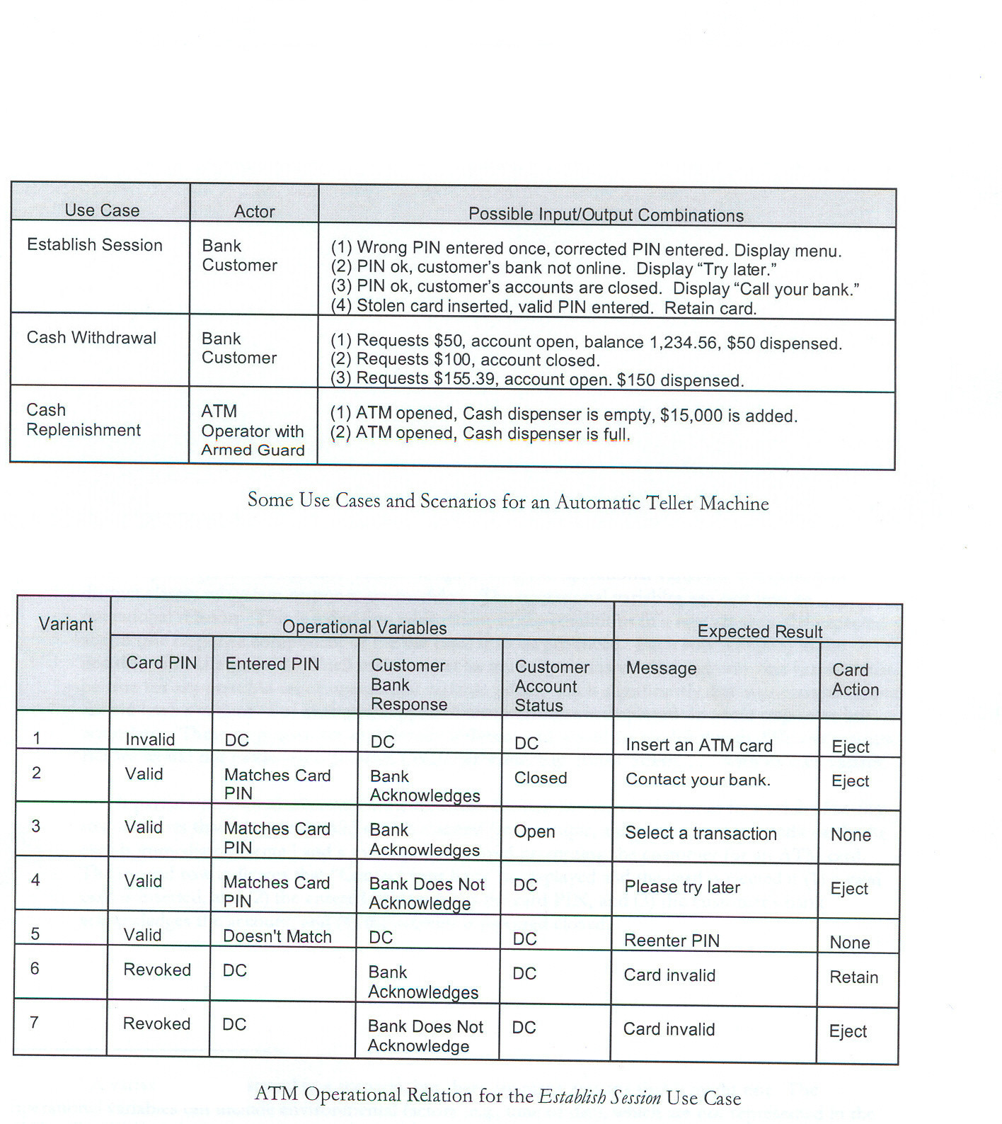
EUC Test Example

Slide 70
Modal Class Test (MCT) Pattern
Some classes can accept any message in any state
  But others restrict based on past messages received or current values (domain)
A modal class is a special class
  places domain constraint as well as sequence constraint while accepting messages
Domain Constraint: An object of class Account will not accept a withdrawal message if the balance less than or 0
Sequence Constraint: From the frozen state, Account object can accept a credit or debit message only after an unfreeze message

Slide 71
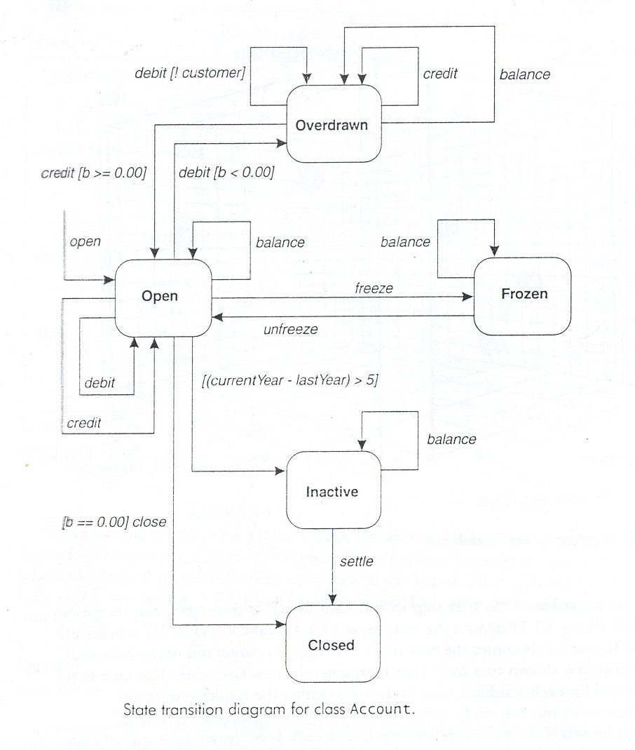
Modal Class Test (MCT) cont..

Slide 72
MCT Fault Model
A class may fail to implement its state model in five ways:
1. Missing transition: A valid message is rejected in a valid state
2. Incorrect action: A wrong response for an accepting state and valid message
3. Invalid resultant state: A message results in transition to a wrong state.
4. Invalid state: An invalid state is produced
5. Sneak path: A sneak path allows a wrong message to be accepted

Slide 73
MCT Test Strategy
The behavior of a class is represented using a state model
Generate the transition tree
Perform conditional transition test
Tabulate events and actions along each path to form test cases
Perform Illegal Transitions & Sneak Path Test

Slide 74
MCT Transition Tree
For each transition out of the root state ,
  a branch is drawn to a node that represents the resultant state
  This step is repeated for each resultant state node
A node is marked terminal
  if no transition to a new state (yet to be drawn) exists
Each branch in the tree (an event path) becomes a test case

Slide 75
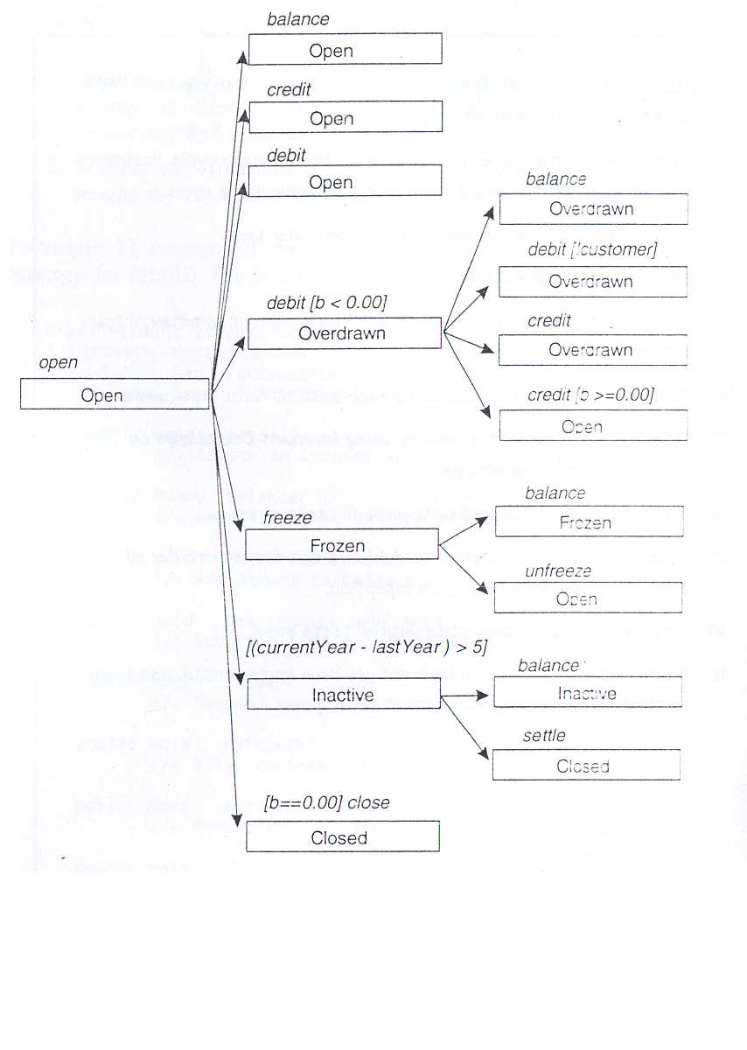
MCT Transition Tree Testing: Example

Slide 76
MCT Conditional Transition Test
Each conditional transition
  analyzed to identify additional test cases
For each conditional transition
  develop a truth table for the variables in the condition
Develop an additional test case
  for each entry in the truth table that is not already exercised

Slide 77
MCT Sneak Path Test
Sneak Path is a bug that allows an illegal message to be accepted,
  resulting in an illegal transition.
Illegal Transition is present
  when a valid state of CUT accepts a message not specified for that state
Illegal Message:
  Results in an illegal transition

Slide 78
MCT Sneak Path cont...
To test sneak paths we send illegal messages
  Example: In the overdrawn state, messages: open, freeze, close etc can lead to possible sneak path
To confirm that no sneak path exist,
  attempt each type of illegal message
The expected response:
  The message should be rejected
  Also the state of the object should be unchanged after rejecting the illegal message

Slide 79
Collaboration Integration Pattern(CIP)
CIP chooses the order of integration
  according to collaborations and the dependencies.
Classes to be integrated are tested by testing one collaboration at a time
A system consists of many collaborations
Their sequence is determined by dependencies and sequential activation constraints
Integration by collaboration exercises interfaces between the participants of a collaboration

Slide 80
CIP Test Procedure
1.Develop a dependency tree for the SUT
2.Map collaborations onto tree until all components and interfaces are covered
3.Choose a sequence in which to apply the collaborations
4.Several heuristics available for choosing a sequence

Slide 81
CIP Test Procedure cont..
Example Heuristics:
  Begin with the simplest and finish with the most complex
  Begin with the collaboration that requires the fewest stubs
  Test in order of risk of disruption of system testing

Slide 82
CIP Test Procedure cont..
5.Develop test suite for each collaboration
6.Run the test suite and debug until first collaboration passes
7.Continue until all collaborations have been exercised

Slide 83
Research Challenge 1: Testing Based on Precode Artifacts
Precode artifacts:
  Design,
  Requirements,
  Architecture specifications.
Software architecture involves the description of elements from which systems are built,
  interactions among those elements,
  patterns that guide their composition,
  constraints on these patterns

Slide 84
Research Challenge 2:Testing Evolving Software
Regression testing is used to test software that undergoes evolution due to:
  technology changes,
  new or modified components.
Regression testing remains one of the most expensive activities performed during a software lifecycle

Slide 85
Research Challenge 3: Measuring Effectiveness Of Testing Techniques
Quantitative values of effectiveness of the test-set design in revealing faults.
  analytical, statistical, or empirical evidence
We also need to understand the classes of faults for which the criteria are useful.

Slide 86
Research Challenge 4: Test Data Generation
Generating test data (inputs for test cases) is often a labor-intensive process.
To date, available techniques generating test data automatically:
  Do not scale to large systems.

Slide 87
Research Challenges 5: Methods and Tools
Along with fundamental research and empirical methods for testing:
  tool development is also needed
An important criterion
  methods and tools be scalable to large systems.
Many of the tools and methods developed so far
  work only on toy systems

