Slide 1
Real-Time Operating Systems
Dr. R. Mall
Dept. of Computer Science and Engineering
Indian Institute of Technology
KHARAGPUR

Slide 2
Organization
  Introduction
  Real-Time task scheduling
    Clock-driven
    Event-driven
  Scheduling of real-time task on a uniprocessor
    Rate Monotonic Analysis (RMA)
    Earliest Deadline First (EDF)
    Scheduling with limited priority levels
  Resource sharing among tasks
    Priority inversion problem
    Priority inheritance protocol

Slide 3
Organization
  An overview of scheduling in multiprocessor and distributed systems
  Commercial real-time operating systems
    Unix as a real-time operating system
    Windows as a real-time operating system
    Extensions to Unix
      Host target approach
      Preemption points
      Fully preemptable kernel
    Overview of some commercial embedded operating systems
    PSOS, VRTX, RT Linux, WinCE
  Benchmarking real-time operating systems

Slide 4
Introduction
Real-time systems are finding increasing applications
According to a recent estimate,
  the number of computers deployed in real-time applications vastly out number those in ordinary applications.
  Many of these computers are embedded.

Slide 5
What is Real-time?
Real-time is a quantitative notion of time measured using a physical clock.
  e.g after an event occurs (temperature exceeds 500 degrees) the corresponding action (coolant shower) must complete within 100mSec.
This is in contrast to the qualitative notion of time
  Expressed using notions such as before, after, sometime, eventually, etc.

Slide 6
What is a Real-Time System?
A system is called real-time
  Whenever we need to quantitatively express time in order to describe it behavior.

Slide 7
Types of Real-Time Systems
Real-time systems are different from the traditional systems
Tasks have deadlines associated with them
  Hard real-time systems
  Soft real-time systems
  Firm real-time system

Slide 8
Hard Real-time Systems
If a deadline is not met,
  then the system is said to have failed
  The task deadlines are of the order of micro or milliseconds
  Many hard real-time systems are safety-critical
Examples
  Industrial control applications
  On-board computers
  Robots

Slide 9
Firm Real-Time Systems
Tasks have deadlines
  If a deadline is missed occasionally, the system does not fail
  The results produced by a task after the deadline are rejected
Utility
D
Time

Slide 10
Soft Real-time Systems
Examples
  A video conferencing application
  A telemetry application
  Satellite-based suveillance applications

Slide 11
Soft Real-Time Systems
Tasks have deadlines
  If a deadline is missed, the system does not fail.
  The performance of the system is said to have degraded
  The utility of a result decreases with time after the deadline
Utility
D
Time

Slide 12
Soft Real-Time Systems
Examples of soft real-time systems:
  Railway reservation system
  Web browsing
  In fact, all interactive applications

Slide 13
Real-Time Task Scheduling
Scheduling of tasks is the primary means by which the operating system meets task deadlines.
So, scheduling is an important problem.
Lot of work has been done in developing appropriate schedulers for real-time tasks
  Scheduling on uniprocessors
  Scheduling on multiprocessors and distributed systems

Slide 14
Task Scheduling on Uniprocessors
Lots of research has been conducted in the seventies and eighties.
Real-time task scheduling can be
  Clock-driven, or
  Preemptive priority-based scheduling

Slide 15
Clock-driven Scheduling
Also called
  Table-driven scheduling
  Offline scheduling
Decision regarding which job to run next is made at specific time instants
  Timers are used to trigger the decision point
  The joblist along with information regarding which run to be run for how long are stored in a table.

Slide 16
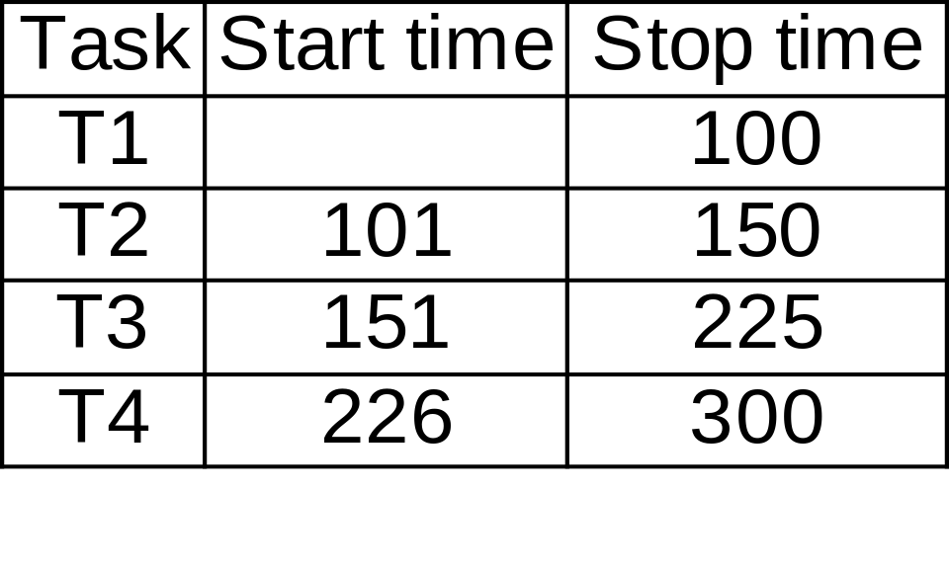
Clock-driven Scheduling

Slide 17
Clock-Driven Scheduling
The scheduler develops a permanent schedule for a period LCM(P1,P2,...,Pn) and stores in a table.
Round robin scheduling is an example of clock-driven scheduling
Clock-driven schedulers are
  Simple: used in low cost applications
  Efficient: very little runtime overhead
  Inflexible: Very difficult to accommodate dynamically changing task set or task characteristics.

Slide 18
Priority-based Schedulers
These are also called event-driven schedulers
  Scheduling decisions are made when certain events occur
    Tasks becoming ready
    Tasks completing execution
These are called preemptive schedulers
  When a higher priority task becomes ready it preempts the executing lower priority task
These are greedy schedulers:
  They never keep the processor idle if a task is ready.

Slide 19
Priority-based Schedulers
Static priority schedulers:
  The task priorities once assigned by the programmers, do not change during runtime
  RMA (Rate Monotonic Algorithm) is the optimal static priority scheduling algorithm
Dynamic priority
  The task priorities can change during runtime based on the relative urgency of completion of tasks
  EDF (Earliest Deadline First) is the optimal uniprocessor scheduling algorithm

Slide 20
Priority-based Schedulers
First let us consider the simplest scenario:
  Uniprocessor
  Independent tasks
    Tasks do not share resources
    There is no precedence ordering among the tasks

Slide 21
Priority-based Scheduling
Independent tasks executed on a uniprocessor
  Two algorithms pretty much summarise the important results in this scenario
    EDF
    RMA

Slide 22
EDF
EDF is the optimal uniprocessor scheduling algorithm
  If EDF cannot feasibly schedule a set of tasks, there exists no other scheduling algorithms to do that.
Can schedule both periodic and aperiodic tasks
Schedulability check:
  Sum of utilization due to tasks is less than one.

Slide 23
EDF
EDF is
  Simple
  Optimal
But, is rarely used
  No commercially available operating system directly supports EDF scheduling
  Let us examine the disadvantages of EDF

Slide 24
Disadvantages of EDF
Transient overload handling
  EDF has very poor transient overload handling capability
  When a low-criticality task becomes delayed it can make even the most critical task miss its deadline
  In fact, it is extremely difficult to predict which task would miss its deadline when a task takes more time

Slide 25
Disadvantages of EDF
Runtime efficiency
  EDF is not very efficient
  Inorder to implement EDF the tasks need to be maintained sorted in a priority queue based on their deadline
  The complexity of maintaining a priority queue is logn, where n is the number of tasks

Slide 26
Disadvantages of EDF
Resource sharing among tasks
  It is very difficult to let tasks share non-premptable resources (called critical sections) without some tasks missing their deadlines
  We shall elaborate this problem later in our discussions.

Slide 27
General EDF Schedulability
When the task deadlines differ from the task periods,
  the schedulability criterion needs to be generalized as follows:

Slide 28
RMA
The priority of a task is proportional to its frequency.
  The higher is the frequency (or lower is the period) of a task, the higher is its priority.
Priority
Frequency

Slide 29
RMA
RMA has been shown to be the optimal uniprocessor static priority scheduling algorithm
  If RMA cannot schedule a set of periodic tasks, no other scheduling algorithm can.
Schedulability conditions
  Utilization Bound 1

Slide 30
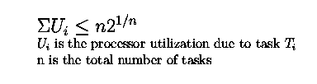
RMA Schedulability
Utilization bound II (Liu and Layland 1971
U
Utilization

Slide 31
Liu and Layland Condition
The upper bound on utilization converges to 69% (ln2)
  As the number of tasks approaches infinity
The Liu and layland's condition is a conservative result in the sense that
  If a set of tasks passes Liu and Layland test, then it would definitely be schedulable under RMA
  But, even if a set of tasks fails Liu and Layland test, still it may be RMA schedulable.

Slide 32
Example
Consider three periodic tasks
  T1: e1=20mSec, p1=100mSec
  T2: e2=40msec, p2=150mSec
  T3: e3=100mSec, p3=350mSec
The utilization for these 3 tasks are
  0.2+0.267+0.286=0.753
The Liu-Layland bound=3((2)^{1/3}-1)=0.779
  Therefore, the tasks are schedulable.

Slide 33
RMA Schedulability Test
Completion time theorem (Liu and Lehoctzky)
  When a set of tasks meet their first deadlines under zero phasings, then they are RMA schedulable for all task phasings.
This theorem states that if we draw up the schedules till the first deadline of each task and observe that it is schedulable,
  Then the task set would be schedulable
However, drawing up the schedule eould be cumbersome when the number of tasks are large.

Slide 34
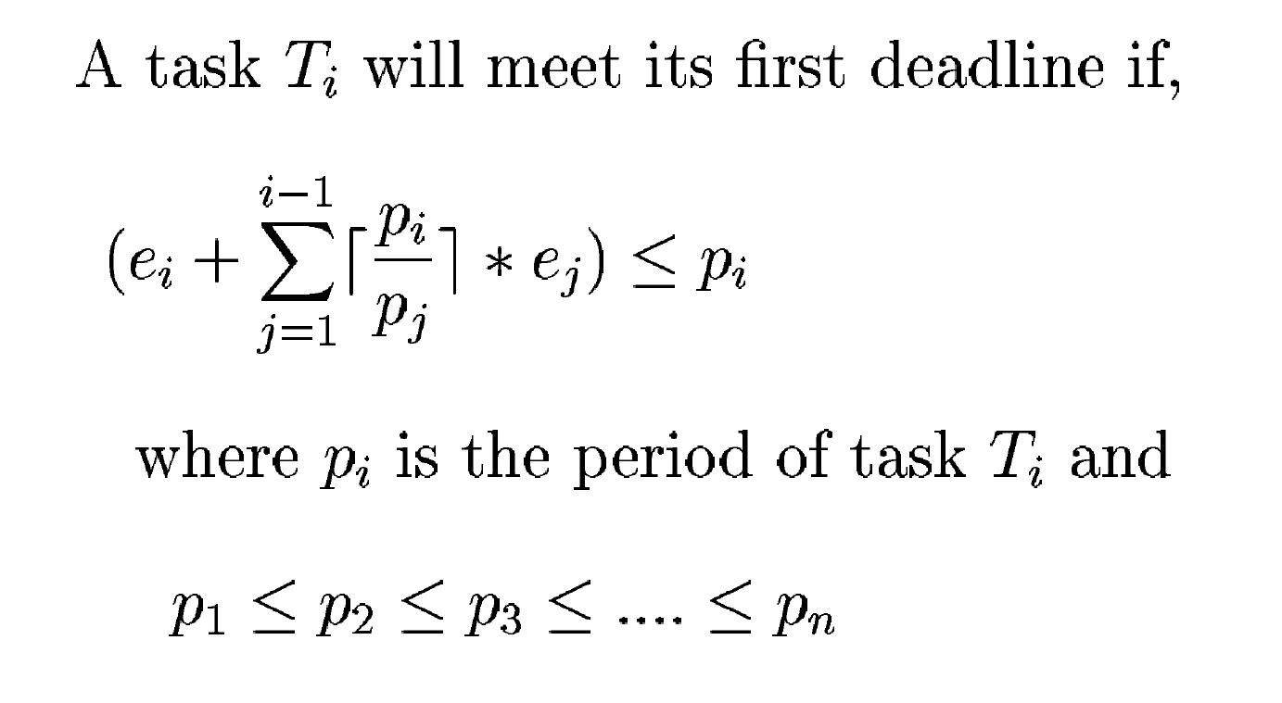
Testing Liu and Lehoctzky's Criterion

Slide 35
Example
Consider three periodic tasks
  T1: e1=20mSec, p1=100mSec
  T2: e2=30mSec, p2=150mSec
  T3: e3=100mSec, p3=250mSec
All three tasks follow Liu-Lehoczky criterion
  Therefore, the tasks are schedulable.

Slide 36
RMA Under Transient Overload
RMS is stable under transient overload conditions:
  If any task starts hetting late, then it is guaranteed that it will not affect the higher priority tasks.
  Even when a task is getting late, it must yield the CPU to a higher priority task unlike EDF

Slide 37
Harmonically Related Tasks
A set of periodic tasks are harmonically related, if for every pait of tasks Ti and Tk, if Pi>Pk, then Pi=n*Pk, where n is an integer.
A set of harmonically related tasks are RMA schedulable, if the sum total of their utilization is less than 1.

Slide 38
Harmonically Related Tasks
A set of periodic tasks are harmonically related, if for every pait of tasks Ti and Tk, if Pi>Pk, then Pi=n*Pk, where n is an integer.
A set of harmonically related tasks are RMA schedulable, if the sum total of their utilization is less than 1.

Slide 39
Insufficient Number of Priorities
All RTOS have a restricted number of priority levels (why?)
  When the number of tasks is moer than the number of available priority values, the schedulability of the system decreases.
Assigning priorities using a priority grid:
  Experiments show that the logarithmic grid works the best.

Slide 40
Insufficient Number of Priorities Example
r=(Pmax/Pmin)^{1/nprio}
If Pmin=1msec, Pmax=100,000 and nprio=32
R=1.43
The gridlines become 1.00,, 1.43, 2.04, ...

Slide 41
Resource sharing
So far, the only resource that we considered is CPU.
However, tasks may need to share resources such as files, memory, data structures.
  These are nonpreemptable resources
  Called critical sections in the operating systems literature

Slide 42
Critical Sections
The traditional operating system solution to share critical sections
  Is through the use of semaphores.
However, in real-time systems this solution does not work well, it gives rise to:
  Priority inversion
  Unbounded priority inversion

Slide 43
Priority Inversion
When resources need to be shared in the exclusive mode
  A task may be blocked by a lower priority task which is already holding the resource.
  A task holding a resource cannot be preempted,
    It would use the resource until it finishes all its required computation using it.
  The higher priority task cannot make progress while the lower priority task progresses.

Slide 44
Unbounded Priority Inversion
Consider the following situation
  A low priority task is holding a resource for which a high priority task is waiting
  However, an intermediate priority task which does not neer resource preempts the low priority task.
  In this case, the priority inversions sufferred by the high priority task can be unbounded
Can cause a task to miss its deadline

Slide 45
Priority Inheritance Protocol
Sha and Rajkumar
When a resource is busy
  The requests to lock the resource are queued in FIFO order
  The priority of the task using the critical section is raised to equal the highes priority task in the queue.
The main idea behind this scheme is that:
  Since a task holding a resource cannot be preempted, it should be allowed to complete as early as possible

Slide 46
Shortcomings of the Basic Priority Inheritance Scheme
Deadlock:
  T1: lock R1, Lock R2, Unlock R2, Unlock R1
  T2: lock R2, Lock R1, Unlock R1, Unlock R2

Slide 47
Highest Locker Protocol
During the design of a system
  a ceiling priority value is assigned to all resources
  The ceiling priority is equal to the highes priority of all tasks using that resource
When a task acquires a resource for use
  Its priority value is raised to the ceiling priority of that resource.

Slide 48
Highest Locker Protocol
Avoids unbounded priority inversion
Prevents deadlock
  T1: lock R1, Lock R2, Unlock R2, Unlock R1
  T2: lock R2, Lock R1, Unlock R1, Unlock R2
Prevents unbounded priority inversion

Slide 49
Shortcomings of HLP
Inheritance blocking
  When the priority value of a low priority task hloding a resource is raised to a high value
  Intermediate priority tasks not needing the resource may undergo priority inversion.

Slide 50
Priority Ceiling Protocol
Each resource is assigned a ceiling priority
  Like the HLP
An Operating System variable is maintained as the highest ceiling of all locked semaphores.
  We will call it Current System Ceiling (CSC)
Unless a task holds a semaphore that set the current system ceiling
  It can lock a resource only if its priority is greater than CSC

Slide 51
Priority Ceiling Protocol (PCP)
If a task is prevented from locking a resource
  The task holding the resource inherits the priority of the blocked task.
PCP prevents deadlocks.
Prevents unbounded priority inversion
Limits inheritance-related inversion.

Slide 52
Types of Priority Inversion in PCP
Direct inversion
Inheritance-related inversion
Avoidance-related inversion

Slide 53
Direct Inversion
A higher priority task waits for ersource as a lower priority task is holding the resource.

Slide 54
Inheritance-related Inversion
When a low priority task is holding a resource and a high priority task is waiting for it
  The priority of the low priority task is raised.
  An intermediate priority task that does not need the resource being held, undergoes inheritance-related inversion.

Slide 55
Avoidance-related Inversion
When a low priority task is holding a resource
  The CSC is made equal to the ceiling of the resource being held
  A high priority task which needs a resource currently not in use undergoes avoidance-related inversion

Slide 56
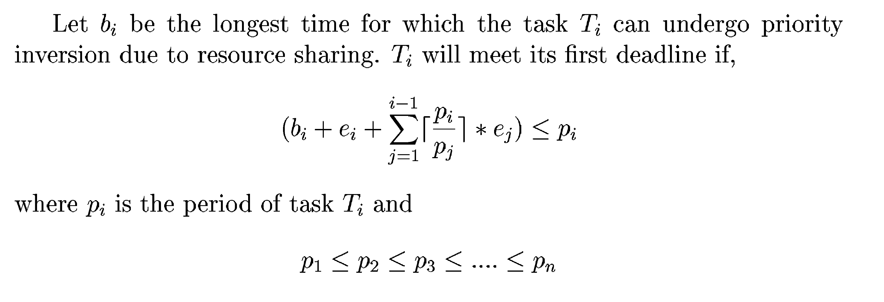
Liu and Lehotczy Condition Under Resource Sharing

Slide 57
Resource Sharing for Dynamic Priority Systems
The priority ceiling values would change dynamically with time.
  An obvious solution would be to update the priority ceiling of each resource and the current system ceiling each time the priority of a task changes
However, this would incur unacceptably high processing overhead.

Slide 58
Allowing Precedence Condition Among Tasks
Arrange the tasks in icreasing order of their deadlines
Do
  Scan the list from the rightmost end
  Find a yet to be scheduled tasks whose all successors have been scheduled. Schedule it as late as possible.
While there are tasks yet to be scheduled
Move all the tasks forward as much as possible

Slide 59
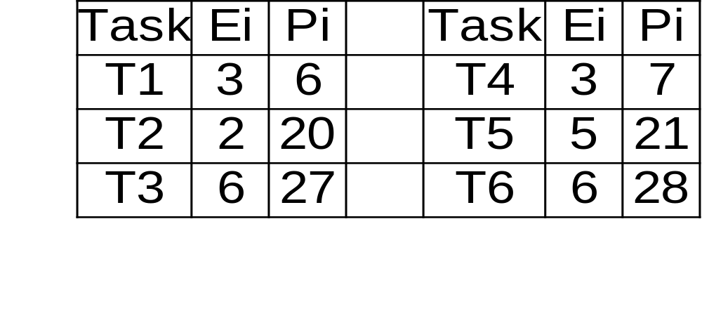
Example

Slide 60
Multiprocessor and Distributed Systems
Multiprocessor and distributed systems are becoming popular
Broadly, there are two types of solutions:
  Static: Tasks are statically assigned to processors
  Dynamic: The processor which would execute a task is dynamically decided.
Almost all multiprocessor/distributed system-based real-time systems built to date are static

Slide 61
The Scheduling Problem
Task assignment problem:
  How to assign tasks to processors?
Scheduling problem:
  How to schedule the tasks on the processor to which it has been assigned.

Slide 62
Important Algorithms
Utilization balancing algorithm
Next-fit algorithm for RMA
Binpacking algorithm for EDF
Focused addressing and bidding algorithm
Buddy algorithm

Slide 63
A Survey of Commercial Real-Time Operating Systems
Criteria for comparing RTOS:
  Scheduling policy supported
  Memory locking and other support
  Timers
  Interrupt handling
  File system support
  Device interfacing

Slide 64
A Survey of Commercial Real-Time Operating Systems
Embedded systems have small memories
  The operating system size is important
  Obviously, OS with large footprint cannot be used in embedded applications
  Power saving features are desirable

Slide 65
Time Services
At each colck interrupt, the kernel carries out the following:
  Process timer events
  Update execution budget
  Update the ready queue

Slide 66
Process Timer Events
The timer queue contains all timers arranged in order of their expiration times.
At each clock interrupt, the kernel checks if any timer event has occurred.
The kernel processes all timer events and queues the specified actions.

Slide 67
Update Execution Budget
After each clock interrupt, the scheduler decrements the remaining time time slice of the executing task.
If the task is not complete when the slice (budget) becomes 0,
  The task is preempted

Slide 68
Update Ready Queue
Some tasks may have become ready
  If a task that has become ready has higher priority than the executing task,
    then the current executing task would have to be preempted.
  Otherwise, these have to be inserted in the ready queue

Slide 69
Clock Resolution
Clock resolution is the time granularity provided by the clock.
In current technology
  It is possible to have clocks of nanosecond granularity
  But the time granularity supported by modern RTOS are of the order of 10s of micro seconds or even milli seconds

Slide 70
Clock Resolution
The kernel typically maintains a software clock
  After each interrupt of the hardware clock, the software clock is updated.
  A task can read the time by the POSIX function clock_gettime()
  The finer is the resolution
    The more frequent is the hardware clock interrupts and the larger is the amount of processor time servicing it.

Slide 71
Clock Resolution
The response of the get time function is not deterministic
  This variation is greater than few hundreds of nano seconds
  Software clock resolution finer than this error is not meaningful.

Slide 72
Hardware Timestamp
Many modern processors such as Pentium provide a hardware timestamp counter
  These can be memory mapped to the address space of the real-time tasks
  Has portability problems

Slide 73
Types of Timer Services
There are 2 types of timers
  One shot
  Periodic
Watchdog timers are an important type of one shot timers
  wd_start();
  Process
  wd_tickle

Slide 74
Unix System V as RTOS
There are two major shortcomings of Unix
  Nonpreemptable kernel
  Dynamic priority levels

Slide 75
Nonpreemptable Kernel
Even a user program can execute in the kernel mode
  When it makes a system call
The original Unix developers did not visualize the use of Unix in real-time and multiprocessor system
  Whenever, the system is in kernel mode, all the interrupts are disabled
  This was an easy and efficient way to preserve the integrity of kernel data

Slide 76
Nonpreemptable Kernel
However, in a real-time application
  a nonpreemptable kernel can cause deadline misses.
  task preeption time=time spent in kernel mode+context switch time
  This can be of the order of a second in the worst case

Slide 77
Dynamic Priorities
The Unix scheduler maintains a multilevel feedback queue
The system by default uses a 1 second time slice
The task priorities are recomputed after each interval

Slide 78
Unix Scheduling
Pr(Ti,j)=CPU(Tj,i)/2+Base(Ti)+nice(Ti)
CPU(Ti,j)=U(Ti,j)/2+CPU(Ti,j-1)
  Pr(Ti,j) is the priority of task Ti at the jth instant
  CPU(Tj,i) is the dynamic component that is recursively defined --- CPU(Tj,i) captures the history of CPU usage with geometriczlly decreasing weights
  Base(Ti) is used to separate different types of tasks into bands
  nice(Ti) is set by the programmer

Slide 79
Base Priorities
Different base priorities segregate tasks into the following base bands
  Kernel process
  Swapper
  Block I/O
  File manipulation
  Character I/O
  User processes

Slide 80
The Central Idea
The central idea behind the dynamic priority recomputation is the following:
  I/O is very slow compared to CPU processing
  I/O is the bottleneck
  Average throughput can be increased by raising the priority of I/O intensive tasks.
  The i/o chanels should be kept as busy as possible

Slide 81
The Consequence
I/O bound processes gravitate towarsd higher and higher priorities
  In real-time systems this would mean that if a task spends time in compuation it may miss its deadline
  This is unacceptable for hard real-time applications

Slide 82
Unix V as RTOS
It is clearly unsuitable for hard real-time applications.
  These have deadlines of the order of milli/micro seconds.
  Deficiencies of Unix System V
    Task preemption time of the order of a second,
    dynamic recomputation of priorities
    Inefficient interrupt processing
    Unsatisfactory support of device interfacing
    Unsatisfactory timers
    Lack of real-time file supprt

Slide 83
Modifications to Unix for Real-Time Application
The different modifications can be classified in to the following
  Extensions to the Unix kernel
  Host/target approach
  Preemption points
  Fully preemptable kernel

Slide 84
Extensions to Unix
Many effort in this direction have been reported
  Implementing more suitable schedulers
  Implementing finer granularity timers
  Real-time file systems,etc.
However, all these provide only minor relief
  The two basic problems still remain

Slide 85
Host/Target Approach
Develop the application on Unix host
  Download to a dedicated OS running on the target
  The Unix host is connected to the target via a TCP/IP interface
  Examples of this category are VRTX (Mentor graphics), VxWorks, and PSoS (Wind river systems), RTLinux, WinCE, etc.

Slide 86
Host/Target Approach
The target operating system is intended to be compact and fast
  Suitable for embedded applications
  Need not support
    Compilation, debugging, libraries, virtual memory, etc.
  The task preemption time is of the order of 10micro seconds,
    compared to 100 milliSec for fast Unix implementations,
    1 Sec for the traditional Unix system V

Slide 87

Host/Target Approach

Slide 88
Host/Target Approach
Development tools
Application
Compilation tools
Libraries
PREPC+
PHILE
PSOS
PNA+
XRAY+
Host
PROBE target
debugger

Slide 89
PSOS
The host provides development tools
  Cross-compiler
  Libraries
  Editor and other development tools
XRAY+ is the source level cross debugger/ analyzer
PNA+ is the network manager

Slide 90
PSOS
The application is developed using the editor, compiler, debugger, and other tools available on the host
  Once the application has been fully tested and debugged it is fused in ROM.

Slide 91
Preemption Points
Preemption points are introduced in systems calls
  At points where kernel data structure cannot be made inconsistent
  At these points the OS looks for other tasks to run, services interrupts, etc.
  Examples: HP-UX

Slide 92
Fully Preemptable Kernel
Locking mechanisms need to be used
  Kernel-level locks
  Spin locks
Locking prevents kernel data structure from corruption

Slide 93
Spin Locks
T1
T2
Busy wait
Shared Resource

Slide 94
Microsoft Windows as RTOS
Sometimes it is required to use Windows as RTOS.
Windows NT series is more stable than the Win98 series
POSIX support
Multithreading

Slide 95
Windows NT
32 levels of priority divided into
  Real-time class
  Dynamic class
A task cannot move between these two classes
The priority level of a task changes
  When you iconify it

Slide 96
Windows NT Priority Levels
Real-time critical
Real-time normal
Real-TIme
Real-time Idle
High foreground
Normal foreground
Normal background
Dynamic
Low foreground
Idle
Nonmigrating

Slide 97
Interrupt Processing in Win NT
When an interrupt occurs
  The handler routine saves the machine state
  Makes the system execute Interrupt Service Routine (ISR)
  Only critical processing is performed in ISR
  Bulk of processing is done in deferred procedure call (DPC)

Slide 98
Deferred Procedure Calls
The DPCs are queued in a FIFO queue.
All DPCs are processed at the same priority level.
  Even unimportant DPCs can affect the execution of a real-time thread.
  Even interrupts due to page faults of a low priority process would execute faster than real-time processes
  If there are tasks doing network or disk I/O it may lead to unbounded response time for eral-time tasks

Slide 99
Priority Inheritance of DPCs
Win CE uses a priority inheritance scheme to avoid priority inversion.
DPCs operate at priority level NORMAL
A DPC of a higher priority process
  Raised to the priority of that process

Slide 100
Major Shortcomings of Windows NT
Unpredictable interrupt handling:
  Can cause unbounded priority inversion
Weak resource access control
  Does not support even the basic priority inherirance scheme
Poor support for distributed applications

Slide 101
Real-Time POSIX
Portable Operating System Interface
  Reduce development cost and time
  Increase availability of add-on pacages
  Increase ease of use
  Facilitate system integration and porting
Types of open standards:
  Binary
  Object
  Source

Slide 102
Real-Time POSIX
POSIX standard defines only interfaces and semantics to OS services
  Does not specify implemetation
  For example, whether the kernel should be single threaded, or multithreaded, etc.

Slide 103
POSIX
POSIX 1: System interface
POSIX 2: Shell and Utilities
POSIX 3: Test methods for verifying conformance to POSIX
POSIX 4: Real-time extensions

Slide 104
Real-Time POSIX
Preemptive priority-based scheduling is essential.
Performance metrics
  Worst case execution time for various system calls
Support for static real-time prioties with
  At least 32 priority levels
Absolute and relative timers
  Nanosleep function to provide high precision timers

Slide 105
Real-Time POSIX
(continued...)
Virtual memory function
  Mlock: lock a page
  Mlockall: lock the entire address space
  Munlock
Multithreading support
Real-time file systems with pre-allocated and contiguous files

Slide 106
RT Linux
RT kernel intercepts and aatends to all interrupts
  If an interrupt is to cause a RT task to run, the RT kernel preempts Linux (if Linux is running that time) and lets the RT task run
RT Kernel
Hard-
ware
Linux

Slide 107
RT Linux
Different modules of the kernel can be selectively loaded to fit into the available memory.
Both fixed and dynamic priority levels are supported.
Context switch time is 15μSec
The biggest advantage is that source code is available
  If specific drivers or specific parts of the kernel is known to be causing the maximum delay, the code can be fine tuned.

Slide 108
Performance Improvement in RT Linux
System calls normally take long time to change mode and preempt.
This overhead is eliminated by runing the realtime processes in kernel space.
The scheduler treats Linux kernel as the lowest priority real-time task.
Users can write their own schedulers which can be used as loadable kernel module
  This makes it possible to experiment different scheduling policies.

Slide 109
Timers in RT Linux
Timing inaccuracies cause deviation from the planed schedule
  Results in task release jitter.
Standard desktop Linux programs the hardware timer to interrupt at 100Hz, e.g. 10ms precision.
RT Linux can use the hardware clock to provide 1 micro second precision
  A programmable interval timer (e.g. 8354) is used.

Slide 110
Interprocess Communication in RT Linux
Linux kernel can be preempted by any real-time tasks
  So, communication using standard Linux primitives is not a satisfactory option
  Simple FIFO buffers are used for interprocess communications

Slide 111
VRTX(Mentor Graphics)
Comes in 2 versions:
  VRTX SA and VRTX MC
VRTX SA is designed for performance
  POSIX compliant library
  Support for priority inheritance and multiprocessing
  Designed for medium and large applications

Slide 112
VRTX MC
Optimized for power consumption and ROM and RAM sizes
  Kernel occupies 4KB Ram and 1KB ROM
  Intended for embedded applications such as a cell phone
First commercial RTOS certified by Federal Aviation Authority (FAA)
  For safety-critical applications such as avionics

Slide 113
Windows CE
Small and reconfigurable
  But feature rich
Bare minimum kernel is called MINKERN
  350KB size
  No graphics or window support
Microsoft provides a broad range of reference builds e.g. MINSHELL, MININPUT, MAXALL
  These can be supplemented from components from WinCE platform builder

Slide 114
Windows CE
Windows CE supports
  Multiple processes
  Multithreaded programming
  DLLs
  Virtual memory management
  A large number of I/O device drivers

Slide 115
Interrupt Handling inWindows CE
Device driver writers provides two pieces that play a key role
  A tiny kernel mode ISR to decide how to handle the interrupt
  A user mode Interrupt Service Thread (IST) which does the bulk of the work.

Slide 116
Interrupt Handling inWindows CE
When an interrupt occurs
  The kernel saves the state of the currently executing user mode code
  The kernel calls ISR to decide how to handle the interrupt
Why do ISRs delegate most of their work?
  They run on a very small stack, so the amount of calling and local variables are limited
  When an ISR runs, most of interrupts are masked

Slide 117
Other Features of Windows CE
Unlike Windows NT and Windows 2000,
  WinCE does not support multiprocessors
Another difference from the desktop versions
  WinCe can support upto only 32 simultaneously executing processes
  Out of which many are taken by the WinCE kernel itself, e.g. kernel(nk.exe), device drivers (device.exe), filesystem, (filesys.exe)
  Processes in WinCE have 32MB address space compared to 2048MB for dektop versions.

Slide 118
Other Features of Windows CE
Resource sharing
  WinCE 3.0 supports priority inheritance
  In earlier versions, processes could undergo unbounded priority inversions
Context switching
  WinCE was designed to have fast context switch
  Unlike Windows 2000 which gives each process its own page table, in WinCE all processes share a single page table

Slide 119
Windows CE .NET
Designed for mobile applications
Supports Bluetooth, IPV6, etc
Supports Kerberos security protocol and the Secure Socket Layer (SSL)
Using emulation. WinCE .NET developers can build and test their application on Win 2000 or Win XP desktops.

Slide 120
How to Select Computer Systems?
Suppose you are asked to select a computer system for a specific application:
  Say to run a web service.
How will you proceed?

Slide 121
Selecting Computer Systems
Conventional CPU speed measurements have severe drawbacks
  MIPS
  FLOPS
  Peak MIPS, Peak FLOPS
Many manufacturers quote peak speeds:
  These imply the figures for the shortest instructions while remaining silent about other instructions.

Slide 122
Synthetic Benchmarks
A large number of practical programs are analyzed
  to determine the distribution of the different types of instructions.
  A synthetic program (may not do anything meaningful) is written to achieve the average instruction distributions
Standard benchmarking programs are not meaningful for real-time systems
  Whetstone, Dhrystone, Linpack, etc.

Slide 123
Rhealstone metric
Synthesized from quantitative measurements of seven components:
  Task switching time
  Task preemption time
  Interrupt latency time
  Semaphore shuffling time
  Deadlock breaking time
  Datagram throughput time
  Process dispatch time

Slide 124
Task Switching Time
Average time that the system takes to switch between two independent tasks of equal priority
T2
T1
T1

Slide 125
Task Preemption Time
Average time it takes to transfer control from a low priority task to a high priority task.
  Recognize the event causing a higher priority task to become ready
  Access the priorities of the tasks
  Perform task switching

Slide 126
Interrupt Latency Time
The time when the CPU receives an interrupt request
  Until the execution of the first instruction of the ISR.
T1
ISR

Slide 127
Unbounded Priority Inversion Prevention Time
Worst case time delay between a higher priority task's request for a semaphore
  Until the higher priority task gets the semaphore
It represents the overhead associated with enforcing mutual exclusion.

Slide 128
Unbounded Priority Inversion Prevention Time
T1
releases
resource
T_{a}
T_{b}
T1
T2
T3
T1
T3
T1
acquires
resource
T3
requests
resource
T3
gets resource

Slide 129
Datagram Throughput Time
The number of Kilobytes that one task can send to another task
  Via calls to RTOS primitives without the use of common buffers
This is an important aspect for real-time systems
  which collect data from outside world and pass it to processes for processing.

Slide 130
Process Dispatch Time (t_{tpdl})
Normally real-time processes wait for some external events to occur to be activated.
(t_{tpdl}) is the time interval between
  The time that the system receives an interrupt request till the beginning of the application task
(t_{tpdl})= interrupt latency time + interrupt routine execution + context switch

Slide 131
Interrupt Latency Time
Consistes of
  Hardware delay+time to finish current instruction+latency time
Hardware delay
  Time required for the hardware to notify the OS
Latency time
  The interrupt handling function prepares the system for the execution of the interrupt routine

Slide 132
Process Dispatch Latency Time
Interrupt Latency Time
Interrupt Routine
Context switch
T1
T2
T3
T4
T5
T6
T7
T8
T1: hardware delay
T6: post processing
T2: time to finish current instruction
T7: software recognizes
the need for context switch
T3: latency time
T4: preprocessing
T8: context switch time
T5: Interrupt servicing

Slide 133
The Tridimensional Measure
Includes three most important features:
  CPU speed MIPS
  Interrupt handling measuresd in millions of interrupts per second (MIPS2)
  I/O throughput in millions of basix I/O operations per second (MIOPS)
volume=m1*m2*m3
measure=(volume)^{1/3}

Slide 134
Interrupt Processing Overhead
Defines how long it takes to complete an application
  At a specific interrupt loading
IPO=[(t_{n}-t0)/t₀]*100
t₀=1Sec, t₂₀₀₀₀=1.6 Seconds
IPO=(1.6-1)*100=60 percent

Slide 135
Conclusions
Scheduling is the primary means by which an operating system tries to meet task constraints
Traditional operating systems such as Unix and Windows can be satisfactorily be used for soft real-time applications.
Embedded RTOS should be light and reconfigurable.
Benchmarking can be carried out to compare RTOS performance.

