Slide 1
Software Project Management (Continued…) Lecture 10
Dr. R. Mall

Slide 2
Organization of this Lecture
Overview of Last Lecture
Staffing
Scheduling
Risk Management
Configuration Management
Summary

Slide 3
Overview of Last Lecture
Last lecture we discussed the broad responsibilities of the project manager:
  Project planning
  Project Monitoring and Control
Cost estimation is an important part of project planning.

Slide 4
Overview of Last Lecture
To estimate software cost:
  Determine size of the product.
  Using size estimation,
    determine effort needed.
  From the effort estimation,
    determine project duration, and cost.

Slide 5
Overview of Last Lecture (CONT.)
Cost estimation techniques:
  Empirical Techniques
  Heuristic Techniques
  Analytical Techniques
Empirical techniques are based on systematic guesses made by experts:
  Expert Judgement
  Delphi Estimation

Slide 6
Overview of Last Lecture (CONT.)
Heuristic techniques:
  assume that different product parameters are related through a simple mathematical expression:
  COCOMO
Analytical techniques:
  derive the estimates starting with some basic assumptions
  Halstead's Software Science

Slide 7
Overview of Last Lecture (CONT.)
Staffing level during the life cycle of a software product:
  follows the Rayleigh curve:
    Maximum number of engineers required during testing.
    Number of engineers at any phase depends on the number of parallel activities possible.
The relationship between schedule change and effort is highly nonlinear.

Slide 8
Overview of Last Lecture (CONT.)
Team organization:
  Chief programmer: Suitable for routine development work.
  Democratic: Suitable for small teams doing R&D type work.
  Mixed: Suitable for large organizations.

Slide 9
Staffing
Project Managers usually take responsibility for choosing their team:
  need to identify and select good software engineers for the success of the project.

Slide 10
Staffing
A common misconception:
  one software engineer is as productive as another:
Experiments reveal:
  a large variation in productivity between the worst and best in a scale of 1 to 10.
  Worst engineers even help reduce the overall productivity of the team
    in effect exhibit negative productivity.

Slide 11
Who is a Good Software Engineer?
Good programming abilities
Good knowledge of the project areas (Domain)
Exposure to Systematic Techniques
Fundamental Knowledge of Computer Science
Ability to work in a team
Intelligence
Good communication skills:
  Oral
  Written
  Interpersonal
High Motivation

Slide 12
Who is a Good Software Engineer? (cont.)
Studies show:
  these attributes vary as much as
  1:30 for poor and bright candidates.
Technical knowledge in the area of the project (domain knowledge) is an important factor, determines:
  productivity of an individual
  quality of the product he develops.

Slide 13
Who is a Good Software Engineer? (cont.)
A programmer having thorough knowledge of database applications (e.g MIS):
  may turn out to be a poor data communication engineer.

Slide 14
Scheduling
Scheduling is an important activity for the project managers.
To determine project schedule:
  Identify tasks needed to complete the project.
  Determine the dependency among different tasks.
  Determine the most likely estimates for the duration of the identified tasks.
  Plan the starting and ending dates for various tasks.

Slide 15
Work Breakdown Structure
Work Breakdown Structure (WBS) provides a notation for representing task structure:
  Activities are represented as nodes of a tree.
  The root of the tree is labelled by the problem name.
  Each task is broken down into smaller tasks and represented as children nodes.
It is not useful to subdivide tasks into units which take less than a week or two to execute.
  Finer subdivisions mean that a large amount of time must be spent on estimating and chart revision.

Slide 16
Work Breakdown Structure
Compiler Project
Requirements
Design
Code
Test
Write Manual
Lexer
Parser
Code Generator

Slide 17
Activity Networks
WBS structure can be refined into an activity network representation:
  Network of boxes and arrows
  shows different tasks making up a project,
  represents the ordering among the tasks.
It is important to realize that developing WBS and activity network
  requires a thorough understanding of the tasks involved.

Slide 18
Activity Network
Code Lexer
Design
Code Parser
Requirements
Test
Code Code Generator
Write Manual

Slide 19
Gantt Charts
Named after its developer Henry Gantt.
  a form of bar chart:
    each bar represents an activity,
    bars are drawn against a time line,
    length of each bar is proportional to the length of time planned for the activity.

Slide 20
Gantt Charts
Gantt charts are not specific to software engineering.
Gantt charts used in software project management are:
  enhanced version of standard Gantt charts.
  colored part of a bar shows the length of time a task is estimated to take.
  white part shows the slack time,
    the latest time by which a task must be finished.

Slide 21
Gantt Chart
Requirements
Design
Code Lexer
Code Parser
Code Code Generator
Test
Write Manual

Slide 22
Scheduling
Many managers believe
  an aggressive schedule motivates the engineers to do a better and faster job.
  However, careful experiments show:
    unrealistic aggressive schedules cause engineers to compromise on intangible quality aspects,
      also cause schedule delays.

Slide 23
Scheduling
A good way to achieve accuracy:
  let people set their own schedules.
Schedule for a large-sized task may take too long:
  Managers need to break large tasks into smaller ones to find more parallelism
    can lead to shorter development time.
    Small-sized tasks help in better tracking

Slide 24
Critical Path
Task dependencies define a partial ordering among tasks, i.e.
  Completion of some tasks must precede the starting time of some other tasks.
A critical path:
  along which every milestone is critical to meeting the project deadline.
A Critical Path is a chain of tasks that determine the duration of the project.

Slide 25
Critical Paths
A critical paths is sequence of tasks such that
  a delay in any of the tasks will cause a delay to the entire project.
There can be more than one critical path in a project.
It is important for the project manager to be aware of the critical paths in a project:
  can ensure that tasks on these paths are completed on time.

Slide 26
Critical Paths
Other tasks may have some room for delay without affecting the entire project.
  If necessary, the manager may switch resources from a noncritical task to a critical task.
Several software packages are available for automating the scheduling process:
  MacProject on Apple Macintosh computer
  MS-Project on Microsoft Windows Operating System.

Slide 27
CPM and PERT Charts
While Gantt charts show the different tasks and their durations clearly:
  they do not show intertask dependencies explicitly.
  this shortcoming of Gantt charts is overcome by PERT charts.

Slide 28
Critical Path Management
Critical Path Management(CPM) is a technique for:
  Identifying critical paths
  Managing project.
The CPM technique is not specific to software engineering
  has a much wider use.

Slide 29
Critical Path Management
CPM can assist in answering questions like:
  What are the critical paths in the project?
  What is the shortest time in which the project can be completed?
  What is the earliest (or latest) time a task can be started (or finished) without delaying the project?

Slide 30
Example
A project involves three tasks:
  task a takes 4 hours,
  task b takes 5 hours
  task c takes 8 hours.
  task c cannot commence until task a is completed.
What is the shortest time in which the project can be completed?
b
5
finish
start
4
a
c
8

Slide 31
Example
Clearly, the project continues until task a and then task c complete:
  which is 12 hours.
  Task b takes only 5 hours.
  Task b can have 7 hours of leeway to start and finish.
b
5
finish
start
4
a
c
8

Slide 32
What data do we need to construct a CPM graph?
To construct a CPM graph,
  a list of tasks and their durations are required.
  Also, for each task a list of tasks upon which it depends is required.
  A task may depend on more than one task.
Project task details can be given in the form of a table.

Slide 33
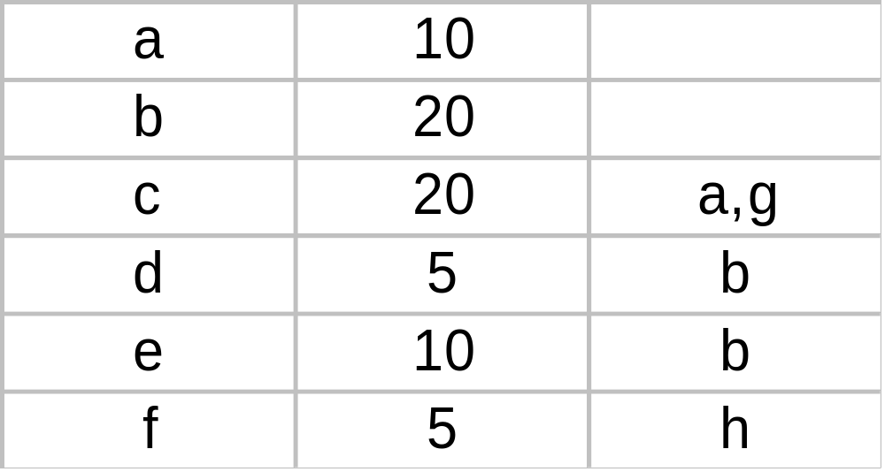
Task Table
Task Duration Dependents

Slide 34
CPM Graph
c:20
a:10
start
finish
g:5
b:20
f:5
d:10
e:10

Slide 35
How do we work out the various start and finish times for tasks?
Minimum time to complete project (MT) = Maximum of all paths from start to finish
Earliest start time (ES) of a task = Maximum of all paths from start to this task
Earliest finish time (EF) of a task = ES + duration of the task
Latest finish time (LF) of a task = MT - Maximum of all paths from this task to finish
Slack time = LS - ES = LF - EF

Slide 36
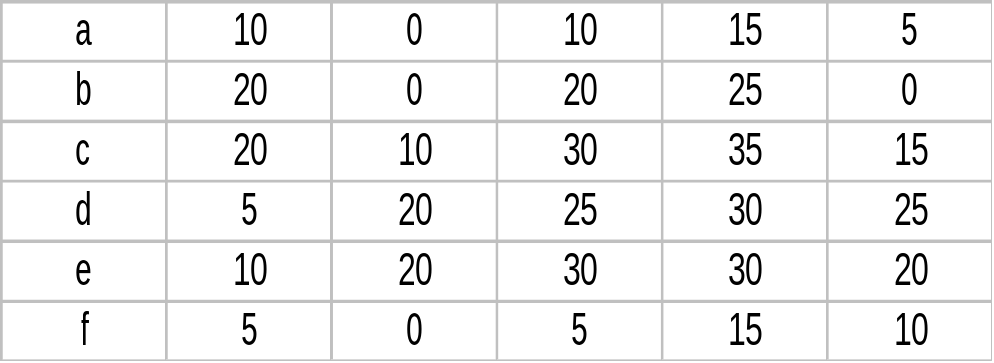
Start and finish times for tasks.
Latest start time (LS) of a task = LF - duration of the task
Task MT EF ES LF LS

Slide 37
What are the float time (or slack time) of tasks?
Float time (or slack time) is the total time that a task may be delayed
  before it will affect the end time of the project.
The float times indicate the "flexibility" in starting and completion of tasks:
A critical activity is an activity with zero (0) slack or float time.

Slide 38
What is PERT and how does it work?
PERT (Program Evaluation and Review Technique) is a variation of CPM:
  incorporates uncertainty about duration of tasks.
Gantt charts can be derived automatically from PERT charts.
Gantt chart representation of schedule is helpful in planning the utilization of resources,
  while PERT chart is more useful for monitoring the timely progress of activities.

Slide 39
Risk Management
A risk is any unfavourable event or circumstance:
  which might hamper successful or timely completion of a project.
Risk management:
  concerned with the reduction of the impact of risks.
Risk management consists of three activities:
  risk identification,
  risk assessment, and
  risk containment.

Slide 40
Risk identification
To be able to identify various risks:
  we must categorize risks into different classes.
Three main categories of risks can affect a software project:
  project risks
  technical risks
  business risks

Slide 41
Project Risks
Project risks associated with:
  budget,
  schedule,
  personnel,
  resource, and
  customer problems.

Slide 42
Technical Risks
Technical risks concern:
  requirements specification
    (e.g ambiguous, incomplete, changing specifications)
  design problems,
  implementation problems,
  interfacing problems,
  testing, and maintenance problems.
  technical uncertainty, and technical obsolescence are technical risk factors too.

Slide 43
Business Risks
Business Risks include:
  building an excellent product that no one wants,
  losing budgetary or personnel commitments, etc.
It is a good idea to have a “company disaster list”,
  a list of all bad things that have happened in the past
  project managers can jog their mind to see which items their project is vulnerable to.

Slide 44
Risk assessment
Objective of risk assessment is to prioritize the risks:
  Likelihood of a risk being real.
  Consequence of the problems associated with that risk.
Prioritization helps in handling the most damaging risks first.
  Priority of a risk is the product of the likelihood of the risk and the consequences of the problems associated with that risk.

Slide 45
Risk Handling
Three main strategies for risk handling:
  Avoid the risk: e.g. change the requirements for performance or functionality.
  Transfer the risk: allocate risks to third party
    or buy insurance to cover any financial loss should the risk become a reality.
  Contingency planning: Prepare contingency pans to minimize the impact of the risk.

Slide 46
Risk Handling
To decide about risk handling options, we must take into account:
  cost of reducing risk
  resulting cost saving from risk reduction.

Slide 47
Risk Containment
Let us see how we can contain an important type of risk:
  schedule slippage
    can be dealt with by increasing the visibility of the project.
Milestones are placed at regular intervals
  provide a manager with regular indication of progress.

Slide 48
Containing Schedule Slippage
A milestone is reached,
  when documentation produced has successfully been reviewed.

Slide 49
Software Configuration Management
The results (aka deliverables) of any large software development effort consists of a large number of objects:
  source code,
  design document,
  SRS document,
  test document,
  project plan (SPMP) document, etc.

Slide 50
Software Configuration Management (CONT.)
A configuration is a collection of deliverables:
  being developed for some customer.
As development proceeds,
  the components comprising a configuration undergo changes:
  Even during maintenance, the components comprising a configuration keep changing.

Slide 51
What is configuration management?
The set of activities through which the configuration items are managed and maintained
  as the product undergoes its life cycle phases.

Slide 52
Versions
A configuration for a particular system is called a version:
  The initial delivery might consist of several versions,
  more versions might be added later on.
  For example, one version of a mathematical package might run on a Unix machine,
    another on Windows NT, and
    another on Solaris.

Slide 53
Versions
As a software is released and used by the customers:
  errors are discovered,
  enhancements to the functionalities might be needed.
A new release of the software is an improved system intended to replace an old one.
Usually a product is described as version m and release n (or as version m.n)

Slide 54
Software Configuration Management
Existence of variants of a software product causes several problems.
Suppose you have several versions of the same module, and
  find a bug in one of them.
  it has to be fixed in all versions.

Slide 55
Software Configuration Management
Different objects are accessed and modified by a number of engineers.
Unless strict discipline is enforced:
  regarding updation and storage of the objects through some automated tool,
  several problems appear.

Slide 56
Software Configuration Management
For example, an engineer might update the module that he has designed ---
  without informing the engineers who need to interface with this module.
Or, two engineers may simultaneously carry out changes to different portions of a module:
  while saving overwrite each other.

Slide 57
Why Configuration Management?
To be able to identify the exact state of different deliverables at any time.
To avoid the problems associated with having replicated objects accessible by multiple engineers.
Controlling concurrent work on a module by different engineers. (Overwriting one engineer’s work by another)
Letting different engineers work on related modules at the same time.
Keeping track of variants (versions) and helping fix bugs in them.
Storing versions and revisions efficiently.
Maintaining revision history (accounting).

Slide 58
Software Configuration Management
Configuration management helps to:
  quickly determine the current state of the product
  change the various components (modifications, revisions, variations etc.) in a controlled manner.
  maintaining the current up-to-date status of various versions of the software,
  control and account changes to the product.

Slide 59
Software Configuration Management Activities
Configuration management is carried out through three principal activities:
  configuration identification,
  configuration control,
  configuration accounting and reporting.

Slide 60
Software Configuration Management Activities
Configuration identification
  which parts of the system must be kept track of?
Configuration control
  ensures that changes to a component happen smoothly.
Configuration accounting
  keeps track of what has been changed, when, and why.

Slide 61
Configuration Identification
Deliverable objects can be classified into three main categories:
  controlled,
  precontrolled,
  uncontrolled.
Controlled objects are under configuration control:
  you must follow some formal procedures to change them.

Slide 62
Configuration Identification
Precontrolled objects are not yet under configuration control,
  but may eventually be under configuration control.
Uncontrolled objects are not and will not be subject to configuration control.

Slide 63
Configuration Identification
Typical controllable objects include:
  Design documents
  Tools used to build the system, such as compilers, linkers, lexical analyzers, parsers, etc.
  Source code for each module
  Test cases
  Problem reports

Slide 64
Configuration Control
Configuration control is the process of managing changes.
  It is the part of configuration management that most directly affects day-to-day operations of the developers.
Once an object goes under configuration control,
  any further changes requires approval from a change control board (CCB).

Slide 65
Configuration Control
The CCB is constituted from among the development team members.
For every change carried out,
  CCB certifies several things about the change:
    Change is well-motivated.
    Developer has considered and documented the effects of change.
    Appropriate people have validated the change.

Slide 66
Configuration Control
An important reason for configuration control:
  people need a stable environment to develop a software product.
Suppose you are trying to integrate module A, with the modules B and C,
  you cannot make progress if developer of module C keeps changing it;
  this is especially frustrating if a change to module C forces you to recompile A.
As soon as a document under configuration control is updated,
  the updated version is frozen and is called a baseline.

Slide 67
Configuration Control
Baseline
New Baseline
A
B
A
B
C
D
C’
D
Reserve
Replace
Cancel Reservation
C
Private Copy

Slide 68
Configuration Control
This establishes a baseline for others to use.
Freezing a configuration may involve archiving everything needed to rebuild it.
  Archiving means copying to a safe place such as a magnetic tape.
At any given time, a programmer may pay attention to:
  Current baseline configuration
  Programmer's private version

Slide 69
SCCS (Source Code Control System)
SCCS is a configuration management tool:
  available on Unix systems:
  helps control and manage text files.
  also implements an efficient way of storing versions:
    minimizes the amount of occupied disk space.

Slide 70
SCCS
Suppose a module is present in 3 versions:
  MOD1.1, MOD1.2, and MOD1.3.
SCCS stores the original module MOD1.1
  together with changes needed to transform it into MOD1.2 and MOD1.3.
  the modifications are called deltas.

Slide 71
SCCS Features
Access control facilities provided by SCCS include:
  facilities for checking components in and out.
  Individual developers check out components and modify them.
    after they have changed a module as required and the module has been successfully tested,
    they check in the changed module into SCCS.

Slide 72
SCCS Features
Revisions are denoted by numbers in ascending order,
  e.g, 1.1, 1.2, 1.3 etc.
It is also possible to create variants of a component
  by creating a fork in the development history.

Slide 73
Summary
Project staffing requires careful understanding of the attributes of good software engineers.
Project scheduling:
  break down large tasks into smaller logical units,
  determine dependencies among tasks,
  determine expected duration of tasks,
  assign resources, and
  assign times.

Slide 74
Summary
Several techniques are available to help in scheduling:
  Work breakdown structure
  Activity networks
  Gantt charts
  PERT and CPM
Commercial software tools are available to assist in developing these.

Slide 75
Summary
It is necessary to determine the critical paths in a project:
  to meet the timing for critical activities.
An important project planning activity is risk management:
  Risk identification
  Risk assessment
  Risk containment

Slide 76
Summary
Configuration management.
  the set of activities by which a large number of objects are managed and maintained.

