Slide 1
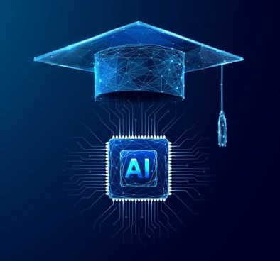
2025
UNLOCKING THE FUTURE WITH EDU-AI : THE FUTURE IS NOW
TEAM MEMBER :
AYUSHI SRIVASTAVA (lead)
AYUSH TRIPATHI
contact – 9140149392,9115002616
sriavastavaayushi902@gmail.com

Slide 2
Edu-AI transforming the education
01
MOVING FROM “0” TO “1”.
Edu-AI: The Future is Now combines AI and FlutterFlow to empower students in managing their academics and career development. Key features include:
Personalized Scheduling: AI-powered custom schedules for better time management.
Curated Resources & Events: Real-time academic resources and career-building events tailored to student needs.
Job & Internship Matches: AI-driven job and internship recommendations based on skills and career goals.
Powered by OpenAI, ChatGPT, and FlutterFlow, Edu-AI offers a seamless, intuitive experience that helps students thrive academically and professionally.

Slide 3
Edi-AI : The Future Is Now
AI-Powered Schedule Management:
It creates personalized schedules by using AI to optimize time for studying, attending classes, and participating in extracurricular activities. It ensures students can balance academic tasks efficiently, reducing stress and improving productivity.
Resource Links and Academic Events
J job and Internship Opportunities
Edu-AI curates real-time links to relevant academic resources, including competitive exams and skill-building events. The AI customizes and updates these links based on student interests and academic needs, keeping them informed and up-to-date
This section connects students with job and internship opportunities based on their skills, preferences, and career goals. AI-driven matching ensures students find the best opportunities to advance their careers and gain valuable experience.

Slide 4


Advantages of AI in Education
Time Management
AI-generated personalized schedules help students balance academics, extracurriculars, and personal time, reducing stress and boosting productivity.
Resource Access
Curated, real-time academic and career resources ensure students always have the right tools and events for success.
Career Development
AI-matches students with relevant job and
internship opportunities, helping them build professional skills and grow their careers.
Personalized Support
Tailored guidance for both academics and
career paths, powered by AI (OpenAI, ChatGPT, FlutterFlow), enhancing the student experience.

Slide 5

TECHNOLOGY STACK
OpenAI & ChatGPT: Drive personalized scheduling, career guidance, and real-time student support with AI-powered recommendations and interactions.
FlutterFlow: Enables a responsive and intuitive user interface for both mobile and web platforms, ensuring an engaging experience.
Cloud Services: Ensure real-time data synchronization, delivering the latest academic resources, events, and job opportunities.
Security: High-level encryption and privacy measures to protect sensitive student data.

Slide 6

Bibliography
OpenAI. (n.d.). GPT-3:
Language Models are Few-Shot Learners.
Retrieved from https://arxiv.org/abs/2005.14165
AIPPT.com. (n.d.).
AI-Powered PPT Creation Tools.
Retrieved from https://aippt.com
Unsplash. (n.d.).
Free High-Quality Images.
Retrieved from https://unsplash.com
FlutterFlow. (n.d.).
FlutterFlow Documentation.
Retrieved from https://flutterflow.io/docs
Google Cloud. (n.d.).
Cloud AI Services.
Retrieved from https://cloud.google.com/products/ai

