Slide 1
QA Agent — Gemini-Powered Test Design Assistant
An Agentic AI Use Case
Automate QA test case creation from user stories with Gen AI
Date: | Prepared by:
05/07/2025 | Ayushi Bhujade BA/QA intern

Slide 2
TABLE OF CONTENT
S NO. | TOPIC
1. | Problem Statement
2. | Objective
3. | The Intelligent Stack
4. | Pipeline Architecture of QA Agent
5. | Workflow of Test Design creation
6. | Tools and Technologies
7. | Demo
8. | Next Steps

Slide 3
1. PROBLEM STATEMENT
⚙️ Manual QA Test Design Challenges:
Manual test case creation is time-consuming and repetitive.
Test coverage is often inconsistent or incomplete, especially with changing user stories.
QA teams spend significant effort translating user stories into structured test cases.
Iterative updates and corrections are difficult to track and apply accurately.
🧩 The Need:
A faster, smarter, and more consistent way to generate test designs directly from user stories — with the ability to adapt, improve, and export.

Slide 4
2. OBJECTIVE: Core Capabilities of the QA Agent
🧠 Understand User Stories
Parses natural language user stories
Extracts intent and testable actions
🧾 Generate Test Cases
Auto-creates step-by-step test designs
Aligns with QA standards and structure
🔁 Enable Iterative Refinement
Accepts human feedback
Updates test cases in real time
📤 Export to Excel
Generate Test Designs with one click Excel download
Ready for import into tools like Azure DevOps

Slide 5






3. THE INTELLIGENT STACK: LLM → GenAI → Agentic AI
Human Interaction
GenAI - Creates Meaningful Content from Context
Storage
Meeting: Project Procurement
Context understanding
Understands Subject of the meeting, duration, audience
- Interacts
- Asks questions
[Meeting notes]
Delivers
- Project Scope
- Timeline
- Requirements
Records
- Improvement
- Enhancement
- Feedback
Alexander
LLM – can speak/respond/understand
AGENTIC AI - takes action, stores output and learns from the feedback

Slide 6
📣 BUSINESS TAKEAWAY:
“An LLM gives you smart answers. An Agentic AI delivers outcomes.”
LLM = Language brain
GenAI = Creator
Agentic AI = Doer

Slide 7
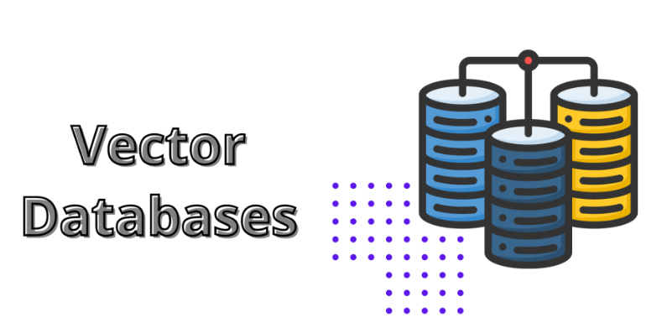

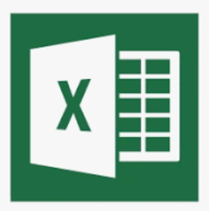

4. PIPELINE ARCHITECHTURE OF QA AGENT
GenAI: Prompt → Response
User Interface (Streamlit)
Storage
Learning Loop Module
Retrieves semantic meaning of feedback and prior designs
- Uploads a user story
- Provides the initial prompt
Prompt Engineering
Feedback/ correction prompt
[Corrections stored as Embeddings]
[User]
Retrieval Augmented Generation (RAG)
Generates test design
Sends correction
Test Design Output
LLM Engine: Gemini 1.5 pro
QA AGENT

Slide 8
5. WORKFLOW OF TEST DESIGN CREATION
Step | Action | Data Used
1 | Upload User Story and generate first Excel | user_story ➔ LLM ➔ test_design_v1
2 | User gives a correction | test_design_v1 + correction ➔ LLM ➔ test_design_v2
3 | User gives another correction | test_design_v2 + correction ➔ LLM ➔ test_design_v3
4 | and so on...

Slide 9
6. TOOLS AND TECHNOLOGIES
🖼️ Streamlit – UI Layer
Uploads user stories and displays test outputs
Enables quick feedback loop from users
🧠 Prompt Engineering + RAG
Crafts structured prompts for LLM
Retrieves past context to improve accuracy
🧩Pinecone -Vector DB
Stores semantic feedback and test cases
Enables fast, relevant memory retrieval
🔮 Gemini 1.5 Pro - LLM
Understands and generates test cases
Handles structured, context-rich input
🤖 LangChain – Agentic Framework
Orchestrates LLM, tools, and memory
Supports multi-step reasoning and feedback

Slide 10
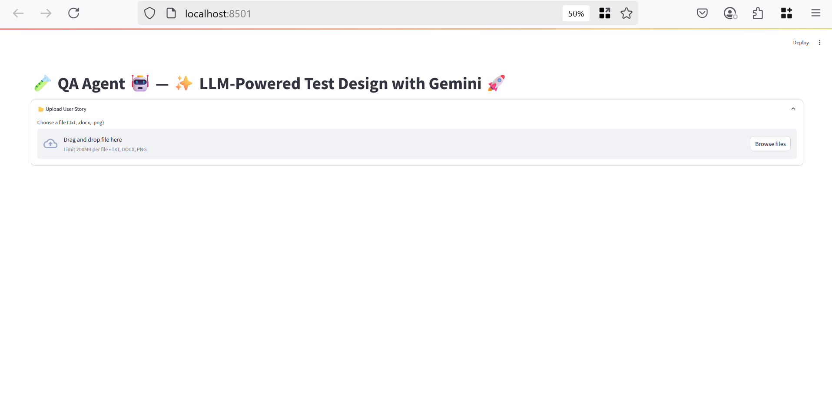
7. DEMO: Browse a User Story File

Slide 11
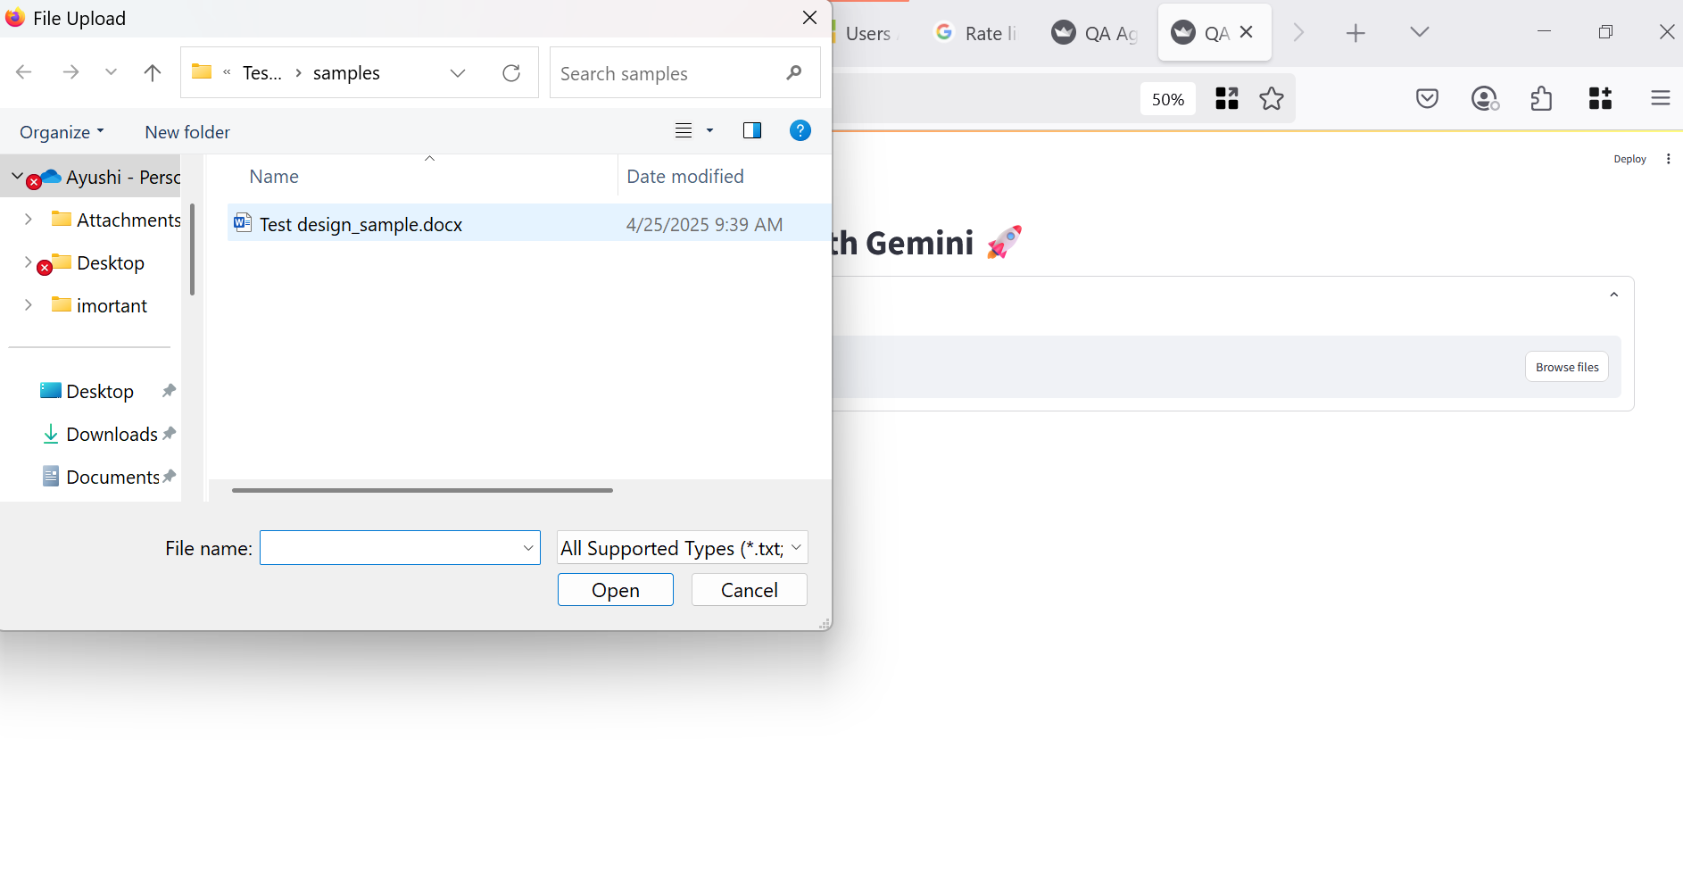
7. DEMO: Upload a User Story

Slide 12
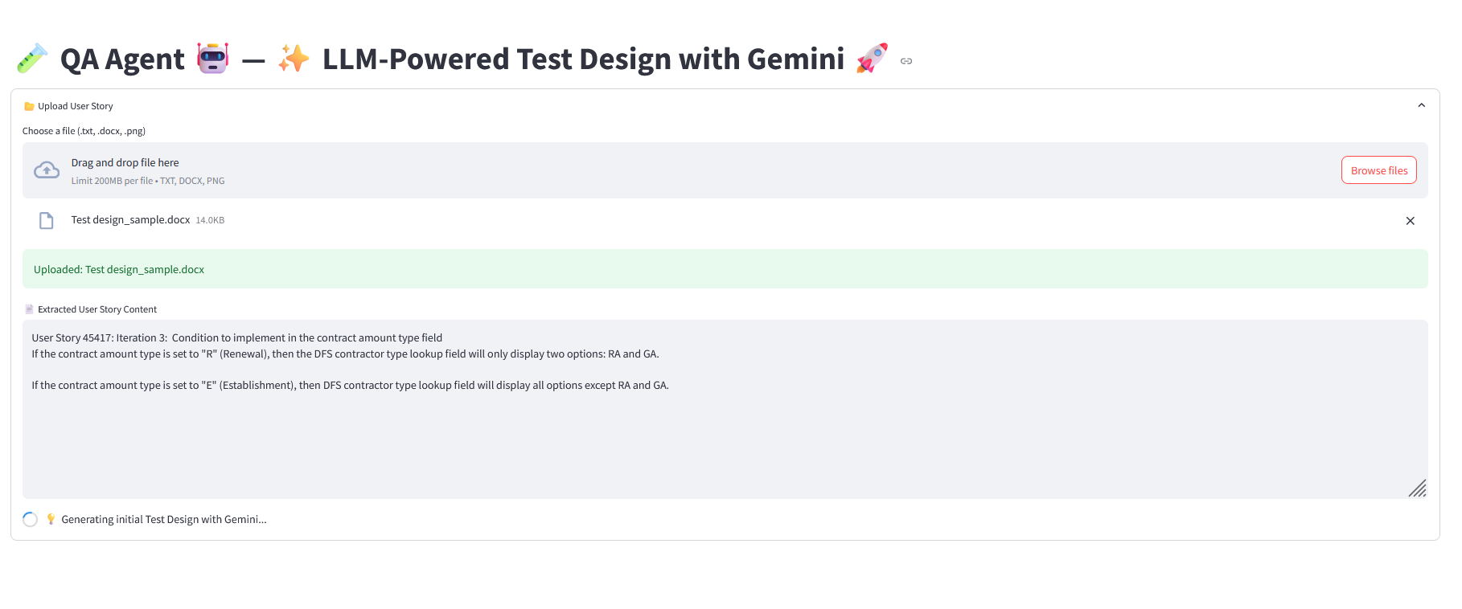
7. DEMO: Gemini Generating Initial Test Design

Slide 13
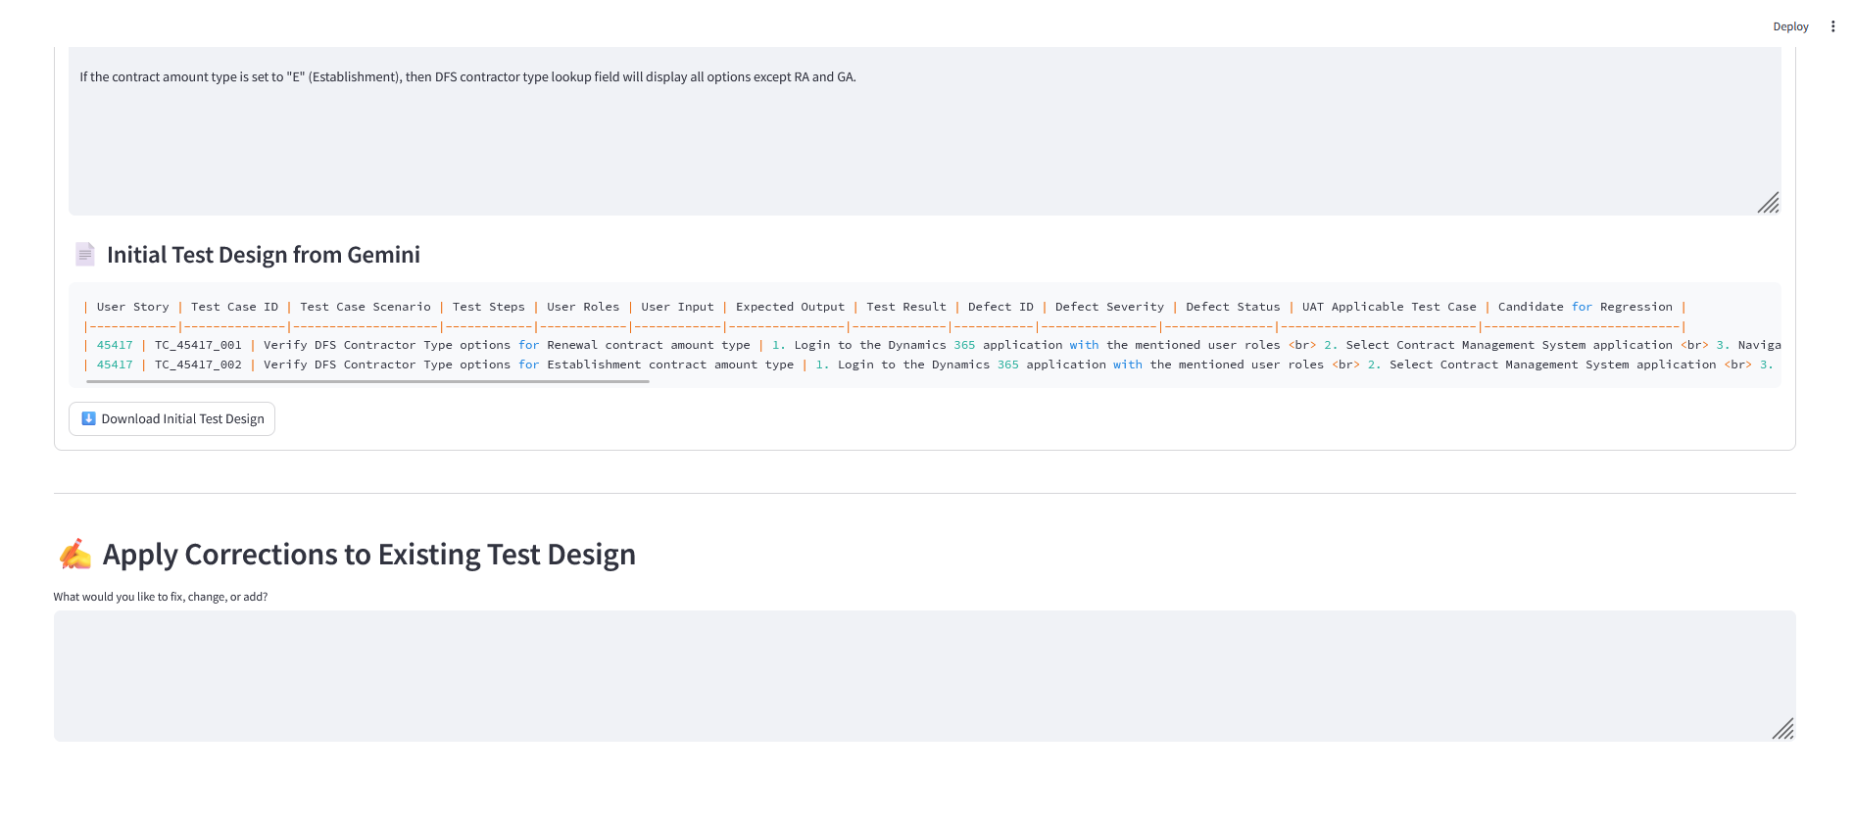
7. DEMO: Initial Test Design Generated

Slide 14
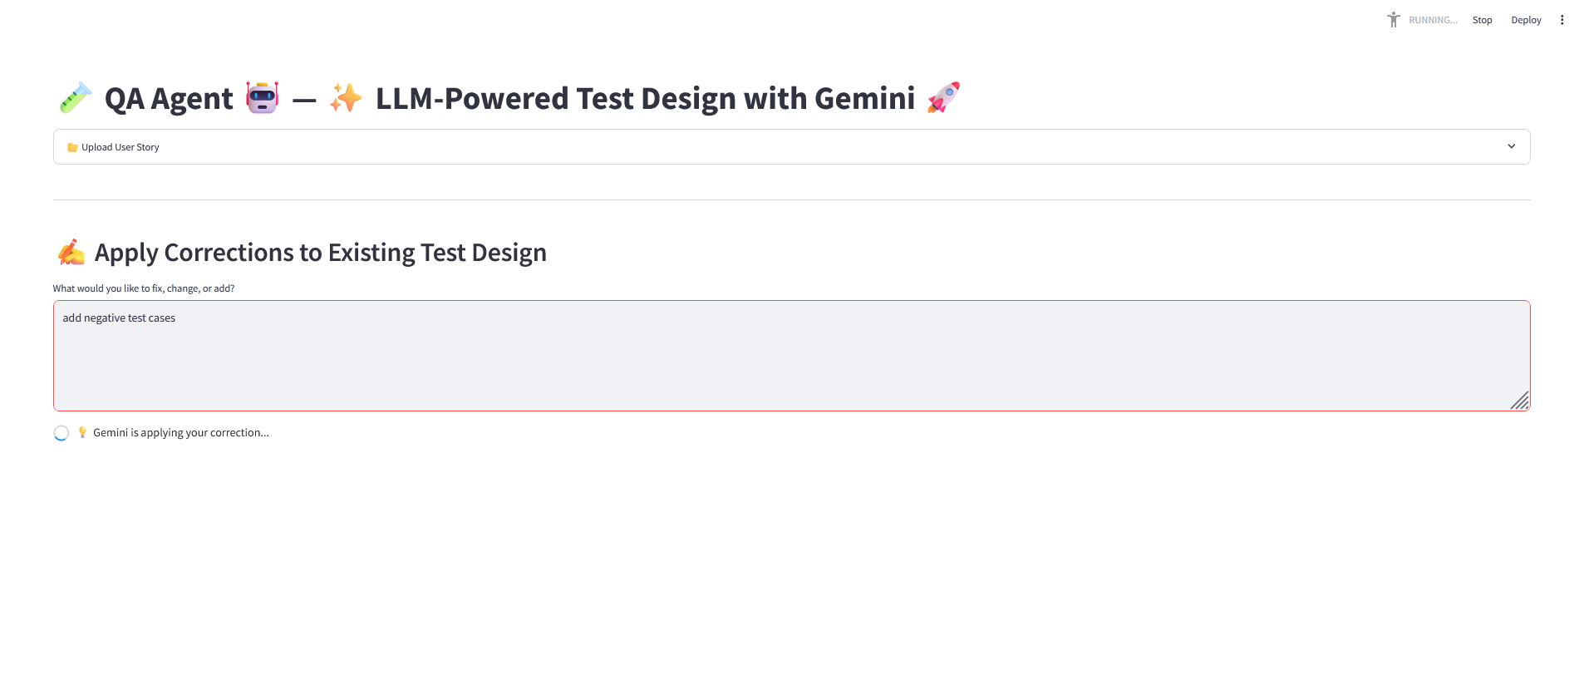
7. DEMO: Apply Corrections

Slide 15
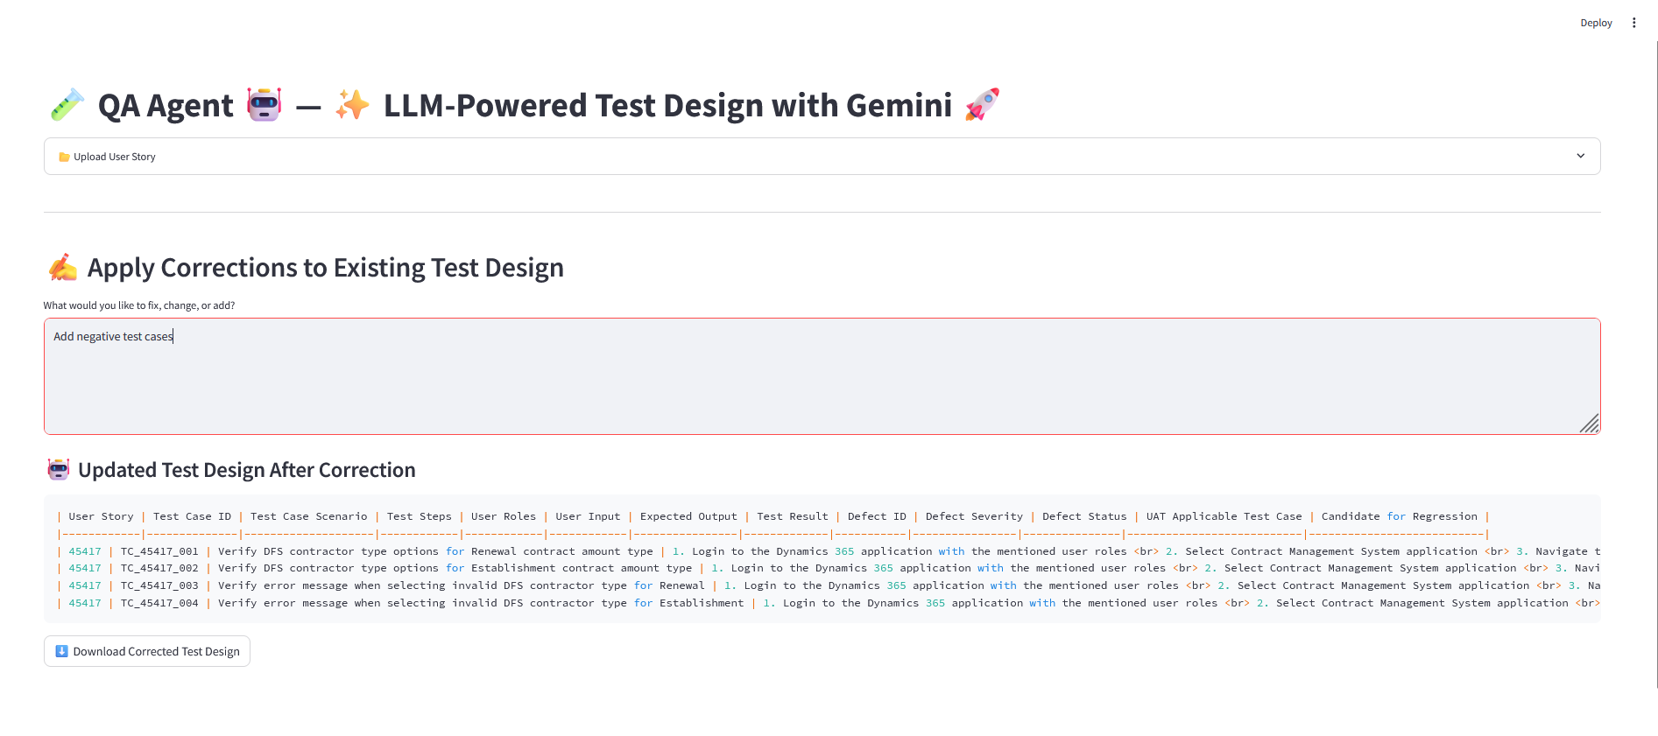
7. DEMO: Download Updated Test Design

Slide 16
8. NEXT STEPS
🌐 1. Make the QA Agent Accessible to All Users
Deploy to Azure App Service - Host the agent on a secure, always-on platform for team-wide access and no local dependency.
🔗 2. Integrate with Azure DevOps
Dynamic User Story Ingestion - Use DevOps APIs to fetch user stories automatically — no manual uploads.
Export Test Cases into DevOps - Push test cases to DevOps Test Plans via API or extensions.
Workflow Automation - Auto-trigger test generation when new stories are created using Pipelines or Logic Apps.

Slide 17
PHASE – 02 – Integrating with Azure Devops

Slide 18
9. WORKING COMPONENTS
Component | Role
VS Code + Azure Repos | Code management
Azure Pipelines | Auto-deploy updated function
Azure Function | Core logic (LLM + Excel)
Azure App Service | UI with buttons, feedback box
Power Automate | Uploads finalized test design to DevOps
Azure DevOps | User stories + final test case attachment

Slide 19
10. PIPELINE FLOW
VS Code
push code
Azure Repos
triggers
Azure Pipelines
Builds and deploys
Azure Function
latest logic ready to be used
Embeds feedback and store in vector DB

Slide 20
8. AZURE APP SERVICE (UI)
Fetch and List User Stories from Azure DevOps
Calls Azure Function (LLM + Excel logic)
Power Automate triggered
Uploads final Excel to Azure DevOps
Shows Excel file, allows download and feedback
User clicks "Finalize"
User clicks "Create Test Design"

Slide 21
THANK YOU

