Slide 1
PROJECT TITLE Optimizing Returns: A Three Month Strategy for Top Auto Giants
Team Members
Ayushi Bhujade (ZG28331) | Nikhitha Guntaka (QG32451)

Slide 2
Abstract
In today’s dynamic financial landscape, optimizing investment returns while managing risk remains a paramount objective for investors. This project present an integrated approach of time-series forecast and financial analysis to develop a strategic investment framework for an automative industry. Leveraging historical data sourced from Yahoo Finance API, we utilize advance time-series forecasting model such as Prophet to predict future returns for leading automotive companies and construct a robust investment strategy spanning a next three-month horizon

Slide 3
Table of Content
S No. | Topic
1. | Introduction
2. | TSA (Time series Analysis) on the stock data
3. | Forecast stock price
4. | CAPM Analysis and SML plot
5. | Stock Evaluation: Sharpe Ratio
6. | Portfolio Construction and Optimization
7. | Conclusion

Slide 4
1. Introduction
The project aims to develop a robust investment strategy on the adjusted closing price of the stock within automotive sector for a next three-month horizon.
Utilizing historical data from Yahoo Finance API over the past two years, we employ advanced time-series forecasting models like Prophet to predict future returns for key automotive companies within the S&P 500, including Tesla, BMW, Mercedes, Ferrari, Toyota Motors, Stellantis, and Honda Motors.
Integrating concepts from the Capital Asset Pricing Model (CAPM) and Security Market Line (SML), we estimate expected returns and evaluate market risk systematically.
Employing mean-variance optimization principles and insights from CAPM, we construct an optimized portfolio to maximize returns while diversifying risk exposure.
Performance evaluation metrics, such as the Sharpe ratio, are utilized to rigorously assess the effectiveness of the investment strategy.

Slide 5
2. TSA (Time Series Analysis) on Stock Data
Time Series Analysis provide insights into the behavior, patterns, and relationships within the stock price time series data, which can inform further modeling and forecasting efforts.
1. | Visualize Stock Prices | Plotted the adjusted close prices of each stock over time to visualize their trends. Checked for patterns, trends, and any outliers in the stock prices.
2. | Check Stationarity | Plotted the differenced time series of each stock to assess stationarity.
3. | Plot Rolling Statistics | Computed and plotted rolling mean and standard deviation of each stock's prices. Used a rolling window of 30 days to calculate these statistics.
4. | Decompose Seasonality | Decomposed each stock's time series into trend, seasonal, and residual components. Used the additive model for decomposition with a seasonal period of 12 months.
5. | Plot Autocorrelation | Plotted the autocorrelation function (ACF) for each stock to assess autocorrelation. Autocorrelation helps identify patterns and relationships between lagged values in the time series.
6. | Plot Partial Autocorrelation | Plotted the partial autocorrelation function (PACF) for each stock to assess partial autocorrelation.

Slide 6
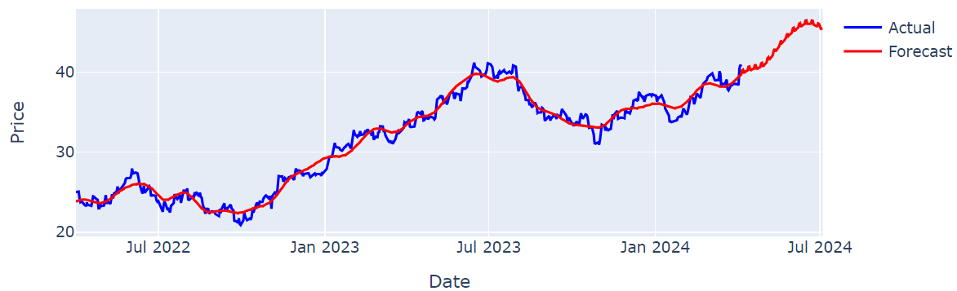
3.1 Forecast Stock Price
Forecast: 90 days
Model Deployed: Prophet model
Output for some of the stocks
BMW Stock Price Forecast

Slide 7
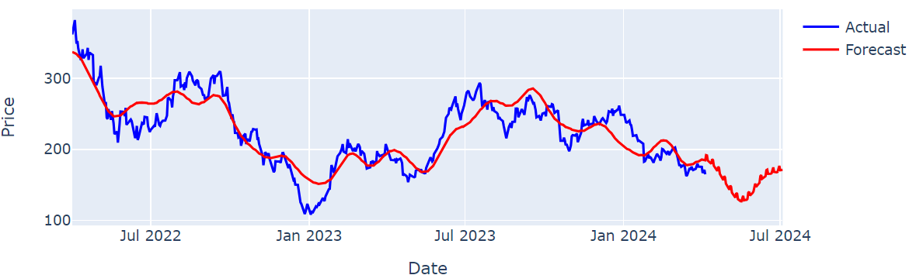
3.1 Forecast Stock Price
Forecast: 90 days
Model Deployed: Prophet model
Output for some of the stocks
Tesla Stock Price Forecast

Slide 8
4.1 CAPM Analysis and SML plot
CAPM (Capital Asset Pricing Model) is used to determine the expected return on an investment based on the risk.
Beta indicate the systematic risk or volatility of an asset relative to the overall market.
CAPM Analysis of the stocks- |  |  | Interpretation:
Stock | Beta | Expected Return | Tesla has a beta of 5.2546, meaning it's highly volatile and tends to move more than 5 times the market. Mercedes has a negative beta of -1.5037, meaning it tends to move in the opposite direction of the market and is less volatile than the market. Toyota, Stellantis, BMW have positive betas, indicating they're more volatile than the market but less volatile than Tesla.
Tesla | 5.2546 | 0.00476
Toyota Motors | 3.0803 | 0.00283
Mercedes | - 1.5037 | - 0.00123
Stellantis | 4.9106 | 0.00446
BMW | 1.7132 | 0.00162
Ferrari | - 1.0197 | -0.00081
Honda | - 1.7865 | -0.00149

Slide 9
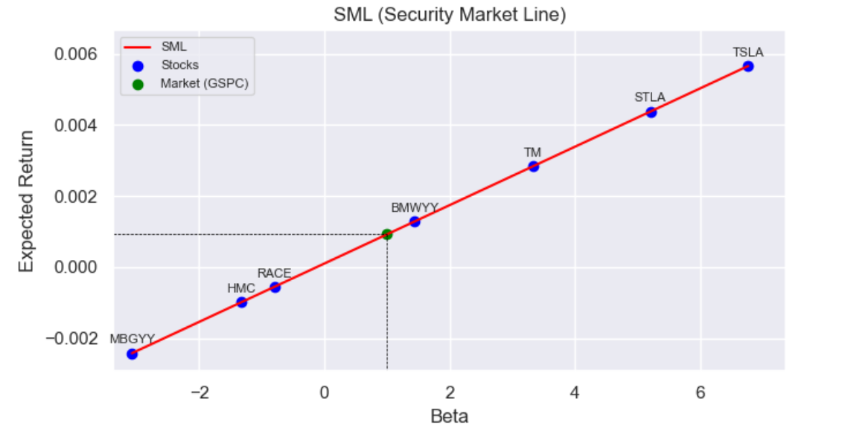
4.2 CAPM Analysis and SML plot
SML(Security Market Line) evaluates risk-return trade off of individual stocks. It helps to assess whether a stock is offering an appropriate return given its level of risk, thus making investment decisions based on relative valuations.
If a stock falls above the SML → Higher return → Potentially Undervalued
If a stock falls below the SML → Lower return → Potentially Overvalued

Slide 10
5. Stock Evaluation: Sharpe Ratio
Sharpe ratio is used to assess the risk –adjusted return of investments or portfolios.
Sharpe Ratio is valuable for constructing efficient portfolios by optimizing the trade off between risk and return.
It considers both systematic and non systematic risk, making it suitable for evaluating diversified portfolios.
Calculated Sharpe Ratio of the stocks- |  | Interpretation:
Tesla | -0.007708 | Tesla has a negative Sharpe Ratio, indicating that its return is not sufficient to compensate for the risk taken. Mercedes also has a relatively high Sharpe Ratio, indicating good risk-adjusted return. Ferrari has the highest Sharpe Ratio, suggesting that it has the best risk-adjusted return among the listed securities.
Toyota Motors | 0.119415
Mercedes | 0.224604
Stellantis | 0.058694
BMW | 0.187550
Ferrari | 0.425031
Honda | 0.220902

Slide 11
6.1 Portfolio Construction and Optimization
The forecasted return is used to construct diversified portfolios of automotive stocks.
The optimization technique such as mean-variance optimization is implemented to determine the optimal portfolio with the optimal Sharpe ratio, considering risk-return trade offs.
Given below are the optimal parameters of the optimal portfolio-
Optimal Return: 0.456
Optimal Volatility: 0.0006
Optimal Sharpe Ratio: 659
Stock name | Tesla | Toyota Motors | Mercedes | Stellantis | BMW | Ferrari | Honda
Optimal Weights | 0.0 | 0.23 | 0.01 | 0.0 | 0.07 | 0.57 | 0.12

Slide 12
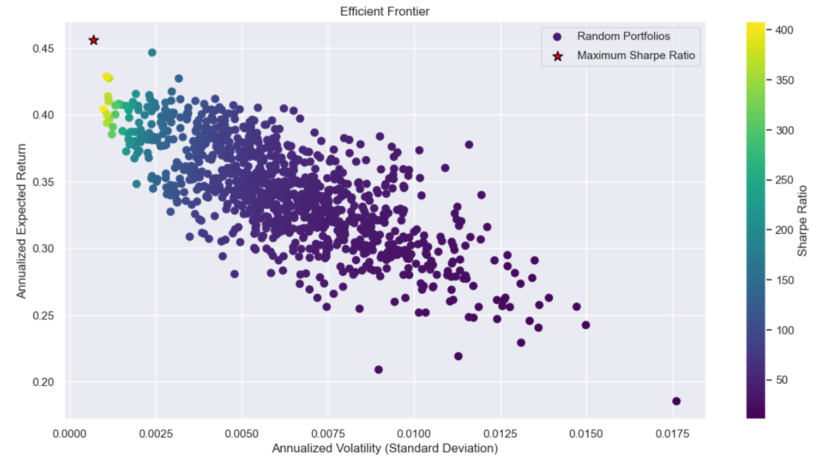
6.2 Portfolio Construction and Optimization
Plotting Efficient Frontier with diversified Portfolios and highlighting the Optimal Portfolio

Slide 13
7. Conclusion
This project embarked on formulating a investment strategy for a automotive sector.
By analyzing historical data and using advanced forecasting methods, we evaluated companies’ potential returns and risks.
Our findings highlighted varying levels of market sensitivity among companies, offering opportunities for diversification.
The optimized portfolio emphasizes two key players - Ferrari and Toyota which demonstrated impressive returns relative to the risk.
Overall, this project demonstrates the power of data-driven decision-making in guiding investment strategies, offering valuable insights for investors seeking to capitalize on opportunities in any sector.

Slide 14
THANK YOU

