Slide 1


Predictive Analytics Project
Title: Sentiment Analysis based on product review and customer segmentation
Guided by:
Dr. Achala Shakya
Presented by:
Name | Roll No. | Branch
Ayushi Gupta | R2142220725 | B.Tech CSE AIML (H)
Uditi Arya | R2142220684 | B.Tech CSE AIML (H)
Purvi Jain | R2142221206 | B.Tech CSE AIML (H)

Slide 2
Content
Introduction
Problem Statement
Motivation
Objectives
Methodology
Implementation
Application of the Project
PERT Chart
References

Slide 3
1. Introduction
The project titled "Sentiment Analysis based on product review and customer segmentation" focuses on examining headphone products available on Flipkart. The primary goal is to analyze customer ratings, selling prices, discounts, and product reviews to extract meaningful insights. Through data visualization, predictive modeling, and sentiment analysis, this project aims to enhance our understanding of consumer behavior and preferences.

Slide 4
2. Problem Statement
This project addresses several key issues related to the analysis of headphones on Flipkart. First, it seeks to understand the relationship between product ratings and selling prices. Second, it examines the impact of discounts on sales performance. Lastly, the project aims to classify customer sentiments based on their product reviews. Overall, there is a pressing need for effective customer segmentation to improve marketing strategies.

Slide 5
3. Motivation
Rapid growth of the e-commerce sector requires data-driven decision-making.
Enhanced understanding of consumer behavior and preferences through data analysis.
Improvement of product offerings and marketing strategies based on insights.
Increased customer satisfaction by tailoring approaches according to data findings.

Slide 6
4. Objectives
Visualize the distribution of average ratings, discounts, and selling prices of headphones.
Build predictive models to estimate selling prices using Long Short-Term Memory (LSTM) networks.
Perform sentiment analysis on customer reviews utilizing BERT (Bidirectional Encoder Representations from Transformers).
Segment customers based on purchasing behavior for more effective marketing strategies.

Slide 7
5. Technology Stack
Programming language- Python
Data Processing- Pandas, Numpy
Machine Learning Libraries – Scikit-learn, Tensorflow/ Keras, Hugging Face Transformers(BERT)
Natural Language Processing- NLTK, spaCy, TextBlob
Data Visualization- Matplotlib, seaborn , Ploty/ Das
Development Environment- Jupyter Notebook, Visual Studio Code
Version Control- Git, GitHub
Documentation-MS Word

Slide 8
6. Methodology
Data Collection: Utilized the Flipkart Headphones dataset, including ratings, prices, and reviews.
Data Preprocessing: Cleaned the dataset, handled missing values, and converted categorical variables.
Exploratory Data Analysis (EDA): Visualized relationships and distributions using histograms, scatter plots, etc.
Modeling:Developed an LSTM model for price prediction and used BERT for sentiment analysis on product reviews.
Customer Segmentation: Applied K-Means clustering to identify distinct customer segments.

Slide 9
7. Implementation
Data Visualization: Utilized Matplotlib and Seaborn for creating insightful visualizations.
Predictive Modeling: Developed an LSTM network for forecasting selling prices based on product features.
Sentiment Analysis: Fine-tuned a BERT model to classify reviews into positive, neutral, or negative sentiments.
Customer Segmentation: Implemented K-Means clustering to categorize customers based on buying patterns.

Slide 10
8. Application of the Project
Provides significant business value by identifying high-value products and effective pricing strategies.
Tailors marketing campaigns to align with customer sentiment and preferences.
Suggests future enhancements, such as:Integrating real-time data for dynamic pricing strategies, developing a user-friendly dashboard for visualizing insights.

Slide 11
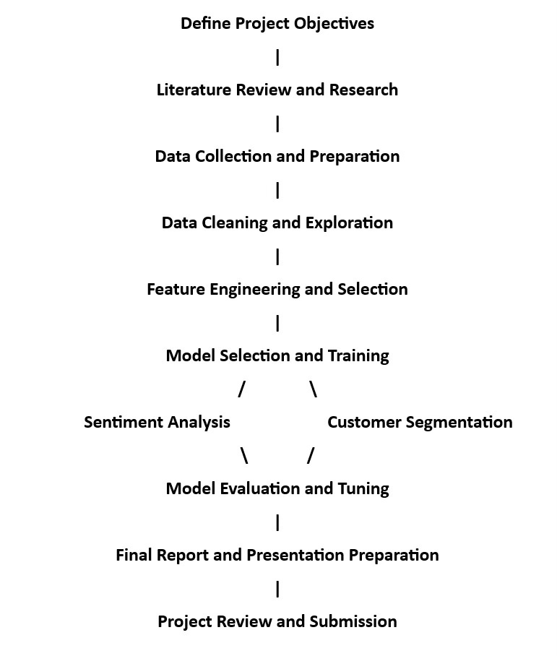
8. PERT Chart

Slide 12
10. References
Pattern Recognition and Machine Learning
Author: Christopher M. Bishop
Publisher: Springer
Year: 2006
Description: This book covers a wide range of machine learning techniques, including algorithms that can be applied to classification problems like sentiment analysis.
Data Science for Business: What You Need to Know about Data Mining and Data-Analytic Thinking
Authors: Foster Provost and Tom Fawcett
Publisher: O'Reilly Media
Year: 2013
Description: This book provides foundational knowledge on data science principles and techniques, with applications in customer segmentation and market analysis.

Slide 13
Thank You

