Slide 1
GBASE
An Efficient Analysis Platform for Large Graphs
Ayushi Sinha

Slide 2
Experiments
Experimental Setting
Space Efficiency Comparison
Indexing Time Comparison
Global Query Time
Targeted Query Time
Notes:
Space Efficiency – How much does their compressed block encoding reduce their data size?
Indexing Time – How do their algorithms scale up with graph sizes and the number of machines?
Global and Targeted Query – How much do their indexing and query execution methods save in query response time?

Slide 3
Experiments
Experimental Setting
Space Efficiency Comparison
Indexing Time Comparison
Global Query Time
Targeted Query Time

Slide 4
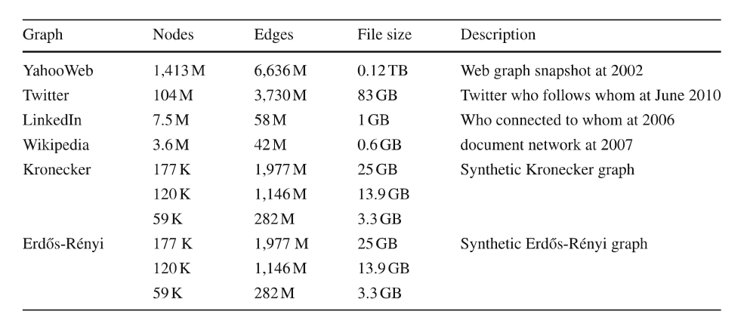
Experimental Setting
Datasets
Notes:
YahooWeb has about 1.4 billion nodes, 6.6 billion edges, and 120GB in space.
Kronecker and Erdős-Rényi are synthetic data generators.

Slide 5
Experimental Setting
Storage Schemes
GBASE RAW
GBASE NNB
GBASE NCB
GBASE CCB
GBASE CCB+GS
Notes:
RAW – Raw encoding, i.e., the original adjacency matrix format
NNB – No clustering, no compression, blocking, i.e., raw block encoding without compression or clustering
NCB – No clustering, compression, blocking, i.e., compressed block encoding without clustering
CCB – Clustering, compression, blocking, i.e., compressed block encoding with clustering
CCB+GS – CCB with grid selection

Slide 6
Experimental Setting
Storage Schemes
GBASE RAW
GBASE NNB
GBASE NCB
GBASE CCB
GBASE CCB+GS
Elias-γ encoding for compression
Notes:
Since Elias-γ achieves higher compression rate than the Gzip algorithm.

Slide 7
Experimental Setting
Storage Schemes
GBASE RAW
GBASE NNB
GBASE NCB
GBASE CCB
GBASE CCB+GS
YahooWeb – Original graph is well clustered
Twitter, LinkedIn, Wikipedia – Shingle ordering for clustering
Kronecker – Original graph is highly clustered, and used as the clustered representation of the Erdős-Rényi graph
Notes:
YahooWeb – Nodes are lexicographically numbered, and therefore, there are many intra edges within domains. To generate a non-clustered version of this graph, they randomly permute node IDs of the original graph.
Kronecker and Erdős-Rényi are synthetic data generators, and can generate multiple graphs of different sizes. Graphs generated using Kronecker are highly clustered from construction.

Slide 8
Experimental Setting
Storage Schemes
GBASE RAW
GBASE NNB
GBASE NCB
GBASE CCB
GBASE CCB+GS
GBASE HADOOP deployed onto M45 HADOOP cluster by Yahoo!
480 machines, 1.5 Petabyte total storage, 3.5 Terabyte memory

Slide 9
Experiments
Experimental Setting
Space Efficiency Comparison
Indexing Time Comparison
Global Query Time
Targeted Query Time

Slide 10
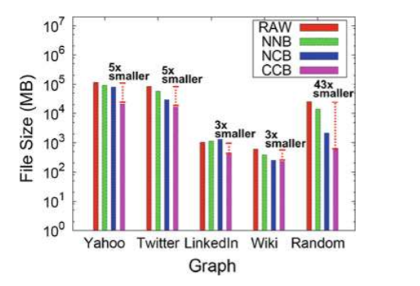
SPACE efficiency comparison

Slide 11
SPACE efficiency comparison
RAW – 108.5GB
NNB – 84.6GB
NCB – 74.75GB
CCB – 19.3GB

Slide 12
SPACE efficiency comparison
RAW – 77.4GB
NNB – 54GB
NCB – 27.6GB
CCB – 15.4GB

Slide 13
SPACE efficiency comparison
RAW – 0.9GB
NNB – 1GB
NCB – 1.2GB
CCB – 0.3GB
Notes:
The original LinkedIn graph is very sparse, and so the storage overhead from meta information such as block row ID, column ID, etc., outweights the savings from the encodings. But CCB is still able to save space.

Slide 14
SPACE efficiency comparison
RAW – 0.5GB
NNB – 0.35GB
NCB – 0.23GB
CCB – 0.2GB

Slide 15
SPACE efficiency comparison
RAW – 23.5GB
NNB – 13GB
NCB – 2GB
CCB – 0.5GB

Slide 16
Experiments
Experimental Setting
Space Efficiency Comparison
Indexing Time Comparison
Global Query Time
Targeted Query Time

Slide 17
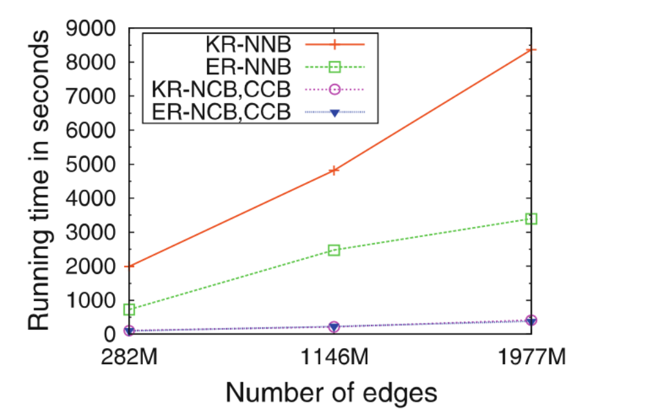
Indexing Time Comparison
Notes:
This graph shows the running time of the GBASE indexing process, against the number of edges. They use 200 machines to run this experiment.
This graph shows that compressed block encoding (NCB and CCB) takes much less time than raw block encoding, despite the additional compression step – since the resulting compressed blocks are much smaller than the blocks from raw block encoding, hence reducing running time for writing blocks to disk.
Also, Kronecker runs slower on the graph with raw block encoding since Kronecker graphs are dense, and Erdős-Rényi graphs are very sparse. Denser graphs take longer encoding time because the running time for mapreduce is bounded by the longest mapper or reducer time.
Note: Indexing time increases linearly, demonstrating scalability.

Slide 18
Experiments
Experimental Setting
Space Efficiency Comparison
Indexing Time Comparison
Global Query Time
Targeted Query Time

Slide 19
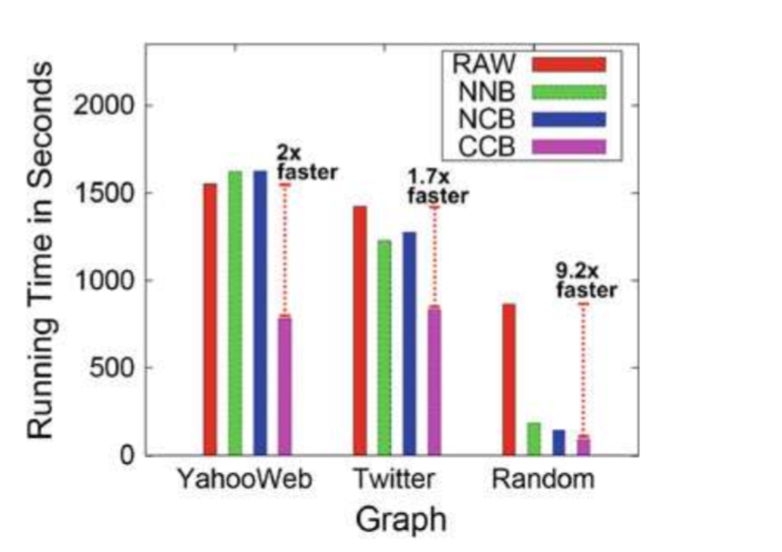
GLOBAL QUERY TIME
Notes:
Using PageRank query.
Running time – time savings are smaller than storage savings. Why? Because additional CPU time is required for decoding blocks, since they are encoded to increase storage savings. However, the overall runtime of CCB is still faster than that of RAW or NNB or NCB, because the decreased I/O time overshadows the decoding time required.

Slide 20
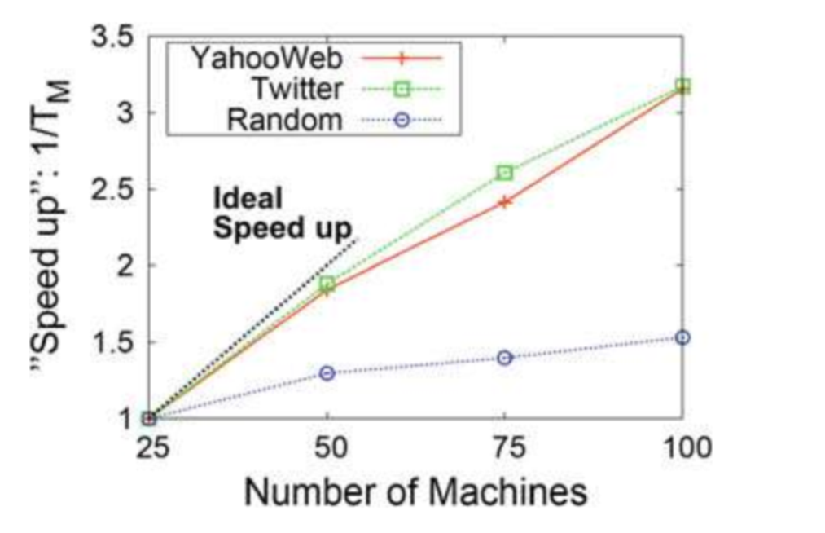
Global Query Time
Notes:
Running times scale up almost linearly with the number of machines.
The slope of the random graph is small since the random data after compression is so small that 25 machines can handle this compressed data in a fairly small amount of time, and adding more machines does not increase speedup since there is a limit on speedup due to the fixed costs to run mapreduce jobs.

Slide 21
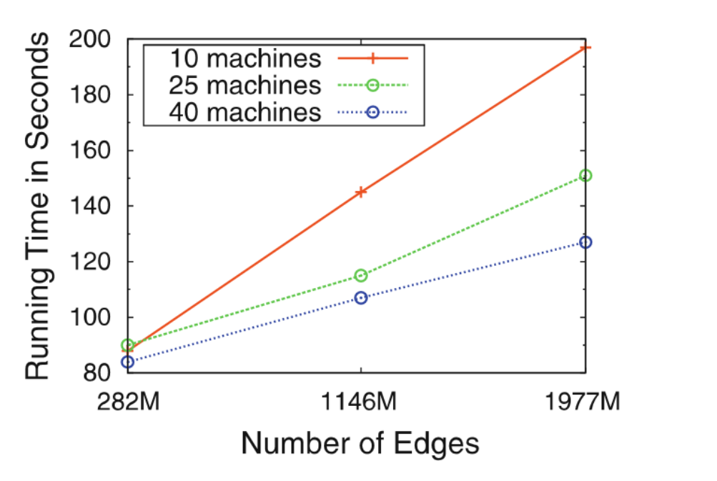
Global Query Time
Notes:
Used Knonecker graphs
Running time scale almost linearly.

Slide 22
Experiments
Experimental Setting
Space Efficiency Comparison
Indexing Time Comparison
Global Query Time
Targeted Query Time

Slide 23
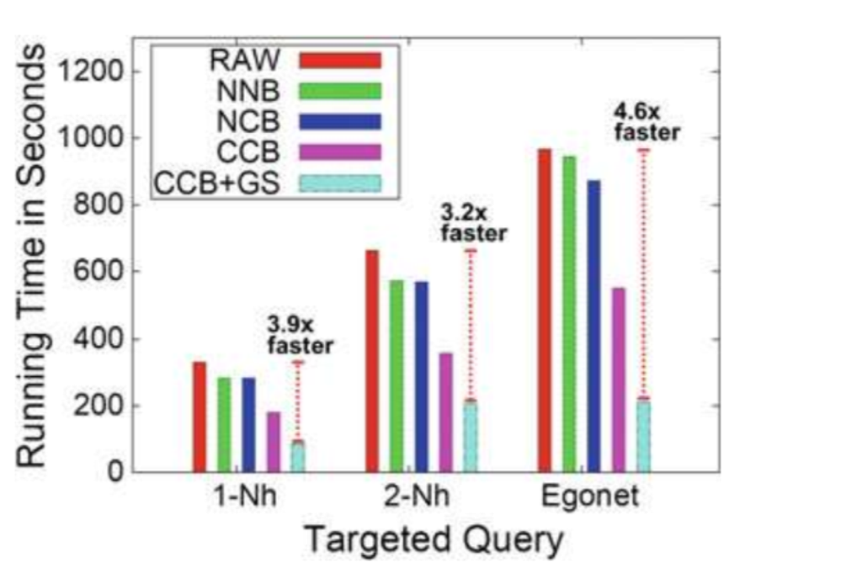
Targeted query time
Twitter
Notes:
Grid selection further reduces runtime because the query selects only relevant grids, reducing the size of selected grids from K to root(K).

Slide 24
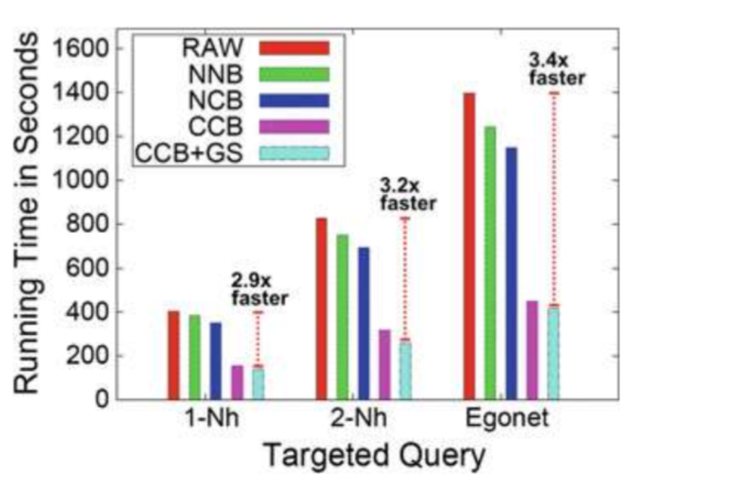
Targeted query time
YahooWeb

