Slide 1
Sentiment Analysis of
Amazon Melatonin Product Reviews
A dose-centered analysis of customer experience
4,984
8
6
1mg–20mg
Unique Reviews
Source Files
Dose Groups
Dose Range
DAMG6105 — Data Science Engineering with Python

Slide 2
Project Goal
Core Goal: Study how customer sentiment and review language vary across different melatonin doses — grouped by dose, not by brand
01
Dose Distribution
02
Sentiment by Dose
03
User Experience
Analyze what percentage of products are at each dose level and which dominate the market
Compare average ratings, review polarity, and positive vs negative sentiment per dose group
Extract real behavioral patterns — timing, side effects, recommendations, and long-term use

Slide 3
Dataset
Dose | Brand | Raw Rows
1mg | Natrol | 4,492
3mg | OLLY | 1,307
5mg | OLLY | 4,478
5mg | Natrol | 7,524
10mg | Natrol | 7,624
12mg | Carlyle | 9,554
12mg | Nature's Truth | 936
20mg | Nature's Perfect Night | 5,336
Data Cleaning Pipeline
Merged all 8 files
1
41,251 rows
Dropped null review text
2
−393 rows
Removed duplicates
3
−35,874 rows
Final clean dataset
4
4,984 rows

Slide 4
Analysis Methods
Data Wrangling
Tools: pandas · regex · os
Dose Distribution
01
02
Tools: pandas · matplotlib
Merged 8 Excel files into one dataframe
Extracted dose from filename (dose_mg column)
Handled nulls, duplicates, date parsing
Grouped reviews by dose_mg
Calculated % market share per dose
Trend analysis 2020–2024
Sentiment Analysis
Tools: ReviewScore · pandas
NLP Analysis
03
04
Tools: re · Counter · regex
Labeled scores: Positive (4-5★), Neutral (3★), Negative (1-2★)
Avg rating, std deviation, polarization per dose
Rating distribution heatmap
Regex-based theme extraction (10 themes)
Bigram frequency analysis per dose
Pattern matching for timing, reactions, recommendations

Slide 5
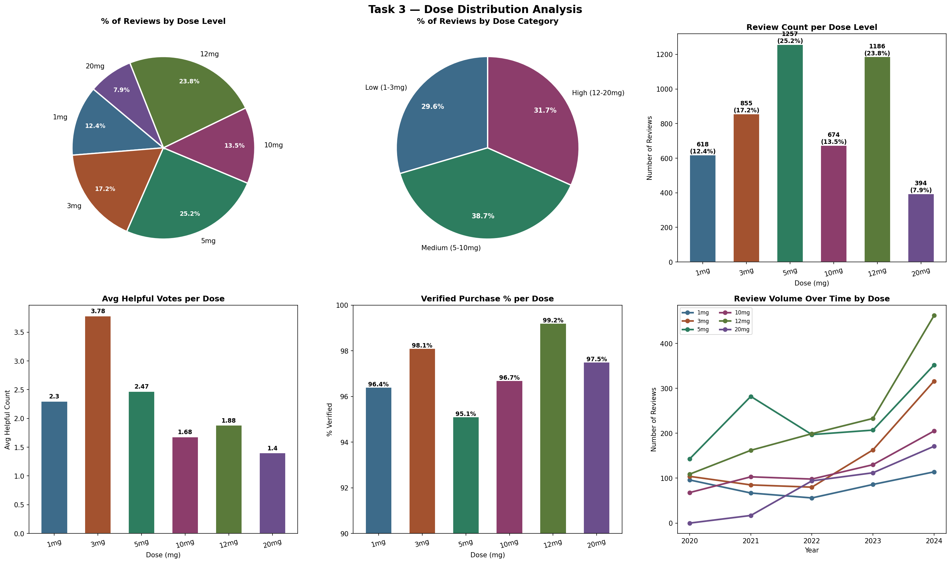
Key Findings — Dose Distribution
25.2%
5mg dominates
38.7%
Medium dose leads
7.9%
20mg is rarest
3x
3mg grew 2020–2024

Slide 6
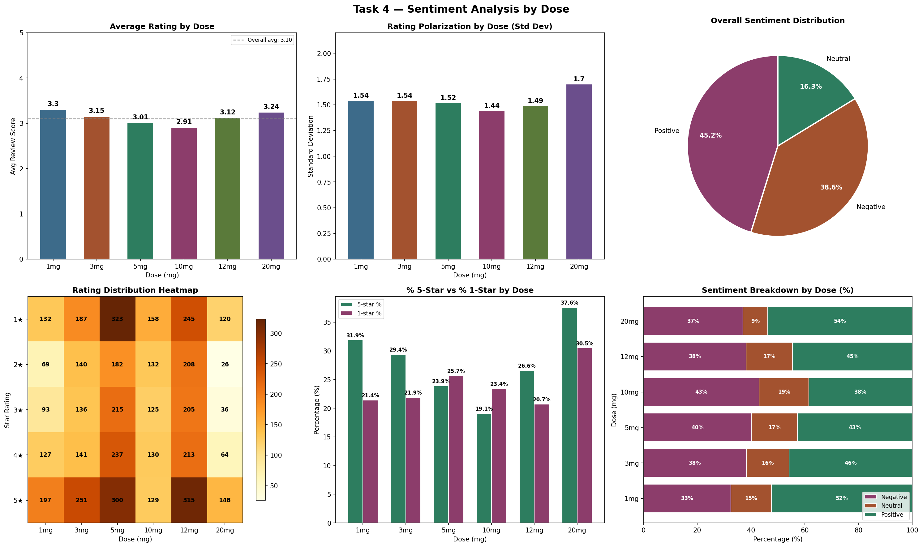
Key Findings — Sentiment Analysis by Dose

Slide 7
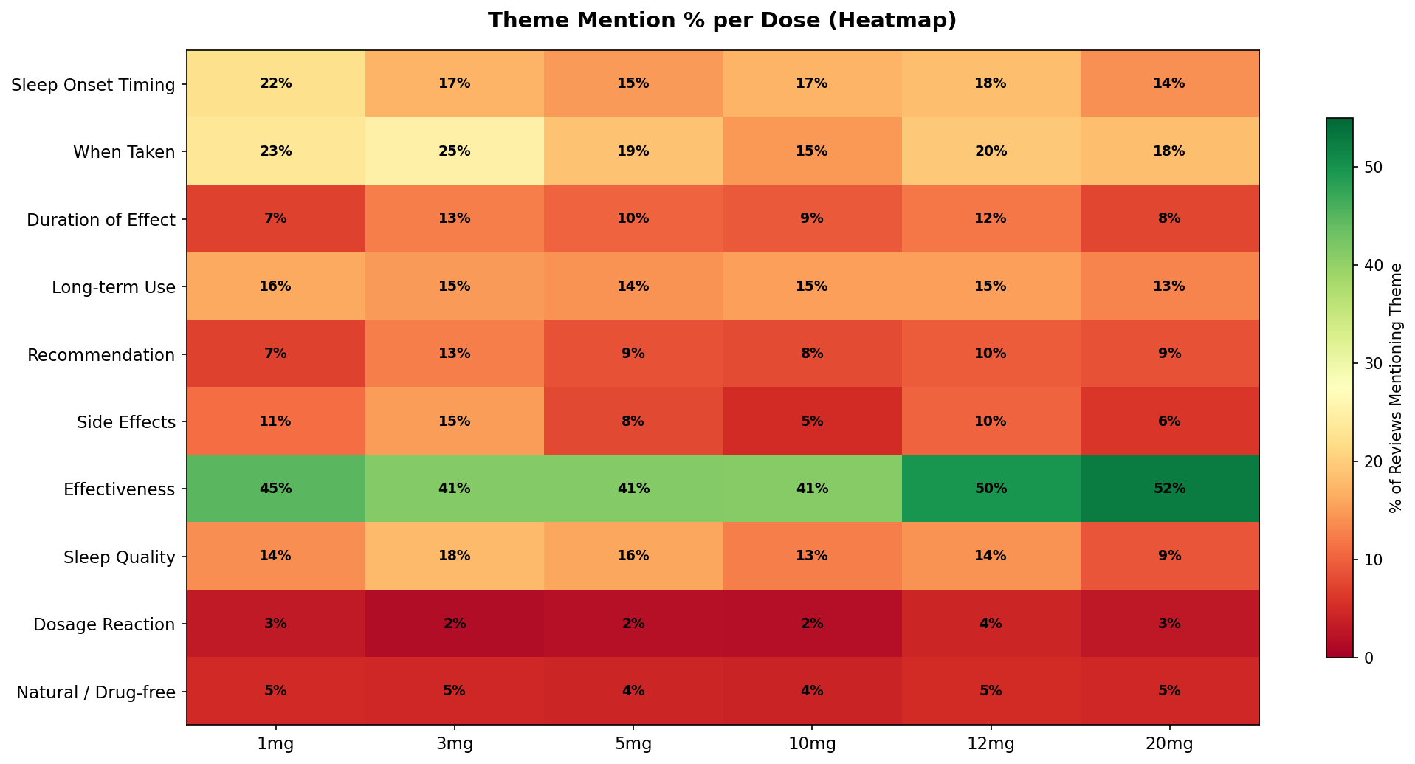
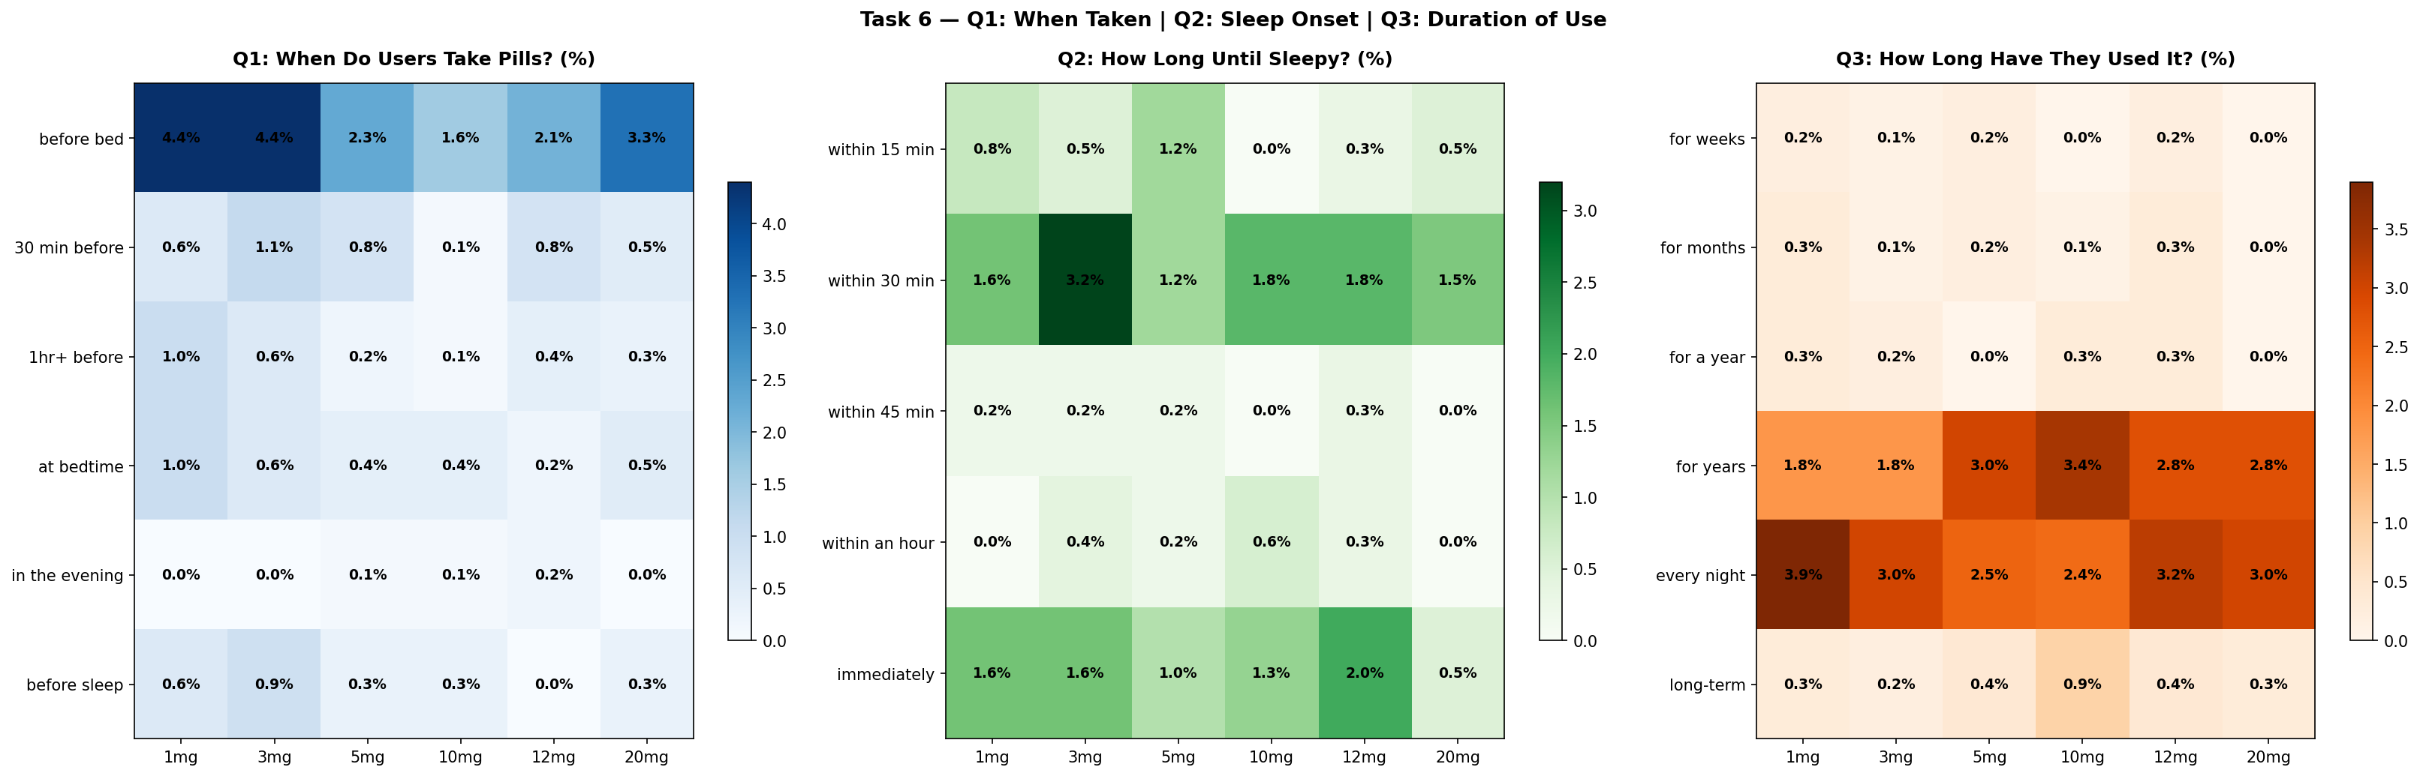
Key Findings — NLP & Behavioral Patterns
#1 Theme
Top Bigram
Effectiveness
"fall asleep"
40–53% across all doses
#1 phrase at every dose
When Taken
Sleep Onset
Before bed
~30 minutes
Most common timing across doses
Most cited timeframe
Long-term Use
No Effect Peak
"for years"
20mg (13.7%)
115 mentions — habitual users
Highest 'doesn't work' rate

Slide 8
Conclusions
The Precision Dose
The Sweet Spot
The Mass Market
1mg
Most satisfied users · Doctor-recommended timing · Highest avg rating (3.30)
3mg
Highest recommendation rate (7.6%) · Most helpful reviews · Best community trust
5mg
Most reviewed (25.2%) · First-time users · Mixed results, high volume
The Disappointed Dose
The Long-term User
The Polarizing Dose
10mg
Lowest avg rating (2.91) · 43% negative sentiment · Most frustration
12mg
99.2% verified purchases · Loyal users · Nightmares noted at higher rate
20mg
Highest 5-star (37.6%) AND 1-star (30.5%) · Works or doesn't — no middle ground

Slide 9
Thank You
Questions?
4,984 unique reviews · 8 source files · 6 dose groups
Methods: Data Wrangling · Sentiment Analysis · NLP · Regex Extraction
5mg dominates market · 1mg most satisfied · 20mg most polarized
DAMG6105 — Data Science Engineering with Python

