Slide 1
Branch prediction
COMPUTER ARCHITECTURE CE6304
Project - 1
Submitted by
Ayushi Chourasia – akc170630 (100%)
Yiheng Gao - yxg171130 (100%)

Slide 2
Objectives
What is Branch Prediction and what are the types of the Branch Prediction?
Adding Branch Predictor support.
Adding BranchMispredPercent to the stats file.
Adding BTBMisPct to the stats file.
The configuration of different Branch Predictors.
Calculation of CPI of each benchmarks.
Combinations for TournamentBP.
How the BTB miss and Branch prediction miss are affected by changing the size of benchmarks.
Discuss the observation.

Slide 3
What is Branch Predictor?
Branch predictor is a mechanism to predict the next fetch address to be used in the next cycle when BRANCH instruction occurs. It motivated by the fact that branch penalties limit the performance of deeply pipelined processors. With branch predictor, therefore, pipelined processors do not need to be stalled when BRANCH instruction is being executed.
The typical prediction structures contains Branch History Tables (BHT) and Branch Target Buffers (BTB). Meanwhile, a branch predictor requires MisPredict recovery mechanism.
There are two types of branch direction prediction schemes: Static and Dynamic. For static way, it predicts always the same direction for the same branch during the whole program execution. It comprises hardware-fixed prediction and compiler-directed prediction. Meanwhile, Dynamic prediction is the hardware that influences the prediction while execution proceeds. Prediction is decided on the computation history of the program.

Slide 4
Types of different Branch Predictors
In the project, 3 types of branch predictors are used: 2bit_local Predictor, Tournament Predictor, Bi_mode Predictor.
2bit_local Predictor: A branch’s outcome can be correlated with past outcomes of the same branch. It based on BHT (Branch History Table) and PHT (Pattern History Table). As a two-level local branch prediction, the predictor will predict according to the content of PHT. The index comes from BHT. Each entry has 2-bits per counter.
Tournament Predictor It has a local predictor, which uses a local history table to index into a table of counters, and a global predictor, which uses a global history to index into a table of counters. A choice predictor chooses between the two. Both the global history register and the selected local history are speculatively updated.

Slide 5
Types of different Branch Predictors
Bi_mode Predictor A branch’s outcome can be correlated with other branch’s outcome. It is a a two-level branch predictor that has three separate history arrays: a taken array, a not-taken array, and a choice array. The taken/not-taken arrays are indexed by a hash of the PC and the global history. The choice array is indexed by the PC only. Because the taken/not-taken arrays use the same index, they must be the same size.
The bi-mode branch predictor aims to eliminate the destructive aliasing that occurs when two branches of opposite biases share the same global history pattern. By separating the predictors into taken/not-taken arrays, and using the branch's PC to choose between the two, destructive aliasing is reduced

Slide 6
Project Definition
To understand the effect of Branch Predictors on various parameters using different benchmarks.
We compared Predictor type, Predictor size, Branch Target Buffer misses and Branch Miss Prediction Percent on the simulation.

Slide 7
PART-1
Environment : own environment(failed)
Installation steps followed
->Installed virtual machine
->installed ubuntu in virtual machine
->Installed gem5 dependable
->Downloaded gem 5 and benchmarks
->Compile gem5 using command : scons build/x86/gem5.opt
Challenge faced
->The system was crashing while compiling the gem architecture.
CE_PROJECT#1

Slide 8
Using UTD Server
Challenge faced : 1. the compilation was failing due to memory unavailability.
2. ImportError occurred when tried to run “runGem5.sh” file.
Solution : 1. new path with space allocation was created to install gem5.
-> Path : /proj/engclasses/ce6304/<utdnet id>
-> Server: ce6304.utdallas.edu
2. environmental variable for python do not set properly.
-> Run following commands:
- unset PYTHONPATH
- unset PYTHONHOME
Advantage
->Dependencies were already installed.
->Able to run longer time compilation and execution.

Slide 9
Steps followed for Gem5
Open terminal window
Connect to the server with ssh <net_id>@ce6304.utdallas.edu
Download gem5 using command
->Git clone https://gem5.googlesource.com/public/gem5
Compiled gem5 in the gem5 folder using command
->scons build/X86/gem5.opt (it takes around 2.5 hours to compile)
Download benchmark using command
->Git clone https://github.com/timberjack/project1_spec

Slide 10
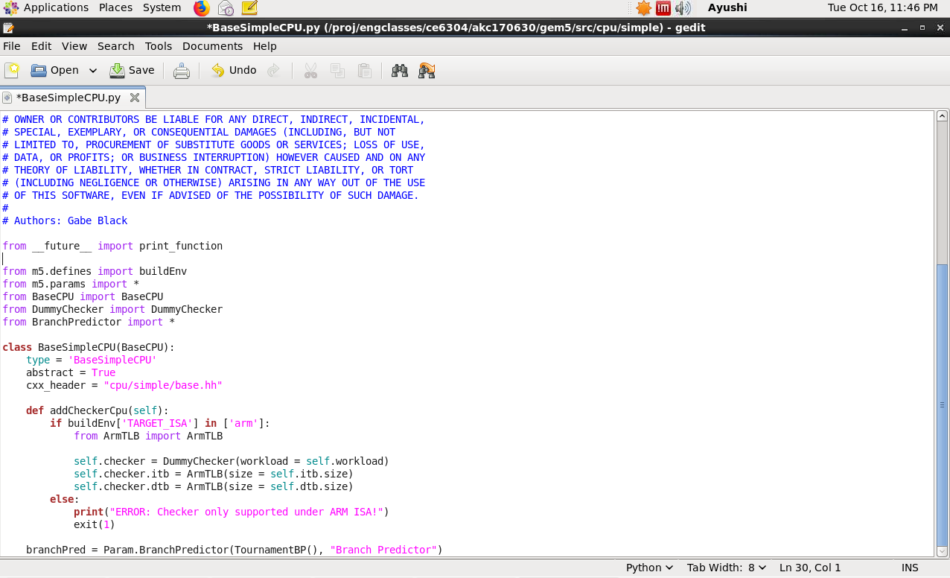
PART 2 Adding Branch Predictor Support
File to be edited : gem5/src/cpu/simple/basesimplecpu.py
Null to TournamentBP() for
tournament branch predictor

Slide 11
Steps Followed
After changing the branch predictor to tournament predictor we need to compile the code.
We do this after deleting the content in gem5/build/x86
Run the sample “hello world” code.
Code : ce6304@~/gem5-stable$ ./build/x86/gem5.opt ./configs/example/se.py -c ./tests/test-progs/hello/bin/x86/linux/hello

Slide 12
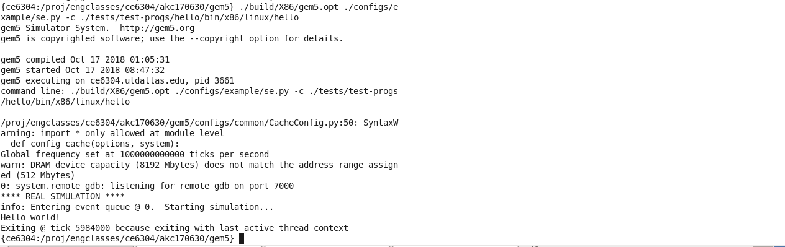
Running HELLO WORLD

Slide 13
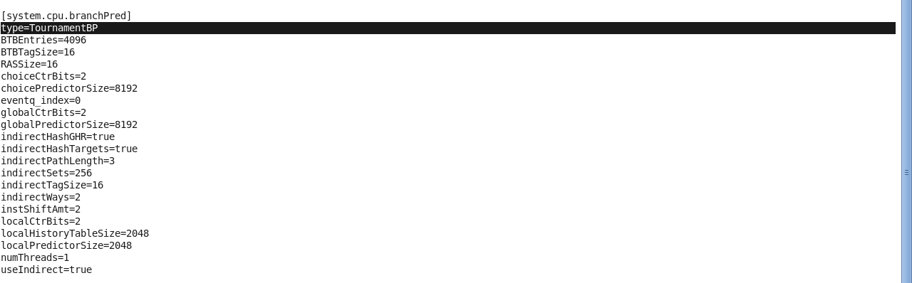
Result in config.ini file
Path: gem5/m5out/config.ini

Slide 14
PART 3
In part 3 we have two tasks.
Adding BranchMisPredPercent to the stats file.
Adding BTBMisPct to the stats file.

Slide 15
Steps Followed
Part 1 - We are adding BranchMispredPercent to the stats file.
We make changes to following paths :
Path 1 : gem5/src/cpu/simple/base.cc file.
Path 2 : gem5/src/cpu/simple/exec_context.hh file.
In base.cc file we add the following command after the “t_info.numBranchMispred” command :
t_info.numBranchMispredpercent
.name(thread_str + “.BranchMispredPercent”)
.desc (“Percent of branch mispredictions”)
.prereq(t_info.numBranchMispredPercent);
t_info.numBranchMispredPercent = (t_info.numBranchMispred / t_info.numBranches) * 100
In exec_context.hh file we add the following command after the “Stats:: Scalar numBranchMispred” command :
Stats :: Formula numBranchMispredPercent

Slide 16
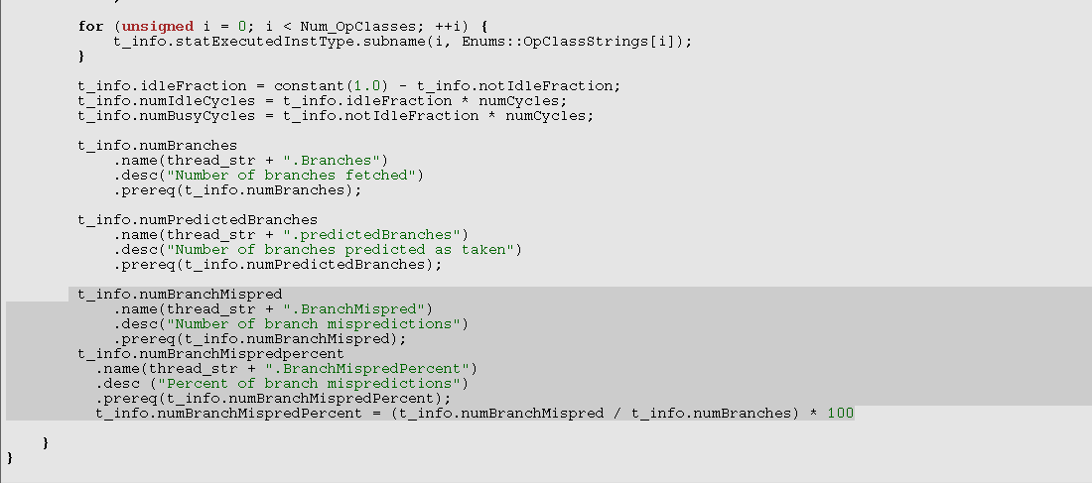
Here, we are adding branchmisspercent to stats file:
Path : gem5/src/cpu/simple/base.cc file

Slide 17
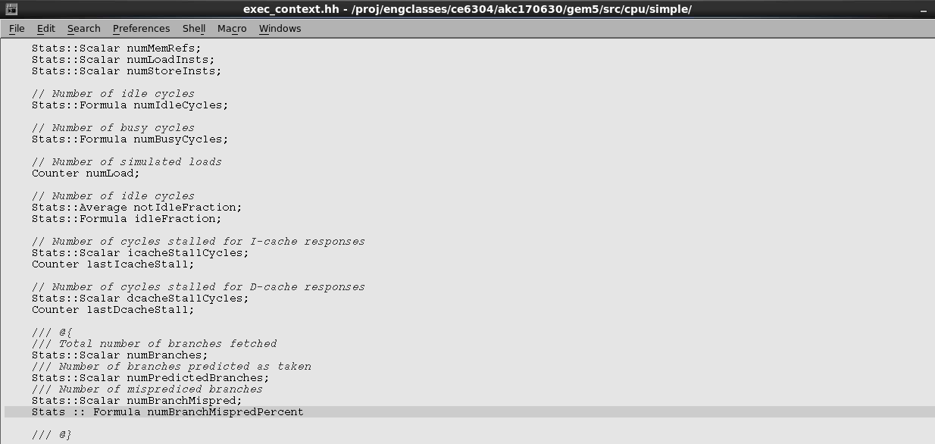
Here, we are adding branchmisspercent to stats file:
Path : gem5/src/cpu/simple/exec_context.hh file

Slide 18
STEPS FOLLOWED
Part 2 - We are adding BTBMisPct to the stats file.
We make changes to following path :
Path 1 : gem5/src/cpu/simple/pred/bpred_unit.cc file
Path 2 : gem5/src/cpu/simple/pred/bpred_unit.hh file
In bpred_unit.cc file we add the following command after the “BTBHitPct” command :
BTBMissPct
.name(name() + “.BTBMisPct”)
.desc (“BTB Miss Percentage”)
.precision(6);
BTBMissPct = (1- (BTBHits / BTBLookups)) *100 ;
In bpred_unit.hh file we add the following command after the “Stats:: Formula BTBHitpct” command :
Stats :: Formula BTBMissPct;

Slide 19
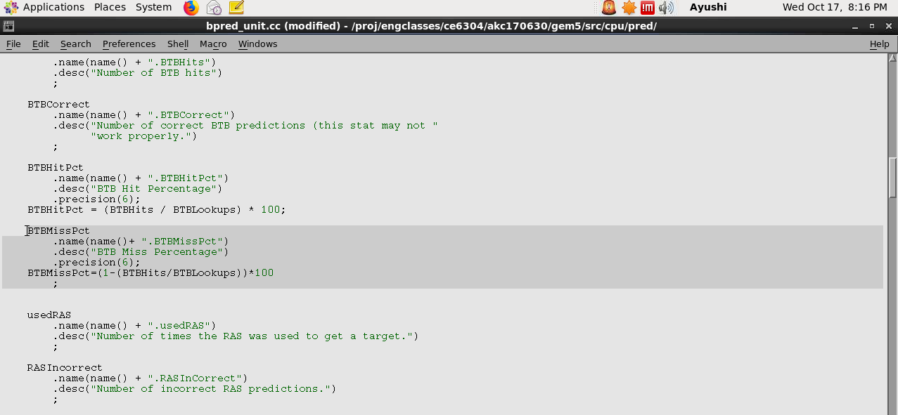
Here, we are adding BTBMisPct to stats file
Path : gem5/src/cpu/simple/bpred_unit.cc file

Slide 20
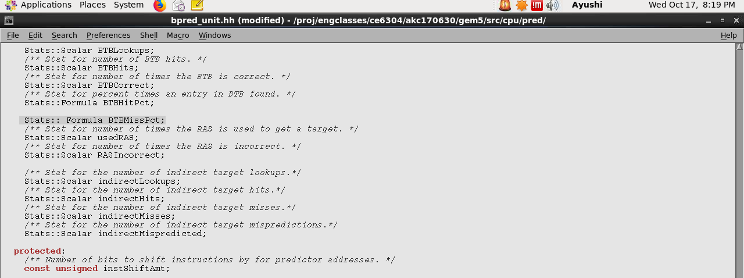
Here, we are adding BTBMisPct to stats file
Path : gem5/src/cpu/simple/bpred_unit.cc file

Slide 21
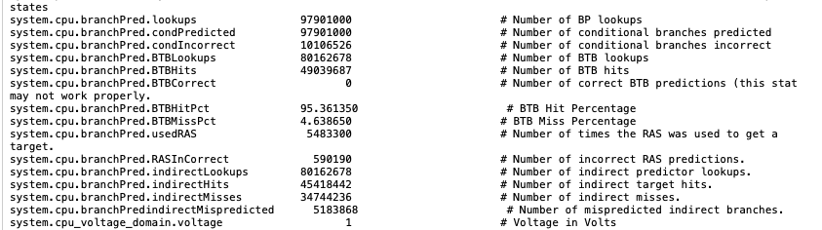
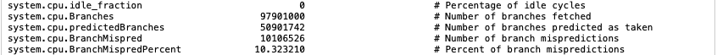
Tournament BP result
Path : gem5 dir/m5out/stats.txt

Slide 22
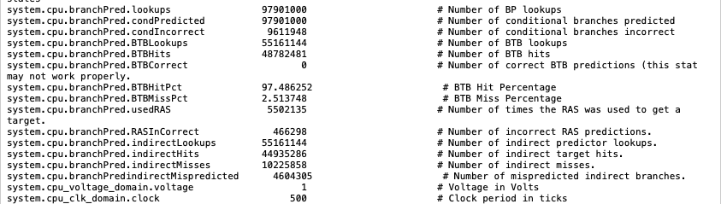
BiMode BP result
Path : gem5 dir/m5out/stats.txt

Slide 23
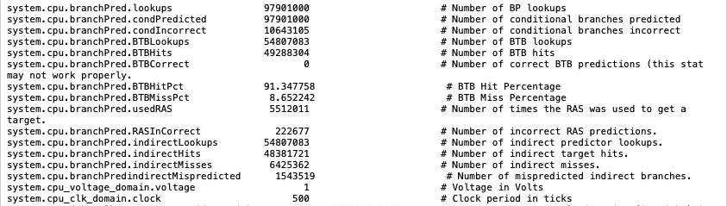
Local BP result
Path : gem5 dir/m5out/stats.txt

Slide 24
PART 4
Here, we are doing the configuration of different Branch Predictors.

Slide 25
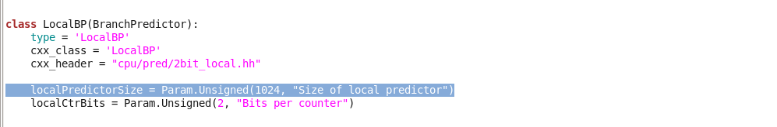
For Local Branch Predictor
Here, we make changes to following path :
gem5/src/cpu/pred/BranchPredictor.py file

Slide 26
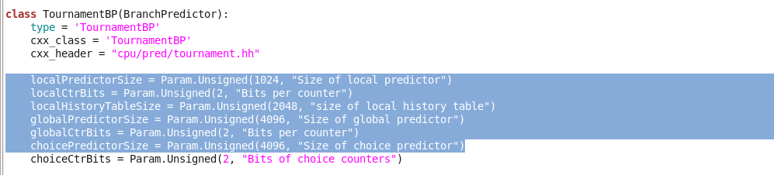
For Tournament Branch Predictor
Here, we make changes to following path :
gem5/src/cpu/pred/BranchPredictor.py file

Slide 27
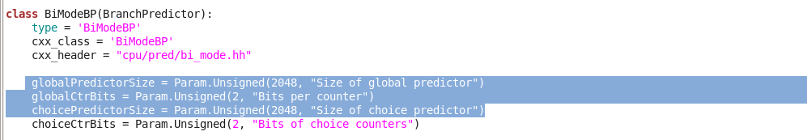
For BiMode Branch Predictor
Here, we make changes to following path :
gem5/src/cpu/pred/BranchPredictor.py file

Slide 28
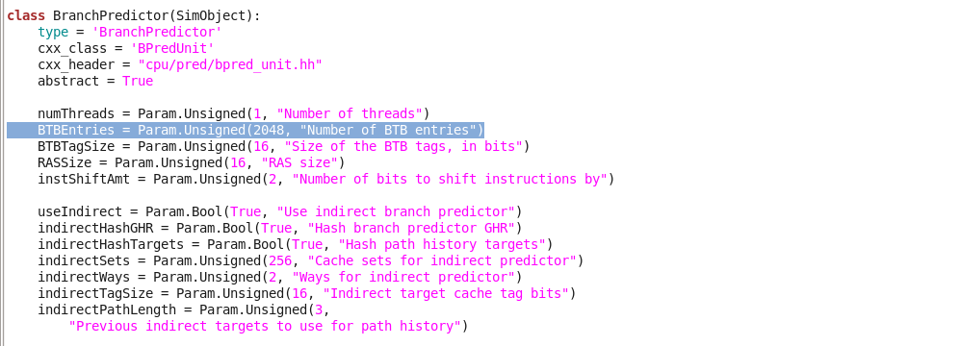
For BranchPredictor
Here, we make changes to following path :
gem5/src/cpu/pred/BranchPredictor.py file

Slide 29
BTBMispct and BranchMispredPercent of Different Benchmarks
For TournmentBP
Benchmarks | Local Predictor size | Global Predictor size | Choice Predictor size | BTBMisPct | BranchMisPercent
401.bzip2 | 1024 | 4096 | 4096 | 0.137098 | 10.213047
429.mcf | 1024 | 4096 | 4096 | 4.63865 | 10.323210
456.hmmer | 1024 | 4096 | 4096 | 1.076399 | 14.410034
458.sjeng | 1024 | 4096 | 4096 | 4.776281 | 9.794292
470.lbm | 1024 | 4096 | 4096 | 0.019583 | 0.22968
CE_PROJECT#1

Slide 30
BTBMispct and BranchMispredPercent of Different Benchmarks
For BiModeBP
Benchmarks | Global Predictor size | Choice Predictor size | BTBMisPct | BranchMisPercent
401.bzip2 | 2048 | 2048 | 0.143772 | 15.40911
429.mcf | 2048 | 2048 | 2.513748 | 9.818028
456.hmmer | 2048 | 2048 | 0.810444 | 13.614727
458.sjeng | 2048 | 2048 | 7.011066 | 10.197635
470.lbm | 2048 | 2048 | 0.003716 | 8.606062

Slide 31
BTBMispct and BranchMispredPercent of Different Benchmarks
For LocalBP
Benchmarks | Local Predictor size | BTBMisPct | BranchMisPercent
401.bzip2 | 1024 | 0.1877777 | 10.972980
429.mcf | 1024 | 8.652242 | 10.871293
456.hmmer | 1024 | 2.477987 | 14.784453
458.sjeng | 1024 | 9.113728 | 14.3672059
470.lbm | 1024 | 0.007379 | 8.606062
27

Slide 32
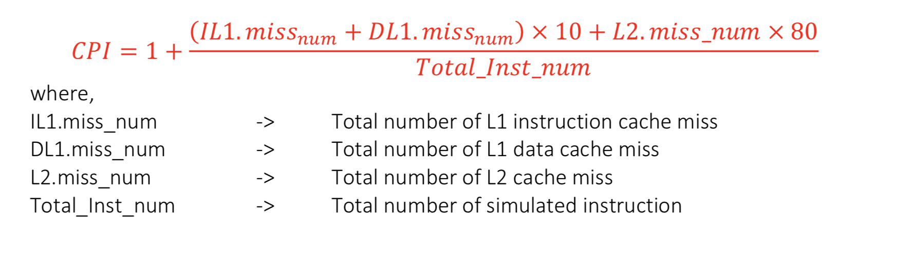
Calculation of CPI of each Benchmarks
We calculate the CPI using below formula for each predictor for each benchmark.
28

Slide 33
Values for CPI calculation
For Local Branch Predictor
Benchmarks | IL1.miss_num | DL1.miss_num | L2.miss_num | Total_Inst_num
401.bzip2 | 954 | 4027264 | 2633342 | 500000000
429.mcf | 676 | 10225987 | 6259473 | 500000000
456.hmmer | 1351 | 197711 | 7056 | 500000000
458.sjeng | 2774 | 8422662 | 8375918 | 500000000
470.lbm | 528 | 6985724 | 6986249 | 500000000

Slide 34
Values for CPI calculation
For BiMode Branch Predictor
Benchmarks | IL1.miss_num | DL1.miss_num | L2.miss_num | Total_Inst_num
401.bzip2 | 954 | 4027264 | 2633342 | 500000000
429.mcf | 676 | 10225987 | 6259473 | 500000000
456.hmmer | 1330 | 197711 | 7035 | 500000000
458.sjeng | 2774 | 8422662 | 8375918 | 500000000
470.lbm | 528 | 6985724 | 6986249 | 500000000

Slide 35
Values for CPI calculation
For Tournament Branch Predictor
Benchmarks | IL1.miss_num | DL1.miss_num | L2.miss_num | Total_Inst_num
401.bzip2 | 954 | 4027264 | 2633342 | 500000000
429.mcf | 676 | 10225987 | 6259473 | 500000000
456.hmmer | 1351 | 197711 | 7056 | 500000000
458.sjeng | 2774 | 8422661 | 8376025 | 500000000
470.lbm | 528 | 6985724 | 6986249 | 500000000

Slide 36
CPI for all Benchmarks
Benchmarks | Local Branch Predictor | BiMode Branch predictor | Tournament Branch Predictor
401.bzip2 | 1.50189909 | 1.50189909 | 1.501899
429.mcf | 2.20604894 | 2.20604894 | 2.206049
456.hmmer | 1.0051102 | 1.00510644 | 1.005106
458.sjeng | 2.5086556 | 2.5086556 | 2.508673
470.lbm | 2.25752488 | 2.25752488 | 2.257525

Slide 37
CPI for all Benchmarks (Graphical Representation)
From this Graph we understand that there is no change in CPI when changing the different Branch predictors (Note: There is a negligible change with Tournament Branch Predictor)

Slide 38
Combinations for TournamentBP
No. of Combinations | Local Predictor size | Global Predictor size | Choice Predictor size
1 | 1024 | 4096 | 4096
2 | 1024 | 4096 | 8192
3 | 2048 | 2048 | 2048
4 | 2048 | 2048 | 4096
5 | 2048 | 4096 | 4096
6 | 2048 | 4096 | 8192
7 | 2048 | 8192 | 8192
8 | 4096 | 2048 | 4096
9 | 4096 | 8192 | 8192
10 | 8192 | 1024 | 1024
We run the tournament BP with different combinations as below for local , global and choice predictor to see its effect on the BTBMissPct and BranchMisPredPercent.

Slide 39
Discussion: Combination Space
We altered the size of local, global and choice predictor with values as 1024,2048,4096 and 8192.
To analyze the effect of single predictor say local predictor when compared to others we kept the other global and choice predictor same for certain combinations. The result of changes to the BTBMissPct and BranchMisPredPercent is visualized in the following graphs.

Slide 40
BranchMisPct
401.bzip2
429.mcf
The X-axis is the combinations of local-global-choice predictor in sorted order and the Y-axis is BTBMissPCT.

Slide 41
BranchMisPct
456.hmmer
458.sjeng
The X-axis is the combinations of local-global-choice predictor in sorted order and the Y-axis is BTBMissPCT.

Slide 42
BranchMisPct
470.lbm
The X-axis is the combinations of local-global-choice predictor in sorted order and the Y-axis is BTBMissPCT.

Slide 43
BranchMispredPercent
401.bzip2
429.mcf
The X-axis is the combinations of local-global-choice predictor in sorted order and the Y-axis is BranchMispredPercent.
CE_PROJECT#1
39

Slide 44
BranchMispredPercent
456.hmmer
458.sjeng
The X-axis is the combinations of local-global-choice predictor in sorted order and the Y-axis is BranchMispredPercent.

Slide 45
BranchMispredPercent
470.lbm
The X-axis is the combinations of local-global-choice predictor in sorted order and the Y-axis is BranchMispredPercent.

Slide 46
Optimal combinations for BTBMisPct and BranchMispredPercent
Optimized combinations for BranchMisPredPercent
Optimized combinations for BTBMisPct
Benchmarks | Local | Global | Choice
401.bzip2 | 8192 | 1024 | 1024
429.mcf | 1024 | 4096 | 8192
456.hmmer | 4096 | 8192 | 8192
458.sjeng | 8192 | 1024 | 1024
470.lbm | 2048 | 4096 | 4096
Benchmarks | Local | Global | Choice
401.bzip2 | 2048 | 2048 | 2048
429.mcf | 2048 | 4096 | 4096
456.hmmer | 4096 | 8192 | 8192
458.sjeng | 1024 | 4096 | 8192
470.lbm | 2048 | 4096 | 4096

Slide 47
Discussion
When the local predictor size increases the BranchMisPredPercent decreases. This we realized by taking all the combinations when the size of local predictor is 1024 and finding the average value, then for 2048 and finding the average and so on, we plotted the graph.
The same results where found with global predictor and choice predictor.

Slide 48
Analysis for BranchMissPredPct
Local Predictor
Global Predictor
Choice Predictor
In all the 3 graphs we see the decrease in BranchMissPredPct as we increase the size.

Slide 49
Results and Discussion
We observed that, values of Branch miss predict percent are highly dependent on the size of Local, Global, Choice predictors in case of Tournament predictor. With increase in the size, values of Branch miss predict decreases.
We also observed that BTB misses are not majorly dependent on the changes of the predictor sizes. Branch target buffer is only slightly affected by this change. This says that as size of BTB increases, there are more chances of finding the target in the table, and get a hit. So, the miss rate decreases.
By comparing the values of the Branch miss predict percent for the three predictors it is observed that the tournament predictor has the lowest number of misses compared to the other two predictors.

Slide 50
Results and Discussion
To understand the effect of the changes in branch predictor on the overall performance of the simulators, we calculated the CPI for each combination. Turns out, the CPI value for all remains the same. This is because we used the same cache configuration for all tests.
We wanted to explore the difference between Branch predicted and Non - Branch predicted systems. So, we compared the CPI values of benchmark 429.mcf with and without branch predictor, keeping the cache configurations consistent. This goes to show that differing above branch predictor parameters has little to no effect on CPI.
As our version of CPI calculation does not include parameters like miss predict rate, changes in CPI values were negligible.

Slide 51
THANK YOU

