Slide 1
CACHE OPTIMIZATION
COMPUTER ARCHITECTURE CE6304
Project#2
Submitted by
Ayushi Chourasia – akc170630 (100%)
Yiheng Gao - yxg171130 (100%)

Slide 2
Objectives
Introduction
Project Definition
Calculate the CPI of given parameters.
Optimize CPI for each benchmarks.
Defining cost function.
Optimize caches for cost/performance

Slide 3
Introduction
Cache is a smaller memory which can be accessed very quickly. It stores the data and applications that are frequently used by the processor. Hence Cache design choices affect the performance of a microprocessor.
During execution, the processor uses data from the cache to increase the speed of execution as the processor does not need to search for data in the main memory.
Thus, in this project the aim is to optimize various cache design choices by making sensible tradeoff between cost and performance of the CPU.

Slide 4
PART 1
Project Definition

Slide 5
Project Definition
In this project, we tuned the cache hierarchy on X86 architecture bases on the gem5 simulator. The cache design parameters are as follows:
CPU Types: Different CPU models.
Cache levels: No cache at all, one level or two levels.
Size: Cache size, one of the most important choices.
Associativity: Selection of cache associativity (e.g. direct mapped, 2-way set associative, etc.).
Block size: Block size of the cache, usually 64 or 32 bytes.
While larger caches generally mean better performance, they also come at a greater cost. Thus, sensible design choices and trade-offs are required.

Slide 6
Project Definition
The gem5 simulator is a modular platform for computer-system architecture research, encompassing system-level architecture as well as processor microarchitecture. In this project Gem 5 is used to model the different cache choices for the provided benchmarks using different configurations

Slide 7
PART 2
CPI for given configuration

Slide 8
Given Configurations
CPU Models: TimingSimpleCPU (timing), DerivO3CPU (detailed), MinorCPU (minor).
Cache levels: Two levels.
Unified caches: Separate L1 data and L1 instruction caches, unified L2 cache.
Size: 128KB L1 data cache, 128KB L1 instruction cache, 1MB unified L2 cache.
Associativity: Two way for L1 caches, Direct Mapped for L2 cache.
Block size: 64 bytes.
Block replacement policy: Least Recent Used policy (LRU).

Slide 9
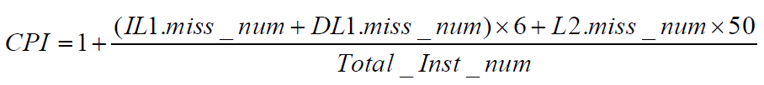
CPI Formula
CPI is a measure of performance of the CPU as it is the number of clock cycles per instruction. A lower CPI indicates better performance.

Slide 10
Configurations
PARAMETERS | VALUES
CPU TIMING | TIMING
L2 CACHE SIZE | 1MB
L2 ASSOCIATIVITY | 2
BLOCK SIZE | 64kB
L1 DATA CACHE SIZE | 128kB
L1 DATA ASSOCIATIVITY | 2
L1 INSTRUCTION CACHE SIZE | 128kB
L1 INSTRUCTION ASSOCIATIVITY | 2

Slide 11
CPI OF ALL THE BENCHMARKS
 | 401.bzip2 | 429.mcf | 456.hmmer | 458.sjeng | 470.lbm
LI Instruction cache misses | 994 | 676 | 1409 | 2774 | 546
L1 Data cache misses | 2044633 | 10225987 | 118032 | 8422662 | 7161902
L2 cache misses | 645445 | 6352827 | 6100 | 8377166 | 7149444
Number of Instructions | 500000000 | 500000000 | 500000001 | 500000000 | 500000000
CPI | 1.089092024 | 1.758002656 | 1.0020432919 | 1.938821832 | 1.800893776

Slide 12
Configurations
PARAMETERS | VALUES
CPU TIMING | Deriv03CPU(Detailed)
L2 CACHE SIZE | 1MB
L2 ASSOCIATIVITY | 2
BLOCK SIZE | 64kB
L1 DATA CACHE SIZE | 128kB
L1 DATA ASSOCIATIVITY | 2
L1 INSTRUCTION CACHE SIZE | 128kB
L1 INSTRUCTION ASSOCIATIVITY | 2

Slide 13
CPI OF ALL THE BENCHMARKS
 | 401.bzip2 | 429.mcf | 456.hmmer | 458.sjeng | 470.lbm
LI Instruction cache misses | 994 | 676 | 1409 | 2774 | 546
L1 Data cache misses | 2044633 | 10225987 | 118032 | 8422662 | 7161902
L2 cache misses | 645445 | 6352827 | 6100 | 8377166 | 7149444
Number of Instructions | 500000000 | 500000000 | 500000001 | 500000000 | 500000000
CPI | 1.996435322 | 1.78532203 | 1.568432124 | 1.9434392132 | 1.774232932

Slide 14
PART 3
CPI optimization of each benchmarks

Slide 15
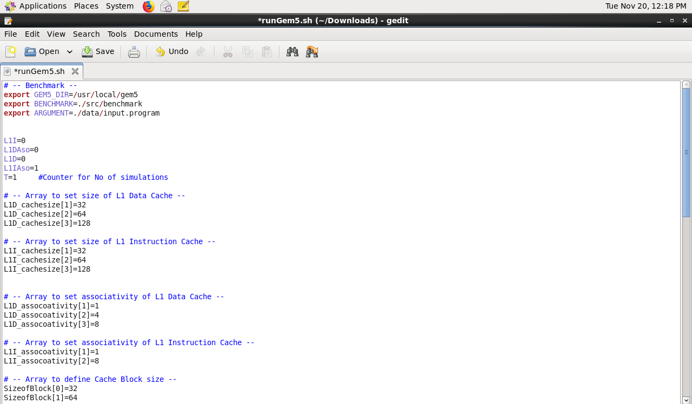
Script for Creating Different Combinations of Benchmark

Slide 16
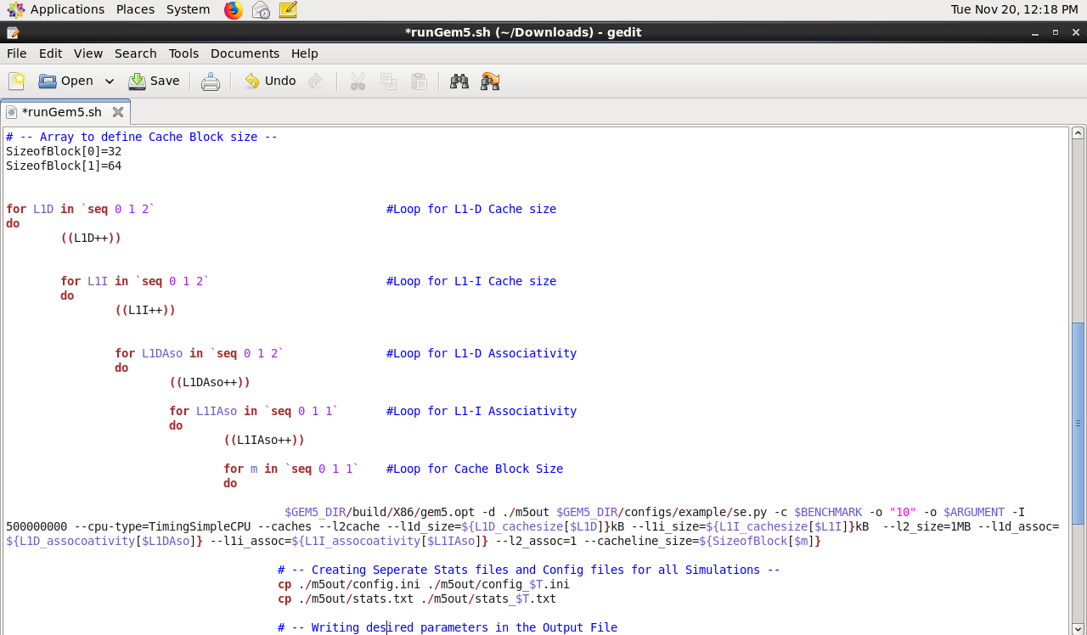
Script for Creating Different Combinations of Benchmark

Slide 17
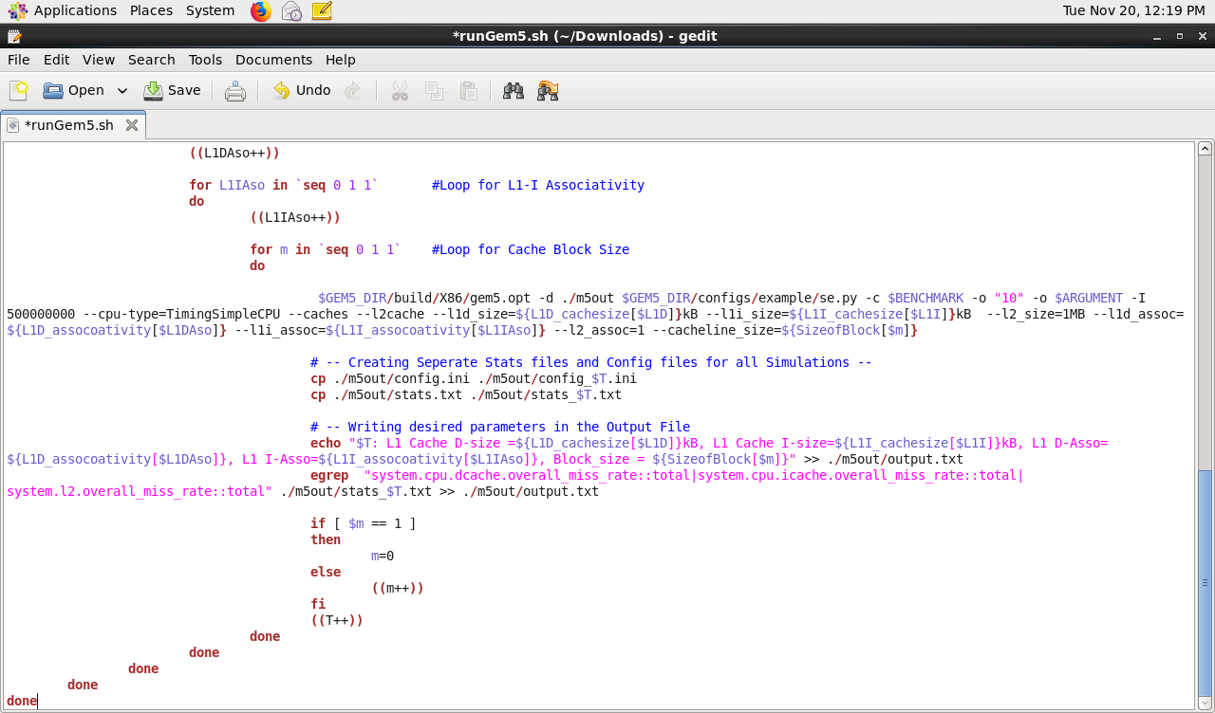
Script for Creating Different Combinations of Benchmark

Slide 18
Design Parameters to Optimize CPI for 401.bzip Benchmark
PARAMETERS | VALUE
CPU TIMING | TIMING
L2 CACHE SIZE | 1MB
L2 ASSOCIATIVITY | 1
BLOCK SIZE | 64KB
L1 DATA CACHE SIZE | 64KB
L1 DATA ASSOCIATIVITY | 1
L1 INSTRUCTION CACHE SIZE | 128KB
L1 INSTRUCTION ASSOCIATIVITY | 1
Optimal CPI | 1.56302464

Slide 19
Optimized CPI of 401.bzip
X axis – Dsize_Isize_Dasso_Iasso_Blocksize
Y axis - CPI

Slide 20
CPI Analysis

Slide 21
CPI Analysis
From the line chart analysis, we obtained the following results:
Greater L2 size results in better CPI.
Higher the L2 associativity and L1 data associativity, better the CPI.
Greater the block size, better the CPI.
Varying L1 data size, L1 instruction size and L1 instruction associativity has no significant impact on CPI.

Slide 22
Design Parameters to Optimize CPI for 429.mcf Benchmark
PARAMETERS | VALUE
CPU TIMING | TIMING
L2 CACHE SIZE | 1MB
L2 ASSOCIATIVITY | 1
BLOCK SIZE | 64KB
L1 DATA CACHE SIZE | 64KB
L1 DATA ASSOCIATIVITY | 1
L1 INSTRUCTION CACHE SIZE | 128KB
L1 INSTRUCTION ASSOCIATIVITY | 1
Optimal CPI | 1.49935404

Slide 23
Optimized CPI of 429.mcf
1.49935404
X axis – Dsize_Isize_Dasso_Iasso_Blocksize
Y axis - CPI

Slide 24
CPI Analysis

Slide 25
CPI Analysis
From the line chart analysis, we obtained the following results:
Varying L2 size, L2 associativity, L1 data size and L1 data associativity has little impact on CPI.
Greater the block size, better the CPI.
Varying L1 instruction size and L1 instruction associativity has no significant impact on CPI.

Slide 26
PART 3: Design parameters to Optimize CPI For 470.lbm Benchmark
PARAMETERS | VALUE
CPU TIMING | TIMING
L2 CACHE SIZE | 1MB
L2 ASSOCIATIVITY | 1
BLOCK SIZE | 64KB
L1 DATA CACHE SIZE | 128KB
L1 DATA ASSOCIATIVITY | 1
L1 INSTRUCTION CACHE SIZE | 128KB
L1 INSTRUCTION ASSOCIATIVITY | 1
Optimal CPI | 1.9965286

Slide 27
Optimized CPI of 470.lbm
Optimal CPI = 1.9965286
X axis – Dsize_Isize_Dasso_Iasso_Blocksize
Y axis - CPI

Slide 28
CPI Analysis

Slide 29
CPI Analysis
From the line chart analysis, we obtained the following results:
Varying L2 size, L2 associativity, L1 data size, L1 data associativity, L1 instruction size and L1 instruction associativity have no significant impact on CPI.
Greater the Block size, better the CPI.

Slide 30
Design parameters to Optimize CPI for 456.hmmer Benchmark
PARAMETERS | VALUE
CPU TIMING | TIMING
L2 CACHE SIZE | 1MB
L2 ASSOCIATIVITY | 1
BLOCK SIZE | 64KB
L1 DATA CACHE SIZE | 32KB
L1 DATA ASSOCIATIVITY | 1
L1 INSTRUCTION CACHE SIZE | 128KB
L1 INSTRUCTION ASSOCIATIVITY | 1
Optimal CPI | 1.00526852

Slide 31
Optimized CPI of 456.hmmer
X axis – Dsize_Isize_Dasso_Iasso_Blocksize
Y axis - CPI

Slide 32
CPI Analysis

Slide 33
CPI Analysis
From the line chart analysis, we obtained the following results:
Varying L2 size, L2 associativity, L1 instruction size and L1 instruction associativity has no significant impact on CPI.
Block size and L1 data associativity have moderate impact on CPI.
Greater the L1 data size, better the CPI.

Slide 34
Design parameters to Optimize CPI For 458.sjeng Benchmark
PARAMETERS | VALUE
CPU TIMING | TIMING
L2 CACHE SIZE | 1MB
L2 ASSOCIATIVITY | 1
BLOCK SIZE | 64KB
L1 DATA CACHE SIZE | 128KB
L1 DATA ASSOCIATIVITY | 1
L1 INSTRUCTION CACHE SIZE | 64KB
L1 INSTRUCTION ASSOCIATIVITY | 1
Optimal CPI | 1.99383124

Slide 35
Optimized CPI of 458.sjeng
X axis – Dsize_Isize_Dasso_Iasso_Blocksize
Y axis - CPI

Slide 36
CPI Analysis

Slide 37
CPI Analysis
From the line chart analysis, we obtained the following results:
Varying L2 size, L2 associativity, L1 data size, L1 data associativity, L1 instruction size and L1 instruction associativity have no significant impact on CPI.
Greater the Block size, better the CPI.

Slide 38
Optimal CPI value of each Benchmarks
Benchmarks | Optimal Value
401.bzip2 | 1.56302464
429.mcf | 1.49935404
470.lbm | 1.9965286
456.hmmer | 1.00526852
458.sjeng | 1.99383124

Slide 39
Part 4 - Cost Function
Parameters | Cost units | Cost per unit
Block Size of 32 bytes | 32 | 32
Block Size of 64 bytes | 64 | 64
L1 Instruction Data Caches of 32 KB | 64 | 64
L1 Instruction Data Caches of 64 KB | 64 | 64
L1 Instruction Data Caches of 128 KB | 128 | 128
L2 Cache of 1MB | 1024 | 1024
1-way associative Cache | 1 | 1
2-way associative Cache | 2 | 2
4-way associative Cache | 4 | 4
8-way associative Cache | 8 | 8
L1:L2 cost ratio | 4 | 4

Slide 40
Cost Formula
Cost = Block_sizecost+L1:L2 cost ratio x {(L1_I_Cachecost×Associativitycost)+ (L1_D_Cachecost×Associativitycost)} + (L2_cachecost × L2_associativitycost)
FUNCTION | FORMULA
Cost Evaluation Function | Total Cost * CPI
Total Cost | L2 Cost + Block Size Cost + L1 D Cost + L1 I Cost
L2 Cost | L2 Size Cost * L2 Associativity Cost
L1 Data Cost | L1 D Size Cost * L1 D Associativity Cost
L1 Instruction Cost | L1 I Size Cost * L1 I Associativity Cost

Slide 41
PART 5
Optimize caches for Performance/Cost

Slide 42
Part 5: Optmized CPI * Cost – 401. bzip2
X axis – Dsize_Isize_Dasso_Iasso_Blocksize
Y axis – Cost*CPI

Slide 43
Part 5: Optmized CPI * Cost – 429.mcf
Optimal Cost*CPI
X axis – Dsize_Isize_Dasso_Iasso_Blocksize
Y axis – Cost*CPI

Slide 44
Part 5: Optmized CPI * Cost – 470.lbm
Optimal Cost*CPI
X axis – Dsize_Isize_Dasso_Iasso_Blocksize
Y axis – Cost*CPI

Slide 45
Part 5: Optmized CPI * Cost – 456.hmmer
X axis – Dsize_Isize_Dasso_Iasso_Blocksize
Y axis – Cost*CPI

Slide 46
Part 5: Optmized CPI * Cost – 458.sjeng
Optimal Cost*CPI
X axis – Dsize_Isize_Dasso_Iasso_Blocksize
Y axis – Cost*CPI

Slide 47
Optimized Cost*CPI for each Benchmark
PARAMETERS | 401.bzip2 | 429.mcf | 456.hmmer | 458.sjeng | 470.lbm
CPU Type | Timing | Timing | Timing | Timing | Timing
L2 Size | 1MB | 1MB | 1MB | 1MB | 1MB
L2 Associativity | 1 | 1 | 1 | 1 | 1
Block Size | 64KB | 64KB | 32KB | 64KB | 32KB
L1 Data Size | 32KB | 32KB | 32KB | 32KB | 32KB
L1 Data Associativity | 1 | 1 | 1 | 1 | 1
L1 Instruction Size | 32KB | 32KB | 32KB | 32KB | 32KB
L1 Instruction Associativity | 1 | 1 | 1 | 1 | 1
Optimal Cost*CPI | 2032.68354 | 1887.552684 | 1324.275124 | 2193.539604 | 2624.95545

Slide 48
Conclusion
We have observed that the Block size, Cache size and associativity are the major parameters in optimizing both CPI and Cost of each Benchmarks.
Size plays the major factor in defining cost function.
The optimized cache configuration for each benchmarks was calculated by the product of CPI and Cost.
The least value of the cost evaluation function indicates the optimum cache configuration.

Slide 49
THANK YOU

