Slide 1
STATEMENTS IN PYTHON
BY- AYUSH GUPTA

Slide 2
INTRODUCTION TO CONTROL STATEMENTS
In Programming , we use statements of code to perform different tasks. There are three types of these statements:
Sequential Statements.
Conditional Statements.
Iterative Statements.

Slide 3
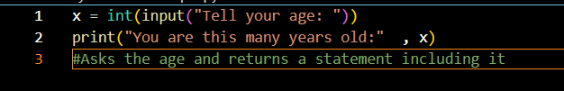
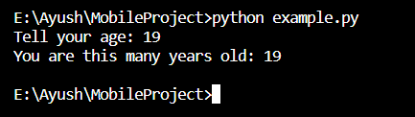
SEQUENTIAL STATEMENTS
These are the simplest kinds of statements. They are used to define the simple logic and flow of the code. They never branch off to another possibility. An example is shown here in Python.

Slide 4



Conditional STATEMENTS
Conditional statements are used to change the behavior of the program based off a condition , mostly evaluated from user input and choice. They take true and false values and change the behavior of the program accordingly. Here’s an example in Python
Condition is True
Condition is False

Slide 5
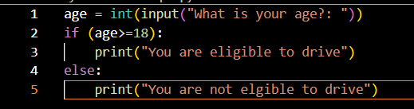


More Kinds of Conditional Statements in Python
If..else statements: If else statements are used in Python to define behavior for both true and false conditions. Here is an example.
Condition is False
Condition is True

Slide 6
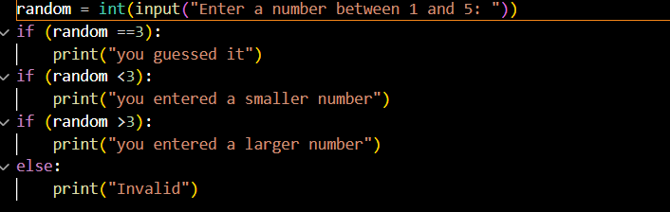

More Kinds of Conditional Statements in Python
2. If..elif..else statements: -If..elif..else statements are used to evaluate many conditions and react according to them. Here’s an example.
One of the conditions

Slide 7
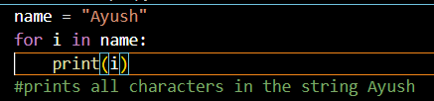
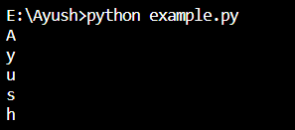
ITERATIVE STATEMENTS
The main purpose of coding applications is to automate jobs using computers. In programming, when we want to perform an action multiple times, we use iterative statements. In Python, one example of this statement is a for-loop
Code with loops
The output

Slide 8
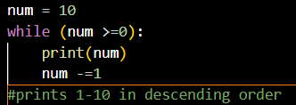
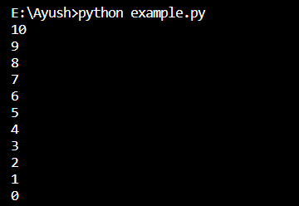
MORE KINDS OF ITERATIVE STATEMENTS IN PYTHON
In Python , there is also an another type of statement known as while loop. It is a bit different from for- loop as it doesn’t have a stopping condition and stops only when provided value is false.
The while loop code
The output

Slide 9
THANK YOU

