Slide 1
GAME ANALYSIS
Ayushi Sharma

Slide 2
INDEX
Introduction​
Correlation
​Outliers in Wage Column
Distribution of Potential Column
Central Limit Theorem

Slide 3
Introduction
The dataset appears to be related to player information in a football (soccer) context. It contains detailed information about football players, including their personal details, playing attributes, and other relevant information. Such datasets are commonly used for football analytics, player comparisons, and various other analyses in the context of football.
Duplicates: There are no duplicate rows found in the dataset. But some duplicate columns are found as follows: CB,RCM,RB,RCB,RW,CM,ST,RAM,CF,RWB,CDM,RF,RS,CAM,RDM,RM. Did not drop these columns as each column is a different attribute.

Slide 4
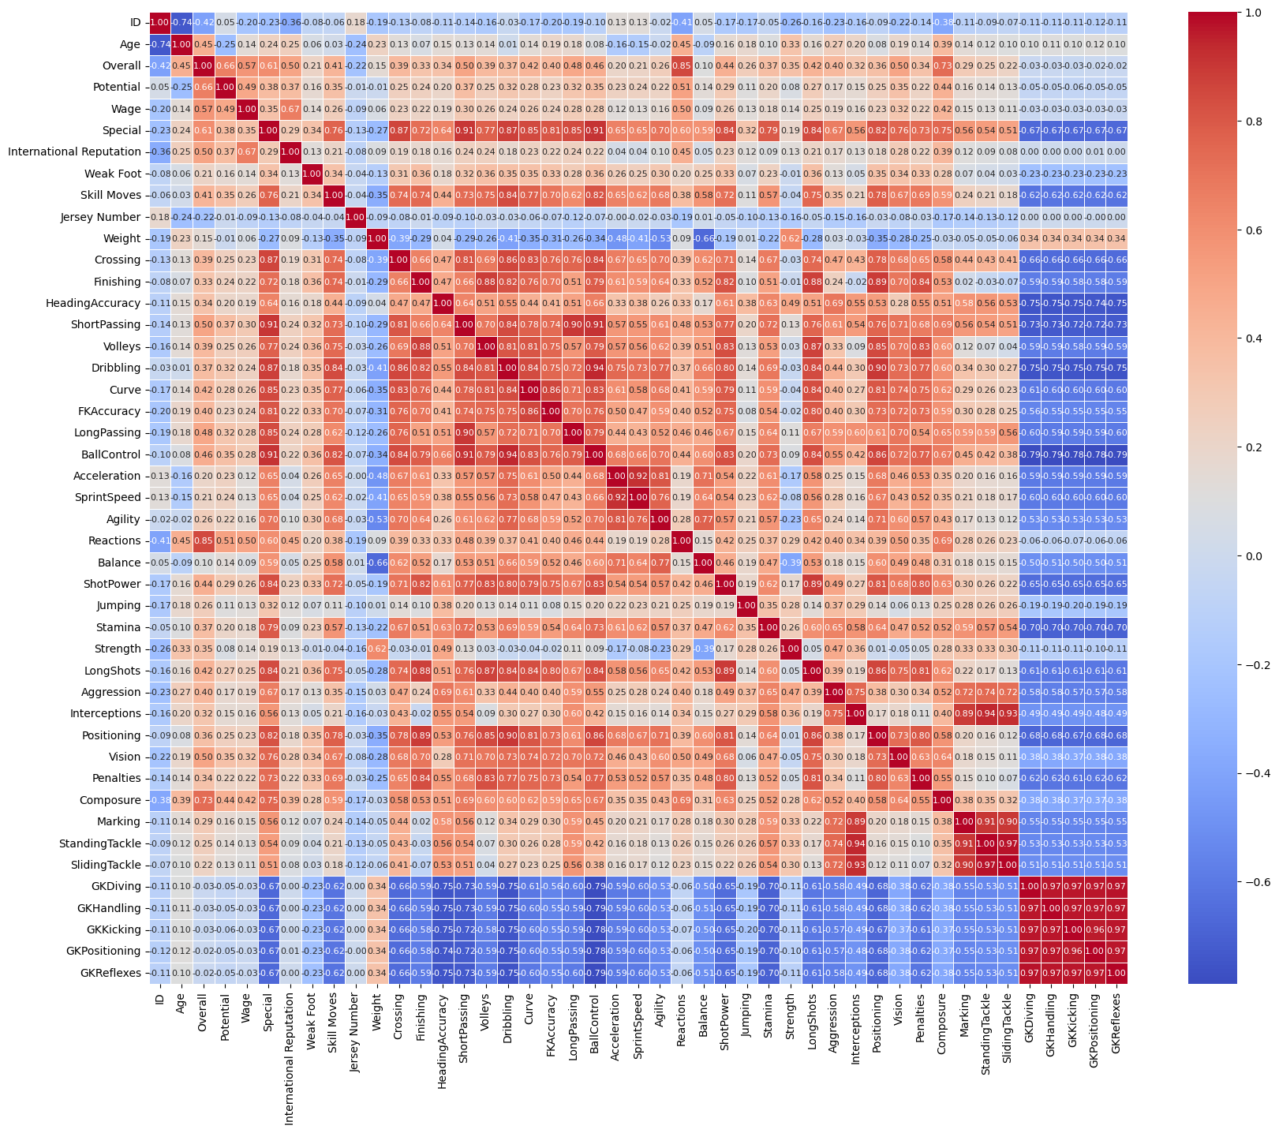
CORRELATION

Slide 5
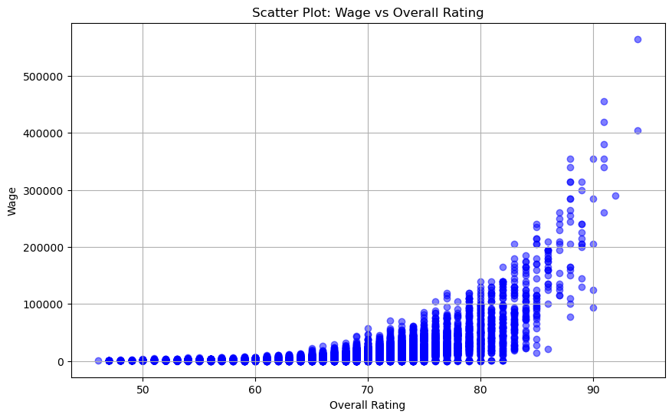
WAGE COLUMN
There seem to be outliers in the "Wage" column, as indicated in the scatterplot , the point are scattered upwards towards right indicating some players having higher wages compared to the majority.

Slide 6
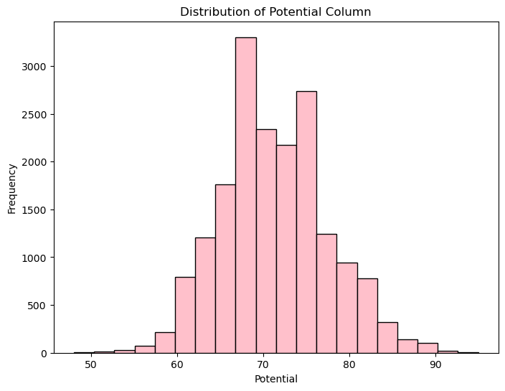
Distribution Of potential column
The mean and median are relatively close, which suggests that the data may be roughly symmetrically distributed. The standard deviation (6.14) indicates that the potential values are spread out from the mean, but the spread is not extremely large. The minimum and maximum values (48 and 95) give us the range of potential values.
The following graph shows a normal distribution. The normal distribution is symmetric, so it has no skew (the mean is equal to the median).

Slide 7
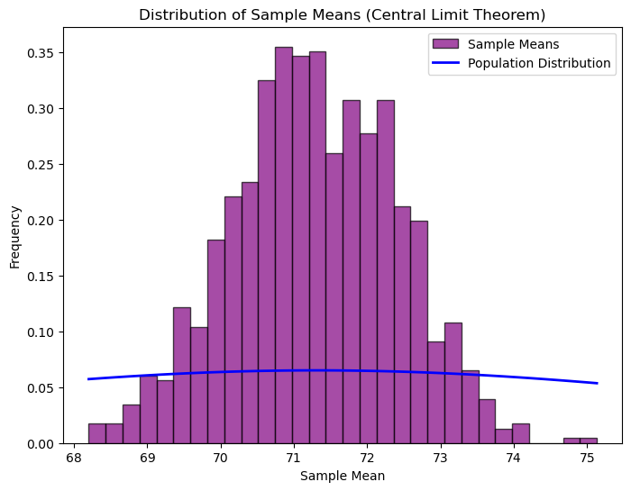
Central limit theorem
Central limit theorem is applied on Potential Column. The Central Limit Theorem (CLT) states that as the sample size increases, the distribution of sample means will tend to follow a normal distribution, regardless of the shape of the original population distribution, as long as the sample size is large enough. The results show that the population mean and the sample mean are very close to each other. Similarly, the population standard deviation and the sample standard deviation are also relatively close. This aligns with the Central Limit Theorem's prediction.

Slide 8
THANK YOU
Ayushi Sharma
ayushisharma761@gmail.com

