Slide 1

Participant Details
Participant Name: Ayush Jaiswal
Problem Statement: NVIDIA Track — Build a data intelligence tool people would actually use, and show how acceleration helps them make a faster or better decision.

Slide 2
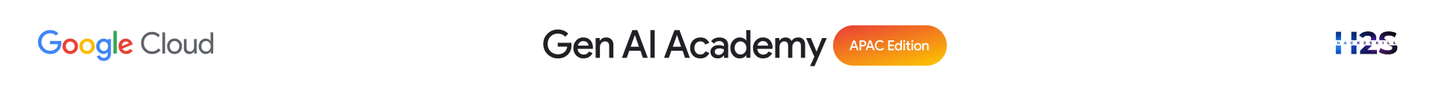
Brief about the idea
RestockIQ is a GPU-accelerated inventory intelligence tool that helps retail store managers prevent stockouts before they happen. It processes 29.2 million POS transaction records, computes stockout risk scores using NVIDIA cudf.pandas — a 6.4x speedup over CPU pandas (120.4s to 18.8s) — and uses Gemini to turn that risk data into a plain-English daily action briefing. The result: a two-minute stale batch report becomes a 19-second, always-fresh decision a manager can act on immediately.

Slide 3
Your solution should be able to explain the following:
How did you approach the common problem statement and translate it into a working solution using Google Cloud technologies (e.g., BigQuery, ADK, Vertex AI, Gemini, etc.) while ensuring the hackathon's core requirements are met? If you selected the NVIDIA problem statement, also explain how NVIDIA technologies were integrated into your solution.
What real-world problem does your solution address, and what practical impact does it create for users, organizations, or communities??
What is the core architecture or workflow behind your solution, and how does it transform data into actionable insights or intelligent decisions?
Approach: DuckDB (BigQuery-style SQL layer) cleans the data, NVIDIA cudf.pandas GPU-accelerates the risk-scoring pipeline, and Gemini turns the results into one actionable recommendation.
Real-world impact: Store managers can't manually track stockout risk across 100,000+ SKU-store combinations. RestockIQ replaces a stale, two-minute batch report with a live, 19-second risk view.
Architecture: POS data → DuckDB cleaning → GPU-accelerated feature engineering & risk fusion (cudf.pandas) → Streamlit dashboard → Gemini daily briefing with one recommended action.

Slide 4
Opportunities
How different is it from any of the other existing ideas?
USP of the proposed solution
Honest acceleration story — we show the case where GPU was initially slower than CPU, and explain the fix, instead of a cherry-picked benchmark.
Decision, not just a dashboard — Gemini turns a 100,000-row risk table into one clear, actionable recommendation.
Fused risk signal — combines stockout urgency, demand velocity, and anomaly detection, not a single metric like "days of stock left."
Tested at scale — benchmarked at both 2.9M and 29.2M rows to show exactly where GPU acceleration starts to matter.

Slide 5
List of features offered by the solution
Stockout risk scoring across 100,000+ SKU-store combinations, refreshed on demand
GPU-accelerated feature engineering with NVIDIA cudf.pandas — a 6.4x speedup, one line of code
Ranked risk table and store-level heatmap dashboard
Anomaly detection that flags sudden demand spikes
Gemini-powered daily briefing with one recommended action, regenerated live on demand
Transparent CPU vs GPU benchmark chart, built into the dashboard itself

Slide 6
Process flow diagram or Use-case diagram
1
2
3
4
5
Ingest
Clean
Accelerate
Score
Decide
29.2M POS rows
DuckDB SQL layer
cudf.pandas GPU
Risk fusion
Gemini briefing
Same use-case throughout: a store manager checks this flow each morning to know exactly what to reorder today.

Slide 7
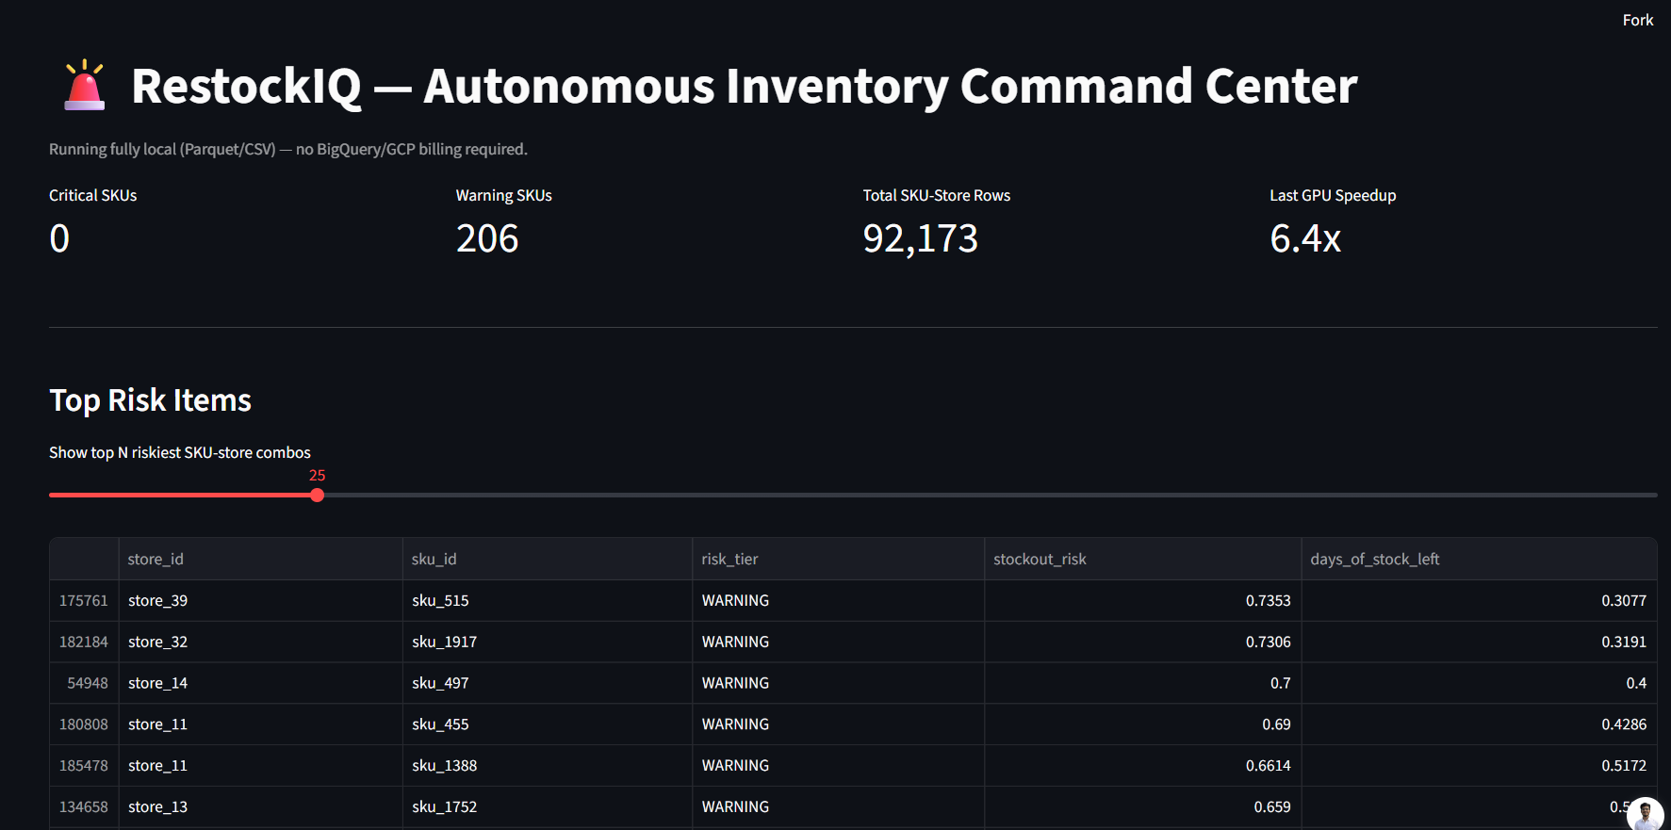
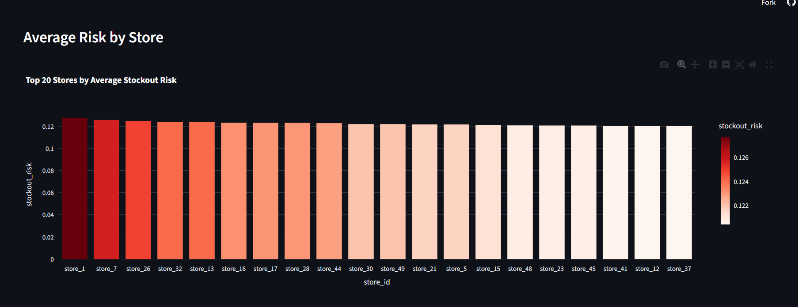
Wireframes/Mock diagrams of the proposed solution
Live risk ranking + KPI header
Store risk heatmap

Slide 8
Architecture diagram of the proposed solution:
Synthetic POS data (29.2M rows)
risk_scores.parquet
DuckDB cleaning layer
Risk fusion: stockout urgency + anomaly + velocity
Streamlit Dashboard (risk table, heatmap, benchmark)
Feature engineering (rolling demand, velocity)
Gemini 2.5 Flash
CPU (pandas) 120.4s
GPU (cudf.pandas) 18.8s
Plain-English briefing + one recommended action

Slide 9
Technologies / Google / Nvidia Services used in the solution (Why did you choose your specific AI stack and system design, and how does it support scalability and real-world deployment?)
NVIDIA:
cudf.pandas — drop-in GPU acceleration for pandas, executed on an NVIDIA T4 GPU
Google / Data & App Layer:
Gemini API (gemini-2.5-flash) — natural-language decision briefing
DuckDB — local SQL transformation layer, mirroring a BigQuery cleaning pattern
Streamlit + Plotly — live public dashboard
Why this stack: cudf.pandas needed zero code rewrite yet delivered a 6.4x speedup, and the whole pipeline maps directly onto BigQuery + Cloud Storage + a GPU VM on Google Cloud for production-scale deployment.
Notes:
All solutions must leverage Google Cloud technologies. NVIDIA technologies should be included by teams that have selected the NVIDIA problem statement.

Slide 10
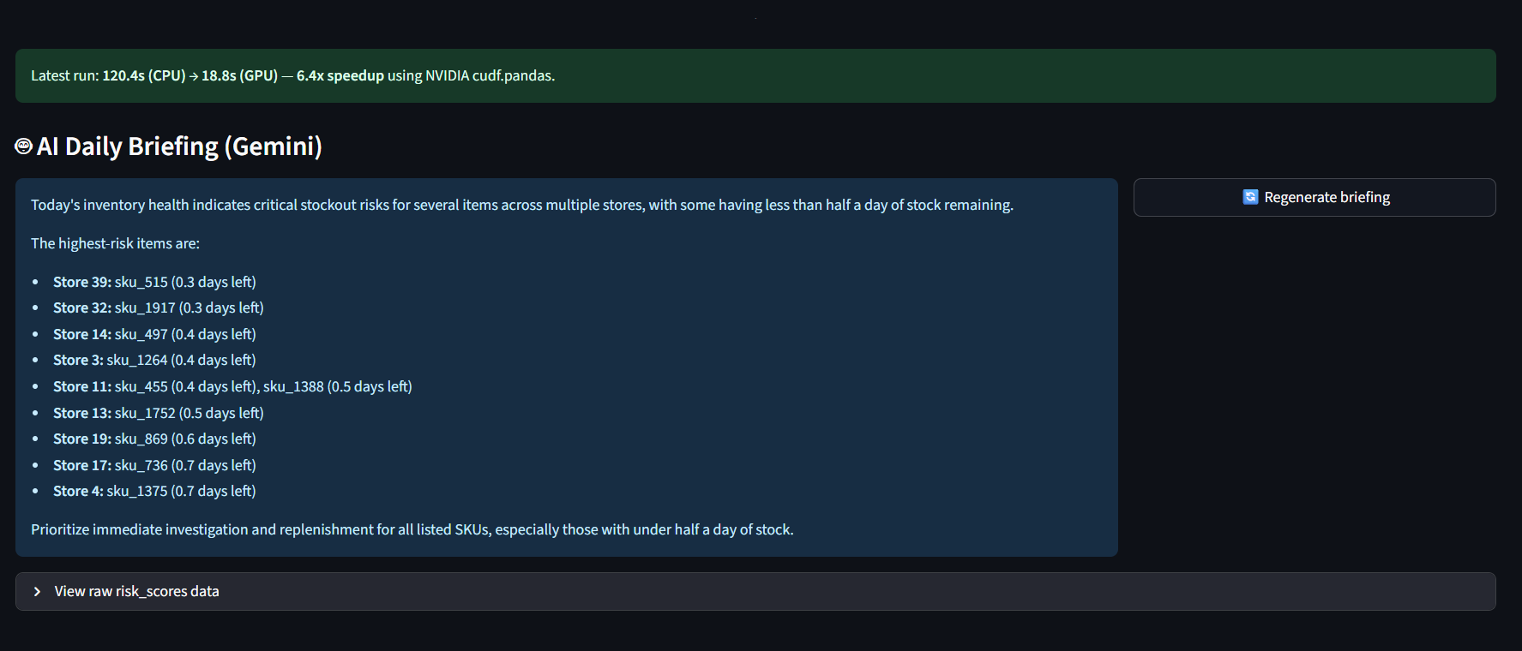
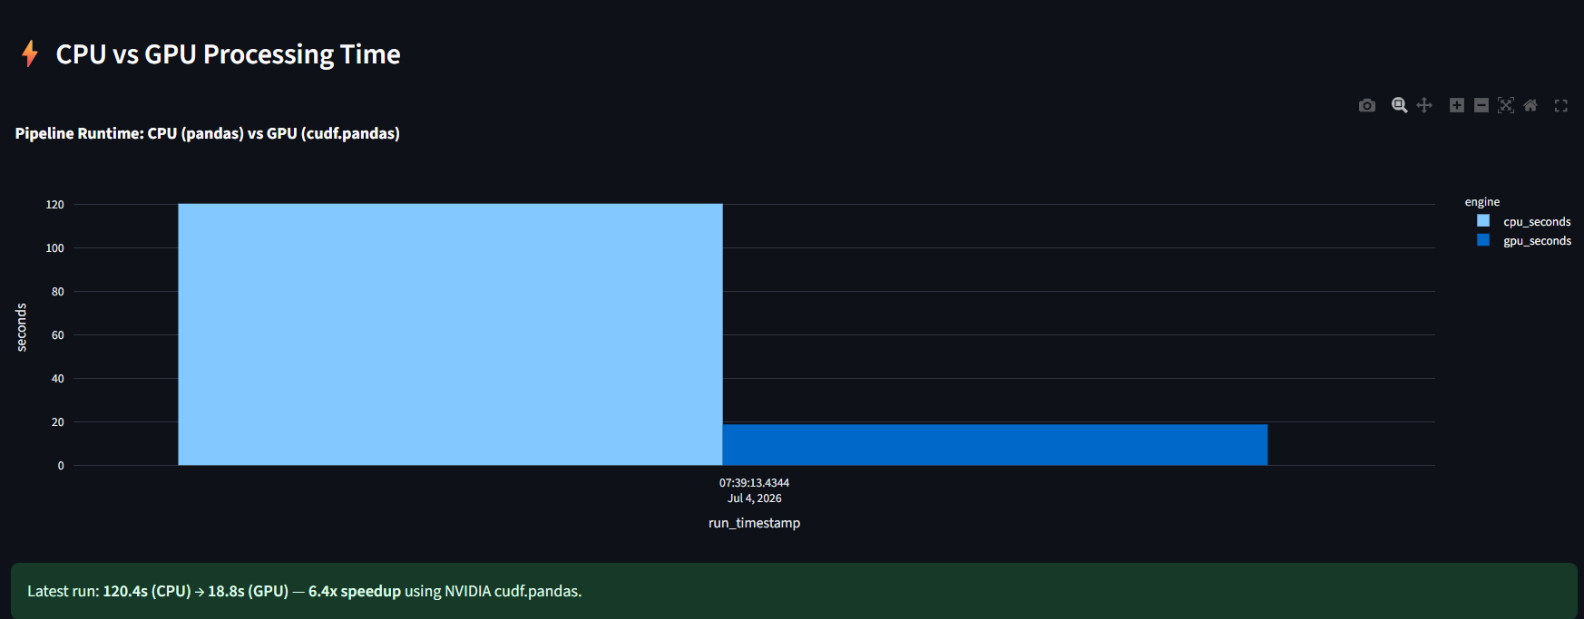
Snapshots of the prototype
Gemini AI daily briefing (live regenerate)
CPU vs GPU benchmark + raw data

Slide 11
