Slide 1

ClaimLens
PRODAPT CAPSTONE | PROJECT 7
AI-Powered Insurance Claims Assistant
Faster triage, smarter precedent search and earlier fraud detection for P&C claims.
Ayush K Shetty

Slide 2



The Problem
Manual claims handling is slow, inconsistent and open to fraud.
Slow triage
18-35
Manual review takes weeks per claim.
days to resolve an average claim
Hidden fraud
Suspicious patterns are hard to spot early.
$308B
Inconsistent payouts
Adjusters dig through old files for precedents.
lost to insurance fraud every year

Slide 3




The Solution
ClaimLens finds similar claims, predicts outcomes and recommends a decision.
Hybrid RAG
Predictive ML
Multi-agent flow
Adjuster UI
Vector + BM25 search finds similar past claims.
Estimates payout, resolution time and fraud risk.
Agents triage, investigate and assess risk.
Dashboard with a human feedback loop.
Final decision:
Auto approve
Adjuster review
SIU referral

Slide 4
How It Works
Every claim moves through six automated steps.
1
2
3
4
5
6
Intake
Retrieve
Investigate
Assess risk
Recommend
Audit
Classify and set priority P1-P4
Similar claims plus ML scores
Tenure, history and peer claims
Exposure and anomalies
Action and adjuster checklist
LLM judge checks the result
Input guardrails screen every claim first. Adjuster feedback is stored to improve the models.

Slide 5
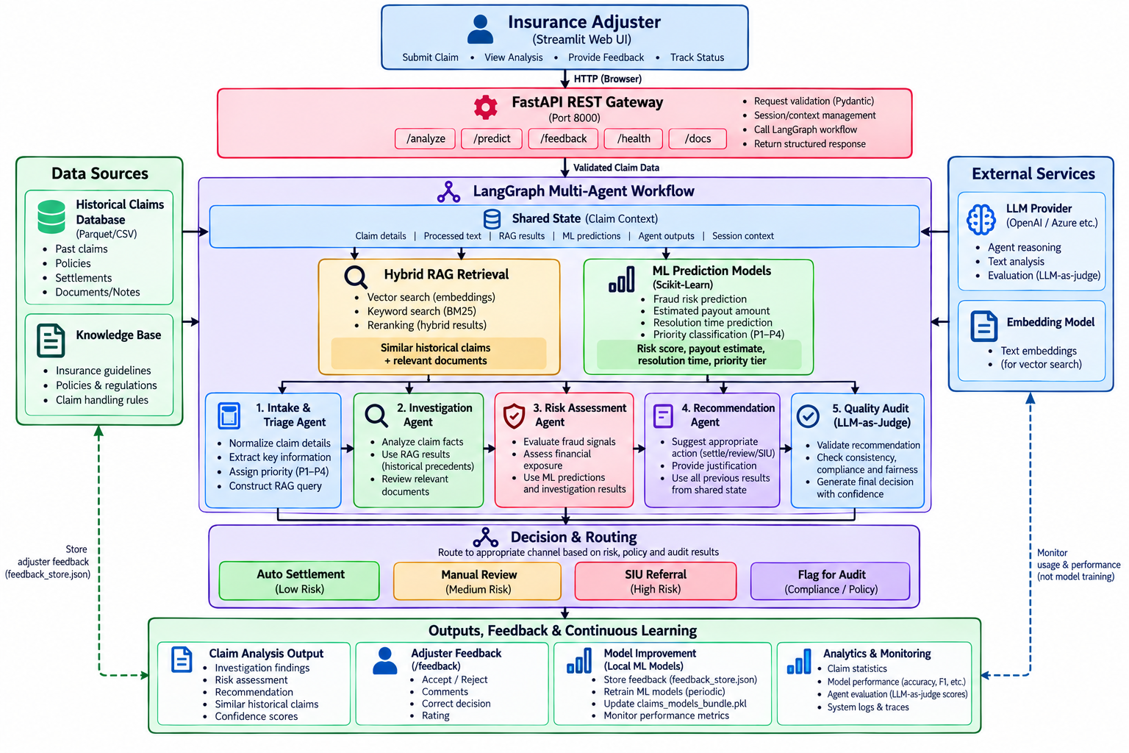
System Architecture
Entry
Streamlit UI calls a FastAPI gateway with validated input.
Core
RAG and ML results feed five LangGraph agents.
Output
Risk-based routing, plus a feedback loop that retrains models.

Slide 6
Tech Stack
Python end to end, from retrieval to the adjuster dashboard.
Language
LLM
Python 3.11
OpenAI gpt-5-nano
3 / 3
benchmark tests passed
Orchestration
Hybrid retrieval
LangGraph
Embeddings + BM25
~3 ms
Machine learning
Backend API
median search over 2,000 claims
Scikit-Learn
FastAPI + Pydantic
10K
Frontend
Testing
Streamlit
Pytest + LLM judge
claims used to train models

