Slide 1

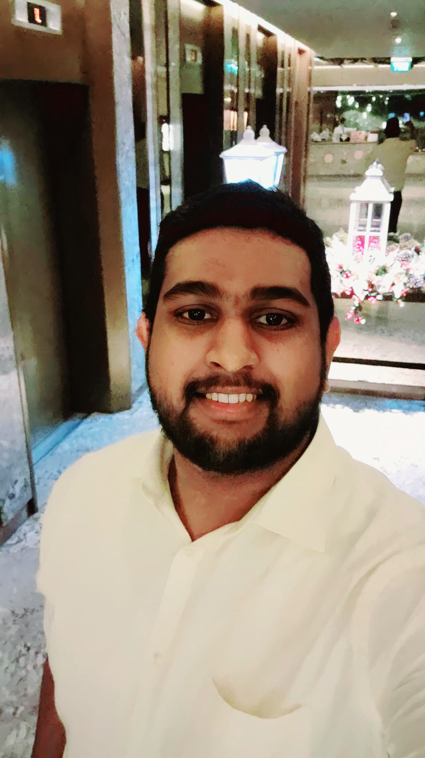
Ayushka Weerasinghe
I’m an IT professional with 5 years of experience in MadMobile.

Slide 2
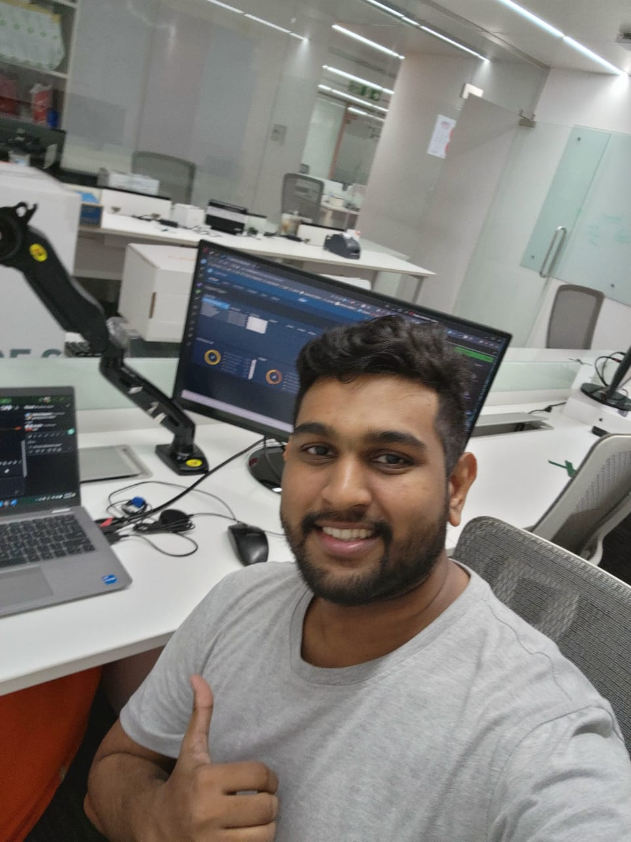
About Me
Hobbies
photography, and gaming
Personal Traits
Curious, and detail-oriented
Core Values
Optimism and Adventures

Slide 3

My Superhero: Batman
Why Batman?
Parallels to Tech
His combination of intellect, technology, and determination inspires me.
Like Batman, I'm driven to use my expertise & skills to solve problems
Defining Moment
Batman's origin story of helping people motivates me.

Slide 4

MadMobile and the Restaurant Industry
1
Mad Mobile elevates the experience of both your retail and restaurant guests with award-winning technology and hardware
2
MadMobile's innovative solutions empower restaurants to adapt mobile and mobile transactions
3
equip businesses with the latest connected technologies so that they can provide superior service to their guests and keep up with the ever-evolving demands of the hospitality industry.

Slide 5

Why am I excited for this Role
Valuable Expertise
Contributions
Exceptional knowledge of customer pain points and understanding of the case creation process by all supporting teams (L1/L2)
Process improvement ideas bridging L1 and L2 work process.
1
2
3
Growth Opportunity
Preaching what I learned from my software engineering degree.

Slide 6
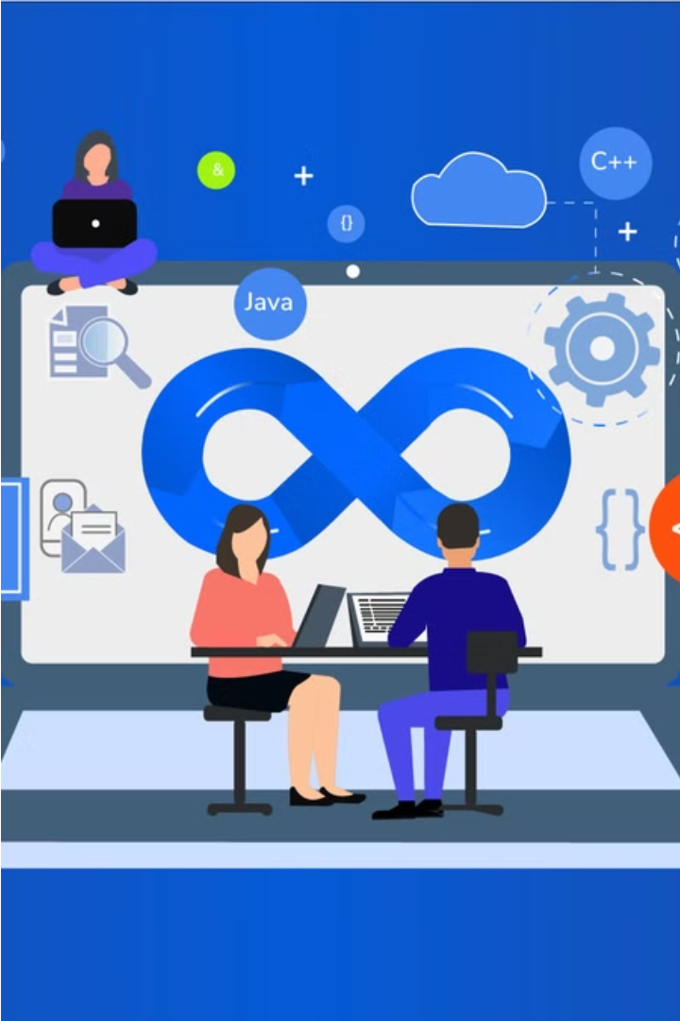
DevOps and SRE
DevOps and Site Reliability Engineering (SRE) are complementary practices that work together to enhance software delivery. DevOps focuses on collaboration, automation, and continuous improvement, while SRE emphasizes reliability, scalability, and performance of production systems.

Slide 7
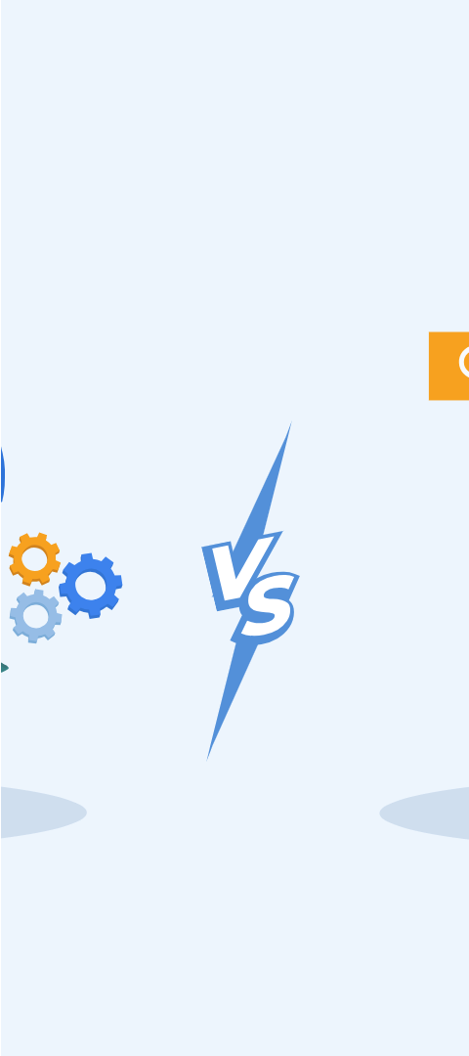



Complementary Practices
DevOps
Streamlines software delivery through collaboration, automation, and continuous improvement.
SRE
Ensures reliability, scalability, and performance of production systems using software engineering principles.
Synergy
DevOps and SRE work together to deliver high-quality, reliable software more efficiently.

