Slide 1
Advance Programming Concept
PG- :17
Ayush Kumar Mishra(2310991803)
Vansh Kaushal(2310990911)
Madhur Dua(2310991337)
Chitkara University Institute of Engineering and Technology,
Chitkara University, Punjab

Slide 2
Table of Contents
Introduction
Problem Statement
Technical Details
Key Features
Result
Conclusion
References/Links Used

Slide 3
Introduction
The Blogging Site is a web-based application designed to simplify the creation, management, and sharing of blog posts. Built using a modern full-stack approach, the project combines React, Tailwind CSS, and Vite for the frontend with Java-based backend processing supported by efficient data structures and algorithms. Data is stored securely in MySQL, and JSON ensures seamless communication between frontend and backend. By offering real-time updates, interactive features, and a scalable architecture, the Blogging Site provides a robust platform for both writers and readers, enabling a more engaging and efficient blogging experience..

Slide 4
Problem Statement
Blogging has become one of the most important mediums for knowledge sharing, communication, and community building. However, traditional blogging platforms often face challenges such as poor search and filtering options, limited engagement tracking, manual content management, and lack of accessibility across devices. These limitations reduce user satisfaction and restrict the growth of blogging communities. The Blogging Site has been developed to address these issues with a modern, automated, and user-friendly approach, ensuring that both writers and readers enjoy a smooth and interactive digital publishing experience.

Slide 5
Technical Details
VS (VISUAL STUDIO) code was used to develop this project.
Languages used:
Frontend: React (TypeScript + TSX), Tailwind CSS, Vite
Backend: Java + Data Structures & Algorithms
Database: MySQL
Communication: JSON (frontend-backend data exchange)
Others: HTML, CSS, JavaScript

Slide 6
Technical Details
The Blogging Site is built using modern web technologies. The frontend is developed using React with TypeScript and TSX, styled with Tailwind CSS, and optimized with Vite for fast performance. The backend is powered by Java, where data structures and algorithms ensure efficient handling of posts, comments, and user interactions. MySQL is used to store user data, blog posts, and engagement records securely, while JSON acts as the communication bridge between frontend and backend. Supporting technologies include HTML, CSS, and JavaScript for additional structure and interactivity.

Slide 7
Key Features
The key features of our project are as follows:
Blog Management: Add, edit, delete posts.
Advanced Search & Filters: By title, author, tags, categories.
Engagement System: Likes, comments, trending posts.
Role-based Access: Writers, readers, and admins.
Mobile-Friendly: Accessible across devices.

Slide 8
Future Projections
AI-powered recommendations for readers.
Analytics dashboard for engagement tracking.
Multi-language support for wider reach.
Integration with social media platforms.
Enhanced mobile app version.

Slide 9
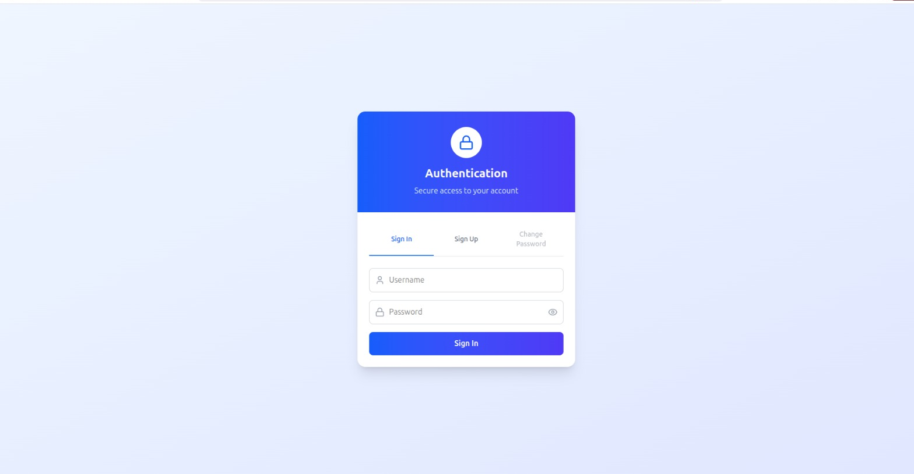
Result

Slide 10
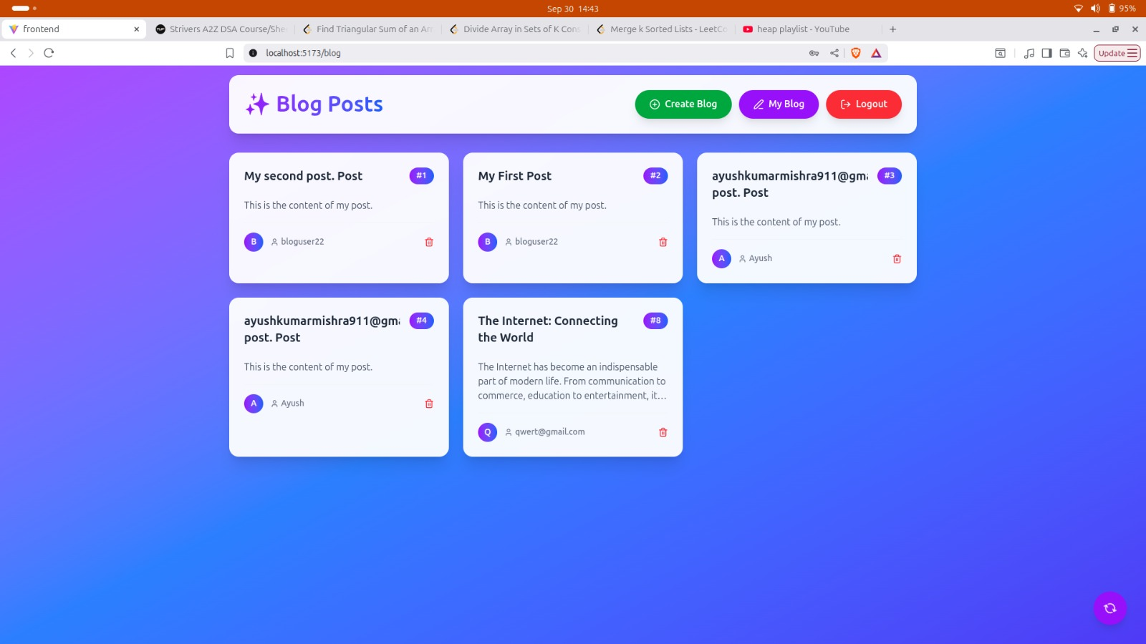
Result

Slide 11
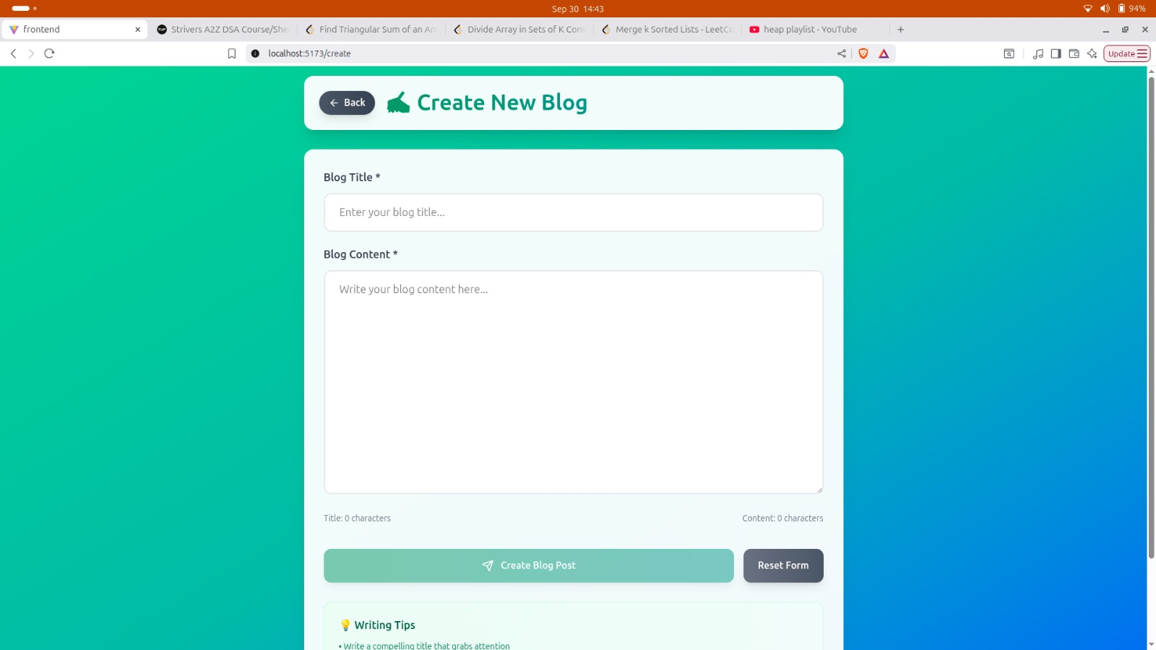
Result

Slide 12
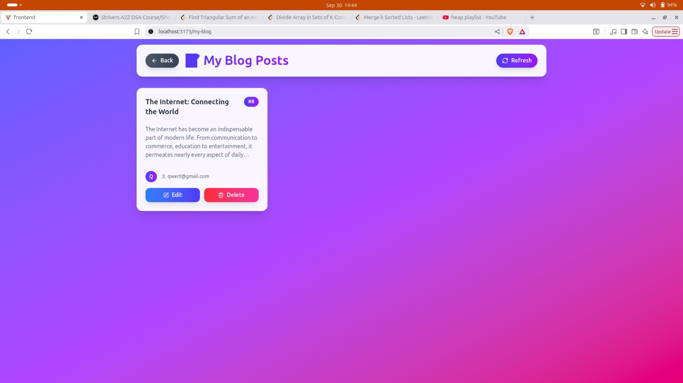
Result

Slide 13
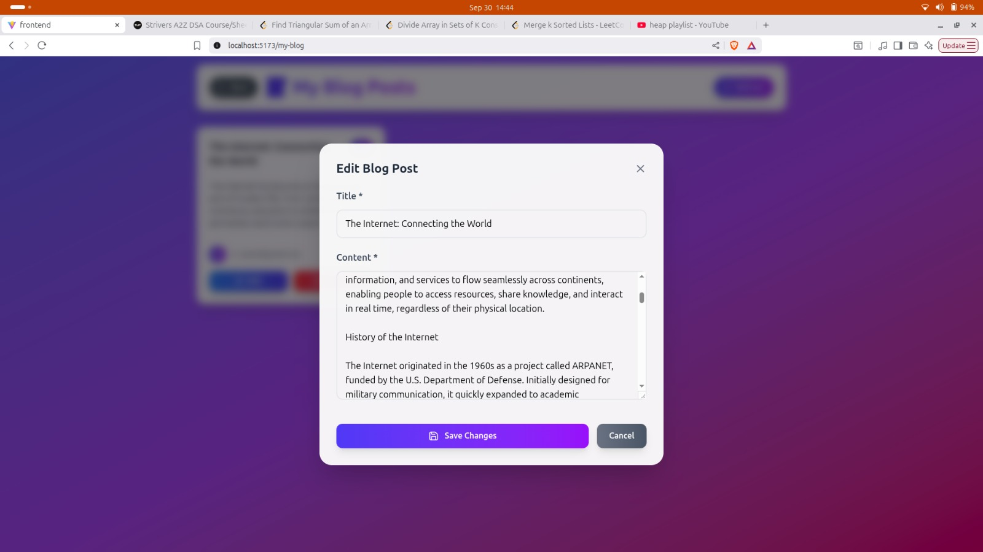

Slide 14
Conclusion
The Blogging Site represents a significant step toward modernizing digital publishing platforms. By automating content management, simplifying interactions, and improving accessibility, the system addresses the limitations of traditional blogging platforms. Its modular architecture ensures scalability, while its interactive features foster user engagement. Overall, the project demonstrates the application of modern web technologies to build a responsive, scalable, and future-ready blogging solution.

Slide 15
References/Links Used
W3Schools.com
Youtube.com
GeeksForGeeks.com
React & Tailwind Official Documentation

