Slide 1

LLMResearch: Large Language Model
Research Toolkit
Presented by
Ayush kumar ( IIT2022090 )
Avinash kumar( IIT2022152 )
Ankit Prakash ( IIT2022222)
Under the Supervision of
Dr. Naveen Saini

Slide 2

INTRODUCTION
PROBLEM: Developing an accurate, automated literature review tool that integrates up-to-date research while minimizing errors generated by Large Language Models (LLMs) to streamline the review process for researchers.

Slide 3
INTRODUCTION
Motivation:-
Information Overload: Researchers face an overwhelming number of new papers daily, making it hard to filter and find relevant content.
Time Constraints: Understanding the importance of each paper is time-consuming, taking time away from research.
Fragmented Knowledge: Current tools explain individual papers but don’t show how they connect, leading to missed insights.

Slide 4
Related Work :-
Author : - Shubham Agarwal, Issam H. Laradji , et.al
Title :- LitLLM: A Toolkit for Scientific Literature Review
Objective:- The objective of the paper is to develop a toolkit for automating the generation of literature reviews using Retrieval Augmented Generation (RAG) techniques.
Approach : - The paper proposes enhancing LLMs through Retrieval-Augmented Generation (RAG), which integrates external knowledge from dynamic databases into the model’s existing knowledge . Additionally, the paper explores how LLMs can be applied to tasks like information retrieval and ranking, leveraging their zero-shot learning abilities.The approach involves techniques such as instruction tuning and prompt engineering, which aim to refine how LLMs respond to unseen tasks, making them more effective and accurate without requiring extensive retraining.

Slide 5
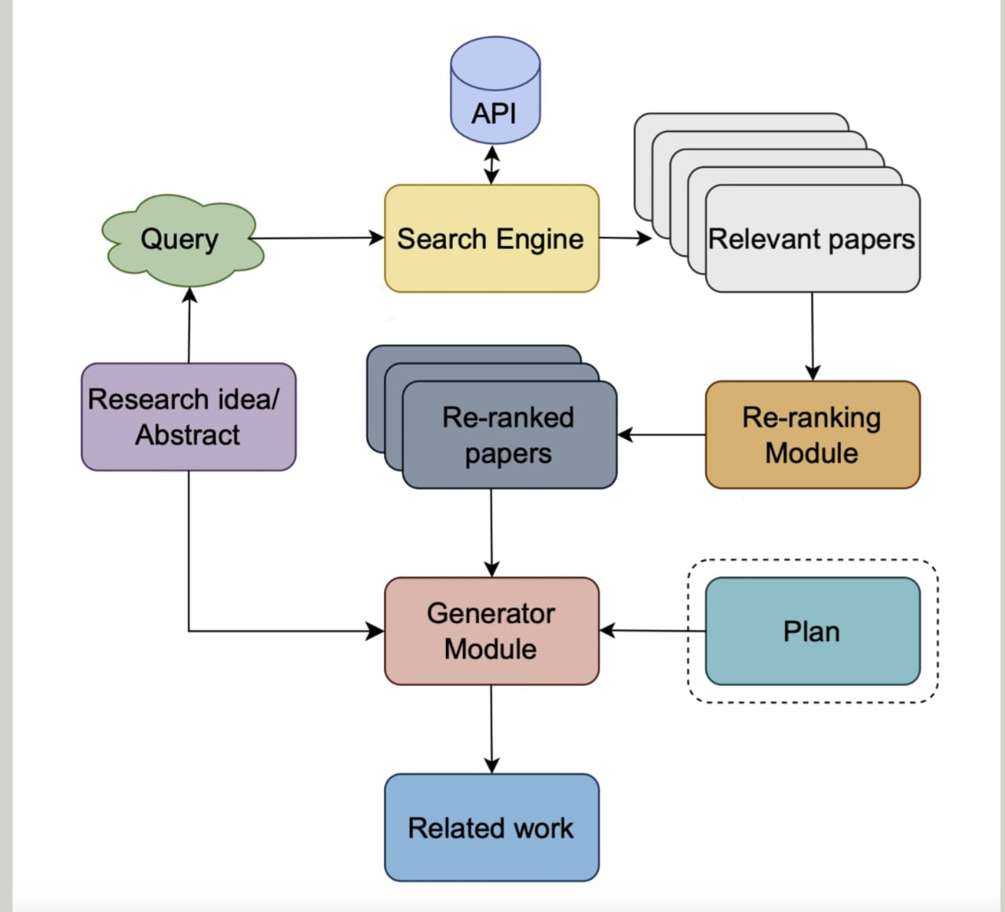

Slide 6
Related Work :-
Author :- Melissa A. Kacena , Lilian I. Plotkin , Jill C. Fehrenbacher
Title : - The Use of Artificial Intelligence in Writing Scientific Review Articles
Objective:-The study aimed to determine if AI can effectively assist in writing scientific papers. While AI speeds up the process, it often makes mistakes, making it unreliable for solo use. Therefore, AI should be used with human oversight to ensure accuracy and adherence to scientific standards.
Methods :- (1)AI‐Only (AIO) Review Articles :- AI Only Review Article are paper written entirely by AI , Like Chatgpt . The AI creates outlines, writes sections, and suggests citations. However, because the AI can be outdated and inaccurate, humans must fact-check and fix errors to make the paper ready for publication.

Slide 7
(2)AI‐Assisted (AIA) Review Articles :- AI-Assisted Review Articles involve AI, like ChatGPT, helping with writing, while humans provide outlines and references. The AI writes sections and suggests citations, but humans must review and fact-check to ensure accuracy.
Result : - AI-assisted reviews streamline the writing process, but human intervention is required for fact-checking and error correction. While AI reduces drafting time, limitations like outdated information and single-document analysis still need human oversight.
Conclusion :- AI can speed up paper writing but isn't fully autonomous. Human expertise is essential for ensuring accuracy, making AI a helpful tool rather than a complete replacement.

Slide 8
Related Work :-
Author :- Xiangci Li And Jessica Ouyang
Title :- Explaining Relationships Among Research Paper
Objective :- The paper aims to develop an automated method for generating concise, customized literature reviews by Analyzing multiple research papers
Approach:- It addresses the limitations of existing methods that focus on single-paper explanations, using feature-based LLM prompts to create richer citation texts with transition sentences.

Slide 9
Parsing of a paper :-
We have used science parser to convert research paper into json file .
To create a Faceted summary of a paper, we need the title, abstract, introduction, and conclusion. We get this information by extracting it from the paper through parsing.

Slide 10
Flow Chart
Summary generation
It will generate faceted summary of the given paper
Relation b/w
Papers
It will find the Relationship between Paper by Using Faceted summary of paper
Generating enriched citations
It will be Generating Enriched usages and intent (Why And How paper is cited ) by using Relation b/w Paper
Generating Main
idea
It Will Generate Main idea by using Faceted Summary and human written related work section
Finally , it will generate Literature Review by using All (Faceted Summary ,Relation b/w papers,Enrichred citations, main ideas )
Generating Literature review

Slide 11
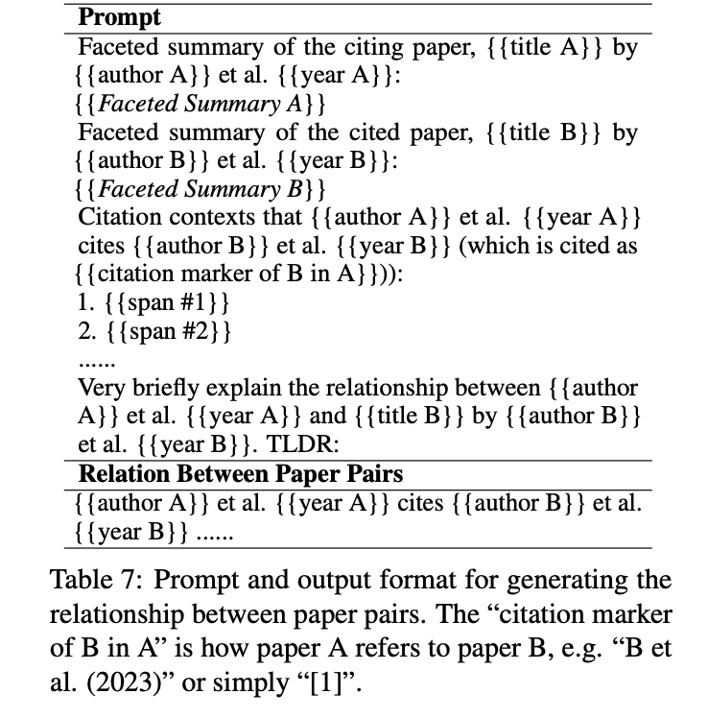
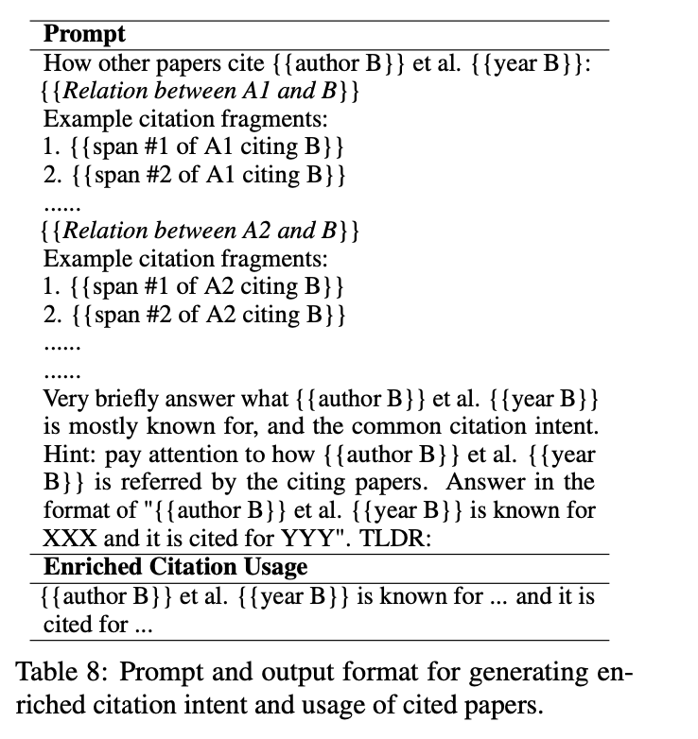

Slide 12
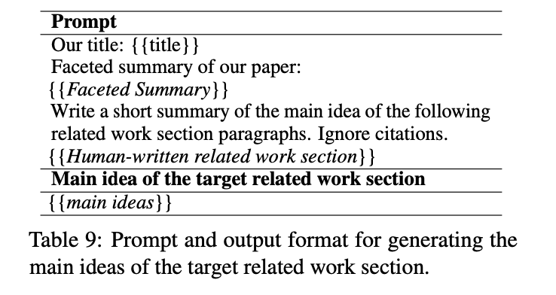

Slide 13
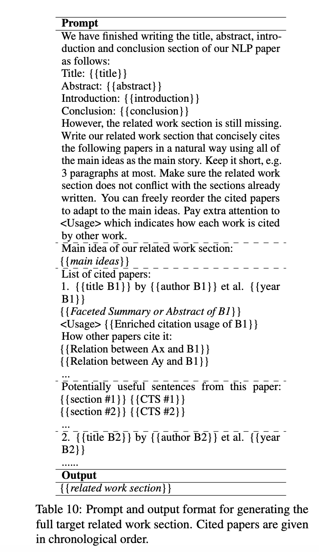
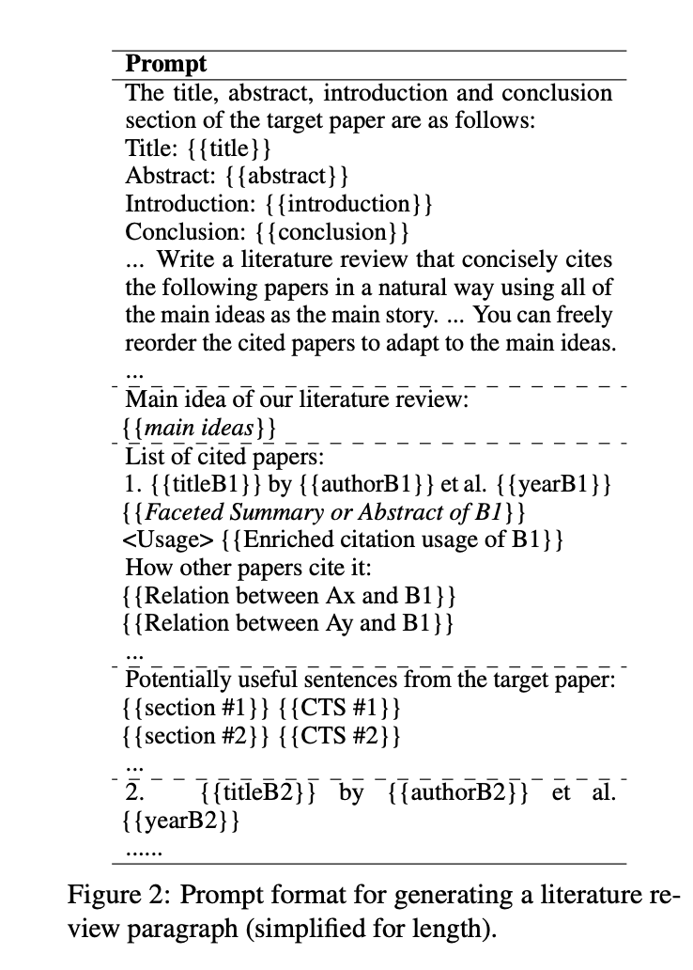

Slide 14
REFRENCES
[1] Melissa A. Kacena, Lilian I. Plotkin, and Jill C. Fehrenbacher, The Use of Artificial Intelligence in Writing Scientific Review Articles, Current Osteoporosis
Reports, 2024.
[2] Xiangci Li and Jessica Ouyang, Explaining Relationships Among Research Pa-
pers, arXiv, 2024.
[3] Shubham Agarwal, Issam H. Laradji, Laurent Charlin and Christopher Pal,
LitLLM: A Toolkit for Scientific Literature Review, arXiv, 2024.

Slide 15
Thank You

